Slide 1
MBUG 2018
Session Title: Help students graduate on time with Ellucian Degree Works Student Educational Planner
Presented By: Serena Hyche
From: Ellucian
September 10, 2018

Slide 2
Session Rules of Etiquette
Please turn off your cell phone
If you must leave the session early, please do so discreetly
Please avoid side conversation during the session

Slide 3
“…(students) need to understand the road map to completion & know how to use it to achieve personal goals.
“Taking Student Retention Seriously”
Vincent Tinto
Distinguished Professor Emeritus
Syracuse University

Slide 4
Student Educational Planner
Plan
Modify
Register
Report

Slide 5
Student Educational Planner
Plan
Register
Modify
Report

Slide 6
Standardized Templates On/Off Track Notification Non-course Requirements
Plan
Notes:
Courage and swagger of the market leader, especially as it relates to breadth, depth and diversity in higher ed expertise
Future-orientation – we are always evolving and adapting to the needs of our diverse customers and the market

Slide 7
Student Educational Planner
Plan
Register
Modify
Report

Slide 8
Multiple Plans Approval Process Create Block
Modify

Slide 9
Student Educational Planner
Plan
Register
Modify
Report

Slide 10
Register
Direct integration with
Banner 9 – XE Registration

Slide 11
Student Educational Planner
Plan
Register
Modify
Report

Slide 12
Report
Delivered Reports
Projected Plan Seat Count Summary
Projected Plan Course List Detail

Slide 13
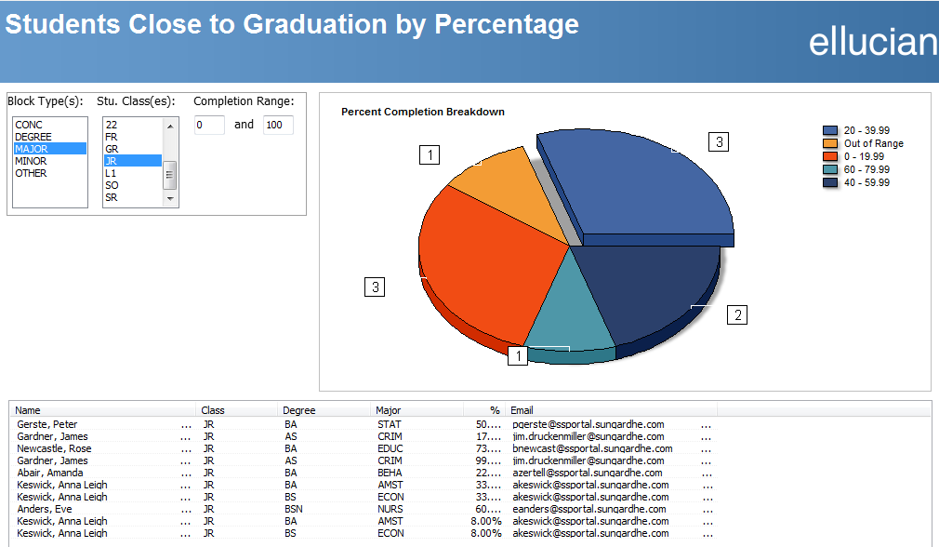
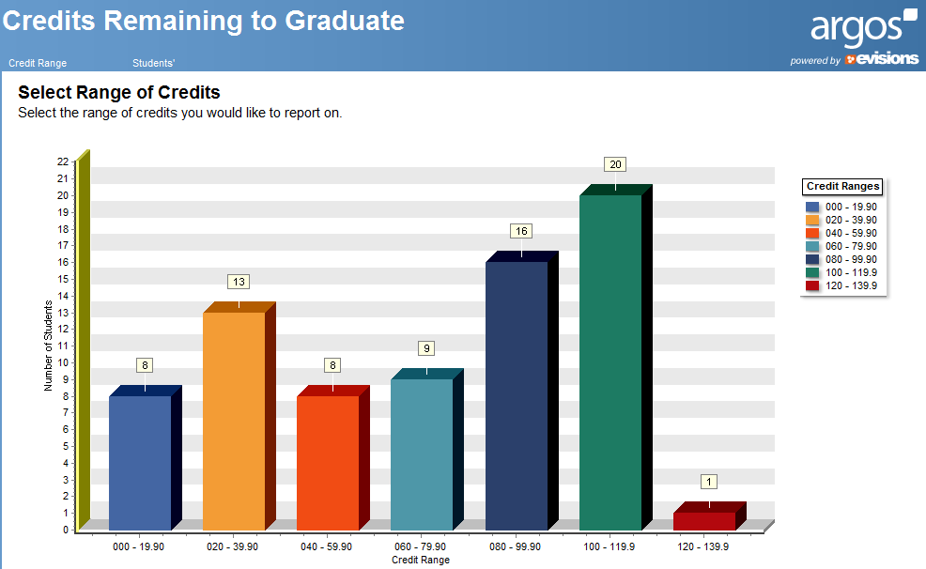
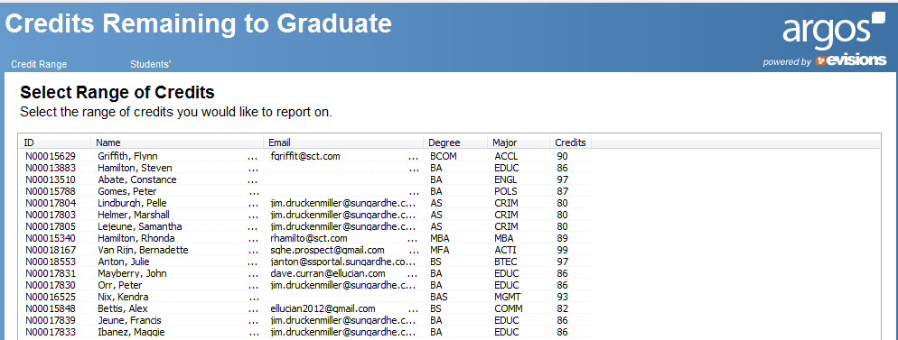
Reports

Slide 14
Student Educational Planner
Plan
Register
Modify
Report

Slide 15
Degree Works Student Educational Planner
Questions
Serena Hyche
Solutions Consultant

