Slide 2
Minding Your P’s and Q’s Purchasing Approval Queues
Lynn Deegen, Director of Purchasing and Property
Nicci Wangerin, Purchasing and Inventory Specialist
Mississippi Gulf Coast Community College (MGCCC)
Dan Webb, Applications Director, Ellucian @ MGCCC
April 20, 2016
ID 40823

Slide 3
Session rules of etiquette
Please turn off your cell phone/pager
If you must leave the session early, please do so as discreetly as possible
Please avoid side conversation during the session
Thank you for your cooperation!

Slide 4
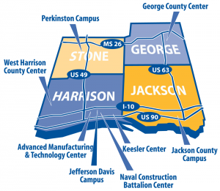
MGCCC
1 of 16 community colleges in the state of MS
3 Main Campuses, 6 Centers located in 4 counties
Established in 1911 as a Junior College
30K students enrolled
10K Credit students
20K Noncredit students

Slide 5
Business Process Modernization (BPM)
Ellucian subject matter experts came onsite to understand our current business practices
College operations were evaluated
Recommendations were made to improve efficiencies within Banner
MGCCC administrators prioritized the recommendations
Goals and timelines were established

Slide 6
Introduction
Discuss approval queue structures
Limits
Routing criteria
Walk through phases of transformation
Share process improvements and new practices for MGCCC
Consistency and standards
“Bottoms up!”

Slide 7
Preparing to launch
Notes:
Change can be scary but also necessary

Slide 8
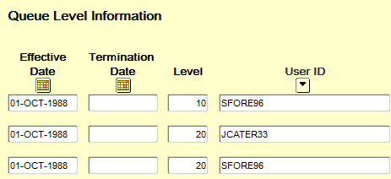
Where We Started
No monetary value set: all set to 0 or infinite
The same person was in both levels or the requisitioner was the approver
Bogged down with old information
Notes:
When I came on board in the Purchasing Department, it was already a goal for the Director to change the current approval queue system. The question at hand was how and do we have the support? At this time, we only use approval queues for requisitions only. Banner is able to turn on approvals for requisitions, purchase orders, change orders
-We chose to keep the queue numbers and electronic history but removed users to clean up the screen

Slide 10
Making the Change Happen

Slide 11
The Roadmap to Change
Assigned monetary limits to the levels with relationship to inventory thresholds
Required at least 2 levels of approvers in each queue
Levels reflect job status
Cleaned up old approvers

Slide 13
What we discovered

Slide 14
Outcomes
Monetary limits were effective and allowed requisitions to move through quickly
The approvers in each queue were more functional
Levels allowed departmental personnel first review
The clean up process made queues visually appealing and less cumbersome

Slide 15
Additional Changes
Notes:
Based on BPM Recommendations

Slide 16
BPM Recommendations
Create a process for new users, queues, and termination
Purchasing Director moved from an approval level to an additional queue
Incorporate Banner Workflow for approval notifications
Move buyers to the frontline approval

Slide 17
Bottoms up

Slide 18
Implementing the BPM
Invert the entire approval queue
Purchasing buyers will be the first to approve
Buyers catch errors and resolve them before others approve
Insight on what’s coming on the horizon
Purchasing Director only approves requisitions $5,000 and greater

Slide 19
In conclusion

Slide 20
Summary
Remember, sometimes it’s trial and error before you find success
Just because a process is “good” doesn’t mean it can’t be “improved”
Don’t be afraid to try new methods
Communicate with other institutions to learn and share

Slide 21
Questions & Answers

Slide 22
Thank you!
Lynn Deegen- lynn.deegen@mgccc.edu
Nicci Wangerin- nicci.wangerin@mgccc.edu
Dan Webb- dan.webb@mgccc.edu
Please complete the online session evaluation form.
Session ID 40823

Slide 23
We need your help Feedback Survey
Access session surveys by using the survey widget on the mobile app or by logging into your session schedule builder at
Session ID 40823
http://tinyurl.com/elive2016surveys

