Slide 1
MBUG 2015
Session Title: Navigating Ellucian XE: Tips and Tricks
Presented By: Antonio Trepesowsky (remote)
Facilitated by: Lee Cipolla
Institution: Ellucian
September 14, 2015

Slide 2
Session Rules of Etiquette
Please turn off your cell phone
If you must leave the session early, please do so discreetly
Please avoid side conversation during the session

Slide 3
Introduction
There are many cool new user experience improvements in Banner XE
Some features in XE are still dependent on setup in 8
Data Extract
My Banner
Let’s discover (or rediscover) navigating Banner

Slide 4
Agenda
#1 Best Feature
Application Navigator
Main Menu
Breadcrumbs and Tasty Tidbits
Go To
Notification Center and Help
Data Extract
Queries
Terminology and Shortcuts
Multi-lingual support

Slide 5
#1 Best Feature
How to make Banner BIGGER
Ctrl = increase zoom (essentially ctrl with +)
Ctrl – decrease zoom
Ctrl 0 reset zoom to 100%
These are all web shortcuts (not new Banner shortcuts) but because XE is not on Oracle forms, these shortcuts actually work now.

Slide 6
Application Navigator
For Admin/INB only
Allows users to navigate between Banner 8 and 9
Uses the Menu Tree, Go To, and previously opened pages
All future releases will use App Navigator

Slide 7
Main Menu
On the Left:
The Home icon will always return you to the Welcome menu
The drop down icon is the beginning of the breadcrumb trail. This icon will also return you from Web XE to standard SSB.
On the Right:
*Persona – Web only
User Name
Sign Out
Notifications – Web only
Preferences – Admin only
Help – Admin only
*Persona: Some web users will be able to perform tasks as different roles but all “see” registration the same way.

Slide 8
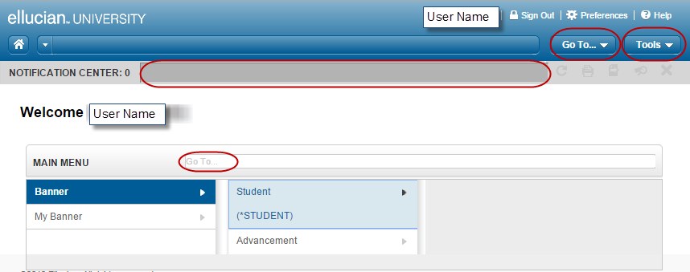
Main Menu
The Menu Tree still exists
My Banner still exists but at this time is only editable in 8.x

Slide 9
Main Menu
Tricks about My Banner
When using GUAPMNU, you can “rename” objects and they are unique to the My Banner setup. This does not rename objects in the system
You can create subfolders in My Banner by adding a folder object to GUAOBJS and then referencing the fold in the My Banner form
Recommend creating folders labeled by office or user with a one up (*REGOFF1, *REGOFF2, etc)
You can use GUTGMNU to edit what objects belong in subfolders
You can copy a My Banner folder from one user to another using GUTPMNU
This is an excellent “trick” to help new hires become more quickly acclimated to Banner
Confirm object is part of Banner 9 using GUAPAGE

Slide 10
Breadcrumbs and Tasty Tidbits
Breadcrumbs
Shows the progression through the menu tree
Aids in learning the menu structure
Required fields have *
Buttons display shortcut with mouse-over

Slide 11
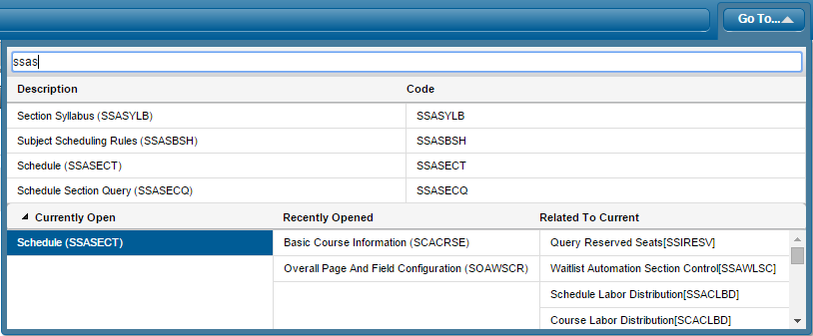
Go To
Use Alt + G
Autocompletes
Uses name and description
Currently Open
Recently Opened (previous 10)
Related to Current
access to old Options menu

Slide 12
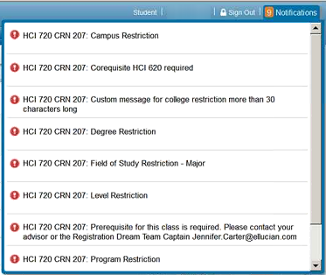
Notification Center
Displays error and informational messages like the hint line in 8
Errors are displayed in red and also display affiliated with the field/record in error
Multiple errors displayed together
Informational messages are green

Slide 13
Help
Online Help is available in the top right corner
When in online help, use the upper left menu button to access the Contents or Search Tabs
Help (Item Properties) is available from Tools
Use this to identify a table/field name for writing reports or troubleshooting with your technical rep
Help (All Fields) is only in Banner 8 at this time
like GURPDED but better

Slide 14
Data Extract
Allows users to extract data “displayed” into an external file (.txt or .csv/.xlsx) which can be saved to a folder or opened
Objects are enabled for Data Extract on GUAOBJS
In XE data extract is an icon under the Go To
In 8x it’s under Help
Controls for Data Extract are under GUAUPRF
Security
Popup Blocker
Default Technical delivery is for M access only
This can be updated to Q access

Slide 15
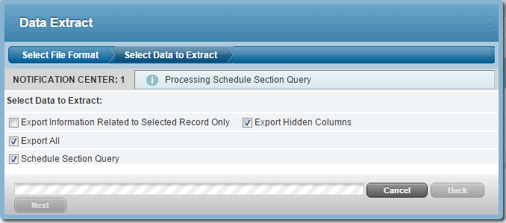
Data Extract
CMS-5132: Debugging data extract option in Banner
Performing Data Extract in XE

Slide 16
Queries
% and _ are wildcards
Percent is any number of characters %Q% = any form with a Q
Underscore is a single character __Q% = any form with a Q in 3rd position
Queries in XE have been retooled and work a lot like excel features and come with common sql/excel like filter options
You can even choose what columns to include in the output

Slide 17
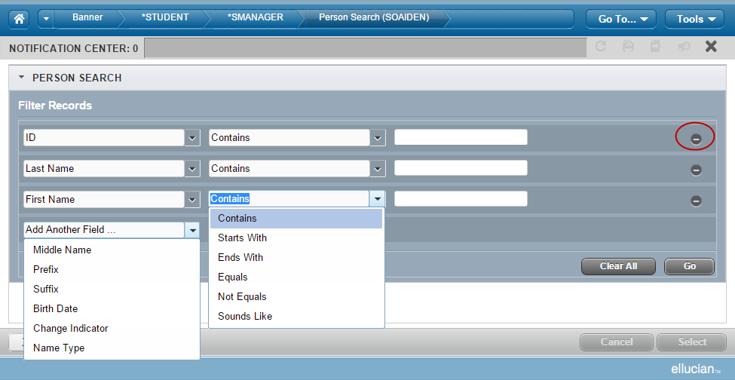
Query = Filter
Execute = Go

Slide 18
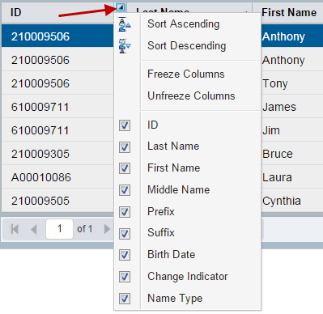
Queries
Enter Query = F7 = Shift + F7
Execute Query = F8 = Shift + F8
Quit Query = Ctrl Q = Ctrl Q
Last Criteria = F7/F7 = auto
Count Hits = Shift + F2 = auto

Slide 19
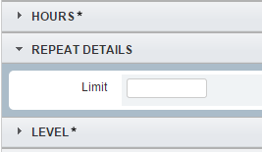
Terminology and Shortcuts
Buttons display shortcut with mouse-over
Blocks become Sections
Page Down and Up Bottom left
Forms = Pages
Rollback = Start Over
Query = Filter

Slide 20
Shortcuts
Save Shift + F10
Go Shift + F3
Next Block/Section Page Down
Previous Block/Section Page Up
Start Over Shift + F2
Exit w/o Application Navigator: Ctrl + Shift + Q
Exit w Application Navigator: Ctrl + Shift + F
Next Field Tab
Previous Field Shift + Tab
Go To Alt + G
Lookup F9

Slide 21
Shortcuts
Filter Shift + F7
Go (on Filter) Shift + F8
Insert Record Shift + F4
Copy Record/Section Shift + F6
Delete Record Shift + F5
Next Record Down Arrow
Previous Record Up Arrow
Clear Field Backspace
Refresh Alt + 5
Copy Term Alt + C
End Term Alt + X

Slide 22
Shortcuts
Export Alt + 9
Expand All/Collapse All Alt + F2
Cancel (window) Esc
When the Cancel button is displayed on an open window, the Esc key can be used to close the window.
Cancel (page) Not available
Help W/o Application Navigator: Alt + F1
Help With Application Navigator: Ctrl + Shift + L
Item Properties Alt + I
Tools Alt + L
Browse Menu Alt + M
Home Shift + Home
(returns to the Main Menu)

Slide 23
Multi-lingual Support
Delivered languages
English
Spanish
Portuguese (Brazil)
Arabic
French (France)
French (Canada)
Button labels, mouse over text, etc

Slide 24
Bonus Tip
GUISRCH – find a person using phone or email
Allows use of Wild cards in fields, can only enter one key per query

Slide 25
Summary
The User Experience in XE has many new and exciting features

