Slide 1
The Transformation of Banner Human Resources
Rick Skeel,
Director of Product Management
Ellucian
MBUG September 2015

Slide 2
Confidentiality
This information provides a general strategic view of Ellucian’s anticipated future offerings. The information in this document is confidential and proprietary to Ellucian and neither the document nor its contents can be disclosed to anyone without a written obligation of confidentiality in place with Ellucian.
The information in this document is not a commitment, promise or other obligation to deliver any material, code or functionality, and it should not be relied upon in making any purchase decision. The document and its contents are subject to change, without prior notice, at the sole discretion of Ellucian.

Slide 3

Agenda
Banner
Human Resources
Transformation
1 | Ellucian XE and Banner Transformation
2 | Transformation Usability Improvements
3 | Transformation Beta Testing Program
4 | Transformation Readiness
5 | Questions and Answers

Slide 4

Ellucian Extensible Ecosystem (XE)
An innovative strategy grounded in common principles, standards, and services that help you leverage economies of scale across your portfolio
Notes:
It is just the next release of Banner built on the same database using the same data that you leverage today.
I’ve been using the phrase Ellucian XE or Banner under the Ellucian XE strategy many times now. I know many of you here are well versed in what Ellucian XE is all about. But I know some of you may be hearing this phrase for the first time. To level the playing field, Ellucian XE stands for the Ellucian Extensible Ecosystem.
Ellucian XE is our strategy that is grounded in common principles, standards, and services that help you leverage economies of scale across your portfolio. This strategy drives the efforts and projects we undertake for any new solutions we develop and for all of our current solutions.
For Banner specifically, when we talk about Banner under the Ellucian XE strategy, those are our efforts to modernize the look and feel, usability, and technology of Banner and self-service.

Slide 5
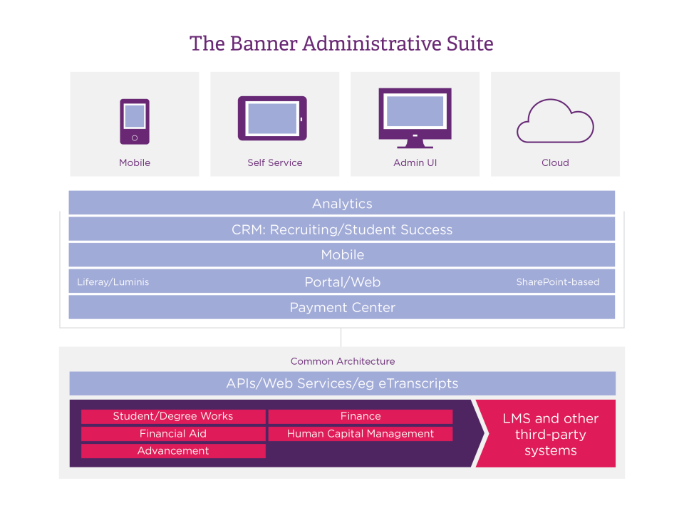
The XE Strategy and Design Principles
XE Design Principles
Usability
Cloud Readiness/Scalability
Configuration over Customization
Extensibility
Features/Functions
Common Architecture
Notes:
So let’s take a look at how XE applied to Banner works in your favor.
As I mentioned XE is a set of guiding principles or development pillars we use to make our products better. These design principles like Usability, Extensibility, Cloud Readiness, Scalability, Accessibility, and mobile readiness help you extend your investment in Banner across your campus for maximum efficiency.
As we move through the XE development we are creating common plugins that can be used consistently across Banner.
We are developing with a mobile first approach using responsive design technology that allows you to use Banner not only on your desktop or laptop but also on your tablet and mobile phone.
Applying the XE strategy to Banner is a giant step forward in improving usability and your ability to use Banner to make business decisions effectively on campus.

Slide 6



Modernizing Banner
Administrative
Imperatives
Technology—Eliminate Oracle Forms
Usability—Consumer web in high productivity mode
Configuration and Extension, not modification
Self-service
Imperatives
Usability—Consumer
web for casual users
Rich functionality, evolving with Higher Education
Configuration and Extension, not modification
Integration
Imperatives
API-based integrations
Industrial Strength Superhighways
Configuration and Extension, not modification
Notes:
Oracle DB still intact
Business rules and business logic intact
Looking to remediate Oracle forms and move to modern web interfaces for the end user
Example for Self-Service is the Employee Profile
Build APIs where we need to

Slide 7
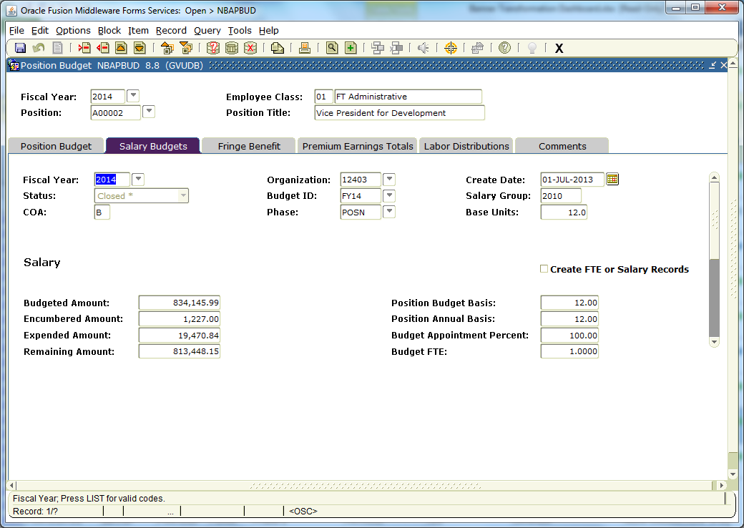
Yesterday
Notes:
Today, this is what the Oracle Forms user experience is like. This example is the Position Budget page (NBAPBUD) in the Banner Position Control module.
This user interface has served its purpose over the years, but we have heard from you that not only is it hard to train new users on, it’s also dated when you look at more modern web applications.
We agree and we embarked on changing the look and feel a few years ago. We started that effort in Banner Student. We learned a lot through uncovering user design patterns through our user experience design, training our teams on the newer technologies, and working with our customer development partner groups on improvements. Parallel to that effort our R&D team also looked to how we could leverage what we learned to accelerate the removal of the Oracle Forms dependency faster.
Ellucian shared last Fall that we have an automated tool that is being used to transform the Oracle Forms to Java web pages with the new look and feel so we could accelerate usability and technology improvements to you.
Again, this is the project called the Banner Transformation!

Slide 8
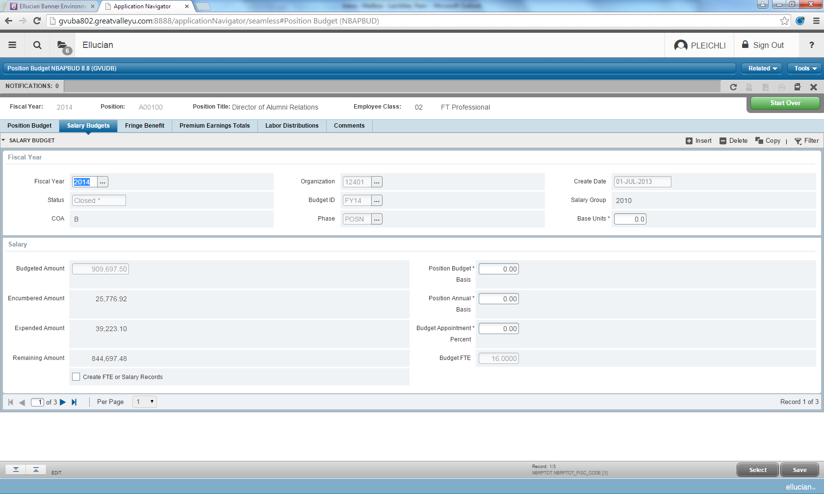
Today… Banner HR in Beta
Notes:
And, here is what the user experience will look like through the Transformation.
This example is the Position Budget page again. Pam will go through the improvements here in a few minutes, but you can see already that the look and feel is more streamlined and simple.
What does this mean for you and why are people in the Banner HR area talking about this to you today?

Slide 9

Let’s Take a Look!

Slide 10
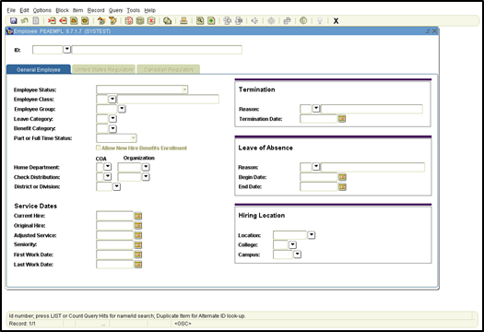
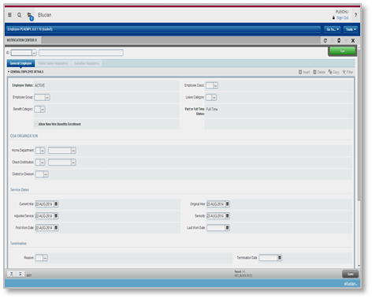
XE Applied to Administrative Applications
Banner INB Modernized with XE:
  Eliminating Oracle Forms and Oracle Reports
  Delivers new Java-based administrative pages
  and reports
  Positons for cloud delivery
  Introduces Notification Center
  Provides enhanced navigation for a seamless experience
  Provides consistent look and feel across Banner
  Eases upgrade process
  Leverages your database, your business rules and your data.
It’s YOUR Banner

Slide 11
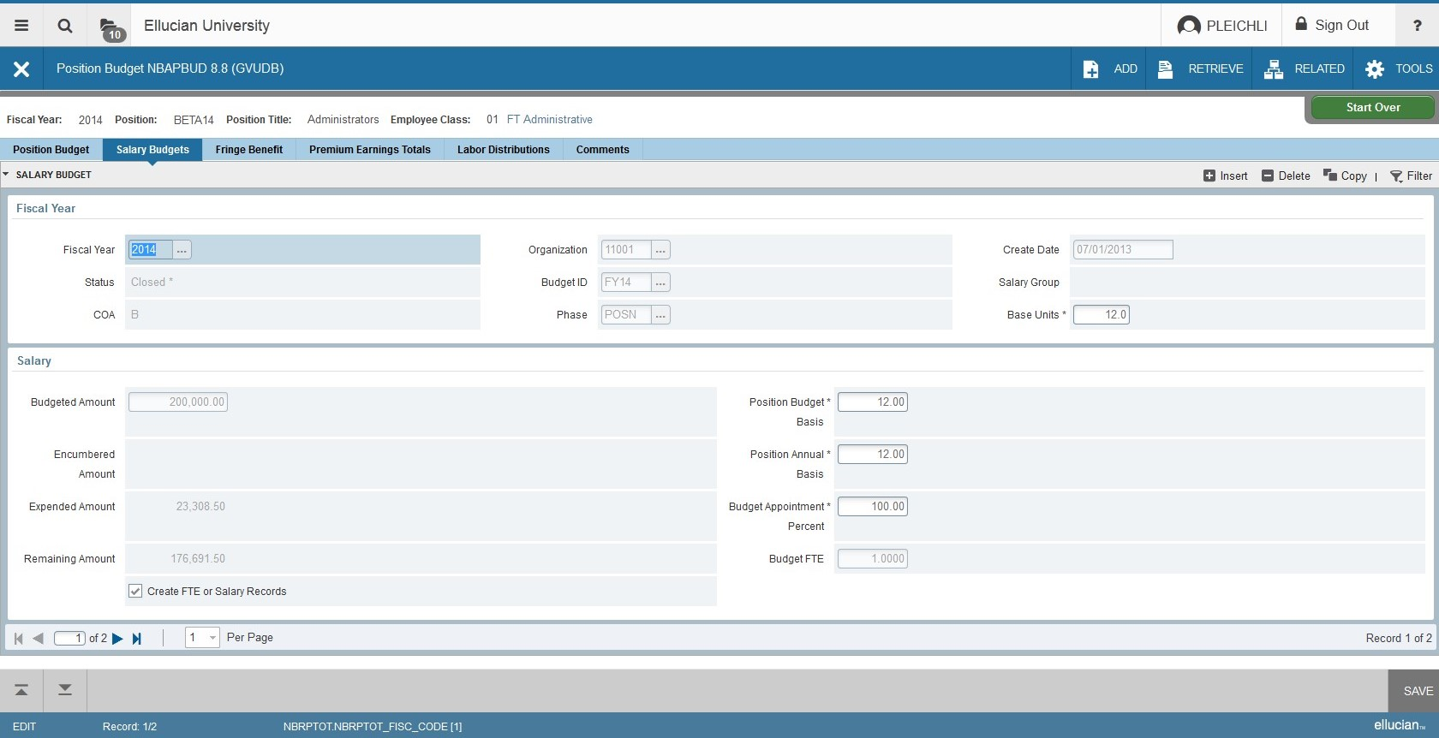
Position Budget page (NBAPBUD)

Slide 12
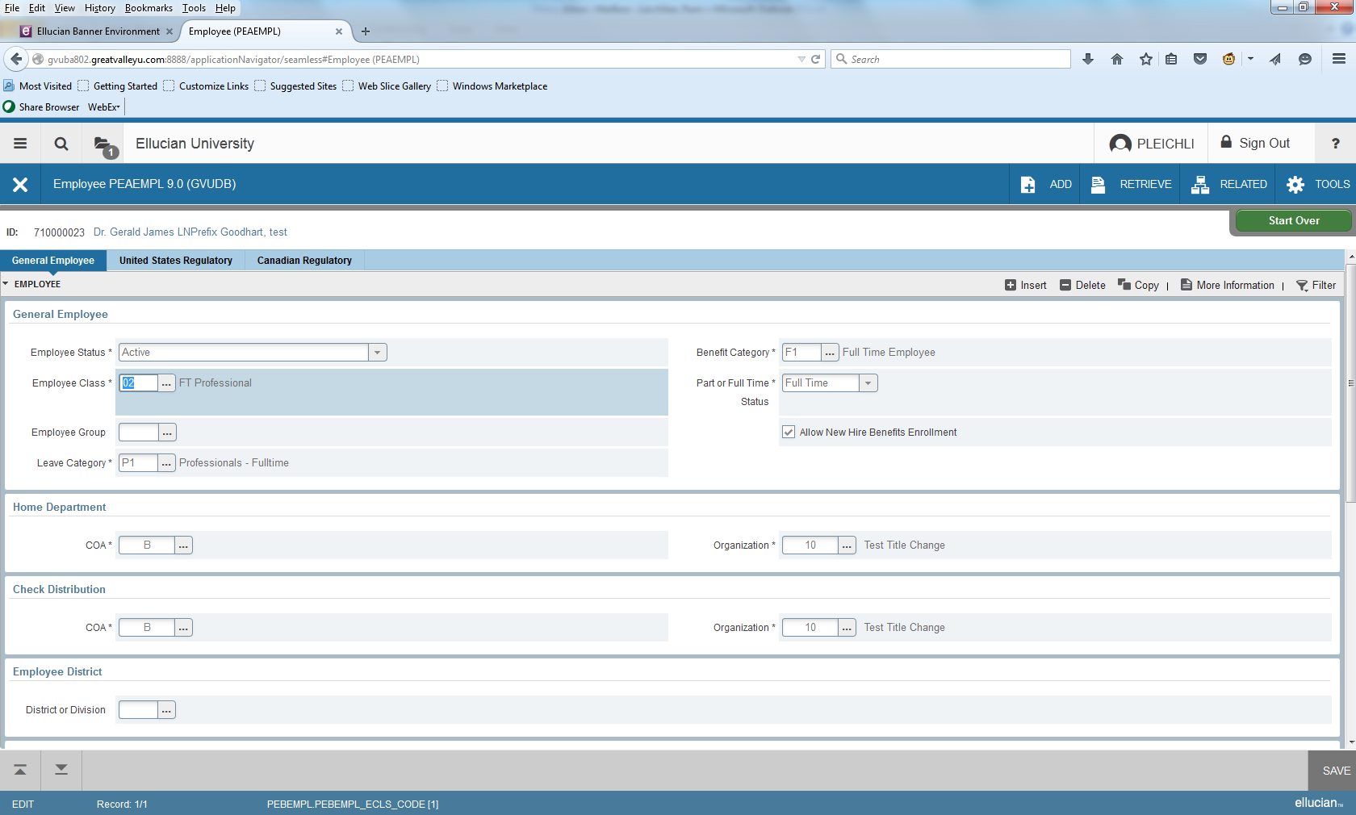
Employee page (PEAEMPL)

Slide 13
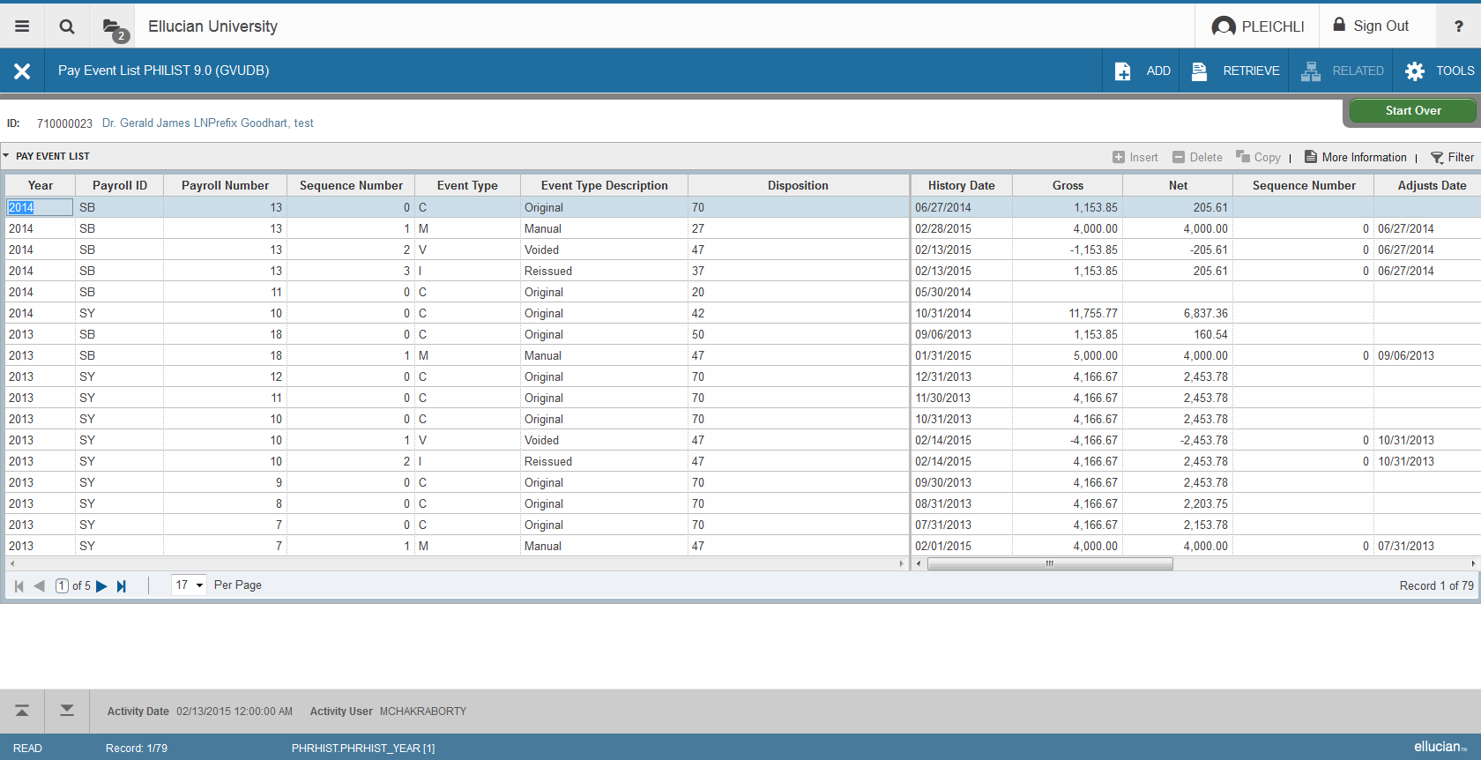
Pay Event List page (PHILIST)

Slide 14
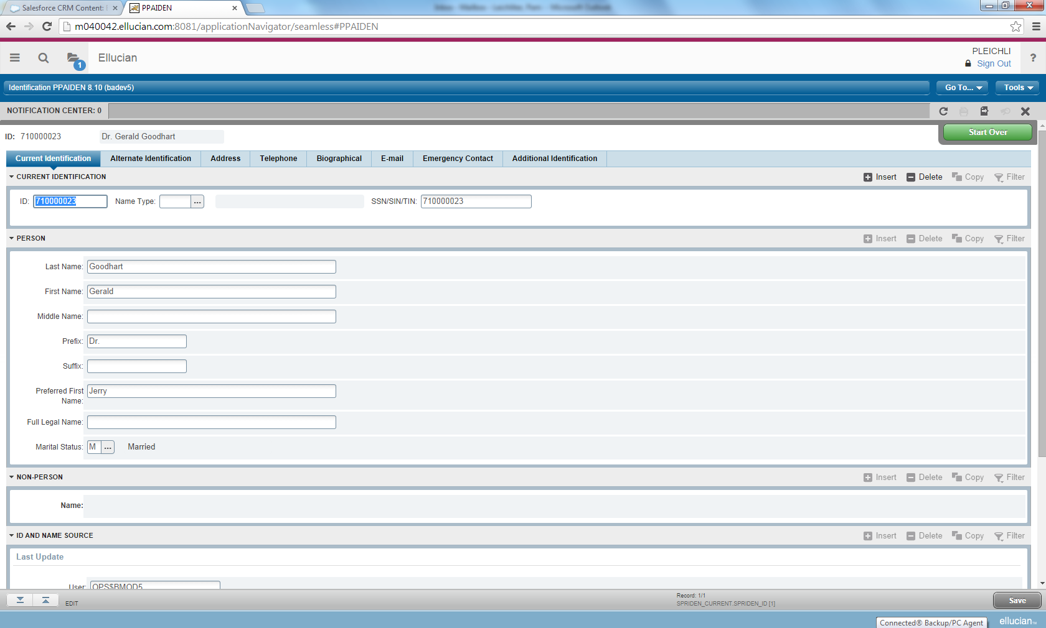
Identification – Person Information
Notes:
FOAIDEN is similar Finance form

Slide 15
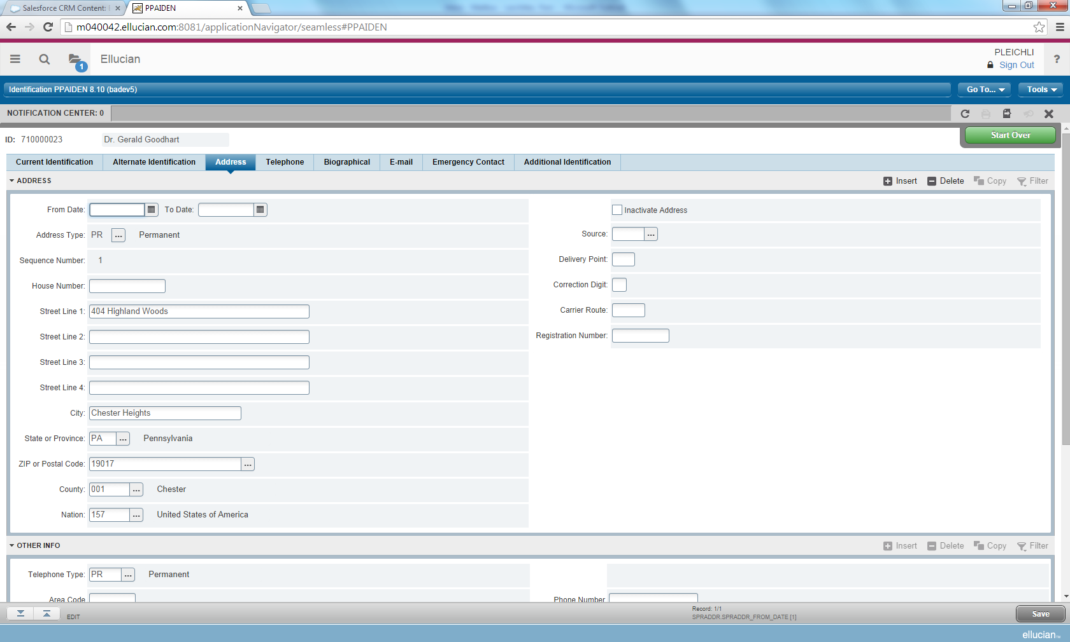
Identification – Address information

Slide 16
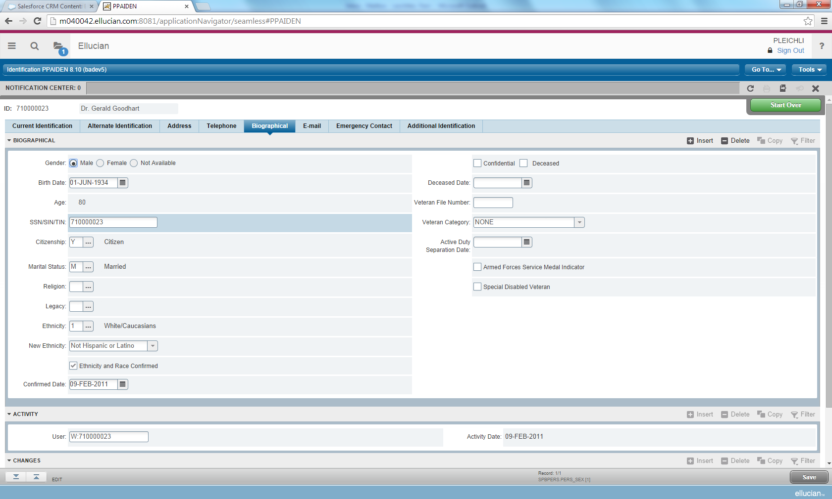
Identification – Biographical information (U.S.)

Slide 17
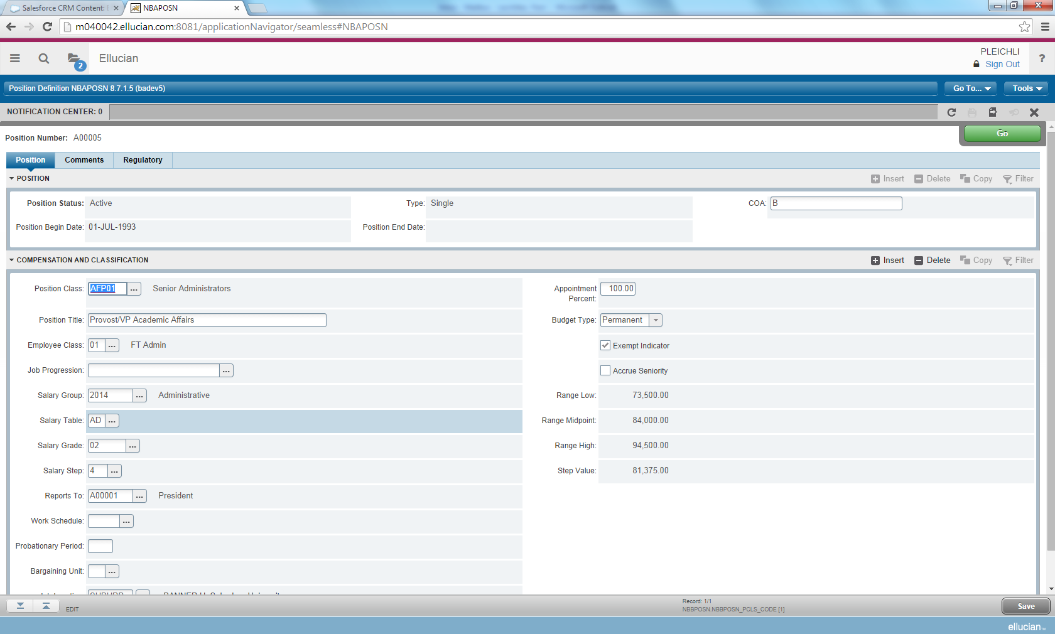
Position
Notes:
Some Finance users may be familiar with this page

Slide 18
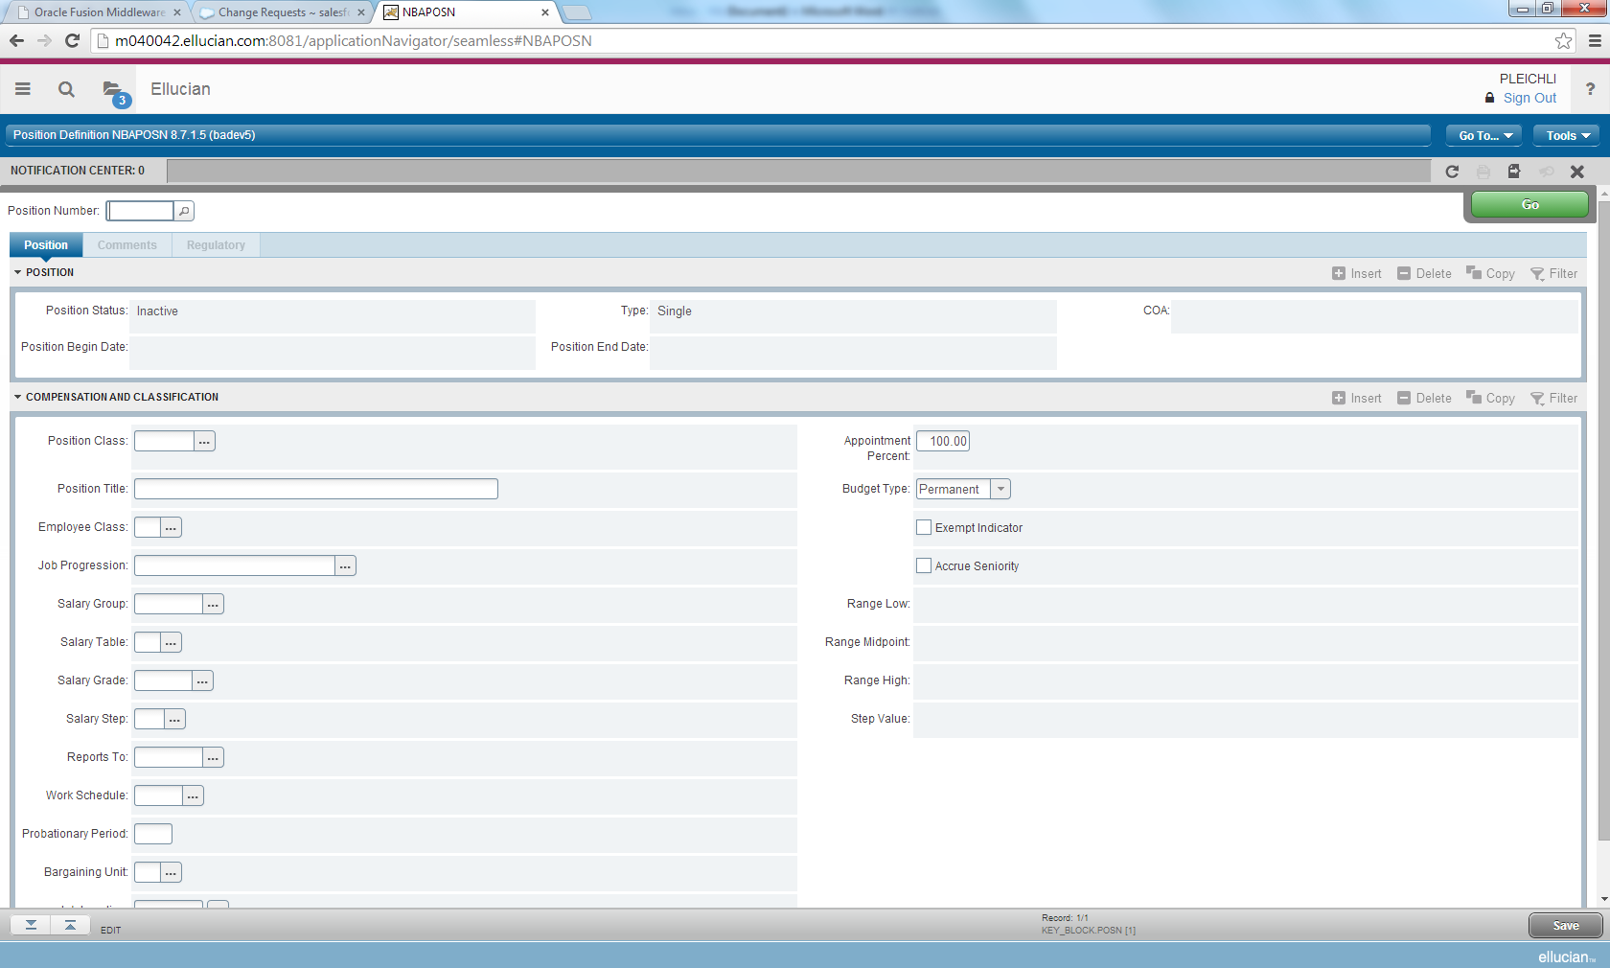
Usability improvement examples
Section Headers:
Expand or collapse and take action
Header section has:
  Institution name, User name, Sign Out, Preferences, and Help
  Go to…, and Tools
  Notification Center and page utilities (feature icons)
Notes:
Slide builds

Slide 19
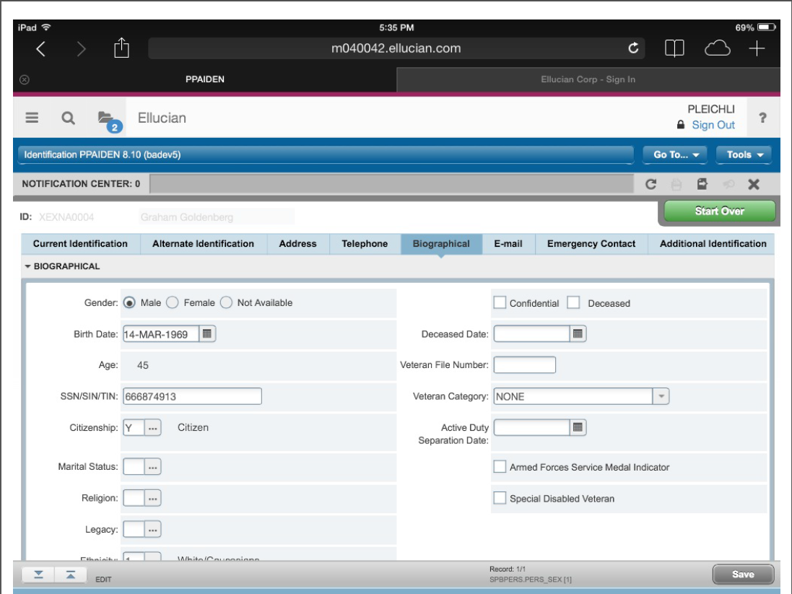
Tablet view
Notes:
You’ll be able to access Banner through your tablet!

Slide 20
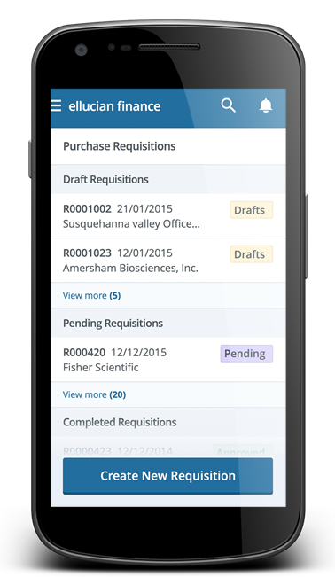
XE Applied to Self-Service Applications
Self-Service Modernized with XE
  Mobile first approach
  Responsive design technology
  Task oriented features
  Accessed directly from your browser and/or Ellucian Go
  Allows you to take Banner with you to make better business decisions

Slide 21




Position Description underway
Goal: Manage the creation, editing, routing, and approval of position descriptions
Replace paper-based, manual processes
Improve efficiencies for key stakeholders
Enable connections with Recruiting systems
Notes:
A Position Description is a “document” that outlines the duties, responsibilities, reporting line, requirements, and expectations of the position
Banner will provide for hiring managers, HR, etc. to manage the creation, editing, routing, and approval of position descriptions with the history of updates kept
Includes the ability to create custom fields for your unique needs, attach key documents as needed, search within a library of position descriptions, and eases integration with third party Recruiting systems

Slide 22
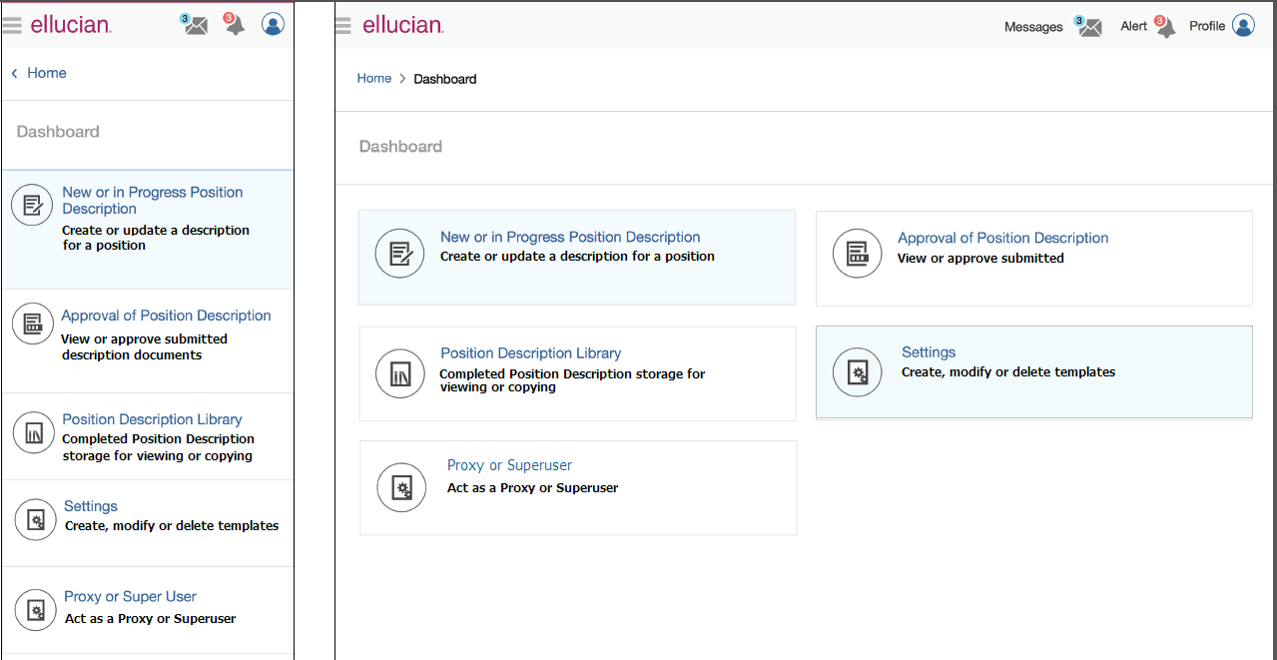
Position Description actions
Notes:
The two menu items our personas will use are the Settings for the Administrator to create a template, and
The ‘New or In Progress Position Description’ for the Originator to create a Position Description

Slide 23







Development Partner Group
Notes:
Thank you to these 14 customers for their participation the Customer Development Partner Group!
Eight of these customers will be early adopters.

Slide 24
Transformation Beta Testing Program

Slide 25






Banner Human Resources Transformation Beta Testing
Customer Development Partners
Notes:
Those customers are ….
Do we have any of the representatives here today? Please stand if you are here. Round of applause.
Thank you to all of them!

Slide 26
Transformation Beta Testing Opportunity
Ability to touch, feel, and review the transformed pages
Accelerate to a modern user experience faster
Become early adopter customer leaders
Be part of the solution
Extraordinary support from Ellucian
Notes:
In order for this effort to be successful, we do need to make sure we are getting it right. We want quality deliverables so that your adoption is streamlined. Customer input helps:
Refines the installation and deployment process
Allows for creation of tips and tricks for documentation
Helps correct early issues that are found
Provides early feedback on usability improvements
Enables peer-to-peer sharing and collaboration
Forges successful adoption paths
As we looked at the project ahead of us, we wanted to include a beta testing period for a small number of customers. We wanted them to test the whole experience, from end to end. All the way from preparing environments, to testing the install, to testing the Transformed pages themselves.
That is no small order as everyone does have day jobs.
I reached out to several HR customers and presented the opportunity, and this is what I shared with them and what the opportunity would mean for them.
They would be able to …

Slide 27
Beta testing participation and feedback is necessary to success!
March 2015 – Summer 2015
Testing of Banner HR and Position Control
Technical and Functional Preparation
Installation of Beta Release via ESM
Testing of Texas and Canada Extensions
Testing of Extensibility Framework
Extraordinary Support
Notes:
The Beta testing effort is critical to your success.
Here is a high level timeline of what these customers will be engaged with over the next several weeks prior to general availability mid year.
They began the process with getting ready which meant moving their test environments forward with the technical requirements and minimum software versions needed. On the Functional side, resources were secured to help test. Partnership between IT and the business side.
When the release was ready, the Betas then installed the necessary pieces through the Ellucian Solution Manager (ESM) which is a requirement for the Transformation which included something called Application Navigator and a Banner General release to support Application Navigator. ESM was used to deploy the HR and Position Control pages. Texas testing their extensions. I probably just introduced a couple of new terms to you: Ellucian Solution Manager and Application Navigator. Pam will talk more about that here in a minute.
Next steps for them will include testing the Extensibility Framework (VT’s mods), our Canadian testers testing their extensions, and testing the Banner General Transformed pages.
Throughout this process, Ellucian has been providing what we call Extraordinary Support. That means all the right people and teams are at the ready to help these customers with questions and issues. And, we’ll help them all the way through this process and beyond as they ready for production when the final release is ready for General Availability.

Slide 28
Transformation Readiness

Slide 29
Path to Adopting XE Application
Understand
Plan
Adopt
Deploy

Slide 30
Transformation Targeted Timeline
Mid-2015
End of 2015
Mid-2016
HR Beta Program
GA: Human Resources, Position Control, Local Extensions
Finance Beta Program
GA: Finance, Local Extensions
Student Beta Program
GA: Student, Accounts Receivable, Financial Aid, Local Extensions
Notes:
We are talking to you about this today because Banner HR, Banner Position Control, and Banner General are the first modules in the Banner suite that will be using this automated tool for the improved user interface.
We are currently in a Beta Testing Program with seven customers—more on that in a minute. The General Availability to all of you is mid-2015. Following HR and Position Control, Banner Finance will be delivered at the end of 2015, also with a beta period prior to release. And, then by mid-2016, the rest of the Banner application will be available.
That means you could be Oracle Forms free in 2016 with a modern new look and feel and technology stack.
Now, you also see here that for each General Availability release that local extensions are listed. That means for any of you that have Ellucian specific regional functionality, that we will also be delivering your localizations at the same time as the baseline pages. With the use of our extensibility tools, you will have a complete user experience and not have to wait months to get your specific pages. Specifically for Banner HR customers, that means if you are in Canada, the Middle East, Latin America, California, Texas, or Tennessee that you will have all you need to move forward with this HR and Position Control 9.0 upgrade for a complete user experience.
The Banner Transformation is not a new product or a reimplementation. The Transformed pages continue to leverage the functionality you expect and the business rules have built all while maintaining the solid Banner database foundation.

Slide 31

XE for Banner Human Resources,
Position Control, and Employee Self-Service
Banner 8 INB
Banner 8 Self-Service
Banner Position Control powered by XE
Banner Human Resources powered by XE
Banner Employee Self-Service powered by XE
Banner Database
Database Extension Utility (DBEU)
Notes:
As I noted before, the Banner database our solid foundation for the Banner products. Currently, we have the 8.x versions of the administrative system INB (Internet Native Banner) and Self-Service that work on top of that database.
Moving forward, our products will receive the new look and feel that has already been in progress on the Student side, but now comes to HR, both from a self-service and Admin experience. We are focusing responsive design down to the phone and table where appropriate.
Any of the new applications we build in the new user interface will still live on our solid foundation of the Banner database and will live alongside the 8.x modules because of our evolutionary approach. In order to make these applications under the XE strategy “go” so to speak, you need to install the Database Extension Utility (DBEU) and as we announced towards the end of last year, that does need to be installed by the end of 2014.
So, to summarize, XE is the Ellucian strategy that is driving the work we are doing in Banner on the user experience for our products and the new technologies we are adopting in support of that. We are beginning our journey with the HR solutions under that XE strategy. And, I have to say we are super excited about it.

Slide 32
High level preparation considerations
Plan Project & Deployment Strategy
Review Technical Requirements
Install Prerequisite Minimums
Install/deploy transformed pages to test
Notes:
Thanks Laura!
I am sure you are all excited and anxious for advice on how to get started on the HR transformation.
As you start to think about your transformation, you will want to consider the identity management strategy, your custom modifications, use the Modification Assessment Tool to understand the level of effort to transform the modifications, and to plan your strategy for them, and to review the test plans you currently use for upgrades.
You will want to review and plan for upgrading or installing the technical environment, to be sure you have everything ready. This includes your Oracle database, the application server, your middle tier platform, and the correct version of Java, the supported browsers and tablets.
Once it is time to begin your implementation, you will make sure you are on the expected versions of the Banner modules, Application Navigator and Ellucian Solution Manager.
Finally, it is deployment time! Using ESM, you will deploy the environment, utilize the extensibility tools to apply your custom modifications, and start testing.

Slide 33
Software and Hardware Requirements
Oracle Database
Application Servers
Middle Tier (Application Server) platforms
Java
Browsers
Tablets
Ellucian Solution Manager
Application Navigator
Banner General, HR, and Position Control
Notes:
We do have technical requirements for the project, from the Oracle database version all the way to the minimum required HR versions. We had requirements for the beta customers that involved ESM, AppNav, General, and HR/Position Control--we are currently refining the requirements through the beta process and will share those with everyone when they are solidified--if, however, you want to get a jump start, our recommendation would be to get current on banner releases and to start looking at ESM

Slide 34

Leveraging Ellucian Solution Manager to Improve Productivity
Transformed Banner pages will be delivered via Ellucian Solution Manager
Helps automate the Banner upgrade process
      Shows the latest version of the module installed in your environment
      Identifies dependency information
      Displays install history
      Identifies what upgrades are available
      Automates the install of user-selected available upgrades, including pre-requisites
Notes:
Ellucian Solution Manager may be a new term to many of you. It is a no-cost application, provided by Ellucian, that will help you manage your environments and the software you receive from Ellucian. You can use it to provision new environments, identify dependencies, capture your installation history, and will automate your Banner software upgrades, thus reducing the effort required on your part.
ESM supports most Banner 8 upgrades released on or after June 1, 2012 and most Banner 9 upgrades. The version of ESM that we will be using for Transformation is 1.4, which will be available in June of 2015.

Slide 35
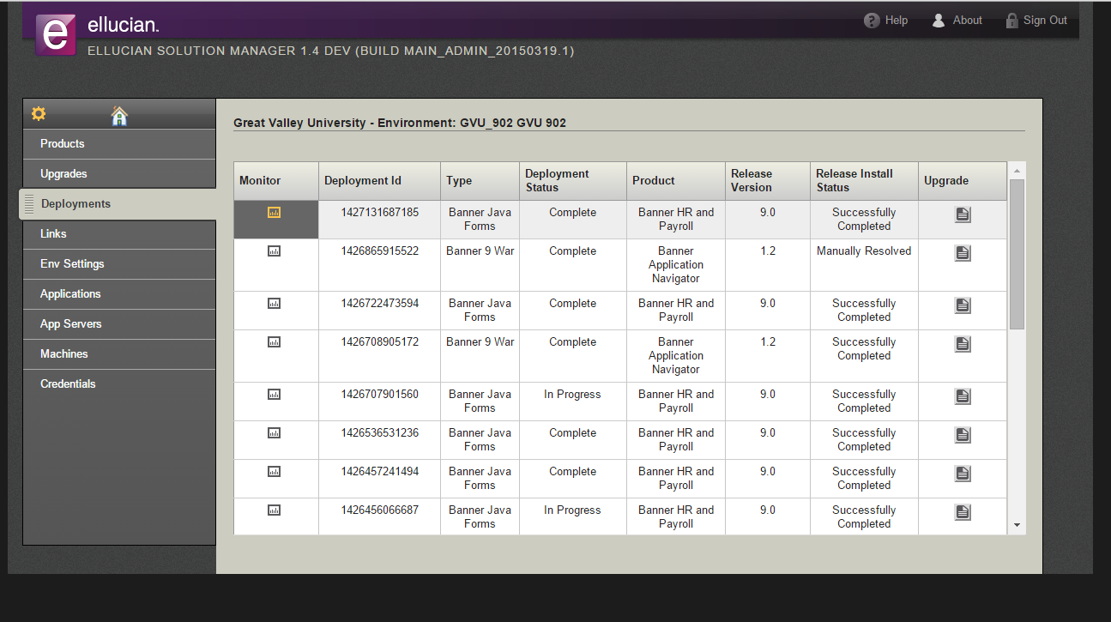
Ellucian Solution Manager example
Notes:
This is an example of Ellucian Solution Manager, and the information you see.

Slide 36

Banner Extensibility Strategy
Code Repositories
and Documentation
Customize Page Components
(UI Extensions)
Domain Model Extensions
Menu Integration
-----------------------------
Application Skinning
Aspect-oriented Programming
External Business Rules
Resource Bundle Editor
Eliminate (or at least greatly reduce and simplify) rework associated with upgrades
Eliminate the need to modify source code
If source modification is necessary, allow for continuous integration
Provide tools that facilitate extensibility
Make tools simple to use
Notes:
Interesting results .. Thank you. It looks like we have mixed bag which is what we expected.
Our Banner Extensibility Strategy is designed to simplify and reduce your need to have separate modifications and customizations. Value is decreased maintance
Specifically, we will deliver a tool set that will allow you to make configuration choices that don’t require the need to modify source code. The idea is that you will have simple tools you can use to customize your pages and create domain model extensions which will be carried forward when you upgrade they system so you don’t need to take separate, labor intensive actions as you would today.
My favorite example of this toolset is changing field tags. You can change field tags on a single page if it will help your users, or change them on multiple pages. Some people like the word department over organization so you may want to change the word “organization” across Banner HR to say “department.”
All those groups I mentioned previously for HR where we have done localizations in the past, meant that when we put out a baseline release, the regional localizations had to be applied on top and the baseline release made compatible. Sometimes that meant customers waited for months to get a new release after everyone else got it.
So, Ellucian has done the same type of modification upkeep that you have for those things.

Slide 37
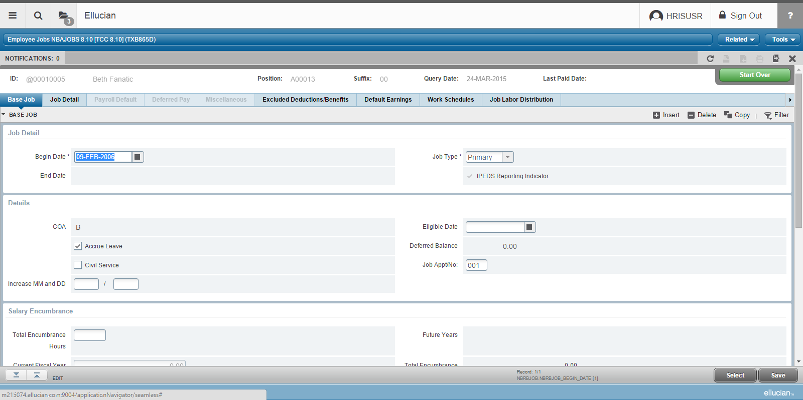
Texas extension example
Notes:
We want to reduce that upkeep too and we also want to make sure those customers don’t have to wait anymore for their releases. So, we are actually using these Extensibility tools ourselves for the regional extensions we have.
As an example, we ran the Texas Connection localizations through this tool and those for HR are now considered extensions. Our Texas customers in the beta program are using those pages now; and the ones for the Canadian customers are coming.
This is the Employee Jobs page with the Job App/No field which is specific to Texas and added with the Extensibility tools.
Not to get too technical, but the extensions will be their own .war file that is deployed after deploying the baseline page .war files. It will overlay the baseline pieces.
Many of you may wonder, well, how are my customizations and modifications impacted by the Extensibility tools as part of the Transformation? Great question!

Slide 38
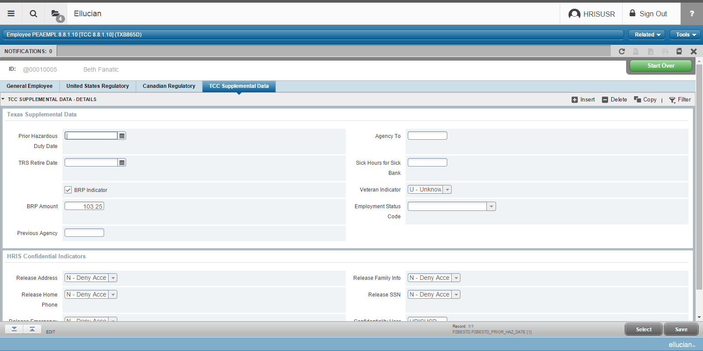
Texas extension example
Notes:
And, here is the Employee page with a tab specific to TCC Supplemental Data that was added with the Extensibility tools.
Not to get too technical, but these Texas extensions will be their own .war file that is deployed after deploying the baseline page .war files. It will overlay the baseline pieces. And, that is how it would work for your modifications if using the tools for your own needs.
So, how do you move your modifications and add-on forms to the new look and feel as part of the Transformation?

Slide 39
Transforming your modifications and customizations
Ellucian will be providing a cost-effective, automated analysis of the effort to move your Banner form modifications and customizations to the Java technology stack
      Includes no-cost electronic code submission and feedback to a secure website (Ellucian Hub)
      Determines the complexity and level of effort to retain your modifications as extensions to the transformed pages
      Analyzes what effort is necessary to transform your add-on forms
      Output of assessment provided back to you to determine next steps
Notes:
Ellucian will be providing an automated assessment process that will determine the level of transformation effort for your Oracle Forms modifications and customizations. The automated analysis will determine the complexity and level of effort to retain the modifications as extensions to the transformed pages, and in addition provide an assessment of the level of effort to transform your custom forms.
This assessment process is at no cost and it will be accessible via your Ellucian Hub login. You will get an output of the assessment to determine next steps.
Note: SSB modifications will remain a manual effort.

Slide 40
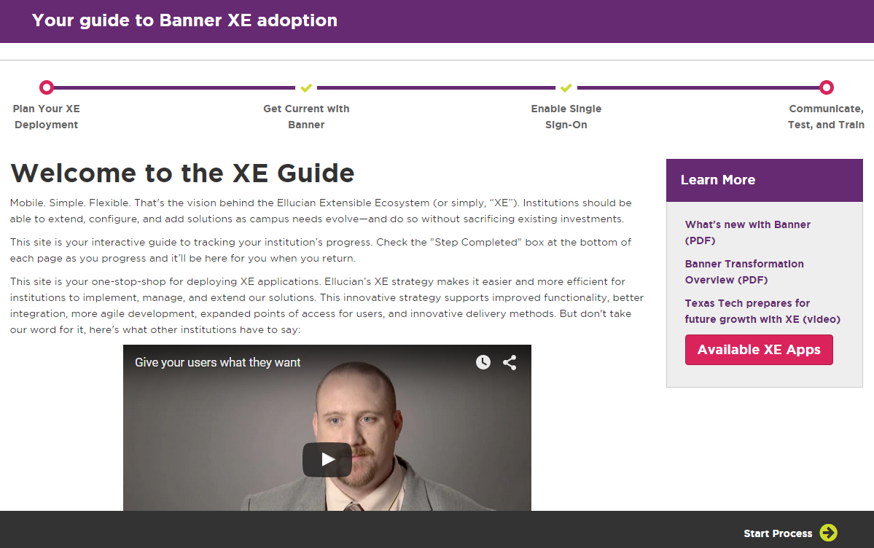
XE Guide is Here! Visit ellucian.com/xeguide
1
2
3
4
Plan XE Deployment | Get current with Banner | Enable Single Sign-On | Communicate, Test, and Train
Notes:
The XE Guide focuses on the four main steps customers need to adopt XE applications. I’ll go through each section in a moment.
The guiding principle of this site is to provide customers with the information they need. We believe we’ve done so with the comprehensive content included in this site. Most of the content is technical in nature, but functional Banner users will also find a lot of great information. We’ve included a listing of all applications released to date (and will continue to update this list as additional applications are released) as well as links to webinars and other resources.
At a high level, customers need to plan what they are going to deploy, and ensure they have the pre-requisites in place to support an XE application deployment. They also need to be current with Banner releases, and should enable single sign-on for the best user experience. They’re then ready to deploy one or many XE applications.

Slide 41
Places To Find More Information
Communities
  Human Resources
  Finance
  Financial Aid
  Student
Information
  White papers
  webinars
  documents
XE Guide
www.ellucian.com/xeguide
Don’t forget to review our roadmaps at www.ellucian.com/
Roadmaps
Attend an Ellucian education class or contact your Client Partner to learn more.
CHAT
Communities
LOOK
Roadmaps
FIND
Download
LEARN
Attend

Slide 42

Rick Skeel
Director of Product Management
+1 405-431-8078 rick.skeel@Ellucian.com
4 Country View Road, Malvern, PA 19355 | 1.800.123.4567

Slide 43
Appendix:
Transformation Usability Improvements

Slide 44
Top 7 Usability Improvements
1
Modernized user interface with Industry Standard
Web Controls
Navigation Improvements
Consistency
System Messaging
5
Multiple record views
Lookups and Filter
Tablet Friendly
6
2
7
3
4
Notes:
These are the top 7 usability improvements we are implementing. There are lots more, but these are the “biggies”.
Remember - It’s still Banner. The underlying platform features such as Oracle security, HR security, Value Based Security, Security for Personally Identifiable Information all still work. You will not need any changes to your institution’s data
We are going to walk through the application now. I am going to show you new pages and talk about the features. I have included slides in this deck you can reference when you get home. So, I am going to leave this presentation now, and log into the application.

Slide 45
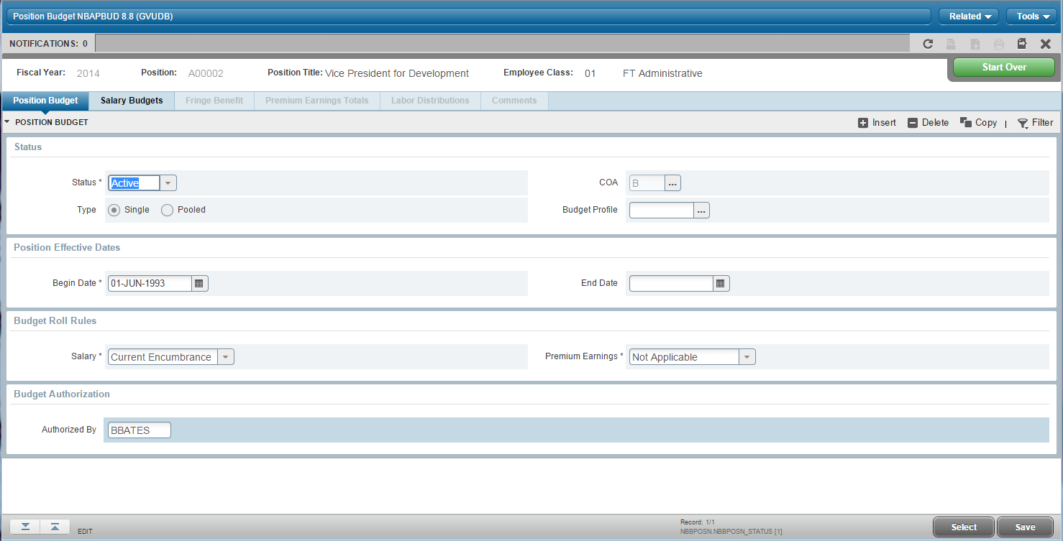
1
Modernized user interface with Industry Standard Web Controls
Section Control
Tabs
Radio Buttons
Calendar Utility
List of Values
Button Controls
Notes:
• Familiar, comfortable, web form controls
- buttons
- tabs
- radio buttons
- list of values
- calendar
- collapse section

Slide 46
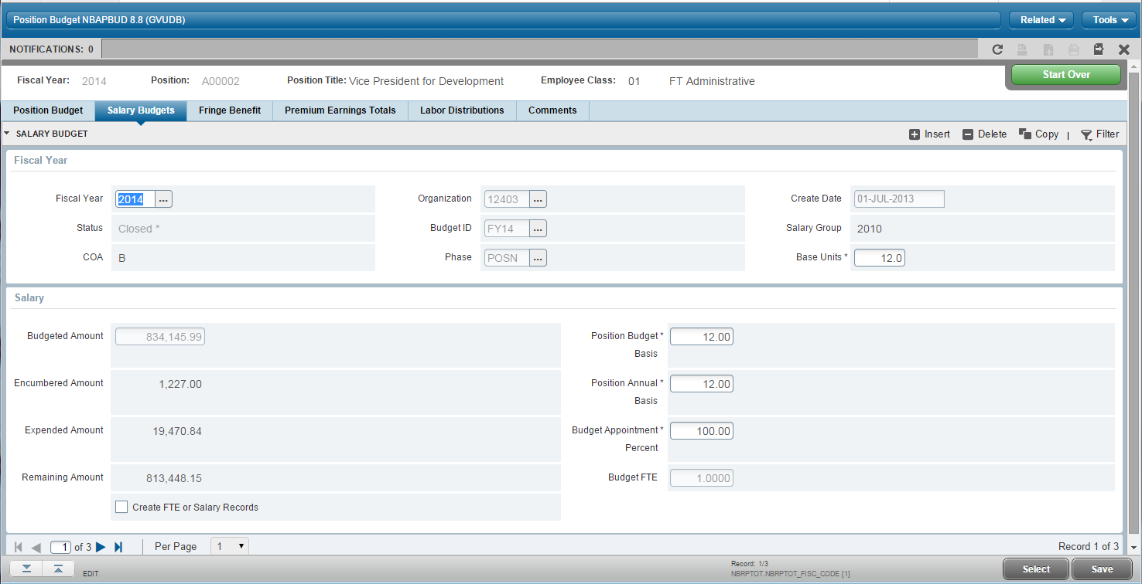
1
Modernized user interface with Industry Standard Web Controls
Read-only vs updatable fields
Required Field Indicator
Checkboxes
Notes:
• Familiar, comfortable, web form controls
- checkboxes
- Visual differentiation between fields that are enterable or read-only
• Like content grouped together
• Required fields marked with an asterisk (*)
• One, two (and three) column layouts. Fields neatly stacked

Slide 47
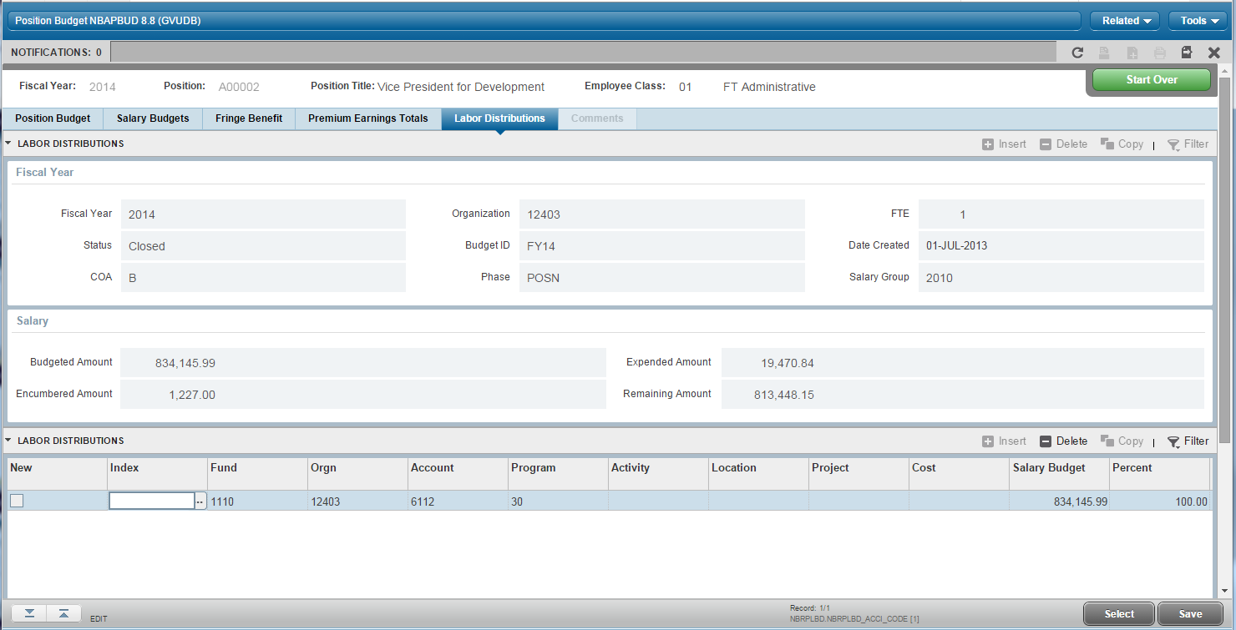
1
Modernized user interface with Industry Standard Web Controls
Active Section Controls
Notes:
• Familiar, comfortable, web form controls
clearly visible actions showing what can be performed based on location (disabled buttons such as insert/delete)

Slide 48
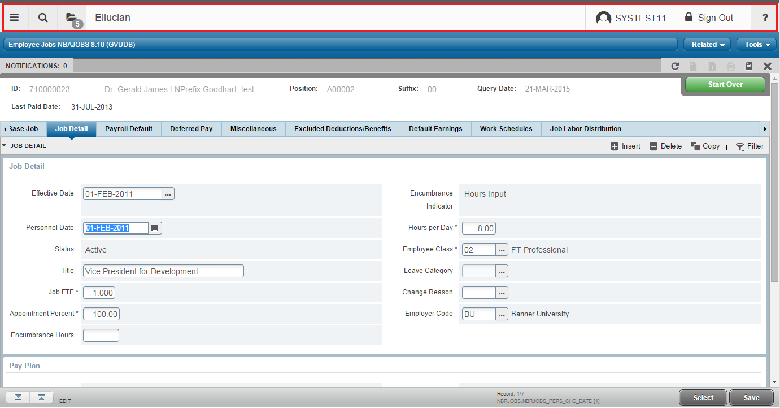
2
Navigation Improvements
Notes:
Easy navigation using mouse or trackpad, keyboard or a combination, along with helpful hints along the way in case you need a quick reminder.
Application Navigator
Although the applications have a different UI than INB, the users will be able to access the forms they need to complete a business process in a consistent manner. The user’s experience is simplified, making it easy to complete a business process even though there are multiple UIs (during the transition to all transformed forms). This means you can start moving to new applications, and you don’t need to wait until the entire Banner product is transformed.

Slide 49
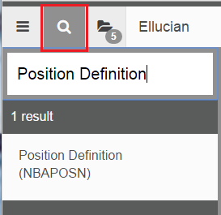
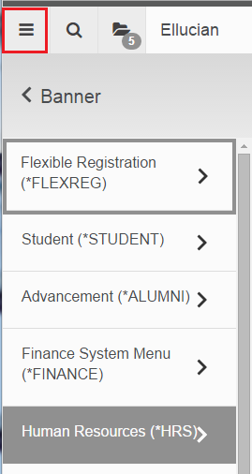
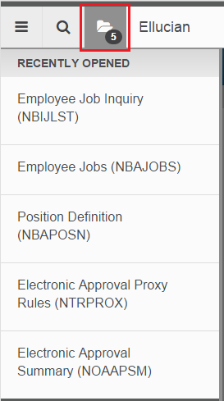

2
Easy Page-to-Page Navigation
Notes:
• Application Navigator
– Menu
- Search
- Recently Opened
- Logged In User
- Sign Out
- Help

Slide 50
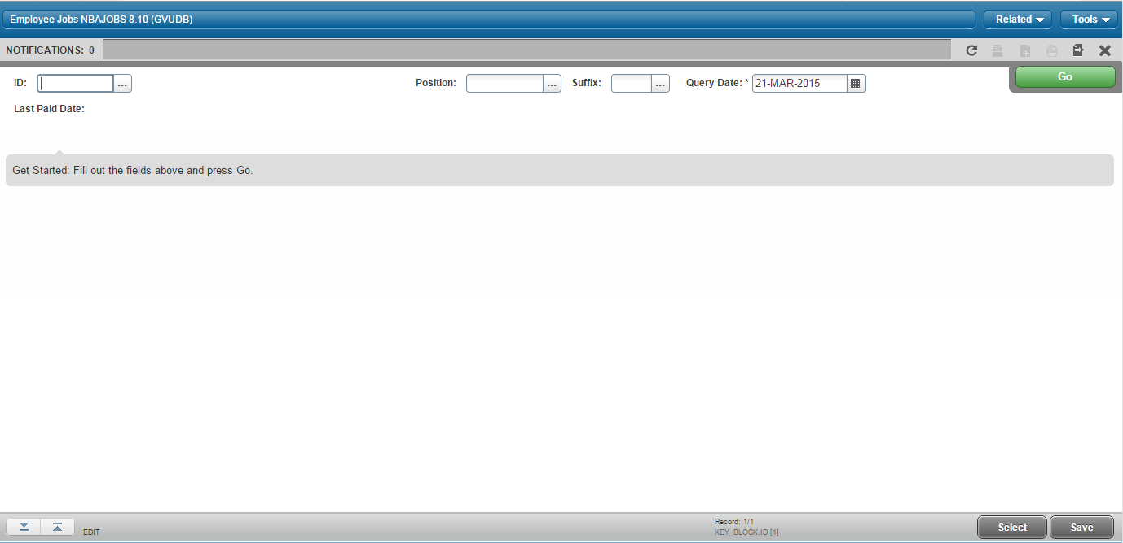
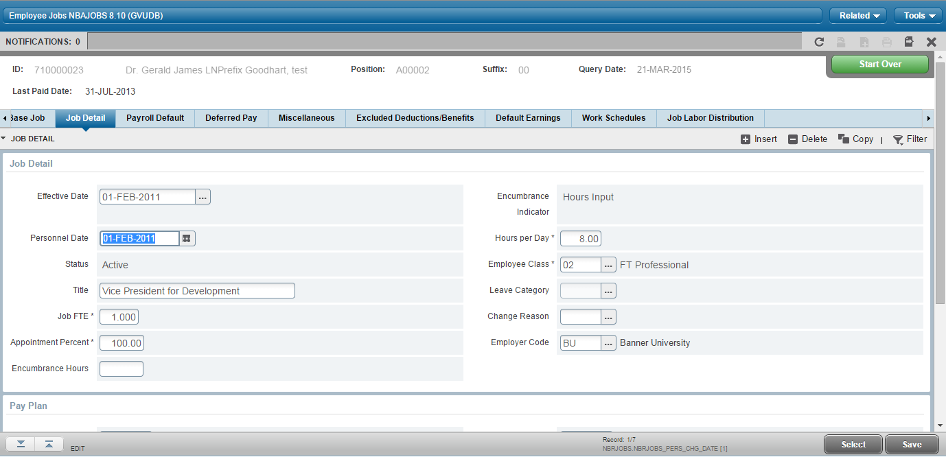
3
Consistency
Notes:
• Familiar Keyblock / Form approach

Slide 51
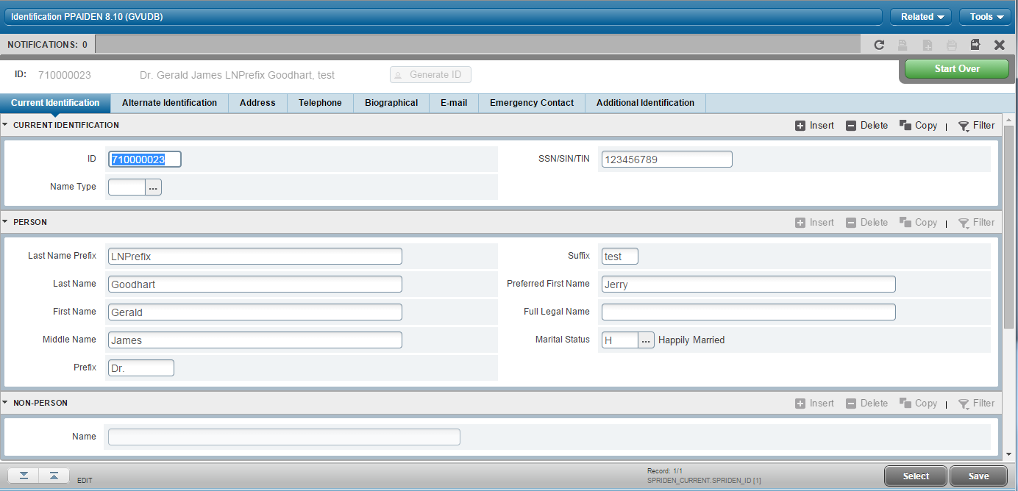
3
Consistency
Notes:
Consistency from one form to another.
Familiar patterns.
Consistency in the layout from one page to another. Improvement in page sections and the ability to expand and collapse sections.
This is the Person Identification page with data grouped in sections and tabs identified below the key block.

Slide 52
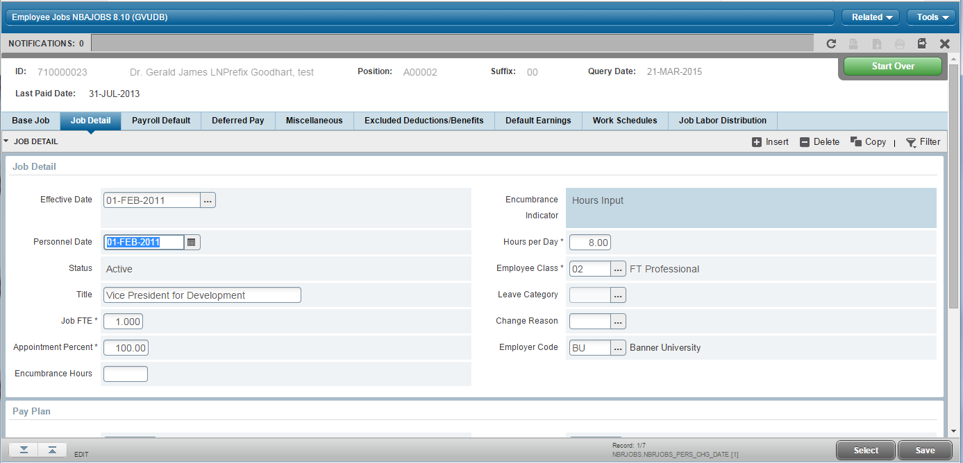
3
Consistency
Notes:
Consistency from one form to another.
Familiar patterns.
Example of the Employee Jobs form with like data grouped together under headings

Slide 53
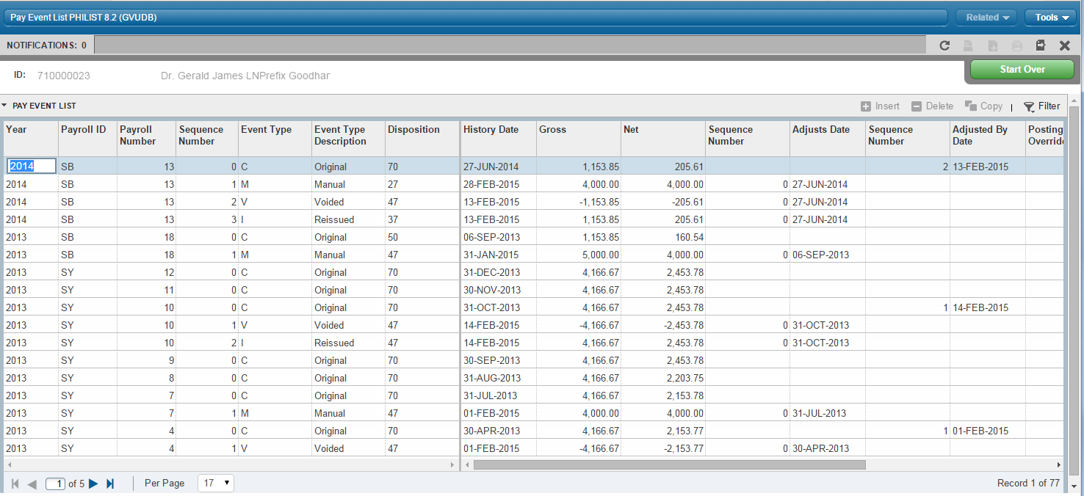
3
Consistency
Notes:
Consistency from one form to another.
Familiar patterns.
Here is the Pay Event List page showing a grid format with the static portion and scrollable section.

Slide 54
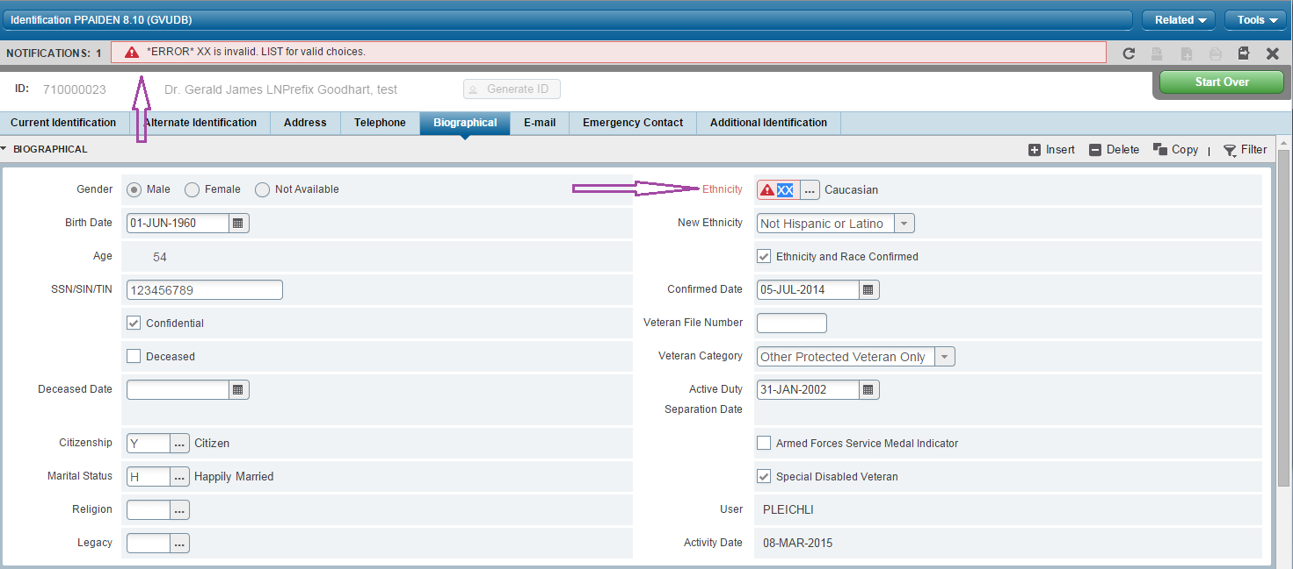
4
System Messaging
Notes:
Messages are now displayed in the Notifications center at the top of the page and at the offending field. This brings attention to any items that the user must address as well as identifying where the error is on the page.
Colors are also used in the notifications to easily recognize successful messages (green), warnings (yellow), and errors (red).

Slide 55
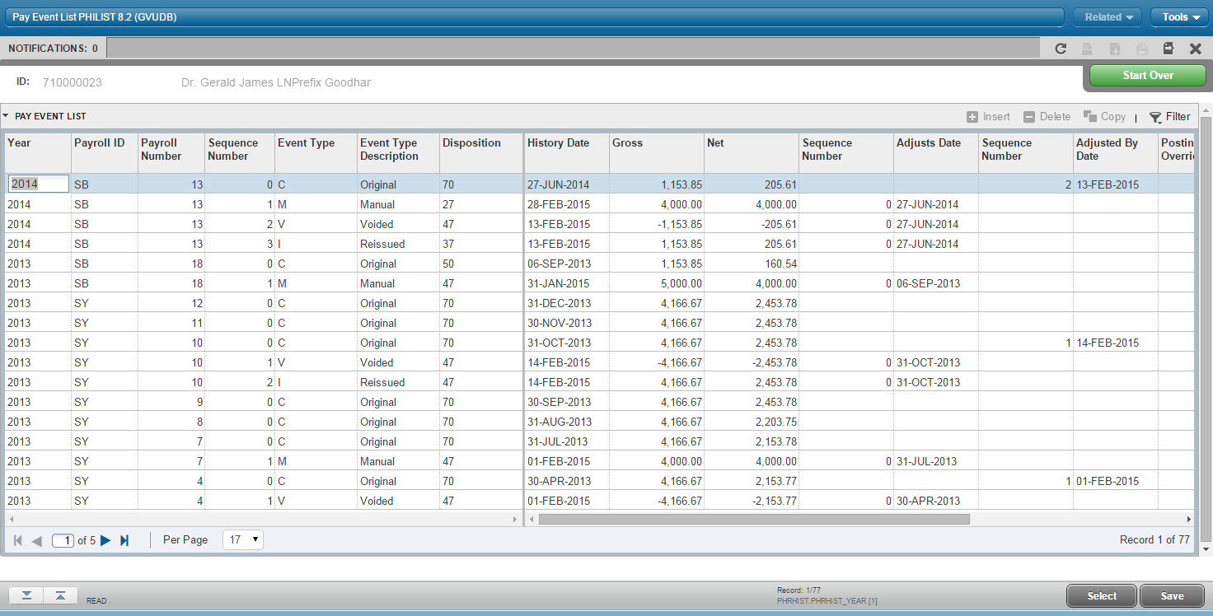
5
Multiple Record Views—Grid
Frozen columns
Drag and drop columns
Pagination Controls
Record Count
Notes:
Grid
Drag to reorder columns
Frozen columns when needed
Total record count
Current record in the list
Pagination by
next, previous, first, last page,
Specific page number

Slide 56
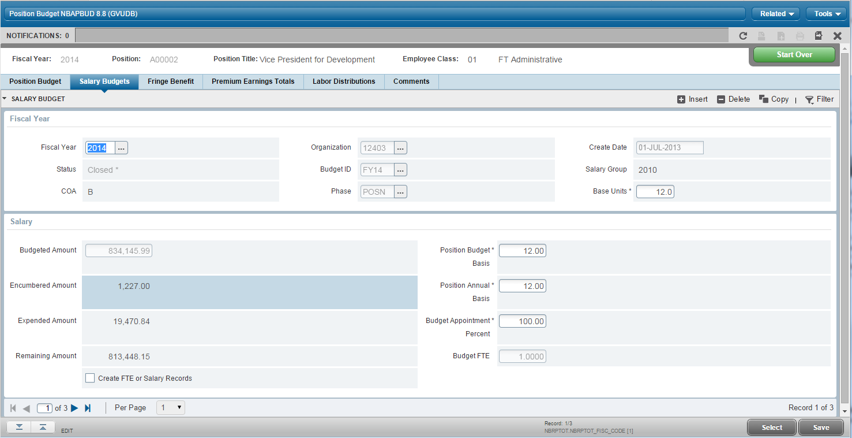
5
Multiple Record Views—Single Record
Notes:
Single record view
Pagination by
next, previous, first, last page,
Specific page number

Slide 57
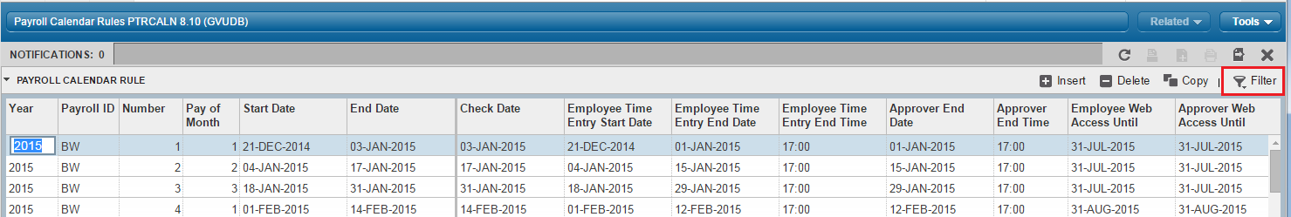
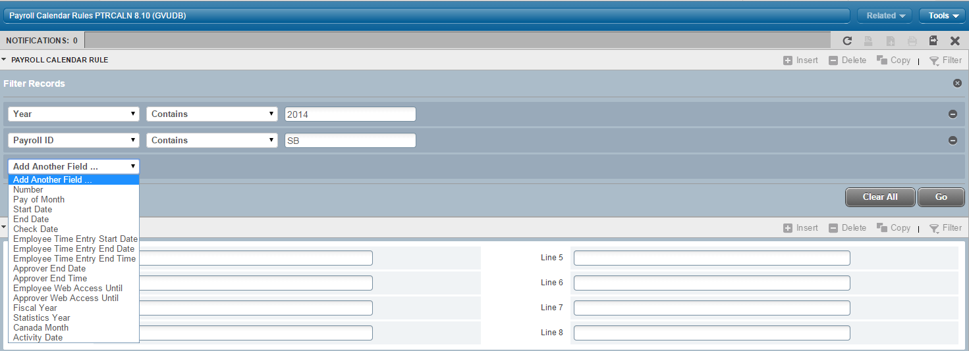
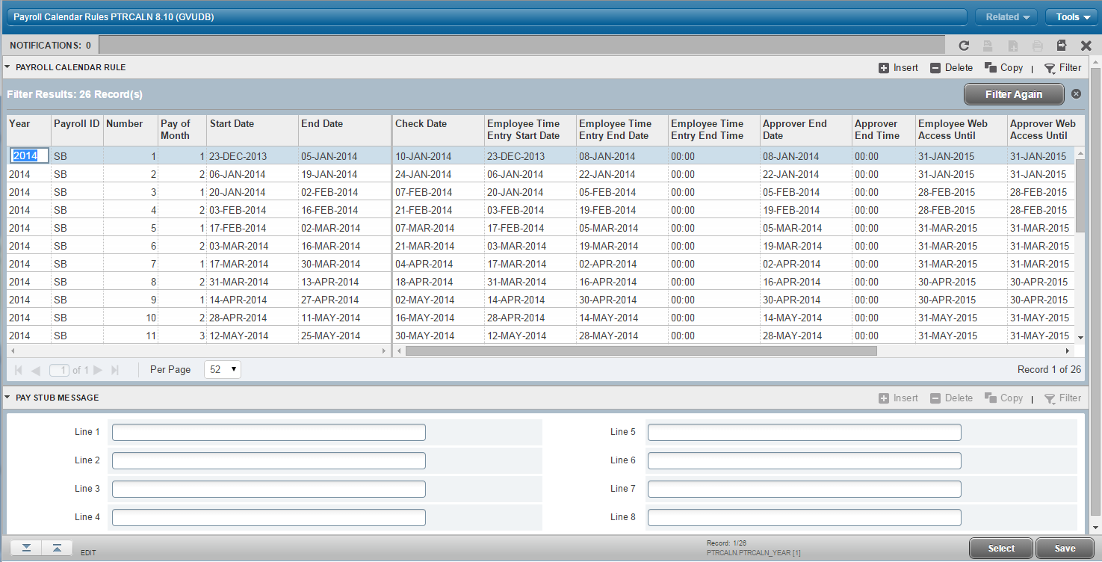
6
Lookup and Filter
Notes:
Filtering allows you to easily select and enter the exact items at the top of the page that you wish to look for without having to scroll horizontally.
You can also set the number of records you would like returned on each page.

Slide 58
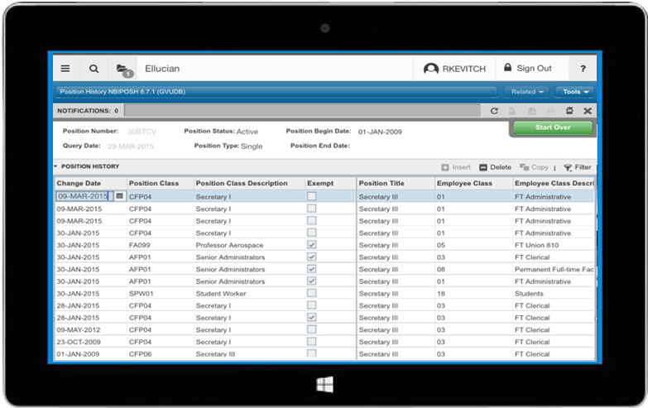
7
Tablet Friendly
Notes:
With our mobile first directive, you can also use the transformed pages on a mobile device, as shown here on a tablet. Now we realize that you might not ever try to create a payroll adjustment on your phone, nor would we want you to – that gives me the shivers! We think that limiting your mobile experience to the tablet will provide the most reasonable mobile experience. As an example, this image was captured from an Ipad Mini (which will be the smallest tablet size you will use).

