Slide 1


Addressing the needs of recruiting and admissions
Ellucian Recruiter:
Mississippi Banner User Group (MBUG) Conference 2014
Jennifer Taylor, Principal Solutions Consultant
Notes:
Replace picture with more relevant one if you have it, such as a photo of the client’s campus.

Slide 2


Slide 3
Today
Difficult to execute on a high-touch strategy, inefficient processes, confusion over what is and what is not working
Missed targets; high discount rates
Decreasing yield on recruitment strategies
Resources invested inefficiently, both time and money

Slide 4

Tomorrow
Ability to identify and engage best-fit prospects
Meaningful information available in real time
Gain efficiencies in business processes & use of staff time
Personalized campaigns

Slide 5

What is Ellucian Recruiter?
Ellucian Recruiter is a comprehensive solution that supports the entire recruiting and admissions lifecycle.

Slide 6

How does it exceed your business needs?
Personalized communications that build relationships with your prospects. Powerful analytics that drive greater admissions yield. Ellucian Recruiter™ helps you find, engage, and enroll more of the right students for your institution.

Slide 7
Automatically drive targeted engagement
?
Meet strategic goals
Personalize the journey and target recruiting
Track enrollment
goals
and
return on investment
ADMISSIONS

Slide 8
We will see…
Management personas: Executive, Director
Counselor persona
Communications expert persona
Ellucian Recruiter and Banner integration
Future student persona

Slide 9
We will see…
Management personas
Counselor persona
Communications expert persona
Access role-based dashboards
Interact with dashboards to manage processes, gauge activity & identify trends
Integration
Future student persona

Slide 10
We will see…
Management personas
Counselor persona
Communications expert persona
Relevant data at your fingertips
Immediate visibility; immediate action; instant ability to measure progress
Integration
Future student persona

Slide 11
We will see…
Management personas
Counselor persona
Communications expert persona
Integration
Future student persona
Inquire and apply
Event search and register
Relevant data at your fingertips
Immediate visibility; immediate action; instant ability to measure progress

Slide 12
We will see…
Management personas
Counselor persona
Communications expert persona
Integration
Future student persona
Easy to use; easy to see what’s next
Personalized and dynamic
Relevant data at your fingertips
Immediate visibility; immediate action; instant ability to measure progress

Slide 13
We will see…
Management personas
Counselor persona
Communications expert persona
Relevant data at your fingertips
Immediate visibility; immediate action; instant ability to measure progress
Access territory dashboard
Work tasks, access lists and review future student record
Integration
Future student persona
Easy to use; easy to see what’s next
Personalized and dynamic

Slide 14
We will see…
Management personas
Counselor persona
Communications expert persona
Relevant data at your fingertips
Immediate visibility; immediate action; instant ability to measure progress
Relevant data at your fingertips
Integration
Future student persona
Easy to use; easy to see what’s next
Personalized and dynamic
More time on meaningful engagement; prioritize your efforts; comprehensive view of touch points and progress

Slide 15
We will see…
Management personas
Counselor persona
Communications expert persona
Relevant data at your fingertips
Immediate visibility; immediate action; instant ability to measure progress
Relevant data at your fingertips
Integration
Future student persona
Easy to use; easy to see what’s next
Personalized and dynamic
More time on meaningful engagement; prioritize your efforts; comprehensive view of touch points and progress
Review delivered integration
Demonstrate the push & the response

Slide 16
We will see…
Management personas
Counselor persona
Communications expert persona
Relevant data at your fingertips
Immediate visibility; immediate action; instant ability to measure progress
Relevant data at your fingertips
Integration
Future student persona
Easy to use; easy to see what’s next
Personalized and dynamic
More time on meaningful engagement; prioritize your efforts; comprehensive view of touch points and progress
Delivered, maintained, enhanced by Ellucian; tailored by you
Powered by web services; automated integration

Slide 17
We will see…
Management personas
Counselor persona
Communications expert persona
Relevant data at your fingertips
Immediate visibility; immediate action; instant ability to measure progress
Relevant data at your fingertips
More time on meaningful engagement; prioritize your efforts; comprehensive view of touch points and progress
Review performance of marketing send
Target messaging using geo-radius and measure impact of campaign on yield
Integration
Delivered, maintained, enhanced by Ellucian; tailored by you
Powered by web services; automated integration
Future student persona
Easy to use; easy to see what’s next
Personalized and dynamic

Slide 18
We will see…
Management personas
Counselor persona
Communications expert persona
Relevant data at your fingertips
Immediate visibility; immediate action; instant ability to measure progress
Relevant data at your fingertips
More time on meaningful engagement; prioritize your efforts; comprehensive view of touch points and progress
Easily assess if you’re reaching your audience
Instant ability to gauge impact; data to drive future outreach
Future student persona
Easy to use; easy to see what’s next
Personalized and dynamic
Integration
Delivered, maintained, enhanced by Ellucian; tailored by you
Powered by web services; automated integration

Slide 19

Why Ellucian Recruiter?
Ability to identify and engage best-fit prospects
Personalized campaigns
Gain efficiencies
Meaningful information available in real time
Delivered, bi-directional, automated integration between Recruiter and Banner.
Able to track & target key influencers, manage travel, gauge email marketing performance.
With one instance of solution, able to support multiple segments of the institution.
Built on enterprise-wide, higher education-specific platform which ensures both robust future development and the ability to extend the systems across the entire student lifecycle.

Slide 20


Slide 21
We were actually 12% over our enrollment goal. We attribute that success strictly to Recruiter.

Slide 22
We are able to substantially increase the volume and quality of communications, we’ve gone from having five touch points with a prospect to 15 or 20, without adding staff.

Slide 23
Next Steps
David Pritchett, Account Executive
David.Pritchett@ellucian.com
Tim Nelson, Client Partner Tim.Nelson@ellucian.com
Jennifer Taylor, Solutions ConsultantJennifer.Taylor@Ellucian.com
Notes:
IDEALLY, THIS SLIDE SHOULD BE PRESENTED BY THE AE

Slide 24

Thanks for your time!
Visit us at: Ellucian.com  Email me at: jennifer.taylor@ellucian.com

Slide 25

Eastern Iowa Community College → Success Story

Slide 26
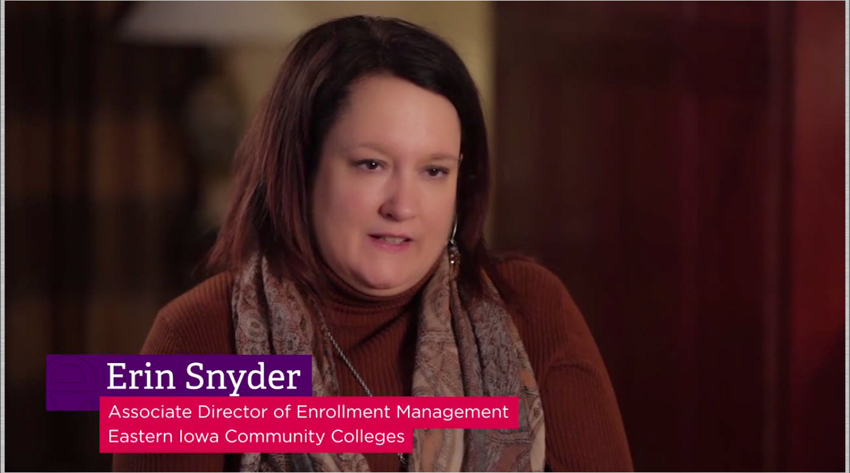
Eastern Iowa Community College → Success Story

Slide 27

Eastern Iowa Community College → Success Story
We were suffering with a 16% enrollment decline…
Some of the results we have seen since implementing Recruiter is the staff efficiency of being able to get those applications in quickly off of our website and just having that quick turn around for those workflows to kick off , those emails to go out.
As a community college we are an open admissions, but yet students still kind of wait for those communications to be accepted even as we're enrolling very close to the start of term. Having that instantaneous response, our admissions staff could focus on high touch interactions as opposed to those routine communications. That was really exciting to see.

Slide 28
Examples of client branding

Slide 29
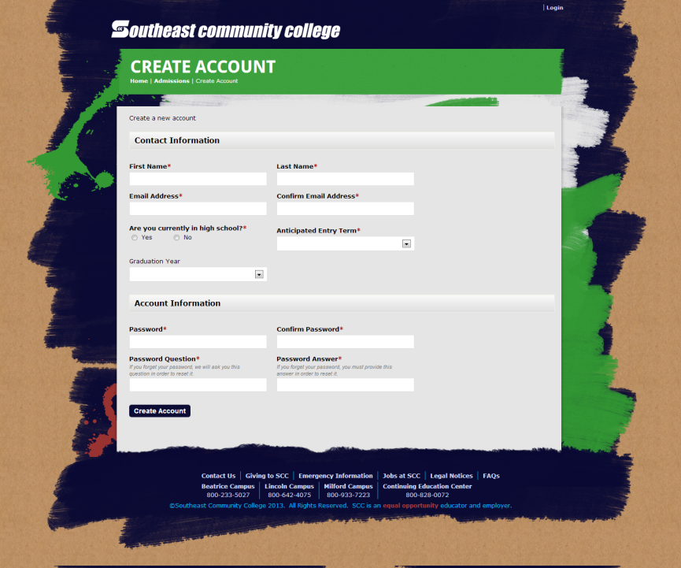

Slide 30
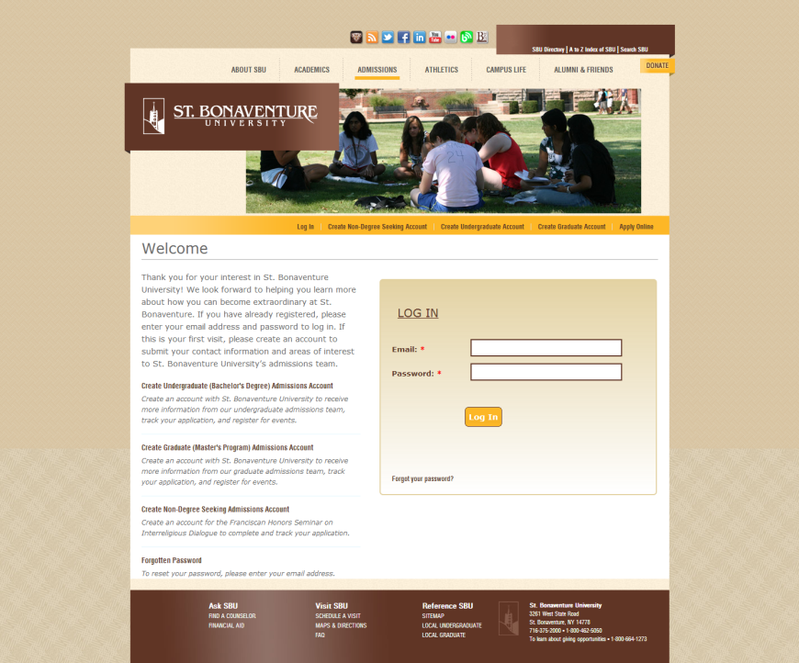

Slide 31
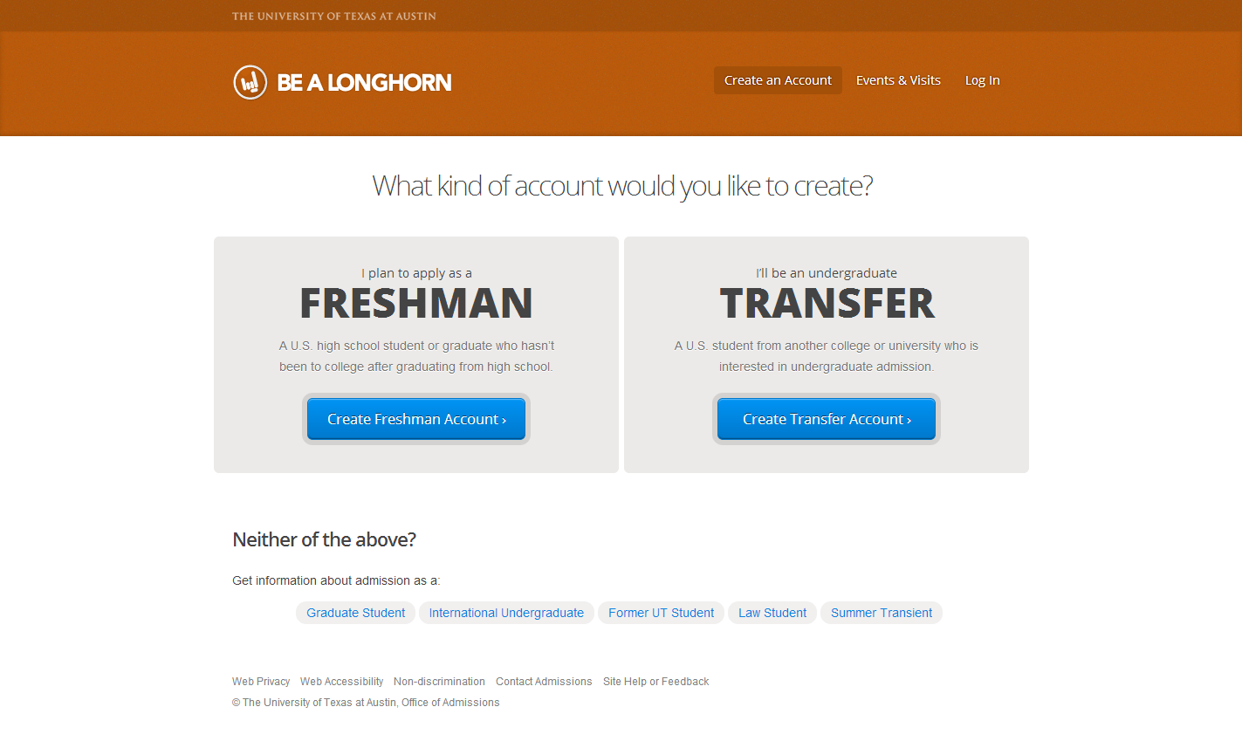

Slide 32
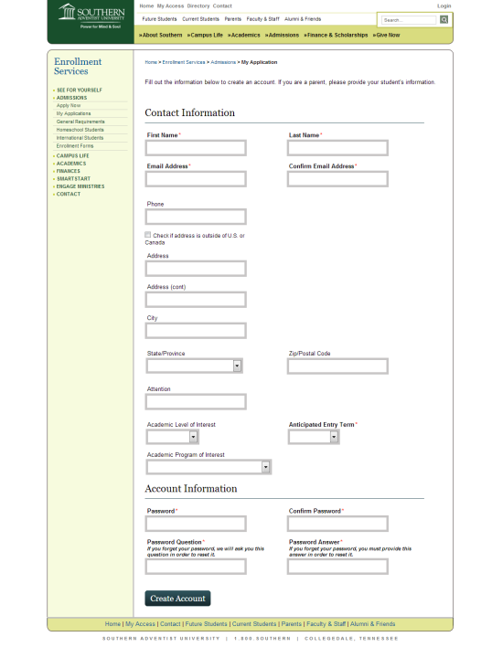

Slide 33
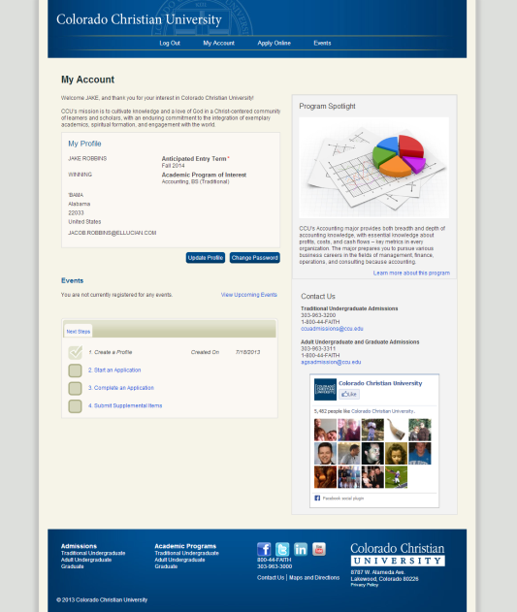

Slide 34
Recruiter Roadmap

Slide 35
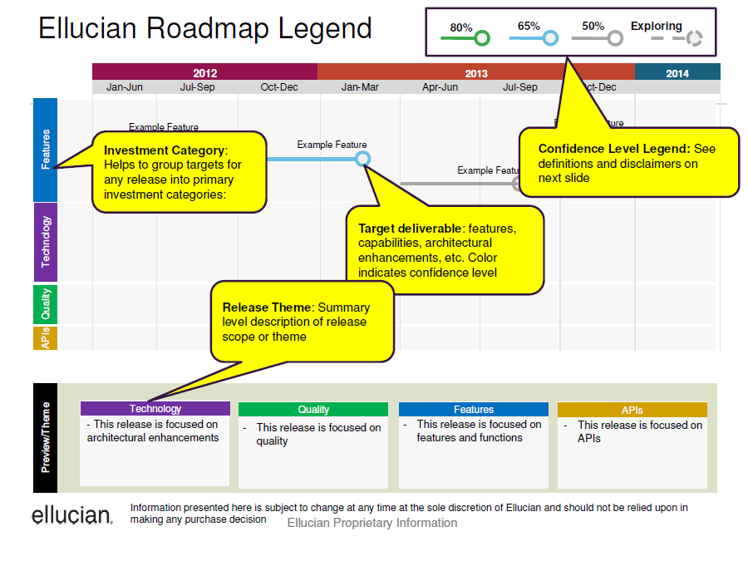

Slide 36
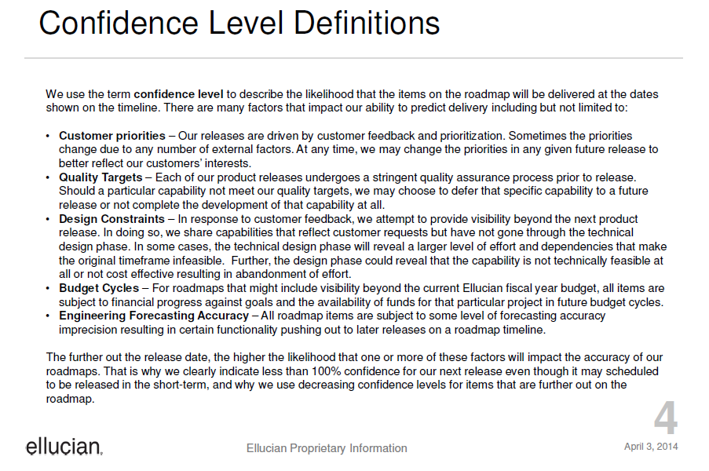

Slide 37
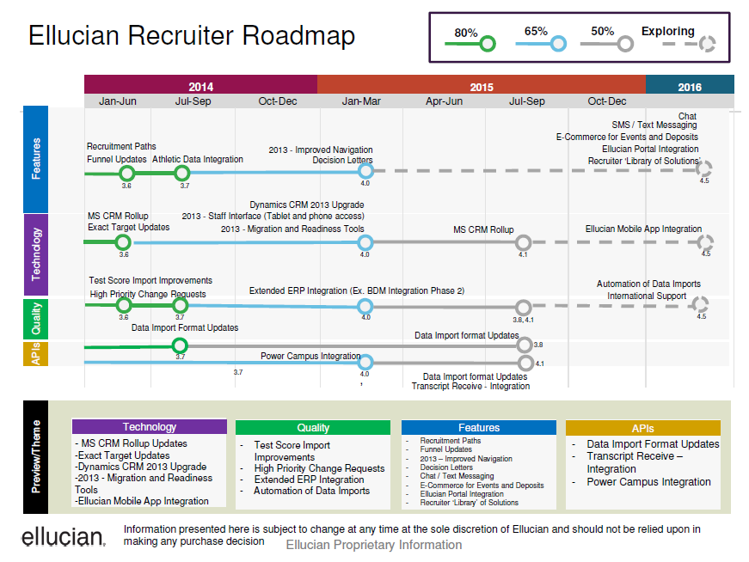
Notes:
Roadmap released in April 2014.

Slide 38



Communication Options
Date-driven
Triggered
Ad-hoc
Automated sends
Automated execution
Catch-ups and drips
Goes beyond correspondence
Individual or mass
Template-based or on-the-fly
Template-based
Template-based
Manual sends
Sends will occur on a specific day
Executes based on an action
Direct vs. white-listed
Notes:
Use this slide to explain the different types of communication rather than just talking through without a supporting visual

Slide 39
Ellucian Recruiter is a full-featured, integrated, scalable, web-based CRM solution that supports the entire recruiting lifecycle.
Inquiry
Application Started
Application Complete
Admitted
Confirmed/ Deposit
Registered
Enrolled
Add/drop or census date
Keep prospects who never apply out of SIS
Support recruiting staff working from a UI that is convenient for them
Support all departments’ needs to view pre-admit information about a student from within SIS
Two-way web services integration powers data flow between SIS and Recruiter so both systems have a comprehensive view of the student
Recruiter
Banner

Slide 40
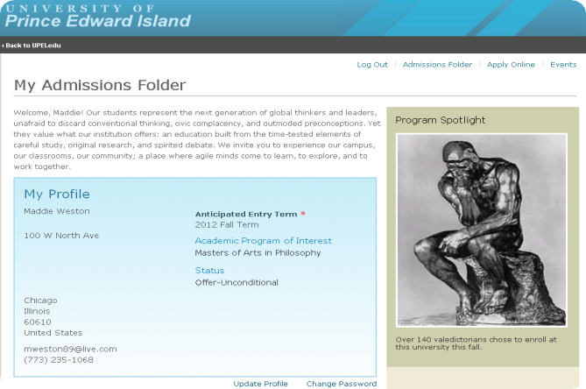
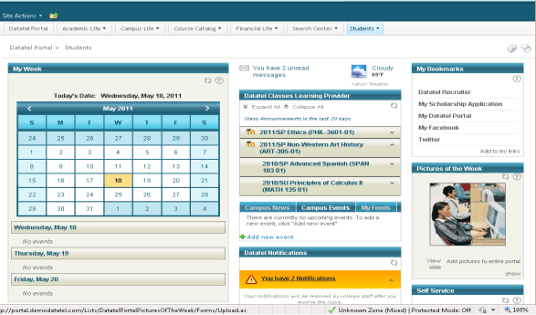
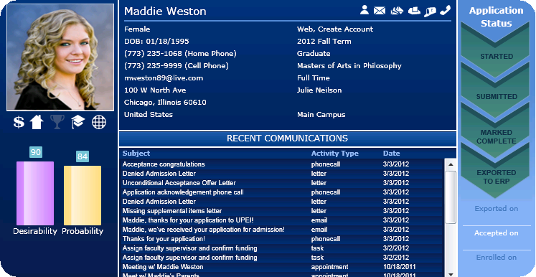
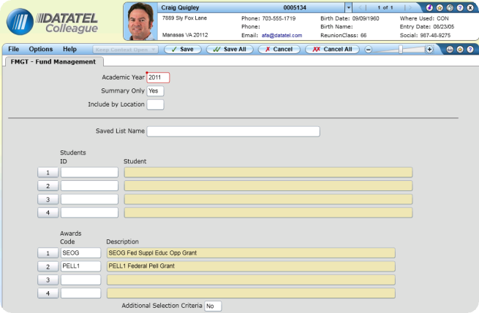
Prospect → Student Transition
Self-Service
Prospects/
Applicants
Confirmed Applicants and
Students
Admin
Processing
Notes:
Use for Colleague NAS demos

Slide 41
Banner Integration

Slide 42
Key Concepts
Optimized flow of data between the two systems
Predefined transactions
Configurability to support your business processes
Out of the box and custom workflows
Leveraging your investments in Banner
Banner validation codes
eCommerce payment processors
Common matching rules
Banner prospect data
Field mappings
Triggers to automate the flow
Configuration Settings
Flexible rules

Slide 43
Integration: Recruiter & Banner
→ Flexible
Inquiry
Application Started
Application Complete
Admitted
Confirmed/ Deposit
Registered
Enrolled
Add/drop or census date
Recruiter
Send information when the decision is made and then only for accepted students
Send prospect information ASAP so that FA processing can begin
Banner Student
  Recruiter provides triggers for sending data automatically that can be configured on or off.
  Information can also be sent manually for individual items or groups of items.
  Many transactions can also be called from Recruiter workflows.
Notes:
RCTR/Banner Integration slide: hide/unhide based on the prospect scenario

Slide 44
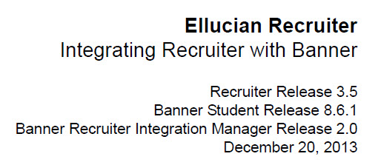
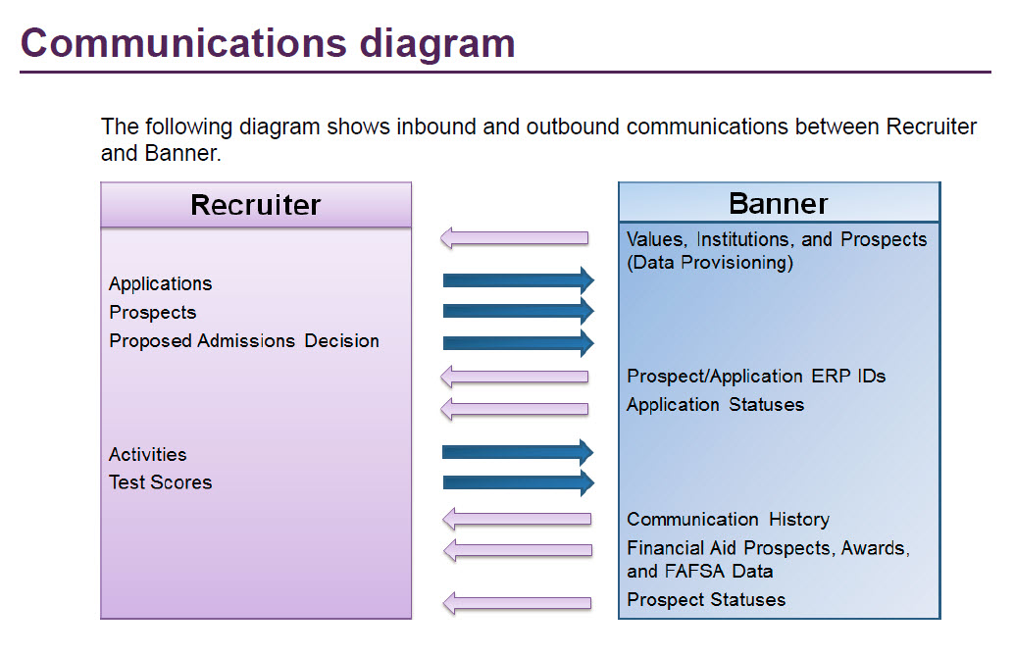
Banner Integration Diagram

Slide 45
Web Service Integration with Banner
HTTP Provision
Recruiter
1
7
6
Recruiter Solution within Dynamics CRM
Recruiter Response Service
HTTP Inbound
Banner XE Recruiter Integration Manager (with RESTful APIs)
Banner Event Publisher (BEP)
6
Permanent Tables
Save to Banner Permanent Tables (Push)
Temporary Tables
4
5
2
Yes
Transform Data & Save to Banner Temporary Tables (Load)
Call Common Matching API (Match)
1
Enterprise ID Match?
HTTP Outbound
No
Recruiter
3
Banner
Notes:
Diagram provided by Jennifer Malkovich in June 2014.

Slide 46
Banner ERP Integration Requirements for Recruiter 3.6 Upgrade
Product | Required Version
Ellucian Recruiter | 3.5.1
Banner Student | 8.6.1, plus 8.6.1.1 patch
Banner General | 8.6
Banner Accounts Receivable | 8.4.5
Banner Financial Aid (optional) | 8.18.3
Banner Database Extension Utility
Payment Gateway (optional) | 1.3*
BDM with AX Web Services & AX Web Access* | 8.4 or 8.5
BRIM | 2.0.0.2*
Banner Event Publisher | 1.2.1
* Payment Gateway 1.3 and the BRIM 2.0.0.2 patch were delivered with Recruiter 3.6 and are not compatible with Recruiter 3.5.1.
Notes:
Posted by Jennifer Malkovich to Recruiter group in Chatter on July 10, 2014.

Slide 47
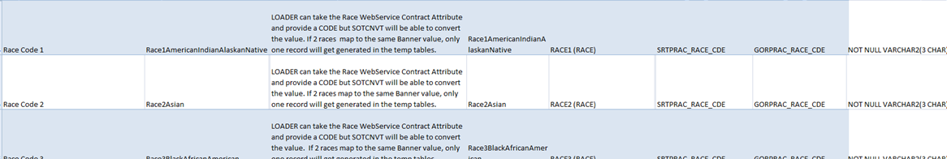
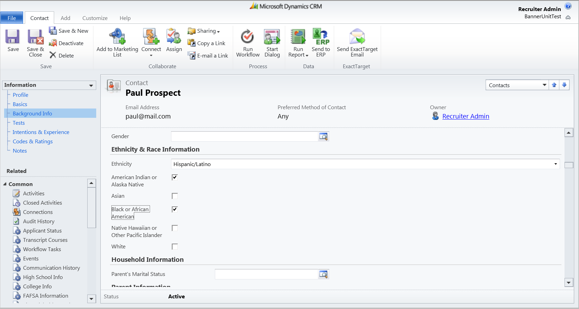
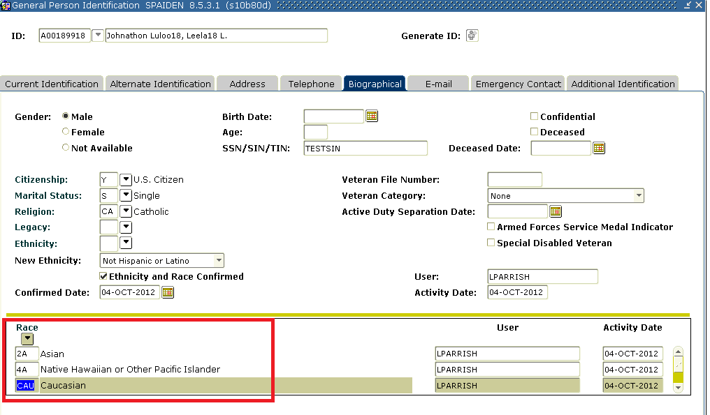
Data Mapping
Recruiter data elements are mapped to Banner tables out of the box
to ensure the data goes to the right place.
Notes:
Hundreds of Recruiter data elements are mapped to comparable 1) Banner Temporary Tables and 2) Production Tables
The Web Service uses this mapping to identify where to load each data element
Records in the temp tables will then be ‘matched’ and ‘pushed’ to Banner Production tables

Slide 48
Easing the Flow of Data
Recruiter
Banner
GUID
Prospects
Applications
PIDM & Banner ID
ERP ID
The ID connection ensures the rest of the transactions can flow back and forth with assurance they’ll land in the right place
Notes:
Recruiter sends prospect or application to Banner
this includes the GUID – Committing Recruiter GUID in Banner as Additional ID triggers Banner to send ERP ID to Recruiter
Banner immediately sends PIDM back to Recruiter - Banner sends the PIDM & the Banner ID, but the PIDM is the unique ID
used to link back to Banner.
Now the two systems are connected and the rest of the transactions can flow back and forth with assurance that they’ll land in the correct place

Slide 49
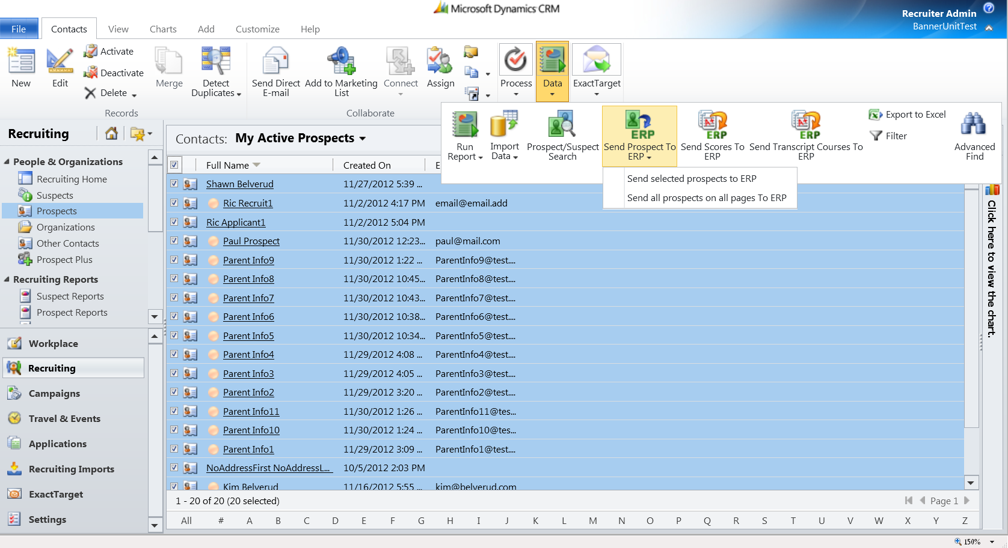
Send selected prospects to Banner manually

Slide 50

Workflows and Events can Trigger Automated Flow of Some Information
Recruiter
Banner
Automate sending of applications with proposed decisions
Applications
Updates to decisions can cause status messages to be sent automatically
Proposed Admissions Decision
Decisions and statuses saved in Recruiter automatically
Application Decision Statuses
Accept & Enrolled Status

Slide 51
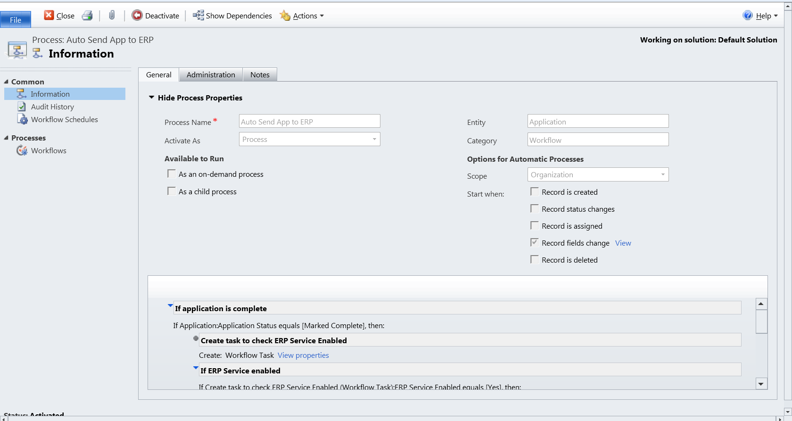
Use delivered and custom workflows to determine when applications are sent
Send application to Banner automatically when marked complete

Slide 52
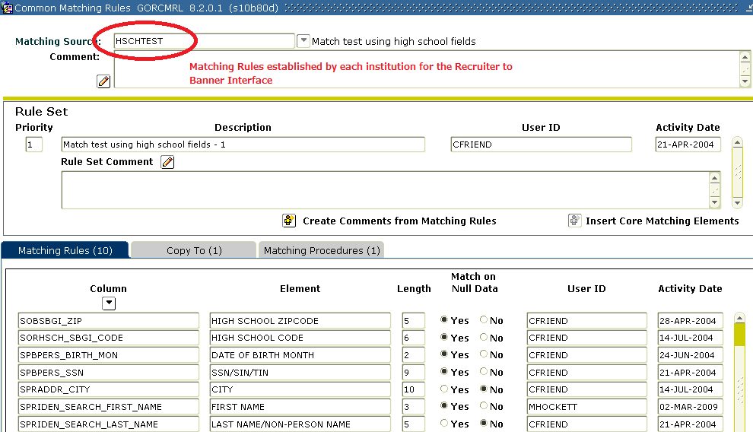
Use Existing Common Matching Rules
Recruiter data loaded to Banner temporary tables is automatically put through
the match process to detect and avoid duplicates

Slide 53
Support for Banner Payment Gateway Providers
Supported payment gateway providers include:
  CASHnet
  Nelnet
  Official Payments
  TouchNet

