Slide 1
Ellucian Elevate
Deliver and manage non-traditional offerings as quickly as the market demands
Jennifer Taylor, Principal
Solutions Consultant

Slide 2
Agenda
1 | Background
2 | Live Demonstration
3 | Integration
4 | Review/Questions

Slide 4
Increasing Pressure Positive Change
Funding Cuts
Falling Enrollments
Increased Competition from MOOCs and other low-cost online programs
Approached strategically, CE offers an untapped opportunity to drive revenue boost enrollment and further an Institutional mission by serving part-time adult students.
But approached ad-hoc, without a thorough understanding of its history and dynamics, efforts to reorganize CE can backfire, costing money, time and resources schools don’t have to spare.

Slide 5
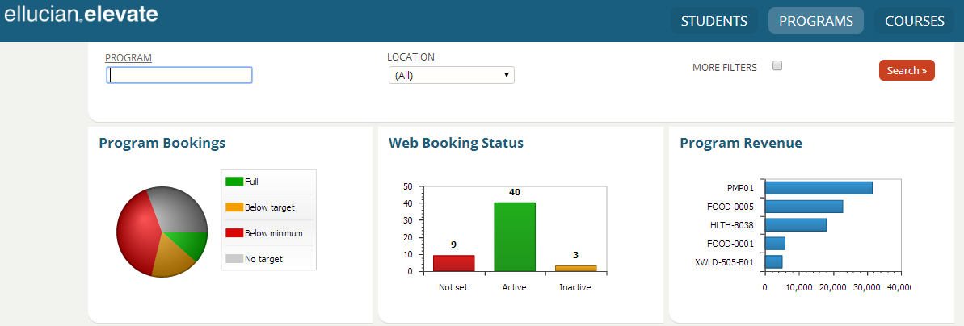
Ellucian Elevate is a mobile-ready SaaS solution that provides greater access to continuing education students--which means greater program enrollment numbers for your institution.

Slide 6
Ellucian XE
A technology strategy to protect your investments and help you expand or adopt solutions as priorities shift.
“What we want is a solution that allows us to tag on new services, new applications, without throwing away everything we’ve done. Without having to adopt a whole new stack, either.”
David Swartz, Chief Information Officer, American University

Slide 7
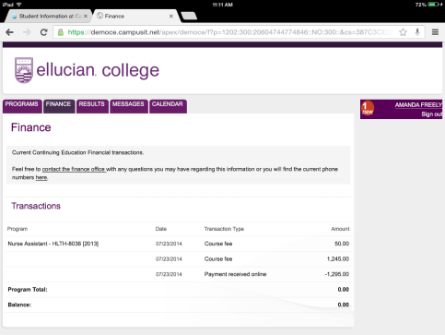
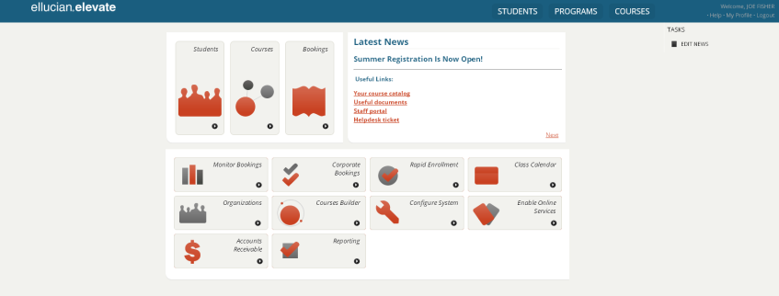
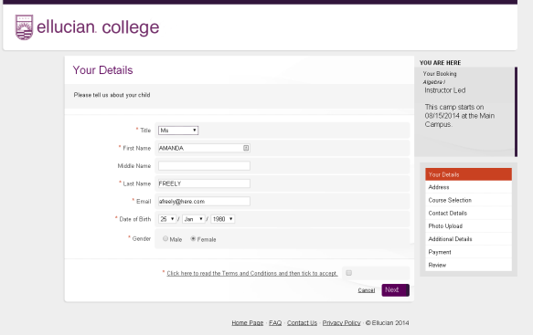
Ellucian Elevate XE Foundation
Mobile
Admin Interface
Web
API’s / Web Services
Common Architecture
Notes:
An architecture that enables a delivery mechanism for continuous enhancement
(future-proofing), while lowering total cost of ownership for institutions
• Extensibility: Tools to easily configure and tune the product to match campus workflow and
needs—customization without touching source code
• Seamless integration and interoperability with other institution assets
• Increased flexibility and hosting options—off-site and cloud
• Superior functionality with streamlined administration
• Modular product design that enables continuous upgrade path—without a major reinstall—built on
existing data and infrastructure
Evolutionary:
Support customers at their pace of change
Open / Modern / Flexible:
Leverage modern open proven technologies
Avoid vendor lock in
Pursue user-centric designs
Standard:
Solutions must follow industry standards (Microsoft .NET4, HTML5, JavaScript, CSS3, etc)
Reduce Costs on IT – standard tools and staffing options
Scalable and Elastic:
Products must be able to scale to meet customer growth
Reusable:
Create and consume efficient reusable components and frameworks
Trend away from complexity toward simplicity
Lean/Agile:
Focus on significant design decisions
Lightweight, modular, team-based tactics (vs. Ivory Tower or method based)
Interaction and collaboration wins over process and tools, avoid big upfront design (BUFD), optimize the whole, eliminate waste, built with quality, deliver fast, defer commitment, respect people, create knowledge

Slide 8
Guiding Principles of Project
Autonomy
CE/WFD need to run their business
Institutional Reporting
Institution needs key data for various reporting agencies
Notes:
There have been two guiding principles of the Elevate project. First, the Continuing Education and Workforce development offices need the autonomy to run their businesses. The need the freedom and speed to create new programs and course offerings. They need a flexible system that is their own to match their unique business needs.
At the same time, the institution needs data for reporting. They need data for board reports, state reports, and other key reports. Banner and Colleague will continue to be the ‘database of record’ and will be the key location for reporting data. Institutions will continue to use their reporting tools. Elevate will have operational reports in it but for those overall institutional reports, Banner/Colleague will be source.

Slide 9
Catalog/Program Management
Course Marketing/Tracking
Enrollment
Managing faculty workload
Tracking breakeven
Private courses
Employer funded coursework
Outbound marketing
Dynamic Website
Registration / Company can enroll student
Billing / Company pre-pays for employee
Cross-sell / up-sell opportunities
Custom attributes for each course type
Completion
Issue certificate
Market next course
Company notification
Attendance tracking
Grading
SIS Integration
For-credit SIS is system of record
Update catalog, grades and faculty workload
Finance
Allow Potential Duplicate Students to Register
Upload/Collect Forms, Files, and Documents
Why Ellucian Elevate?
Embedded Break Even Dashboard

Slide 10
Demonstration
Student
Locate, register, and pay
Administration
Manage registration pathways
Integration
Key data back in Banner
Monitor bookings/registrations
Notes:
Let’s take a quick look at the software with a live demonstration. Today we will take a quick look at the student registration experience. We will see a student find a course offering on our website, go through the registration process and finally pay for the class. Next we will look at how easy it is to customize or tailor the registration process. You can easily change the registration experience for the different types of offerings that you have. Lastly we know it is important to stay on top of our offerings and monitor our progress. We will look at a key form that will help us monitor our course offerings.
Student Registration
Locate, Register, and Buy Course
Managing Booking Process
Tailor Booking Path and Communications
Administrative view of Elevate
Front page – access is controlled by log in.
Monitor offerings.

Slide 11
Demographics
Academic
Finance
i
i
i
CE/WFD Business Process
XE
APIs | Web services
ERP
Courses
i
Facilities
Faculty
Student
Finance
Ellucian Elevate
Banner by Ellucian
Unparalleled Integration

Slide 12
Benefits of Elevate
Student
Intuitive navigation
Administration
Ease of use
Integration
Delivered dashboards
Mobile enabled
Easy to buy a class!
Manage all facets of your business
Mobile enabled
Better informed decision making
Real-time updates with Banner/Colleague
Notes:
Let’s take a quick look at the software with a live demonstration. Today we will take a quick look at the student registration experience. We will see a student find a course offering on our website, go through the registration process and finally pay for the class. Next we will look at how easy it is to customize or tailor the registration process. You can easily change the registration experience for the different types of offerings that you have. Lastly we know it is important to stay on top of our offerings and monitor our progress. We will look at a key form that will help us monitor our course offerings.
Student Registration
Locate, Register, and Buy Course
Managing Booking Process
Tailor Booking Path and Communications
Administrative view of Elevate
Front page – access is controlled by log in.
Monitor offerings.

Slide 13
Ellucian Roadmap Legend
80%
65%
50%
Exploring
2012 |  |  | 2013 |  |  |  |  | 2014
Jan-Jun | Jul-Sep | Oct-Dec |  | Jan-Mar | Apr-Jun | Jul-Sep | Oct-Dec
 |  |  |  | ,
Example Feature
Example Feature
Features
Investment Category: Helps to group targets for any release into primary investment categories:
Example Feature
Confidence Level Legend: See definitions and disclaimers on next slide
Example Feature
Target deliverable: features, capabilities, architectural enhancements, etc. Color indicates confidence level
Technology
Release Theme: Summary level description of release scope or theme
Quality
APIs
Technology
Quality
Features
APIs
This release is focused on architectural enhancements
This release is focused on quality
This release is focused on features and functions
This release is focused on APIs
Preview/Theme
Information presented here is subject to change at any time at the sole discretion of Ellucian and should not be relied upon in making any purchase decision

Slide 14
Confidence Level Definitions
We use the term confidence level to describe the likelihood that the items on the roadmap will be delivered at the dates shown on the timeline. There are many factors that impact our ability to predict delivery including but not limited to:
Customer priorities – Our releases are driven by customer feedback and prioritization. Sometimes the priorities change due to any number of external factors. At any time, we may change the priorities in any given future release to better reflect our customers’ interests.
Quality Targets – Each of our product releases undergoes a stringent quality assurance process prior to release. Should a particular capability not meet our quality targets, we may choose to defer that specific capability to a future release or not complete the development of that capability at all.
Design Constraints – In response to customer feedback, we attempt to provide visibility beyond the next product release. In doing so, we share capabilities that reflect customer requests but have not gone through the technical design phase. In some cases, the technical design phase will reveal a larger level of effort and dependencies that make the original timeframe infeasible. Further, the design phase could reveal that the capability is not technically feasible at all or not cost effective resulting in abandonment of effort.
Budget Cycles – For roadmaps that might include visibility beyond the current Ellucian fiscal year budget, all items are subject to financial progress against goals and the availability of funds for that particular project in future budget cycles.
Engineering Forecasting Accuracy – All roadmap items are subject to some level of forecasting accuracy imprecision resulting in certain functionality pushing out to later releases on a roadmap timeline.
The further out the release date, the higher the likelihood that one or more of these factors will impact the accuracy of our roadmaps. That is why we clearly indicate less than 100% confidence for our next release even though it may scheduled to be released in the short-term, and why we use decreasing confidence levels for items that are further out on the roadmap.

Slide 15
Elevate Roadmap Q3 ‘14
80%
65%
50%
Exploring
Delivered
2014 |  |  |  | 2015 |  |  |  | 2016
Jan-Mar | Apr-Jun | Jul-Sep | Oct-Dec | Jan-Mar | Apr-Jun | Jul-Sep | Oct-Dec | Jan - Dec
,
Integration
Features
Elevate
Initial Release
Enhanced Integration
Cross sell
MEP Support
Conferencing
Technology
Quality
Ongoing quality improvements
APIs
Features
Features
Features
Features
Preview/Theme
Initial release of Ellucian Elevate
Initial Banner and Colleague integration
Cross Sell Widget
Student Record integration
SMS
Additional Reporting
MEP Support for Banner integration
Parent Registration for youth programs
Additional Conferencing support
Information presented here is subject to change at any time at the sole discretion of Ellucian and should not be relied upon in making any purchase decision

Slide 16
Let’s see it!

Slide 17
Elevate Timeline
December: General Availability
February: Quarterly 2015 Release
Summer: North American Launch (Beta)
Notes:
To help you understand where we are moving and how fast, let’s talk a little bit about timeline. Our beta clients are currently working with Elevate. The beta clients will work with the product during the summer months leading up to our December general release. In February, we plan on deepening the integration to Banner/Colleague with additional student academic history, adding cross-sell widgets, and make it easier to communicate with students via SMS text messaging. Later in 2015, you should see parent’s ability to register youth in offerings like summer camps and better conference functionality. As each of these updates take place, we will be rolling out new features and incorporating client feedback.

Slide 19
Contact us
Keenan Hogg
Director, Continuing Education and Workforce Development
TEL: 703-261-2523 EMAIL: keenan.hogg@ellucian.com
Notes:
Contact Us
Mention Keenan Hogg

