Slide 1
Financial Aid and Repeat Courses

Slide 2
Financial Aid Repeat Course Set Up

Slide 3
US Federal Regulations
Effective July 1, 2011
Allows disbursement for 1 repeat of a previously passed course
Allows disbursement if all attempts are failures
  Once student finally passes, allows for 1 repeat of the previously passed course
Prevents disbursement for repetition of previously passed course due to failure of other coursework
  Common in Health Professions and Law programs
Notes:
Repetition passed courses when failing other coursework in lock step program, you still cannot get paid if you pass 1 course and fail 3, you will not get paid for the 1 course. This is a manual review of this situation

Slide 4
Repeat Coursework Processing Setup
Pre 8.14.2 Install
  ROAINST – setup is to check to Allow Use of Repeat Course Checking for aid year and has to be checked to update RFRMGMT funds for repeats.
  RFRMGMT/ROAMGMT – Use Repeat Course
  RFRRPCC Financial Aid Repeat Course Checking used to check if funds were using repeat course checking
Post 8.14.2 Install
  ROAINST – Allow Use of Repeat Course flag has been removed and replace with Enrollment Rules.
  RFRMGMT/ROAMGMT changed form to use Enrollment Rules
  RFRRPCC Financial Aid Repeat Course Checking is made obsolete with the new form RFRENRR Fund Enrollment Rules form.

Slide 5
RORRPCX Financial Aid Repeat Course Exclusion
Use this form to enter Subject and Course numbers for courses to be excluded from Financial Aid Repeat Course enrollment calculation
Identical courses may be entered in this form, providing their term ranges do not coincide nor do they exist in a previously established term range for an existing row matching the same Subject and Course. Also, there is no stipulation on length of the term range; it can be as short as one term and as long as infinity.

Slide 6
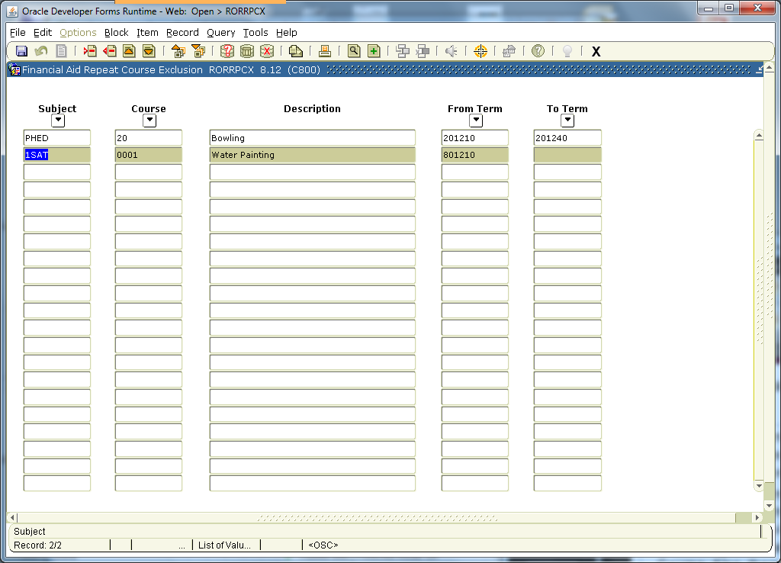

Slide 7
RTVENRR Enrollment Rule Validation
This new form allows you to define Enrollment Rule Codes and Descriptions.
An Enrollment Rule is then created for the aid year and assigned to a fund for determining the criteria that is to be used when calculating the enrollment load.

Slide 8
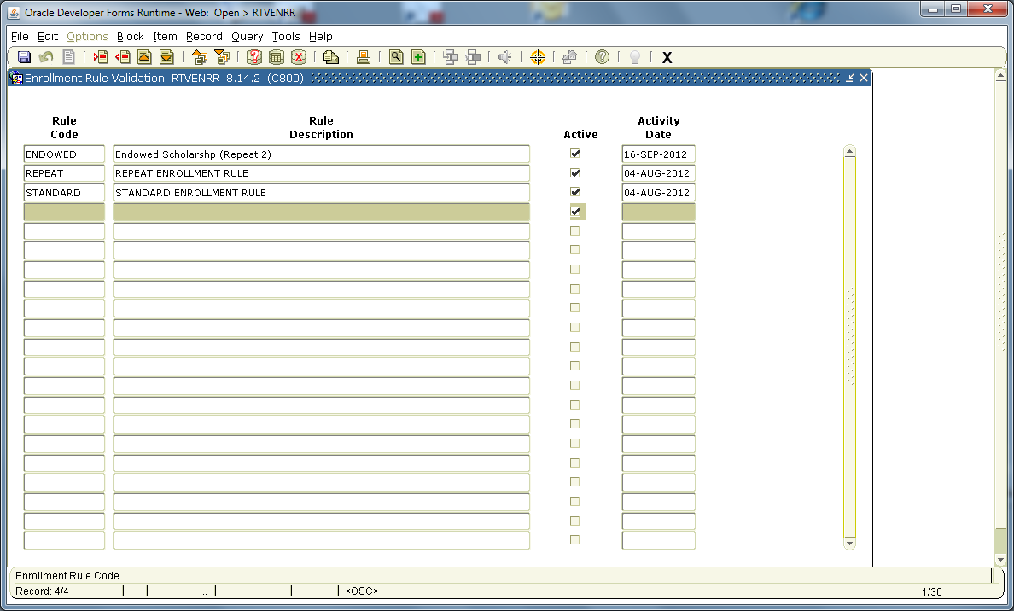

Slide 9
RORENRR Enrollment Rules
This new form is used to setup the rule name and criteria for determining if a course should be included in the calculation of a student’s credit, billing and adjusted hours
  Exclude Remedial Courses and Use Only Courses In Program are delivered for future use and cannot be updated at this time
  Attendance Must be Verified indicator allows you to count courses as repeats only if attendance in the course has been verified. Verification is completed on the student form SFAALST manually.

Slide 10
RORENRR - Count Withdrawal Status as Repeat Attempt
This indicator allows the school to determine whether they want their withdrawn status codes to be counted as an attempted repeat in their Repeat Coursework processing.
All Status Codes from the Course Registration Status Code Validation (STVRSTS) form that have the Withdrawal Indicator checked (STVRSTS_WITHDRAW_IND = Y) will be considered when the Repeat Coursework logic determines if the course is considered a repeat.

Slide 11
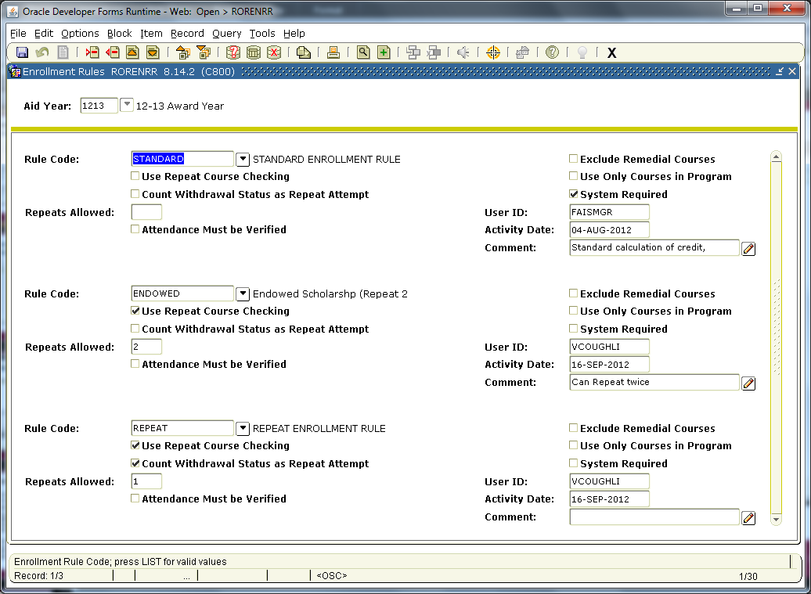
Future Use

Slide 12
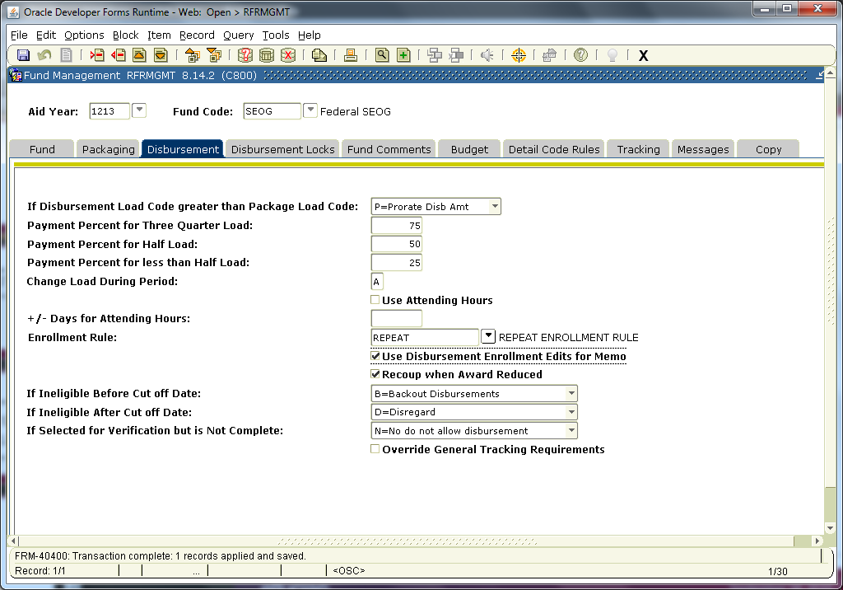
Enter this per fund or use the RFRENRR to update multiple funds.
Notes:
Standard rule code is delivered with the release as system and mimic’s current functionality and cannot be updated. The REPEAT rule code is delivered and loaded with the release if you have ROAINST checked to use repeat processing.

Slide 13
RFRENRR Fund Enrollment Rules
This new form allows you to apply Enrollment rules to multiple fund codes rather than doing it individually on RFRMGMT or ROAMGMT forms.
  Query on the specific fund source, fund type, federal fund ID and/or enrollment rule and go to the Update Using Enrollment Rule field and select the enrollment rule you want applied to those funds and then click the Update Enrollment Rules button
  Prior to doing a query on the specific fund source, fund type, federal fund ID and/or enrollment rule, you can select the Enrollment and go to the Fund block and do your query and then click the Update Enrollment Rules button.

Slide 14
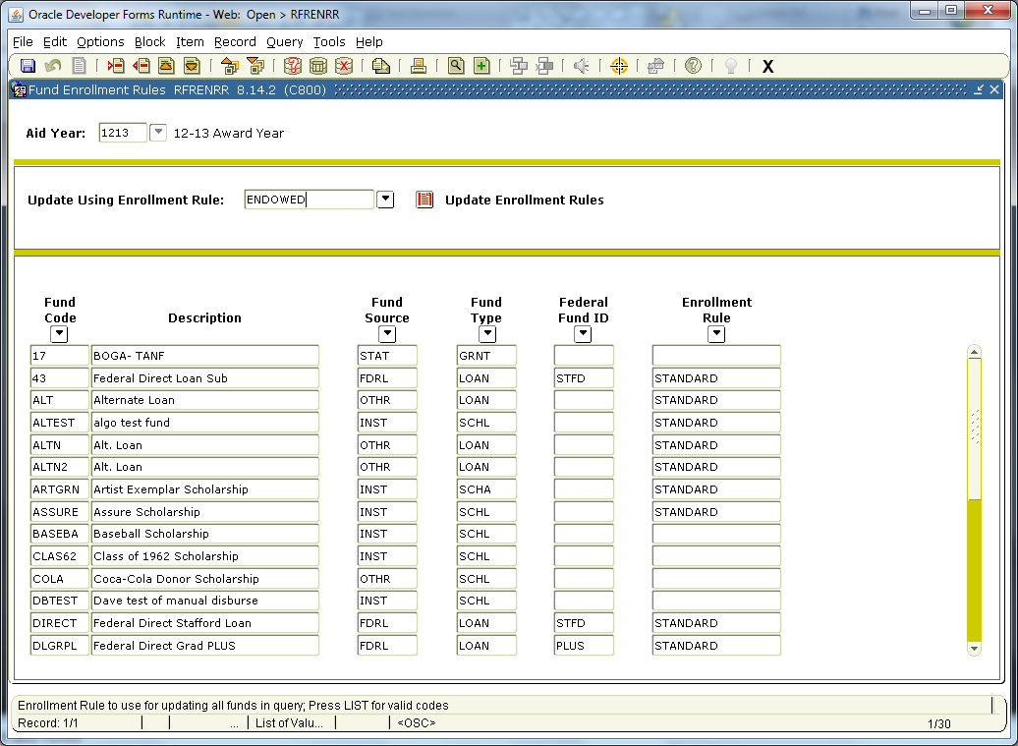

Slide 15
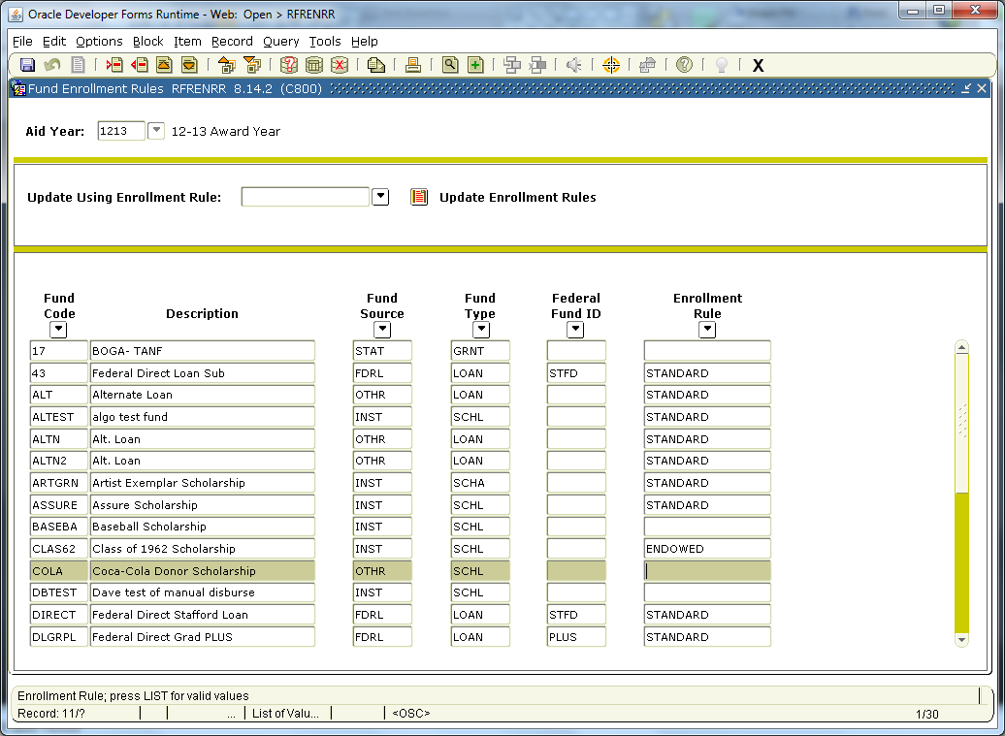

Slide 16
Banner Repeat Logic

Slide 17
Banner Logic Will Look At…
Courses not graded, not rolled to academic history
  From student’s registration, both previous and current
Courses graded, not rolled to academic history
Courses rolled to academic history
Transfer courses and their equivalencies
For those interested in code location, the logic for determining repeats is the Financial Aid Repeat Course (ROKRPTS) package.

Slide 18
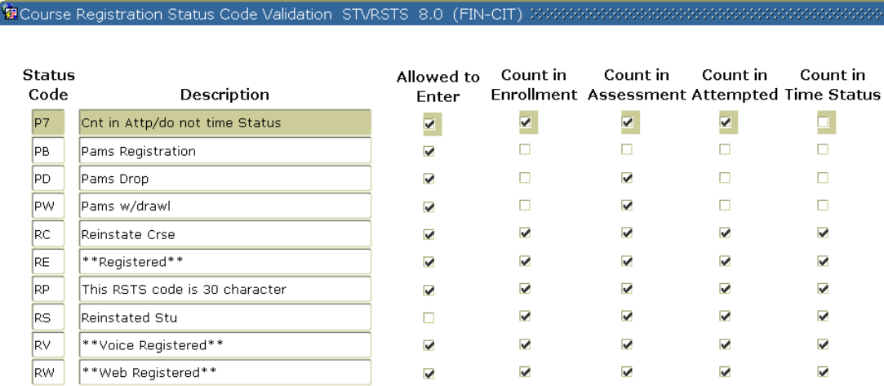
STVRSTS Course Registration Status Code Validation
Status Code must be checked to Count in Enrollment
  True for repeat coursework and total hours calculations

Slide 19
SHAGRDE Grade Code Maintenance
  Repeat Indicator
    Must be checked to use in repeat course checking
      Gives school additional control for which Grade Codes to use and which not to use
    If indicator is changed at any time, the repeat calculation may be affected
  Count in Passed Indicator
    Must be checked for Grade Code to be considered as a “Passing Grade”

Slide 20
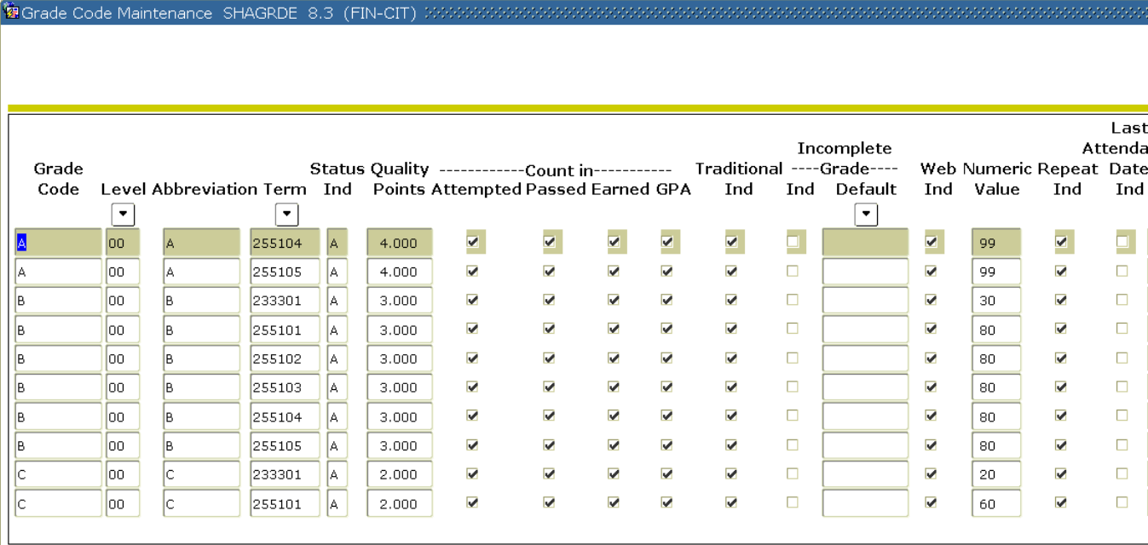

Slide 21
SHATRNS Transfer Course
Regulation
  Transfer coursework accepted towards program of study must be included in repeat calculation
Banner Logic
  Transfer course must have Equivalency Detail completed, if applicable
  Count in GPA indicator checked
  Must have Transfer indicator checked on SHARPTR
  Repeat indicator on SHAGRDE checked
Repeat coursework calculation works with transfer courses entered manually on SHATRNS or via the Transfer Articulation module in Banner Student

Slide 22
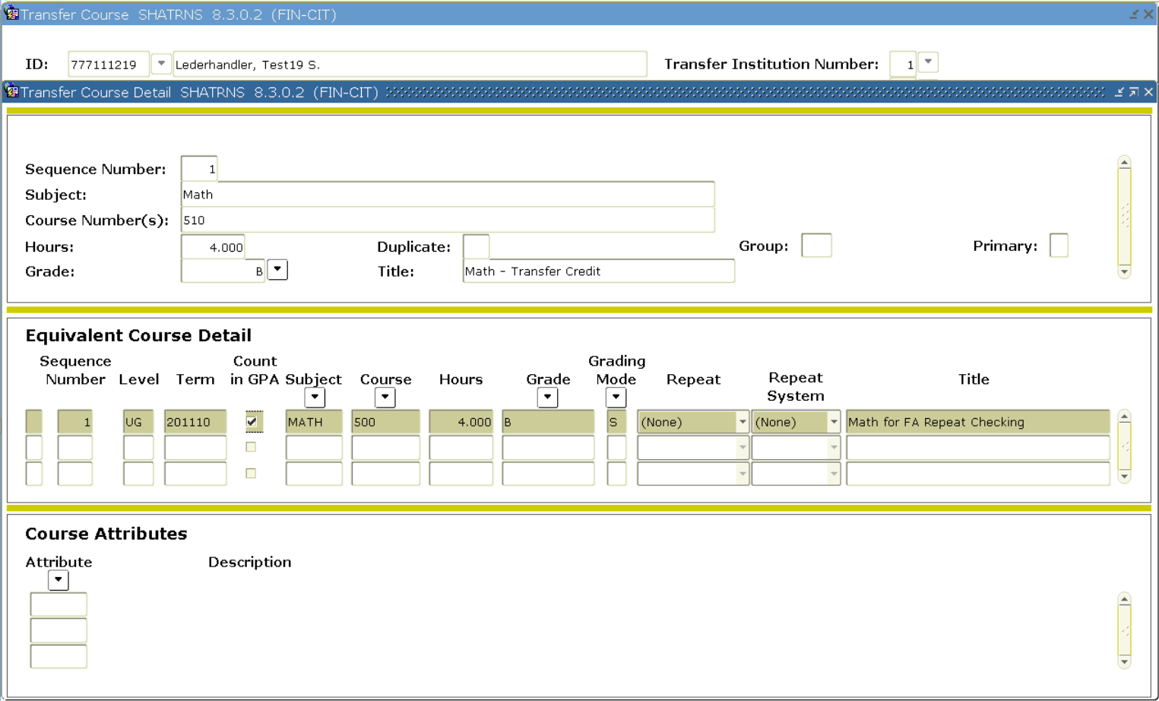

Slide 23
SHARPTR Repeat/Multiple Course Rules
  Financial Aid repeat course checking only uses the:
    Level Indicator
    Title Indicator
    Schedule Type Indicator
    Transfer Course Indicator
  No other fields are used from this form
  Financial Aid office must coordinate with Registrars office to ensure indicators are set according to both institutional policy and repeat coursework regulations.

Slide 24
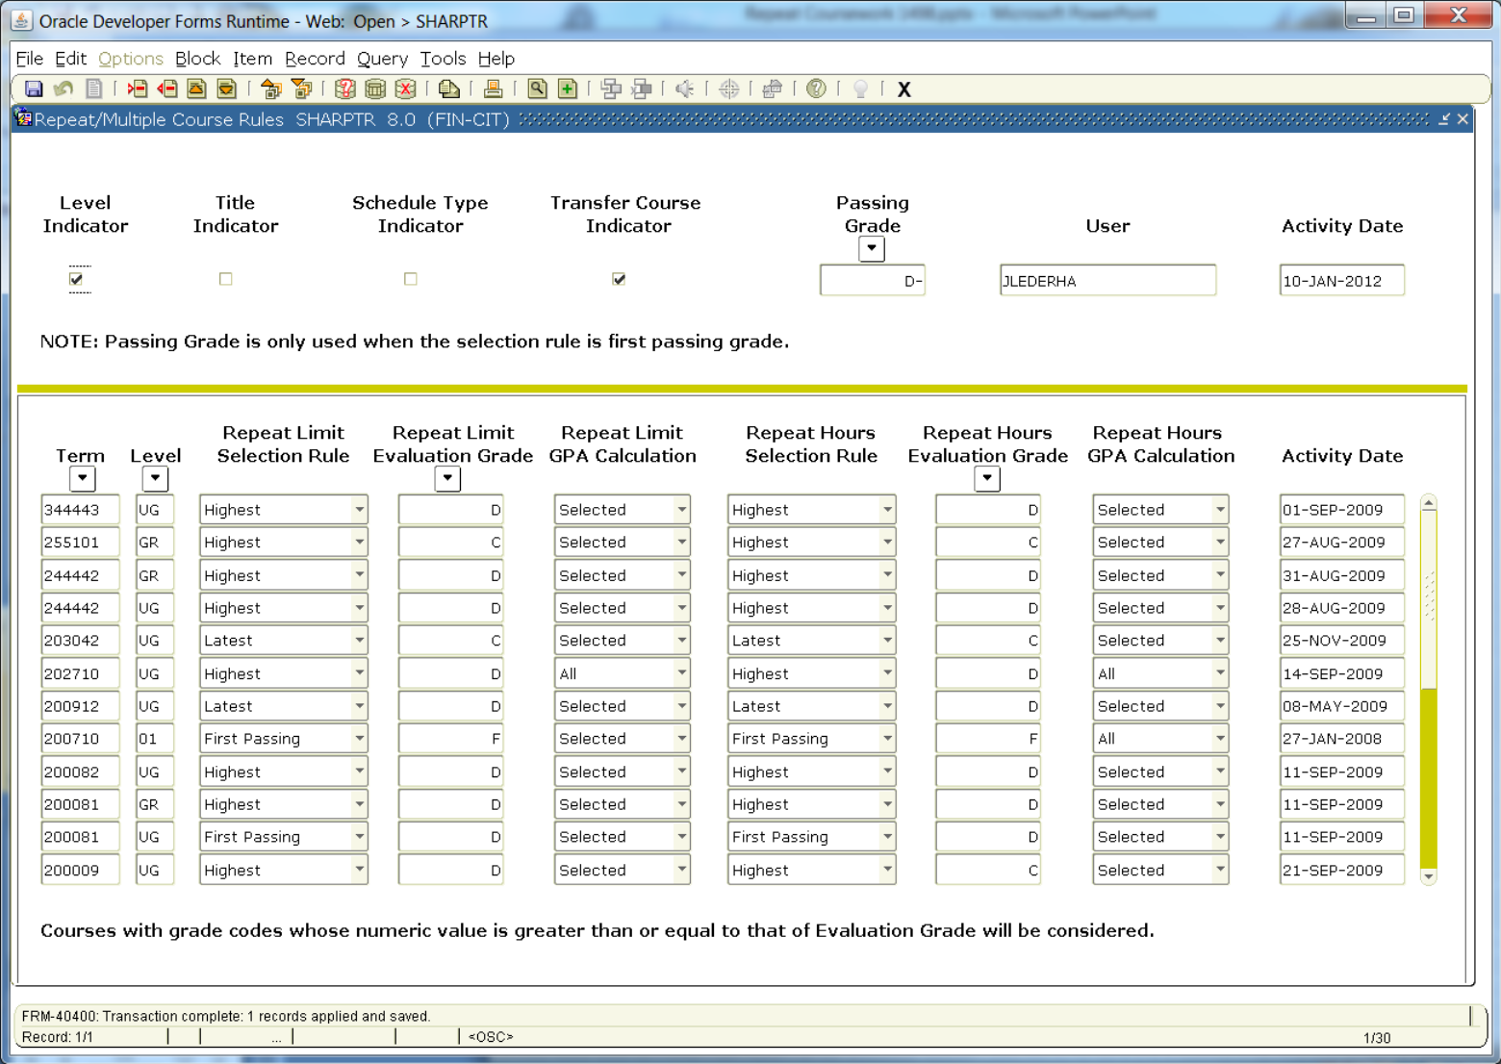

Slide 25
SCADETL Course Detail Information
Used to indicate course equivalencies or “course inclusion”
Course equivalencies may already be defined by institutional policy or course expiration
  Financial Aid and Registrar office should coordinate to ensure all applicable courses are properly defined as equivalencies
  Examples:
    Institution has ENG 101 for freshman, ENG 201 for sophomore. The student can take it at either level, but not both
    Course HIST 500 is now called HIST 600, but course is the same
Refer to Student User Guide for additional form setup detail

Slide 26
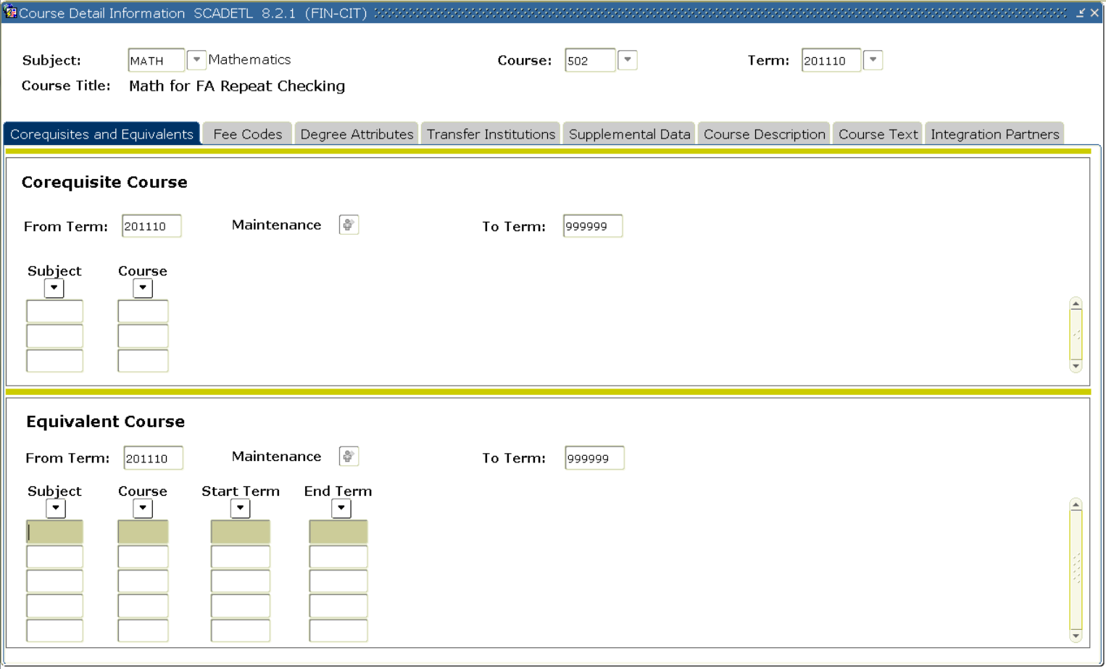

Slide 27
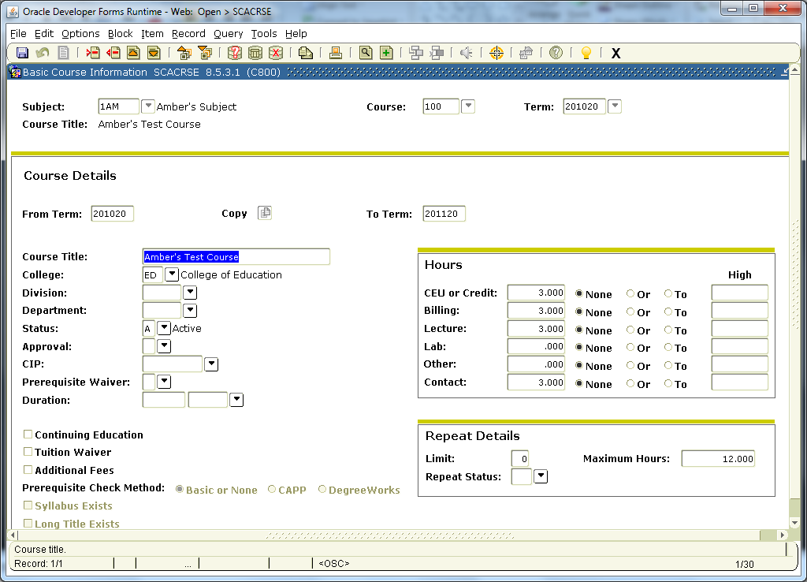

Slide 28
Financial Aid Changes

Slide 29
ROAENRL Financial Aid Enrollment Changes
Removed the Repeat Coursework Calculation fields (Credit, Bill and Adjusted hour) and add the Enrollment Rule field.
Allows you to view and update the enrollment load for each enrollment rule defined on the RORENRR form.

Slide 30
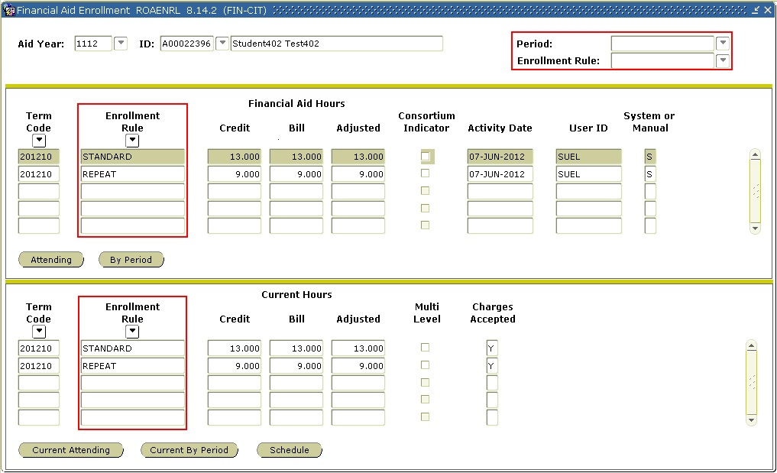

Slide 31
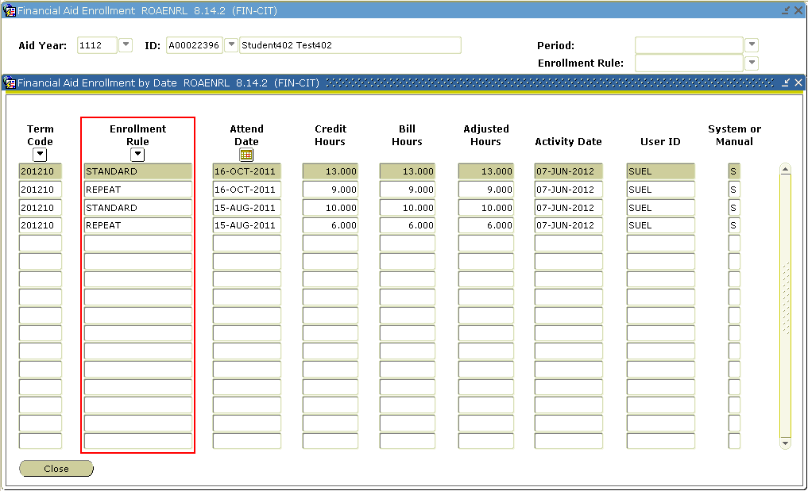
Financial Aid Enrollment by Date

Slide 32
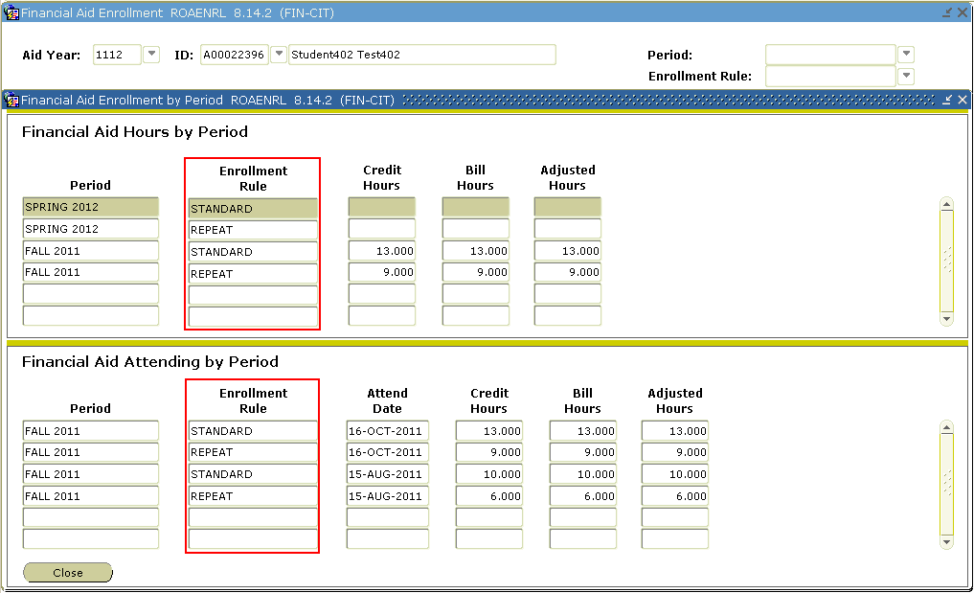
Financial Aid Enrollment by Period

Slide 33
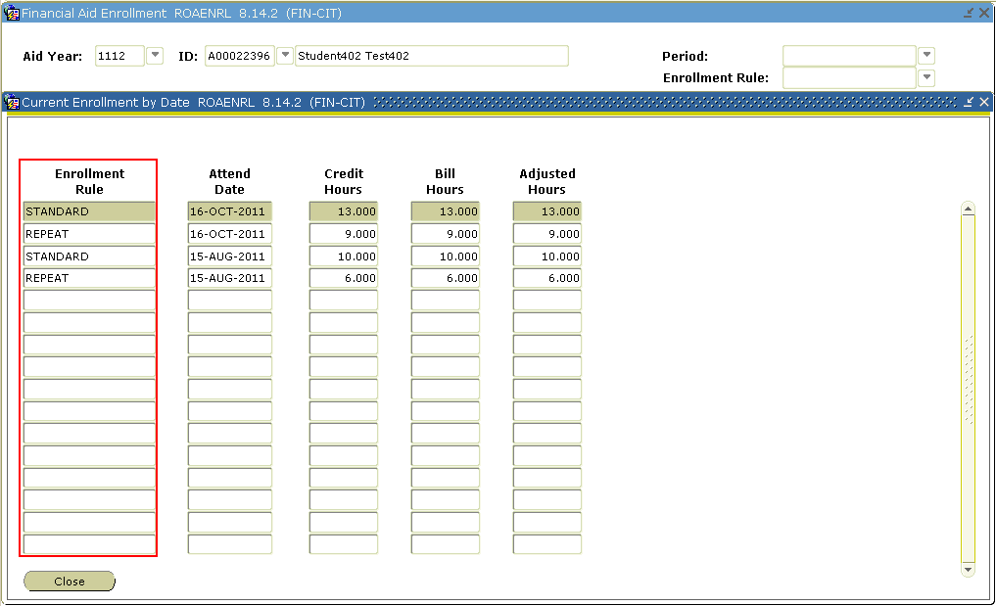
Current Enrollment by Date (Student)

Slide 34
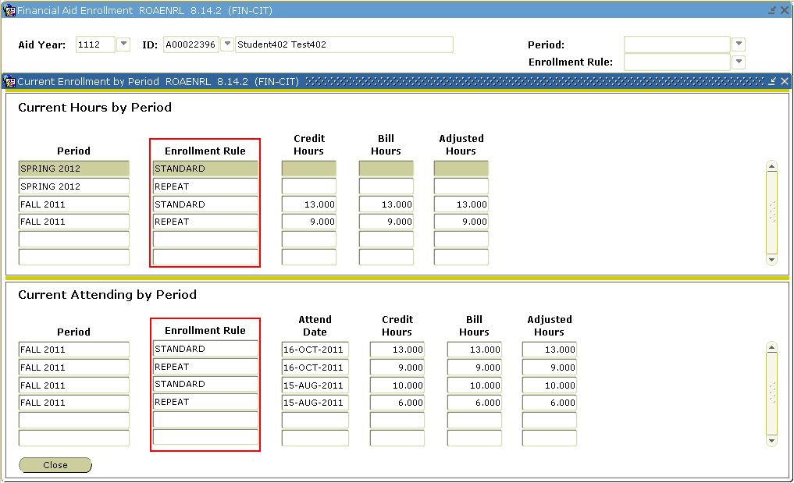
Current Hours By Period (Student)

Slide 35
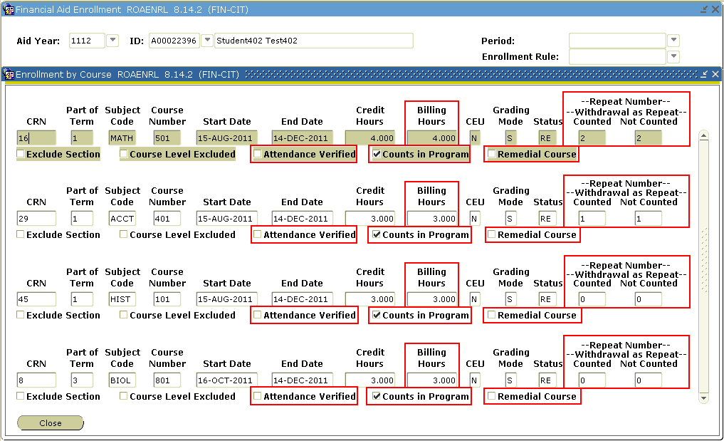
Current Hours Schedule – Enrollment by Course

Slide 36
Changed Processes
Fund Description Report (RFRFUND)
  • Add the Enrollment Rule field/value.
  • Remove the Use Repeat Course Checking field/value.
FA New Year Roll Process (ROPROLL)
  • Add the Enrollment Rule field/values as part of the fund data roll.
Grade Exception Report (RORGRDE)
  Remove the Excluded Repeat Course field/value.

Slide 37
Financial Aid Reg. Report (RORREGS)
  This program’s logic and output have been to modified to consider the values of two existing parameters (Registration Report Type and Period).
  When Parameter 03 - Registration Report Type = A and Parameter 10 - Period is NOT NULL, the process will find and return all records which have an aid period that contains the period defined in Parameter 10 - Period.
  The output will then list the credit, billing, and adjusted hours by enrollment rule for the terms within the each period.
  Processing for all other parameter combinations will remain unchanged, except that only the courses will be displayed on the report. Hours will not be calculated and will not be displayed. 

Slide 38
CLM Disbursement Feed (RPBLMID)
  The RPBLMID process has been modified to use the Enrollment Rule of STANDARD when reporting the enrollment load for the student.
  Enrollment Calculation - Functional
Disbursement Process (RPEDISB)
  The RPEDISB program has been modified to use the Enrollment Rule associated with the fund being disbursed.
Packaging Process (RPEPCKG)
  The RPEPCKG has been modified to use the Enrollment Rule defined for the fund when awarding TEACH Grants using Billing or Adjusted hours.

Slide 39
Pell Calculation Process (RPEPELL)
  The RPEPELL program has been modified to use the Enrollment Rule associated with the Pell fund when calculating the Pell load.
Grant Calculation Process (RPRGRNT)
  The RPRGRNT has been modified to use the Enrollment Rule defined for the fund when awarding TEACH Grants using Billing or Adjusted hours.
Disbursement Validation Report (RPRVDIS)
  The RPRVDIS program has been modified to use the enrollment rule code associated with the fund for the Load Calculation (UCLRTN).

Slide 40
Applicant Requirements Report (RRRAREQ)
  The RRRAREQ program has been modified to remove all logic used to display and calculate enrollment status. The process has been updated for budget group processing to display the period budget group.
Exit Interview Requirements (RRREXIT)
  The RRREXIT process has been modified to use the Enrollment Rule of STANDARD when evaluating the student’s enrollment or when the Consortium indicator has been checked and Financial Aid Hours are used.

Slide 41
Financial Aid Enrollment Hours (RSRENRL)
The RSRENRL process has been modified to calculate the Credit, Billing, and Adjusted hours for each Enrollment Rule defined for the aid year. The Financial Aid Hours and Attending hours in the RORENRL and RORATND tables will be inserted/updated for each Enrollment Rule based on your parameter selection.
A new parameter has also been added to insert/update Financial Aid hours and Attending hours for a specific Enrollment Rule. If this new parameter is left blank, all enrollment rules will be addressed by the process. If a specific enrollment rule is entered for this parameter, then that enrollment rule will be processed.
  Parameter Descriptions
    10 Enrollment Rule Code

