Slide 1
Financial Aid Packaging Aid
Disbursement Enrollment Freeze

Slide 2
Packaging Aid

Slide 3
Ways of Packaging Aid
Enter Awards Manually
Use Mass Offer Form to Enter Awards
Run Auto-Packaging Using Algorithmic Rules
Load List from an Excel Spreadsheet

Slide 4
Enter Awards Manually or Use Mass Offer Form to Enter Awards

Slide 5
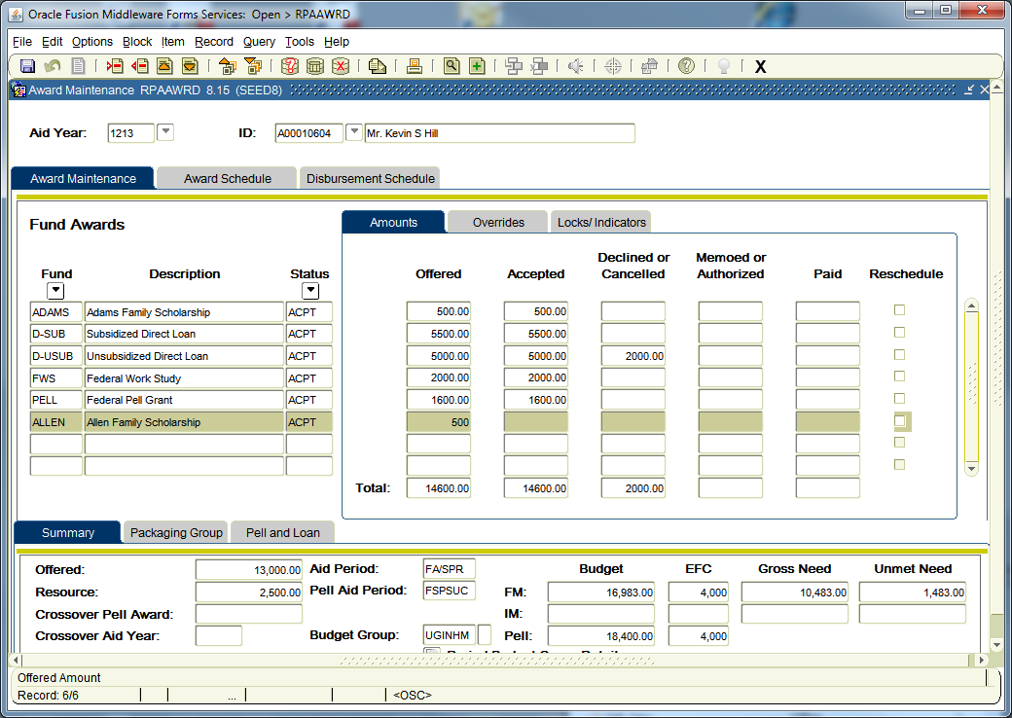
RPAAWRD Award Maintenance

Slide 6
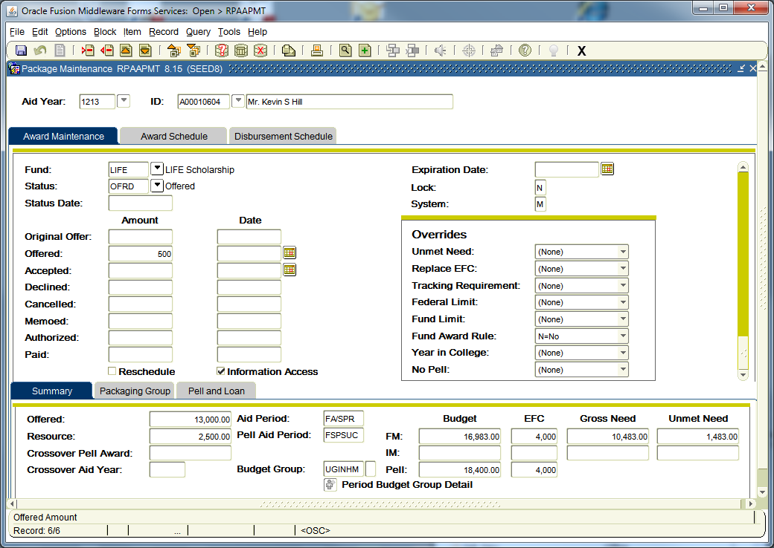
RPAAPMT Package Maintenance

Slide 7
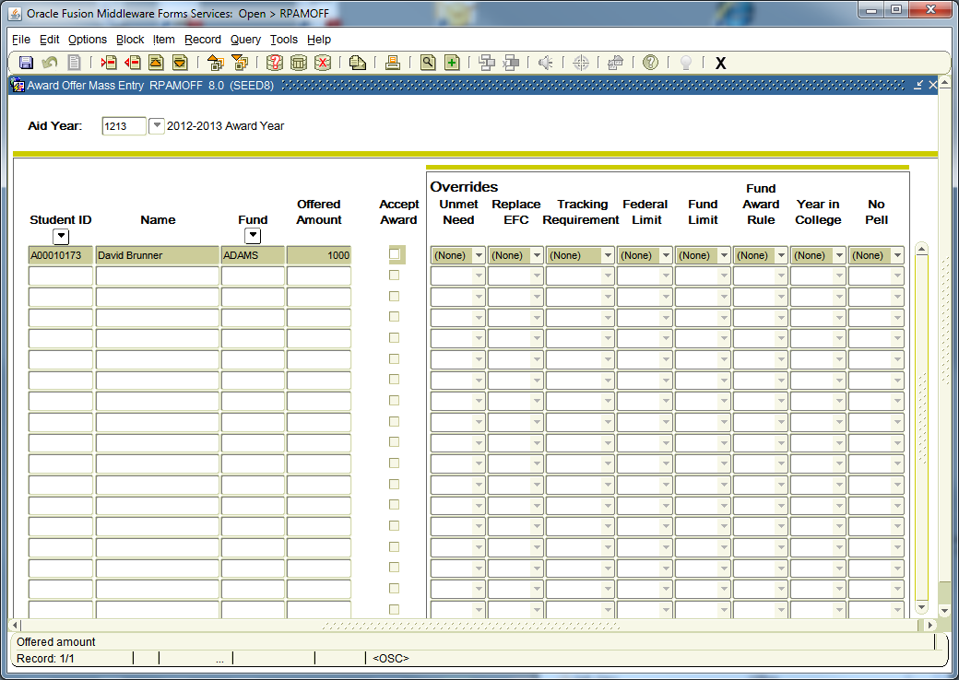
RPAMOFF – Award Offer Mass Entry
Notes:
ROAMOFF form can be used to accept awards that are already posted

Slide 8
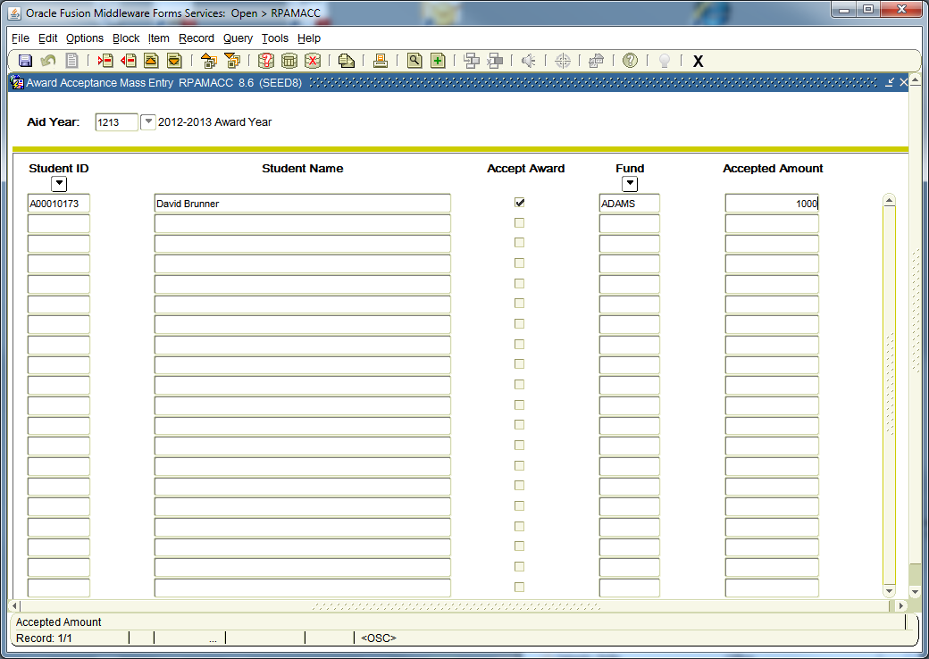
RPAMACC Award Accept Mass Entry

Slide 9
Run Auto-Packaging Using Algorithmic Rules

Slide 10
Algorithmic Packaging
A Set of rules are created and can then be assigned to a fund listed on a packaging group.
RORRULE Fund Awarding Rules indicate WHO should get a fund and RPRALGR – Algorithmic Packaging Rules tell you HOW MUCH they can get.

Slide 11
Examples of Algorithmic Rules
Awarding one fund as a percentage of another fund
  XYZ Scholarship is awarded 25% of ABC Scholarship
Awarding specific amount according to EFC
  Sequence 1 SEOG is awarded $1,000 if EFC = 0
  Sequence 2 SEOG is awarded $800 if EFC is between 1 – 2000
Awarding based on Banner fields,
  Sequence 1 rule is looking to award $9500 where a specific Test Score is >= 27 and High School GPA is >= 3.5
  Sequence 2 rule is looking to award $7500 where a specific test score is between 25 and 26 and High School GPA is >= 3.0
Award based on having other fund amounts
  Mississippi State Grant is based on a static amount, less the students Pell Grant, less the PC (dependent) or SC (independent)

Slide 12
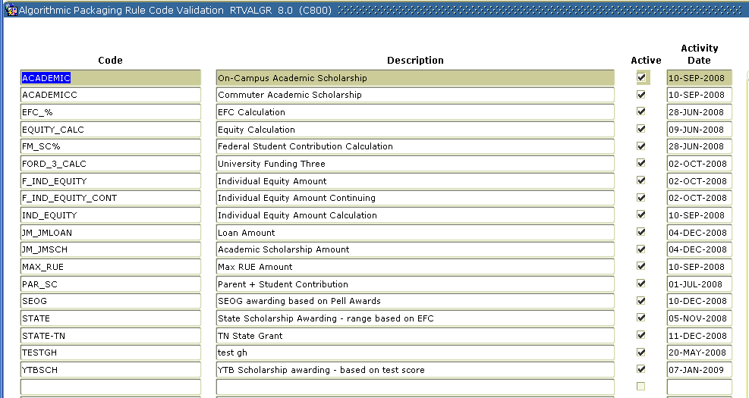
Forms Used in Algorithmic Packaging
Only 4 forms are used with this setup
RTVALGR – Define Algorithmic Rule Codes

Slide 13
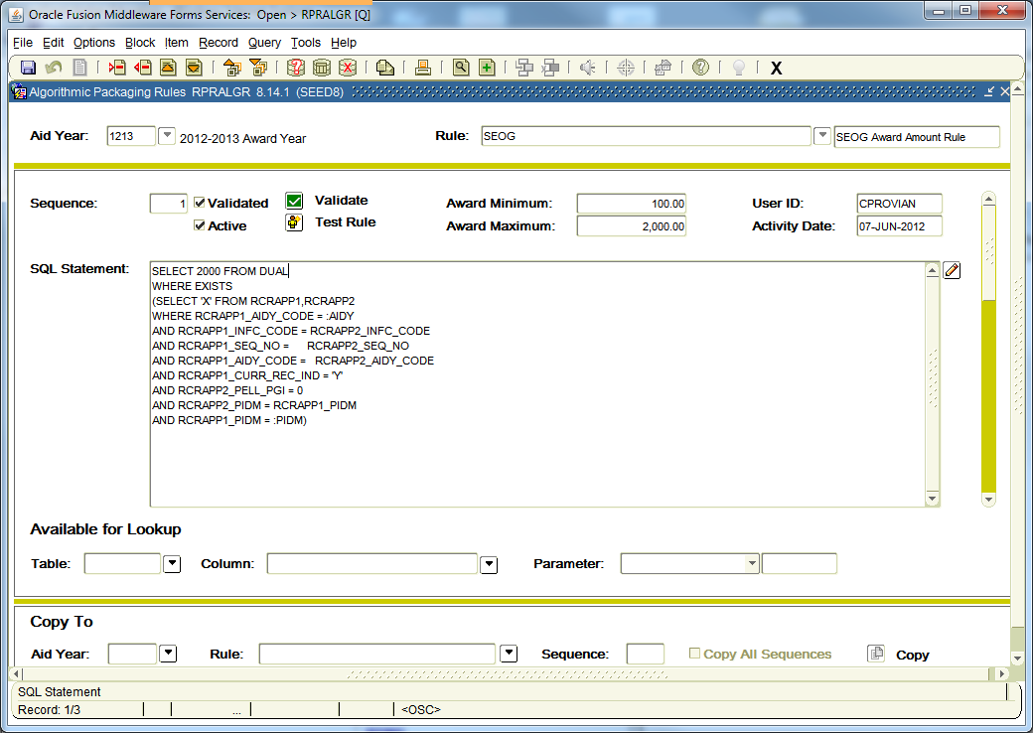
RPRALGR – Build Algorithmic Rule Logic

Slide 14
Load Award List from Excel Spreadsheet

Slide 15
Loading List of Awards
You will need technical assistance to set this up
You will populate a manual population selection from GLAEXTR from excel spreadsheet and then run posting to award the funds.
Some examples of how you can get the list in Banner I have collected from Banner List Serve

Slide 16
Edit/copy the list of PIDMS from the spreadsheet and paste into a new file on UNIX.
Create a temp table called sytpidm with one column for PIDM that is sqlldr with from the new flat file
LOAD DATA
INFILE 'pidms.txt'
REPLACE INTO TABLE SYTPIDM
(PIDM POSITION (1:8))
Then using the PIDMS in that table load glbextr
delete from glbextr
where glbextr_user_id = 'USERID'
and glbextr_selection = 'SELECTION_ID'
and glbextr_application='FINAID'
/
insert into glbextr
select distinct 'FINAID','SELECTION_ID','USERID','USERID',pidm,sysdate,
'M',null
from sytpidm
/

Slide 17
created a csv file with the following columns relating to glbextr...
_key, _User_Id, _Creator_ID, _Selection, _Application, Sys_Ind, _Activity_Date
Each contained values such: (where <> denotes actual values to replace)
<9 dig PIDM>, <USER_ID>, <USER_ID>, <MAN_SELECT>, <BAN_APP>, <M>, <16-APR-2003>
The csv file was then edited to have the following control statement preceding all data elements:
LOAD DATA
INFILE *
APPEND
INTO TABLE Glbextr
FIELDS TERMINATED BY ','
(Glbextr_Key, Glbextr_User_Id, Glbextr_Creator_ID,
Glbextr_Selection, Glbextr_Application, Glbextr_Sys_Ind,
Glbextr_Activity_Date)
BEGINDATA
Moved into the database by invoking the sql loader app...
.../user> sqlldr <userid>/<pswd> control=<data_loader.csv>
log=<data_loader.log> bad=<data_loader.bad> discard=<data_loader.dis>
errors=<6000>
note: errors defaults to 50 and we chose a number that wouldn't prevent the entire file from loading completely...of about 5400 pidms, about 400 were dupes and didn't load and were reported in the .bad file...

Slide 18
Enrollment Freeze

Slide 19
Freezing Student Hours to Financial Aid Hours
Freezing allows Banner to disburse on those hours that were frozen at a specified time.
Decisions that need to be made:
  When to run the process
  What population will you include (population selection)
  Will you update if students enroll in parts of term after the initial freeze process, if yes you will need to run for those that withdraw during the term also
  Will you also freeze attending hours
  Will you use a Repeat Enrollment Rule or the Standard Enrollment Rule (8.14.2)

Slide 20
Disbursement Rules

Slide 21
RORRULE Fund Disbursement
Fund Disbursement rules are reviewed when you run disbursement RPEDISB or from ROAIMMP
The most popular disbursement rules are:
  checking enrollment
Overriding the disbursement rule can be accomplished by setting up a user defined field and adding that to your fund disbursement rule

Slide 22
Validation Process and Report

Slide 23
RPRVAWD Validate Award Process
This process validates all awards within an applicant’s package to ensure that no changes made to the applicant, or the funds, invalidated the awards.
A report is generated with:
  the applicants processed
  summary information regarding the applicant’s aid period and cost of attendance
  awards and amounts offered and/or accepted
  the appropriate reject message when an award is no longer valid

Slide 24
RPRVDIS Disbursement Validation Report
This process validates all disbursements for all awards within an applicant’s package to ensure that no changes made to the applicant or the funds invalidated the disbursements.
A report is generated with:
  the applicants processed
  awards, accepted amounts
  any memoed, authorized or paid amounts
  the appropriate reject message when a disbursement is no longer valid.

