Slide 1
Communication - Emails

Slide 2
Sending Emails to Students

Slide 3
Overview
Email will save time and staff resources
E-mail notifications can be used to inform students to visit Banner Self Service to view outstanding requirements, new/changed awards, or updated SAP
Students must have a ROASTAT record for the aid year and email address defined on GOAEMAL.
ROREMAL Financial Aid Email job requires a population selection

Slide 4
Email Setup
01

Slide 5
Email Setup Forms
GLRSLCT – create a population selection that identifies students needing emails
RTVELTM – Email Letter Module Validation form is delivered data that will not be updated or deleted
GTVLETR – Letter Code Validation form is used to name and describe your email letters
RORELTR – Email Letter Rules Form is used to define your email
RORELTF Email Letter Format Rules form is used to enter/format data for your email.

Slide 6
GLRSLCT – Sample Population Selection
This popsel can be used to select students ready for tracking emails. It contains a user defined field (#5) that keeps you from selecting students who do not have email addresses and need a paper letter and contains another user defined field (#35) that stops you from selecting students that will not attend. The user defined of will not attend must be updated manually. See next slide for sample to find students that did not receive email or review output from ROREMAL.
Application: FINAID Selection ID: EMAIL_TRACK_FLAG
Creator: YOUR USER ID
Track Letter Flag Activated
Select: RORSTAT_PIDM
From: RORSTAT,ROBUSDF
RORSTAT_AIDY_CODE = &AIDY AND
RORSTAT_TGRP_CODE NOT IN ('DECLIN', 'REVIEW') AND
RORSTAT_AWD_LTR_IND = 'Y'
AND ( ROBUSDF_VALUE_5 NOT IN ('Y','y') (user defined -needs paper letter)
OR ROBUSDF_VALUE_5 IS NULL )
AND ROBUSDR_VALUE_35 IS NULL (user defined for will not attend)
AND RORSTAT_PCKG_COMP_DATE IS NOT NULL
AND RORSTAT_AIDY_CODE = ROBUSDF_AIDY_CODE

Slide 7
GLRSLCT – Sample Population Selection
The following popsel when you minus with the previous popsel will give you the students who did not get the email. You can then batch post to user defined field, or you can manually review the output from ROREMAL and manually update the user defined field.
Application: FINAID
Selection ID: EMAIL_TRACK_FAILED
Creator: YOUR USER ID
No/Incorrect email address
Select: RORSTAT_PIDM
From: RORSTAT,ROBUSDF,GURMAIL
RORSTAT_AIDY_CODE = &AIDY AND
RORSTAT_TGRP_CODE NOT IN ('DECLIN', 'REVIEW') AND
RORSTAT_TRK_LTR_IND = ‘Y’ AND
( ROBUSDF_VALUE_5 NOT IN (‘Y‘,’y’) OR
ROBUSDF_VALUE_5 IS NULL ) AND
GURMAIL_LETR_CODE = ‘FA_EMAIL_TRACK’
RORSTAT_AIDY_CODE = ROBUSDF_AIDY_CODE
RORSTAT_AIDY_CODE = GURMAIL_AIDY_CODE

Slide 8
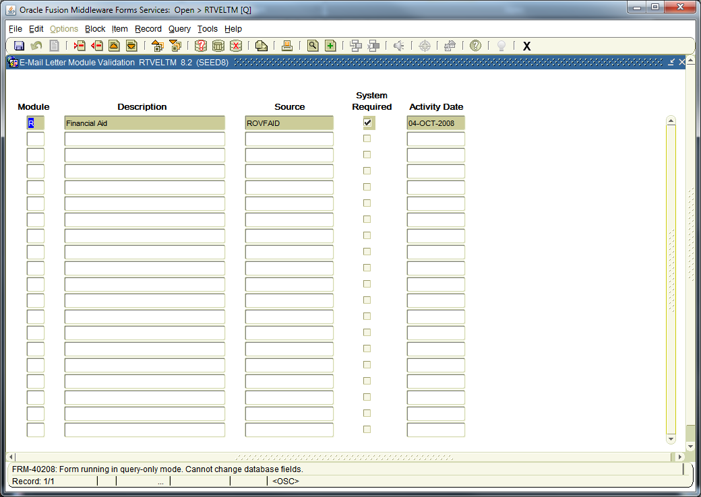
RTVELTM – Email Letter Module Validation

Slide 9
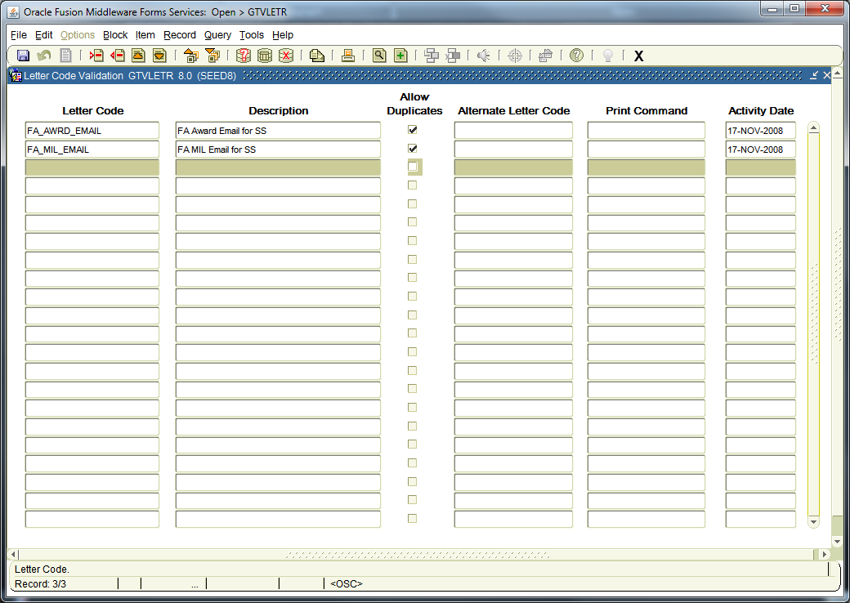
GTVLETR – Letter Code Validation

Slide 10
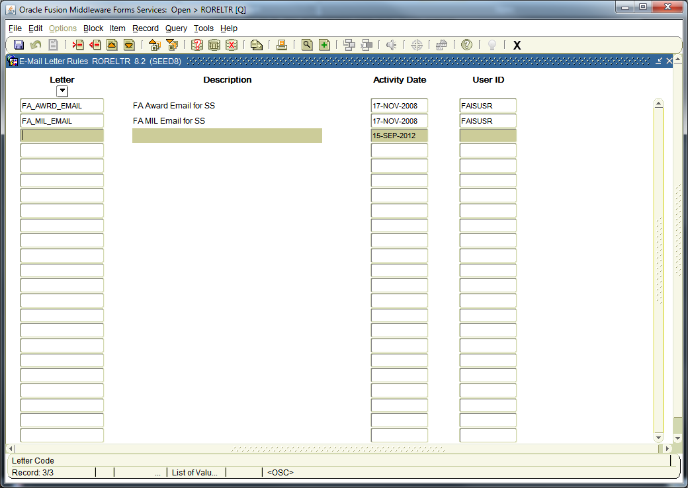
RORELTR – Email Letter Rules

Slide 11
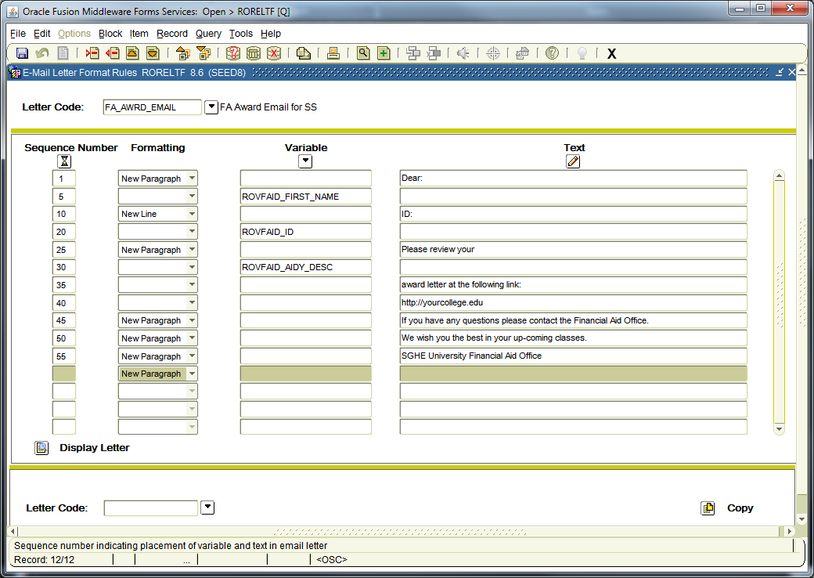
RORELTF Email Letter Format Rules
Clicking on the Display Letter button will allow you to see your email.

Slide 12
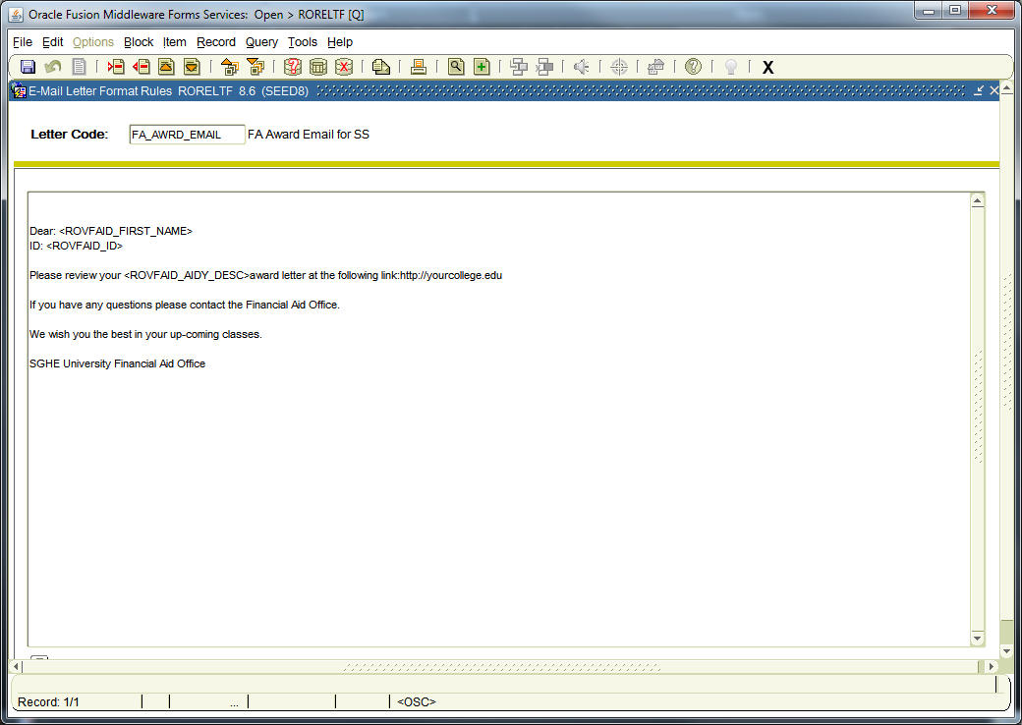

Slide 13
  Sequence Numbers: indicates which order you want each line to display. These sequence numbers cannot be updated later without removing the entire line. Best practice is to use numbers on increments of 5 in case you need to add a line later.
  Formatting Commands:
    New Paragraph – Starts a new paragraph in your email
    New Line – Starts a new line in your email
    Horizontal Rule – Insert variable or text to the right side of the email, the line that you see in the display letter will not be in the email once sent.
    Blank – Continues test on the same line as previous line.

Slide 14
      Variable: Student specific information from the ROVFAID view, you can not add any additional variables, these are delivered.
      Column Name
      ROVFAID_AIDY_CODE
      ROVFAID_AIDY_DESC
      ROVFAID_FIRST_NAME
      ROVFAID_FULL_NAME
      ROVFAID_ID
      ROVFAID_LAST_NAME
      ROVFAID_MI
      ROVFAID_PIDM
Text: Test for the email. You can also enter a website to direct the student to Banner Self Service. Maximum 250 characters. The website will display as a hyperlink in the email when entered as an internet address (example: https://yourcollege.edu:9090 )

Slide 15
Email Processing
02

Slide 16
Email Process
Run the population process GLBDATA to get your list of students that need emails
Run ROREMAL Financial Aid Email Process which creates the emails and sends them
Emails are posted to the RUAMAIL and GUIMAIL forms
Review the ROREMAL .lis file output to view students who do not have an email address so you can send them a paper letter

Slide 17
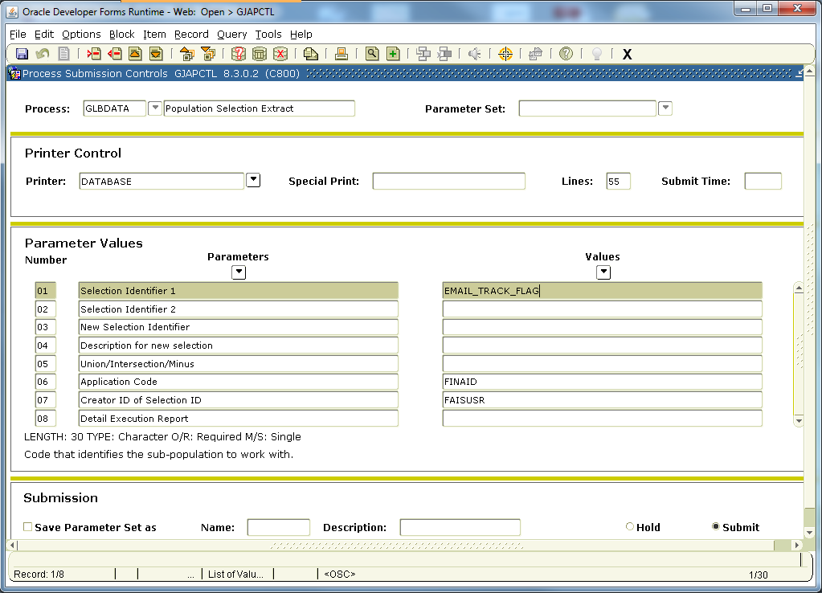
Run population selection GLBDATA

Slide 18
Run ROREMAL to create and send Emails (caution when testing, these will produce and send emails)
01 Aid Year Code
02 Email Letter Code
03 Email Address Type Preference
04 Student ID
05 Application ID
06 Selection ID
07 Creator ID
08 User ID
  Enter Aid Year
  Letter Code from RORLETR
  Choose email type (1MA,
  2PERS, 3YAHOO)
  If using popsel leave blank
  FINAID (popsel)
  EMAIL_AWARD (popsel)
  FAISUSR
  User ID who ran GLBDATA

Slide 19
ROREMAL, Continued
09 Audit/Update Mode
10 Email Subject Line
11 From Email Address
12 Email Senders Name
13 Mail Host
14 Mail Host Port Number
15 Content-type
16 Extra Line Feed
17 Use only defined email types
Enter A-Audit mode to view; enter U-Update mode to send emails
Enter free form text for the Subject Line of the email
Enter email address email is from
(Optional) Enter name of sender
Enter your institutions mail host
Port number from which e-mail is sent
For e-mail header; supports plain text or HTML email
Y = force extra line feed after each new line
Y = will use only email types specified in Parameter 03

Slide 20
Reset Flags, update letter codes, display all letters generated
RLRLETR – Award/Tracking Letter Indicator Reset Process. If your population selection uses the award or tracking flag to select students who need emails then you must run this process to reset the flags to blank after your emails are completed.
RUAMAIL – Applicant Mail Form. Will be updated with the letter code defined with an Originator Code of “E” for email process.
GUIMAIL - The mail Query Form. Displays all letters generated for a student from anywhere in the college.

