Slide 1
SFRFASC Batch Fee Assessment Kimberly A Saving-Sherman kimberly.saving-sherman@ellucian.com Ellucian

Slide 2
Agenda
Introduction
Overview
An Explanation of SFRFASC
What is Used by SFRFASC
Known Fee Assessment Misunderstandings
How to Troubleshoot Fee Assessment Issues
Questions

Slide 3
Introduction

Slide 4
Overview

Slide 5
Overview
Fee Assessment was rewritten in version 6.x
All areas of Banner call the same program
Plateau amount was removed and flat rate added
Many additional fields added over the years
Audit trail added for troubleshooting

Slide 6
An Explanation of SFRFASC

Slide 7
An Explanation of SFRFASC
Can be run by population selection, collector table (SFRBTCH), enrollment status (SFBETRM), or for a single student
Choices are for Regular or Pre-Bill rules
Choose if you want a record inserted into invoice collector table (TBRCBRQ) including the printer
Accounting Detail to Print and Report Type
Create Accounting Records – Set Always to Y
Sort – Name or ID

Slide 8
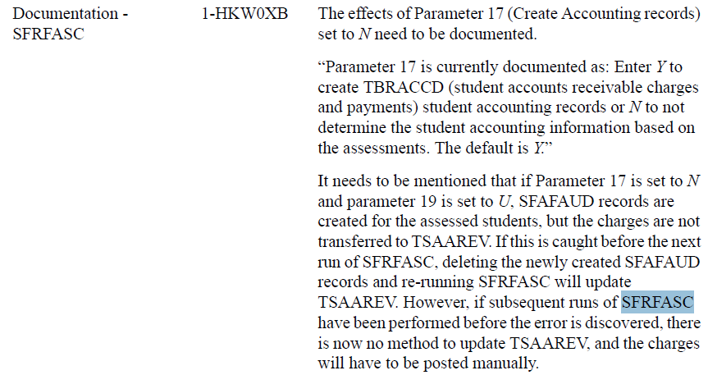
An Explanation of SFRFASC
Create Accounting Records – Set Always to Y

Slide 9
An Explanation of SFRFASC
Refund by Total Date is for percentage selection
Term
Run Mode
Full or Part Time Indicator – not controlled by registration

Slide 10
An Explanation of SFRFASC
Assessment Date:
Hierarchy used to assign the effective date:
the date in the Registration Fee Assessment Effective Date field on SOATERM
the date in this parameter
the Banner system date
Additional settings that affect the assigning of the effective date:
When the Effective Date field on TSACTRL is set to Date of Charges, and a future date exists in SOATERM or in this parameter, the future date will always be used.
If the Effective Date field on TSACTRL is set to Current Date, and this parameter is set to a future date or a future date exists on SOATERM, and the Accept Charges (Indicator) is set to Y, the system date will be used.

Slide 11
What is Used by SFRFASC

Slide 12
What is Used by SFRFASC
SFARGFE – Registration Fee Assessment Rules
SSADETL – Schedule Detail Form
SFAEFEE – Registration Additional Fees Form
SFAFMAX – Registration Fees Min/Max Charge Control Form
SFARSTS – Course Registration Status Form
SFAESTS – Enrollment Status Control Form
SFARFND – Registration Fee Assessment Refund by Total Rules Form
SSARULE – Schedule Processing Rules Form
SOATERM – Term Control Form

Slide 13
Known Fee Assessment Misunderstandings

Slide 14
Known Fee Assessment Misunderstandings
Flat Rate fields on SFARGFE should not be used for flat fees
Full and part time assessment rules must be built separately
SFAFMAX is not used for section fees (SSADETL) when Track by CRN is checked on SOATERM
You cannot check Track by CRN if you have already fee assessed anyone for the term
You cannot use refund rules on SFARSTS and SFAESTS at the same time

Slide 15
How to Troubleshoot Fee Assessment Issues

Slide 16
How to Troubleshoot Fee Assessment Issues
Review SFAFAUD to find the type of rule and the sequence number of the rule that caused the transaction
Match the transaction number on TSAAREV to the transaction number on SFAFAUD to find the records that caused the AR transaction
Did you run fee assessment and then check Track by CRN?

Slide 17
Questions?

