Slide 1
Electronic Personnel Action Forms (ePAF) September 18, 2012 Cyd Hawkins Principal Needs Center Consultant for Human Capital Management
Notes:
NOTE: Replacement images can be found on the Ellucian Brand Page on the intranet

Slide 2
Agenda
Introduction
Terminology and Definitions
Rule and Validation Forms
Internet Native Banner
Banner Self Service
Benefits of Using ePAFs

Slide 3
Cyd Hawkins Principal Needs Center Consultant Human Capital Management 503-329-9970 cyd.hawkins@ellucian.com

Slide 4
Terminology and Definitions

Slide 5
Terminology and Definitions
Term | Definition
ePAF | electronic personnel action form Electronically submitted and process actions for entry into PPAIDEN, PEAEMPL & NBAJOBS Can default common values Determine who can enter, approve and apply the actions
FYI or Acknowledger | Reviews ePAF personnel transactions. No actions are allowed on the transaction. This is a non-mandatory approval.
Applier | Updates the ePAF transaction into the Banner database

Slide 6
Terminology and Definitions
Term | Definition
Approval Category | Approval categories represent the purpose of the personnel action – the reason the Personnel Action is being created. Approval categories are commonly performed functions at an institution such as the transfer of an employee or the reclassification of an employee.
Approval Type | Approval types are defined to be the most basic type of action and specific to the processing of a Personnel Action. They are actions such as establishing a new job assignment for an employee or terminating an existing job assignment for an employee.
Originator | The creator of an Electronic Personnel Action.
Proxy | Proxies are individuals authorized to take approval action in the absence of the approver.

Slide 7
Terminology
Term | Definition
Queue Status | The status of the Electronic Personnel Action (ePAF) for each individual defined in the approval queue.
Required Action | Required Action is a field on several of the Electronic Approval forms. The valid Options for input are: Approval: The individual must take action on the PAF. FYI: The individual is seeing the PAF for information only. Apply: The individual must apply the PAF to the database after final approval.
Superuser | A superuser has the ability to approve any transaction at any time during the approval process and bypass the people in the approval queue that have not yet taken action on the transaction.
Transaction Status | The status of the Electronic Personnel Action (ePAF) itself.

Slide 8
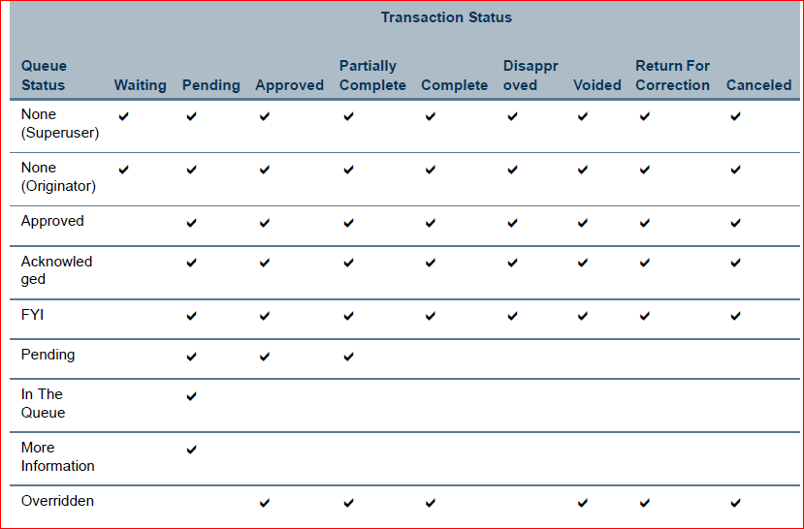

Slide 9
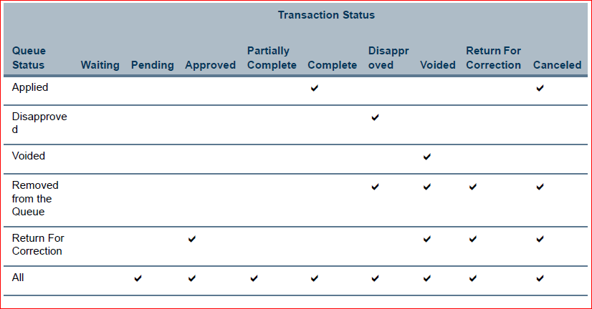

Slide 10
Rule and Validation Forms

Slide 11
Set Up - Validation forms
Electronic Approval Category Code Validation Form (NTVACAT)
Electronic Approval Type Code Validation Form (NTVAPTY)
Electronic Approval Groups (NTVAGRP)
Notes:
NOTE: Alternate images that match the Ellucian photography style can be found on the Ellucian Flickr site. If you need access to the site, set up a flickr account and email your username to tiffany.johnson@ellucian.com.

Slide 12
Electronic Approval Category Code Validation Form (NTVACAT)
NTVACAT Is used to create the various categories of approvals that are specific to your institution. This may be specific to each individual function or may encompass multiple types of functions.

Slide 13
Electronic Approval Type Code Validation Form (NTVAPTY)
NTRAPTY is used to establish the rules that tie Banner forms, blocks, and fields to an Approval Type or action. This form will determine the look of the institution’s Electronic Personnel Action Form for each site-defined Approval Type.

Slide 14
Electronic Approval Groups (NTVAGRP)
Approval groups is an optional security measure for electronic approvals that allows you to group one or more approval categories and associate them with a finite set of users. This feature is an optional one-time set up and is specific to Employee Self-Service only. If approval groups are not established in Banner, all approval categories will be presented for EPAFs in Employee Self-Service.

Slide 15
Set Up - Rule forms
Electronic Approval Category Rule Form (NTRACAT)
Electronic Approval Level Rule Form (NTRALVL)
Electronic Approval Type Rule Form (NTRAPTY)
Electronic Approval Usage Rule Form (NTRAUSG)
Position Control Installation Rule Form (NTRINST)
Electronic Approval Groups (NTRAGRP)
Electronic Approval Proxy Rule Form (NTRPROX)
Electronic Approval Routing Rule Form (NTRROUT)
Notes:
NOTE: Alternate images that match the Ellucian photography style can be found on the Ellucian Flickr site. If you need access to the site, set up a flickr account and email your username to tiffany.johnson@ellucian.com.

Slide 16
Electronic Approval Category Rule Form (NTRACAT)
NTRACAT is used to establish the rules that tie combinations of Approval Types together so that approvers are approving one entire transaction, the Approval Category.

Slide 17
NTRACAT – Fields / Default Values

Slide 18
Electronic Approval Level Rule Form (NTRALVL)
NTRALVL is used to define levels of approval.

Slide 19
NTRALVL - Users

Slide 20
Electronic Approval Type Rule Form (NTRAPTY)
NTRAPTY is used to establish the rules that tie Banner forms, blocks, and fields to an Approval Type or action. This form will determine the look of the institution’s Electronic Personnel Action Form for each site-defined Approval Type.

Slide 21
NTRAPTY – Field Information

Slide 22
Electronic Approval Usage Rule Form (NTRAUSG)
NTRAUSG defines rules that permit execution of Electronic Approval functions at the form, block/field level. This form is a Do Not Touch form and is delivered and maintained by Ellucian.
The Block Information area displays the block description within the form(s) defined in the Form block. The blocks that are supported in the Electronic Approval process are only those that appear on this form.
Note: The only thing a client can do on this form is change the ‘description’ of a field to be more user friendly.

Slide 23
NTRAUSG - Definitions

Slide 24
Position Control Installation Rule Form (NTRINST)
NTRINST accommodates and establishes the global usage parameters of Electronic Approval functionality

Slide 25
Electronic Approval Groups (NTRAGRP)
Using NTRAGRP an institution can assign individual EPAF users to an appropriate approval group. Users associated with an approval group get default access to all approval categories listed within the approval group. You can associate an EPAF user with more than one approval group, based on the functions he or
she is required to execute within the electronic approvals process.

Slide 26
NTRAGRP – User Definition

Slide 27
Electronic Approval Proxy Rule Form (NTRPROX)
NTRPROX permits each individual approver to designate personal proxies who are authorized to take approval action in the absence of the approver for every level of approval in which they are defined.

Slide 28
Electronic Approval Routing Rule Form (NTRROUT)
NTRROUT enables individual originators to identify the individuals who are standard in their routing of the PAF’s they create. This will default into the electronic approval entered by the user at the time of PAF entry. This sets up a “standard” but can be overwritten by the originator when creating a PAF if necessary.

Slide 29
Internet Native Banner

Slide 30
Applications and Processes
Electronic Personnel Action Form (NOAEPAF)
Electronic Approval Summary Form (NOAAPSM)
Electronic Approval Routing Rule Form (NTRROUT)
Errors and Warnings Detail Form (NOIEMSG)
Electronic Approvals Mass Apply Process (NOPEAMA)

Slide 31
Banner Self Service

Slide 32
Employee Self Service
Create an ePAF
Check status of ePAF
Approve ePAF
ePAF Summary
Notes:
NOTE: Alternate images that match the Ellucian photography style can be found on the Ellucian Flickr site. If you need access to the site, set up a flickr account and email your username to tiffany.johnson@ellucian.com.

Slide 33
Benefits of Using ePAFs

Slide 34
Benefits
Accountability for data entry is shifted to the originator (Departments)
Increase speed and efficiency of the process
Less opportunity for data entry errors &/or errors being caught before they get to the database
Ability to track a transaction through the approval process
Ability to write reports on ePAF data including approvals
Notes:
NOTE: Alternate images that match the Ellucian photography style can be found on the Ellucian Flickr site. If you need access to the site, set up a flickr account and email your username to tiffany.johnson@ellucian.com.

Slide 35
Notes:
NOTE: Replacement images can be found on the Ellucian Brand Page on the intranet

Slide 36
Cyd Hawkins cyd.hawkins@ellucian.com 503-329-9970
Notes:
NOTE: Replacement images can be found on the Ellucian Brand Page on the intranet

