Slide 1

MBUG 2023
Financial Aid Self-Service 9 – Why the Upgrade is Worth It
Jaime Missimer
Pearl River Community College
September 11, 2023

Slide 2
Session Rules of Etiquette
Please turn off your cell phone
If you must leave the session early, please do so discreetly
Please avoid side conversation during the session

Slide 3
In This Session…
Quick look at Self-Service 8
How Self-Service 9 looks for students
Navigating SSB 9
How to set up SSB 9 in Banner

Slide 4
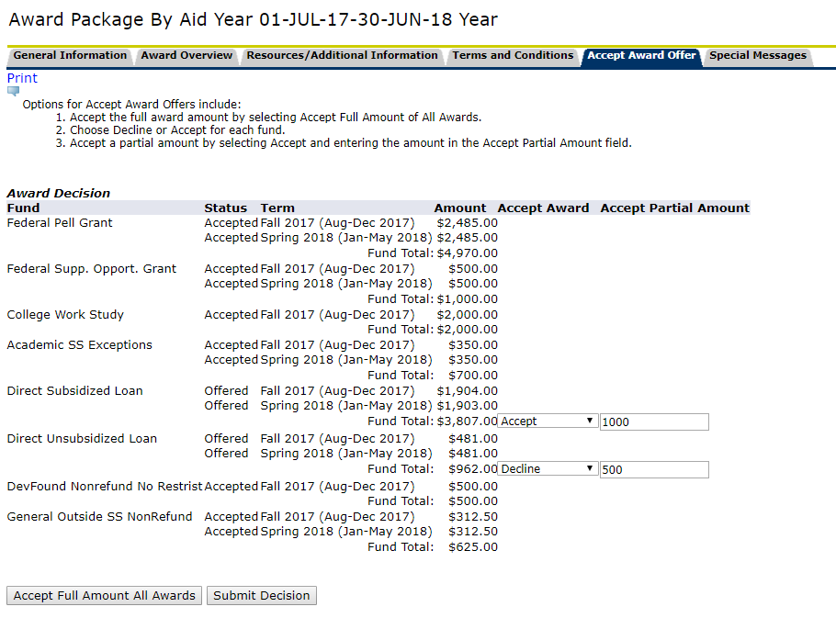
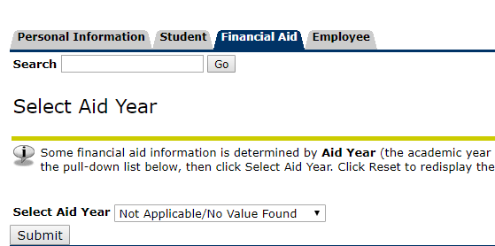
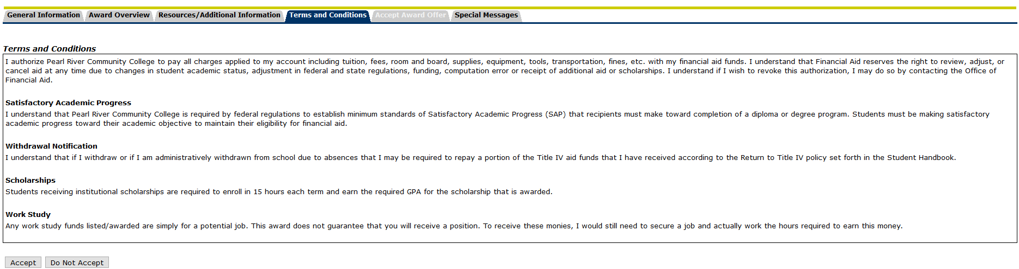
Still Using Self-Service 8?

Slide 5
Let’s look at Self-Service 9!
Live demo

Slide 6

Benefits of SSB 9
Nicer to look at
Easier to navigate
Students have fewer questions about where to find everything
Much more user-friendly and intuitive
Customizable
This Photo by Unknown Author is licensed under CC BY-NC

Slide 7
Forms Needed for Set Up
ROAINST
RFRMGMT
RTVWEBQ
RORWBQA
RTVTRST
RTVWTXT
RORWTXT
RORWTAB
GUAINFO
RBRPBYR
  Period Budgeting
RTVCOMP
  Aid Year Budgeting

Slide 8
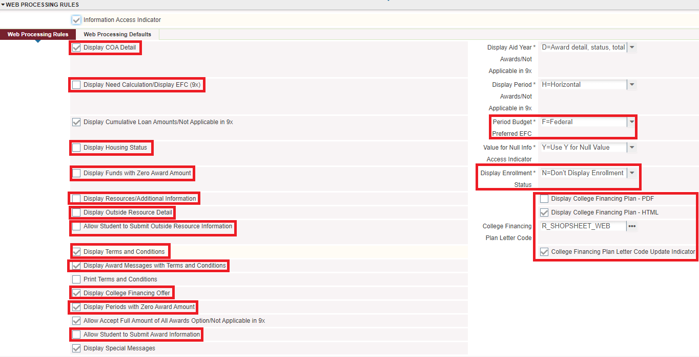
ROAINST – Aid Year Set Up

Slide 9
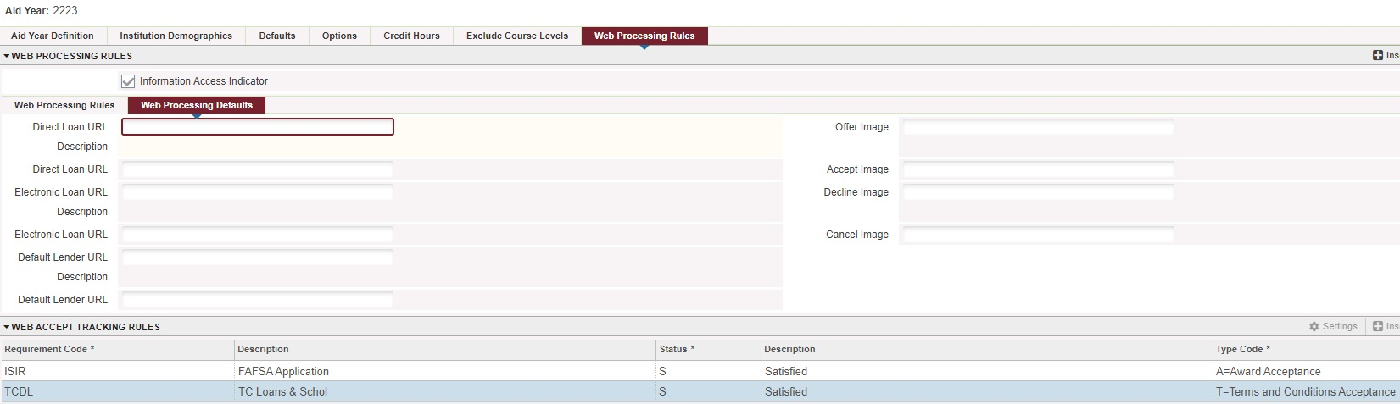
ROAINST – Aid Year Set Up

Slide 10
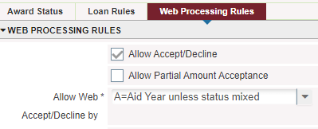
RFRMGMT – Fund Management

Slide 11
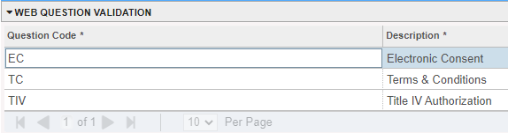
RTVWEBQ – Web Question Validation
Need these set up before creating Web Questions

Slide 12
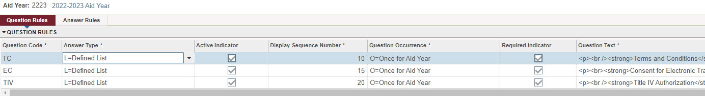
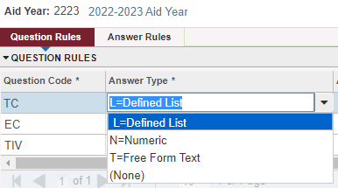
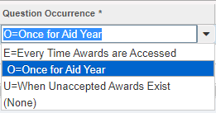
RORWBQA – Web Questions & Answers

Slide 13
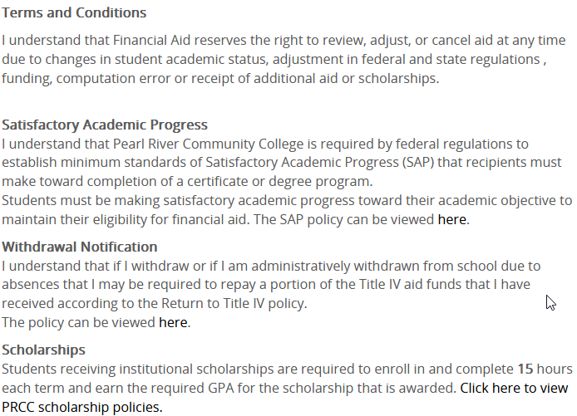
RORWBQA – Web Questions & Answers
You can use HTML for the Question Text
<p><br /><strong>Terms and Conditions</strong><br /><p>I understand that Financial Aid reserves the right to review, adjust, or cancel aid at any time due to changes in student academic status, adjustment in federal and state regulations , funding, computation error or receipt of additional aid or scholarships.</p> <p><br /><strong>Satisfactory Academic Progress</strong><br />I understand that Pearl River Community College is required by federal regulations to establish minimum standards of Satisfactory Academic Progress (SAP) that recipients must make toward completion of a certificate or degree program. <br />Students must be making satisfactory academic progress toward their academic objective to maintain their eligibility for financial aid. The SAP policy can be viewed <span style="color: #0000ff;"><a style="color: #0000ff;" href=http://www.prcc.edu/financial-aid/satisfactory-progress target="_blank">here</a></span>.</p> <p><strong>Withdrawal Notification</strong> <br />I understand that if I withdraw or if I am administratively withdrawn from school due to absences that I may be required to repay a portion of the Title IV aid funds that I have received according to the Return to Title IV policy. <br />The policy can be viewed <span style="color: #0000ff;"><a style="color: #0000ff;" href=http://www.prcc.edu/financial-aid/refund target="_blank">here</a></span>.</p> <p> <strong>Scholarships</strong> <br />Students receiving institutional scholarships are required to enroll in and complete <strong>15</strong> hours each term and earn the required GPA for the scholarship that is awarded. <span style="color: #0000ff;"><a href=http://www.prcc.edu/financial-aid/academic-scholarships target="_blank">Click here to view PRCC scholarship policies.</a></span></p>
HTML in Banner
Text in Self-Service

Slide 14
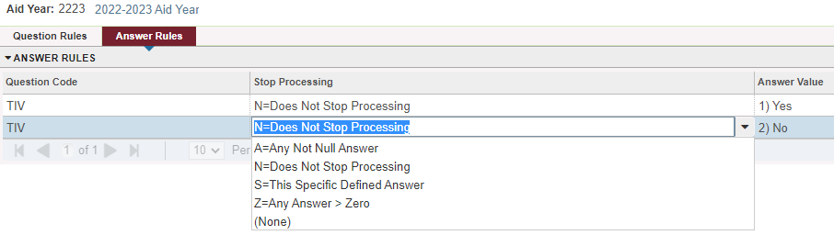
RORWBQA – Web Questions & Answers
Students will see answers listed alphabetically, no matter what order you list them on this form

Slide 15
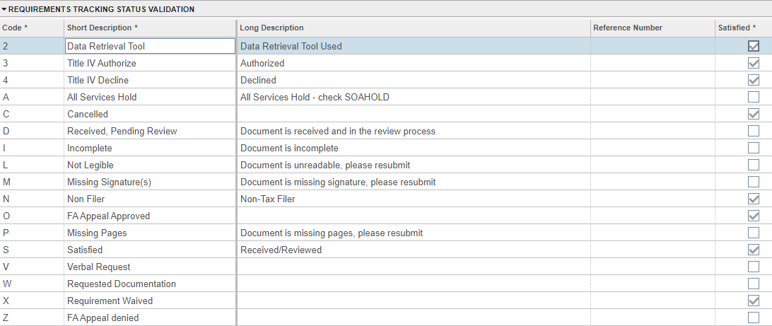
RTVTRST – Req. Tracking Status

Slide 16
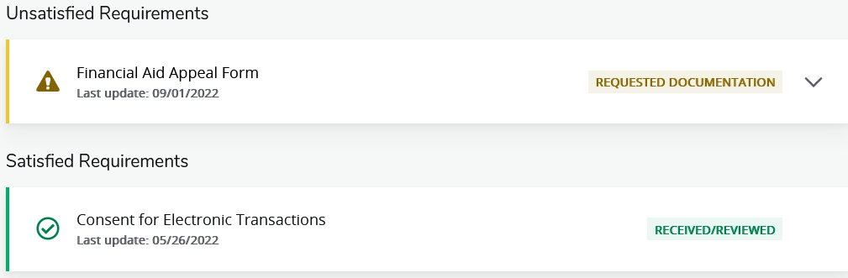
RTVTRST – In Self-Service
Students can see the descriptions listed
  Will see short description if there is no long descriptions
  Will see long description if there is one listed
Satisfied vs. Unsatisfied

Slide 17
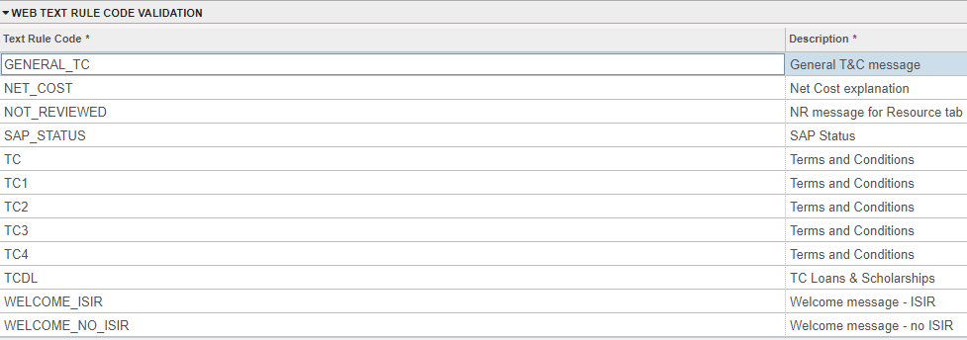
RTVWTXT – Web Text Rule Validation
Must set this up before making web text

Slide 18

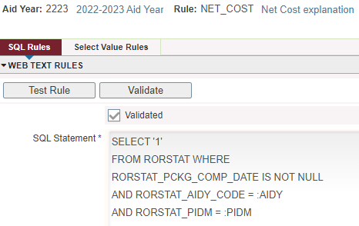
RORWTXT – Web Text Rules
Yes, there is SQL here
This Photo by Unknown Author is licensed under CC BY

Slide 19
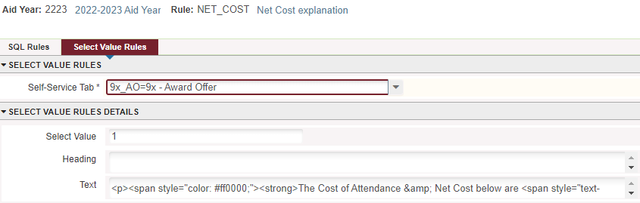
RORWTXT – Web Text Rules
You can use HTML in the text box
The text box is super tiny – only one line visible at a time
Write your text & HTML in Notepad and then copy/paste in the text box

Slide 20
RORWTXT – Web Text Rules
<p><span style="color: #ff0000;"><strong>The Cost of Attendance &amp; Net Cost below are <span style="text-decoration: underline;">NOT WHAT YOU OWE</span> and are estimates only.&nbsp;<span style="color: #0000ff;">&nbsp;</span></strong></span><span style="color: #0000ff;"><strong><a style="color: #0000ff;" href="https://banss-p.prcc.edu:8100/StudentSelfService/ssb/accountDetailByTerm#!/" target="_blank" rel="noopener">Click here to see your bill for your actual charges.&nbsp; </a></strong></span>
The Cost of Attendance & Net Cost below are NOT WHAT YOU OWE and are estimates only. Click here to see your bill for your actual charges.
HTML in Banner
Text in Self-Service

Slide 21
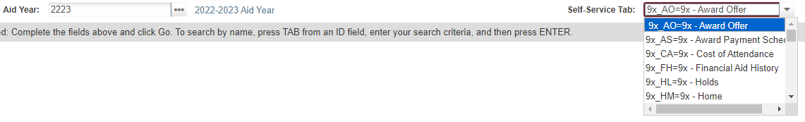
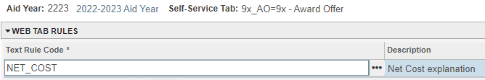
RORWTAB – Web Tab Rules
Choose one of the 9x options
Enter the Text Rule Code for that tab

Slide 22
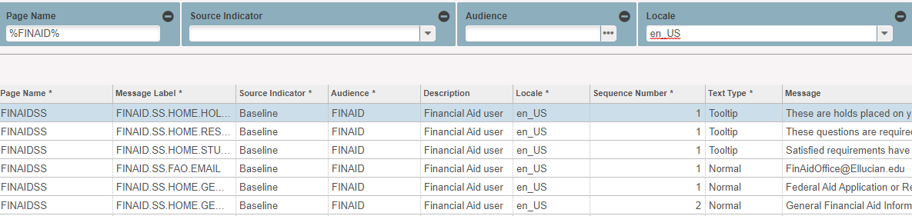
GUAINFO – Info Text Editor
Customizable tool tips, links, and text
Use the filter options

Slide 23
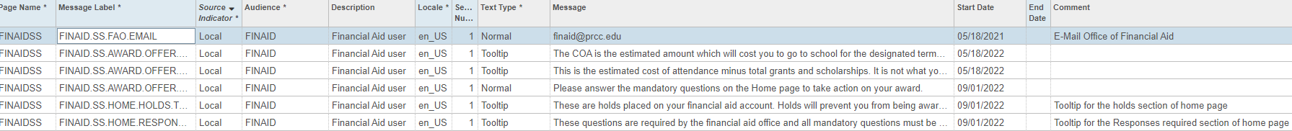
GUAINFO – Info Text Editor
To customize anything, you MUST copy the line you want to change
  If you try to change the “Baseline” information, it will not be reflected on the site
  When you copy it, it changes the source to “Local”

Slide 24
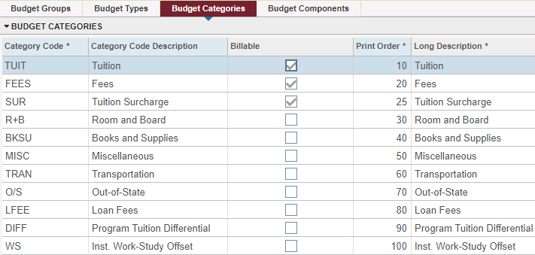
Budget Rules
RBRPBYR for period-based budgeting

Slide 25
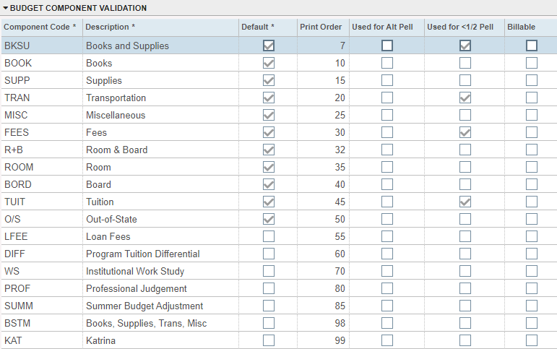
Budget Rules
RTVCOMP for aid year budgeting

Slide 26
Questions?
Jaime Missimer
Director of Financial Aid
Pearl River Community College
jmissimer@prcc.edu

