Slide 1

MBUG 2023
Session Title: ESM App Deployments
Presented By: Andrew Garner
Institution: Mississippi University for Women
September 11, 2023

Slide 2
Session Rules of Etiquette
Please turn off your cell phone
If you must leave the session early, please do so discreetly
Please avoid side conversation during the session

Slide 3
Background
Earlier this year, we were tasked with bringing our Banner upgrades in-house.
With this change, our update frequency changed from quarterly to monthly.
ESM was built-out and functional except for Self-Service App Deployments.
Those deployments were a manual process.

Slide 4
Overview
NFS Share
Jenkins
  Node Creation
  Setup on App Servers
App Servers
  Script Execution
ESM Configuration
  Machines
  App Servers
Jobsub Server
  Deploy Scripts
  Groovy Files
Tomcat Environment

Slide 5
NFS Share
Set up an NFS share on your Jobsub server for your War File Staging Path .
  vi /etc/exports
  {staging path} {app server} (ro,no_root_squash)
    Read-only is fine
  exportfs -r
Mount the NFS share on each App server.
  vi /etc/fstab
  {jobsub server}:{staging path} {app server staging path} nfs defaults 0 0
  mount -av

Slide 6
Jenkins
Create and configure the node in Jenkins.
  The node name will be referenced in ESM.
  Remote root directory of Jenkins on the app server.
Jenkins will provide the commands for starting up the agent (curl and java).
We used the same user for both Tomcat and Jenkins.

Slide 7

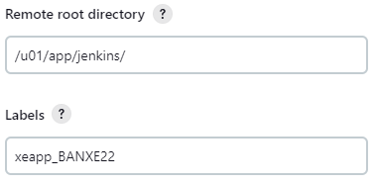
Jenkins

Slide 8
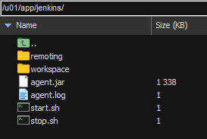
Jenkins
Start – Java command provided in Jenkins
Stop – pkill -f "java -jar agent.jar"

Slide 9
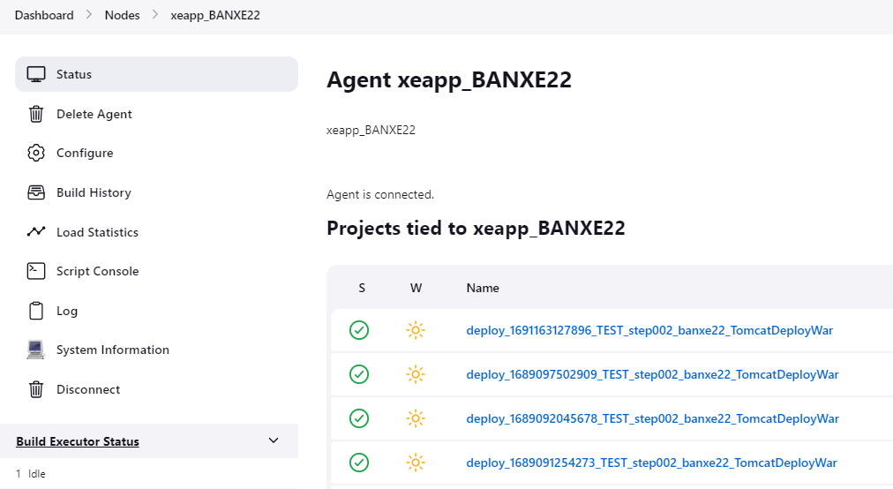
Jenkins
Agent is Connected

Slide 10
App Server
In home directory of the script execution user:
  Create a file named .wgetrc
    http_user = scripting-username
    http_password = scripting-user-pwd
    auth-no-challenge = on
  chmod 600 .wgetrc
The script execution user is created in ESM.

Slide 11
ESM Config - Machine
Enter the Host Name and App
Provide the IP
Deployment Agent Name
  Use the Node Name in Jenkins
Public Network for Proxy
Use the NFS share on the app server for the staging path.

Slide 12
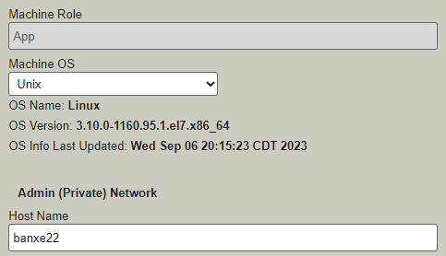


ESM Config - Machine

Slide 13
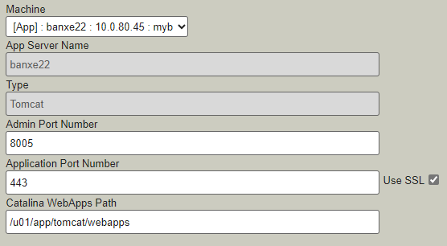

ESM Config – App Server

Slide 14
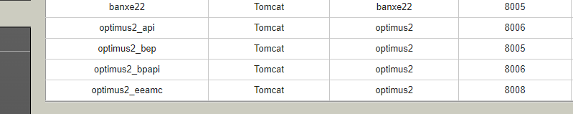
ESM Config – App Server
Two App Servers can point to the same port and web apps path.

Slide 15
Deployment Scripts
The scripts reside in the Staging Path on the Jobsub server.
deployScripts
  preBuild and postBuild
  preDeploy and postDeploy
Custom scripts that run during deployment.
We utilize preBuild to backup our current config files, then we copy over the latest files from the deployment.

Slide 16
Deployment Scripts
Each application will have its own set of deployment scripts.
There is also a sub folder for each server that the application is deployed to.

Slide 17
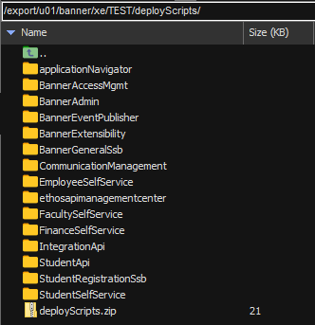
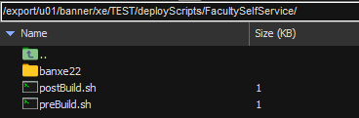

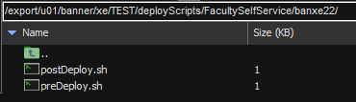
Deployment Scripts

Slide 18
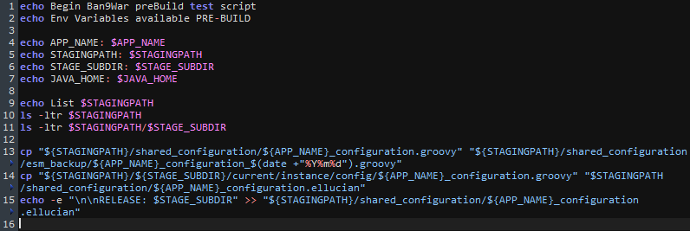
Deployment Scripts
Add to preBuild.sh
Self-Service Apps

Slide 19
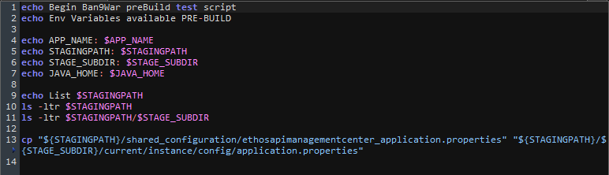
Deployment Scripts
Add to preBuild.sh
Ethos API Management Center

Slide 20
Configuration Files
Our groovy files are in the staging path.
After a deployment, we compare the two groovy files and move over any changes.
We use the Java Opts to load our config files.

Slide 21
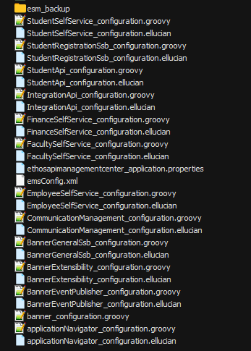
Configuration Files

Slide 22
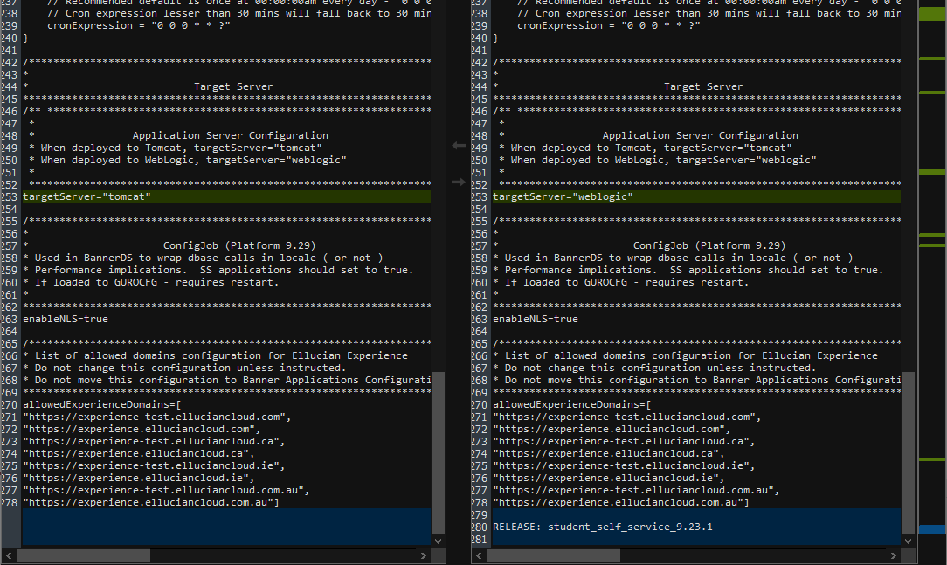
Configuration Files

Slide 23
Configuration Files
In the Tomcat setenv, add the Java Opts config.

Slide 24
Deploying in ESM
Click on your Deployment in ESM
Check App Name
Select App Server
Click Start Deployment
Check Groovy Files
Bounce Tomcat

Slide 25
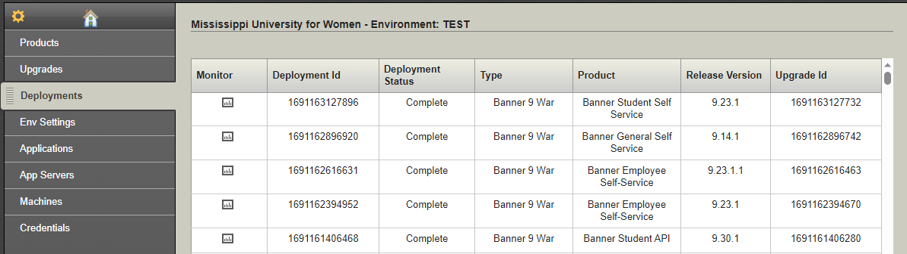
Deploying in ESM

Slide 26
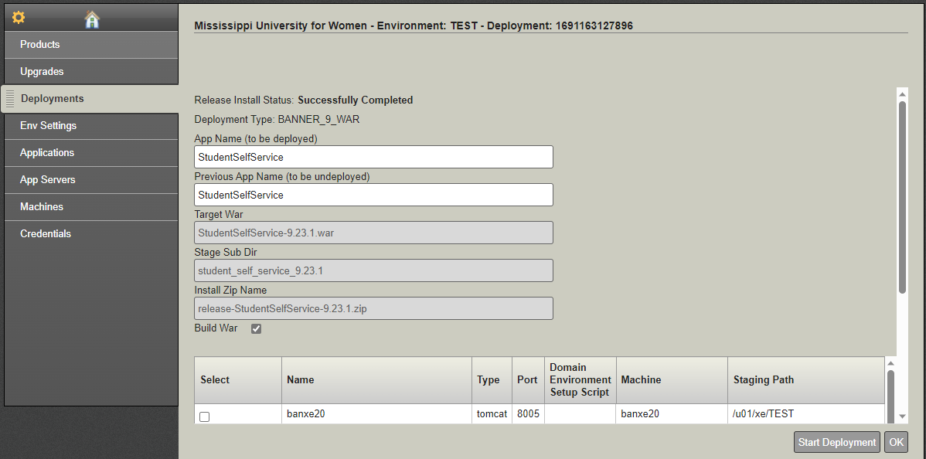
Deploying in ESM

Slide 27
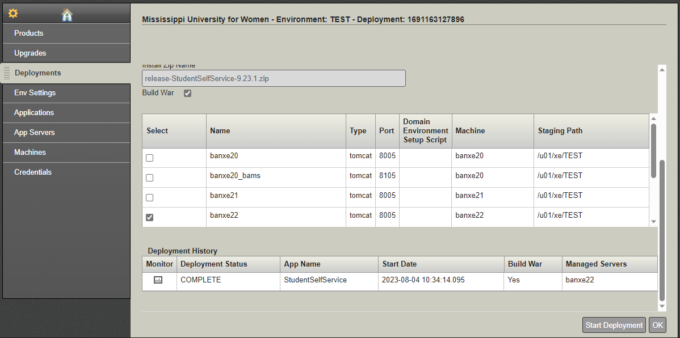
Deploying in ESM

Slide 28
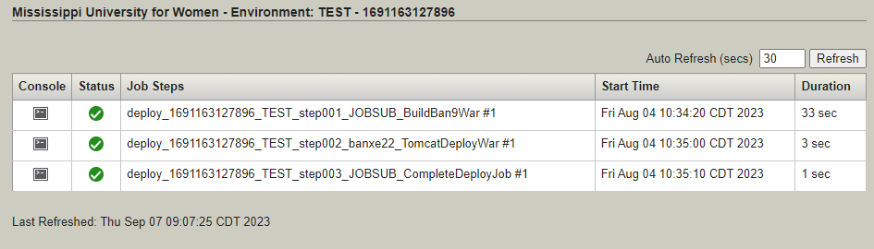
Deploying in ESM

Slide 29
Resources
Article 000035245
  Banner 9 and Configuring External Configuration banner_configuration BannerApp_configuration groovy files
Article 000046382
  Ellucian Solution Manager (ESM) 1.15+ sample/test custom deployment scripts

Slide 30
Questions?
Contact Information:
amgarner@muw.edu (662) 329-7285

