Slide 1


How to Transition to Electronic Forms with Dynamic Forms
Presented by: Amanda Brumfield
Pearl River Community College

Slide 2
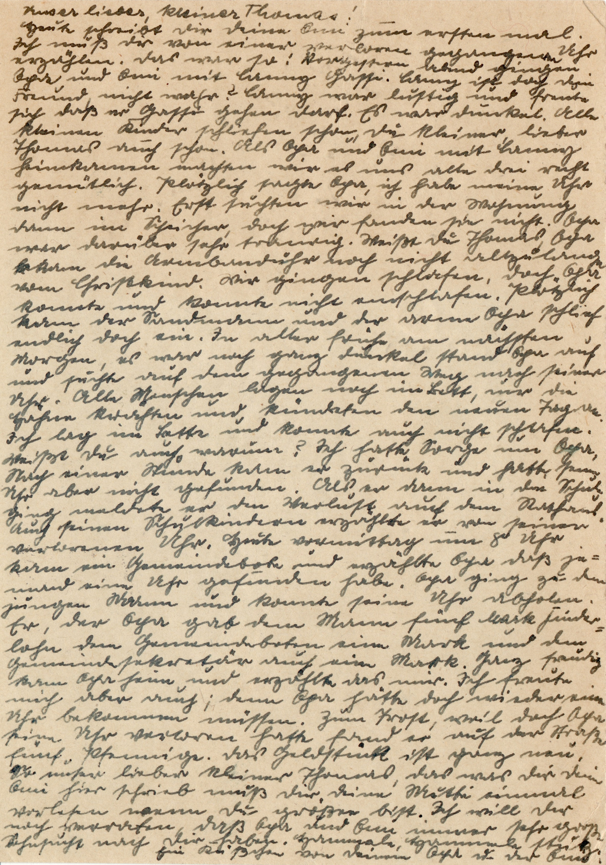
Why go electronic?
Our forms were outdated!
  basic webforms
  fillable or printable PDF
  free web surveys
  forms on PAPER

Slide 3




What are the benefits?
Better
Security
Advanced
Features
Modern
Look

Slide 4
S
Lock that data down!
E
  Data is HTTPS encrypted
  Integrates with SSO
    CAS, ADFS, LDAP, Shibboleth, InCommon, Passthrough, SAML, OneLogin, etc.
  You control who in your institution can get access to form data
C
U
R
I
T
Y

Slide 5
F
The "oohs" and "aahs"
E
  Collect multiple electronic signatures
  Route forms with workflows
  SSO forms can pre-fill data from SIS
  Users can see form history
  Institutions have full control of forms
  Files can be uploaded to forms
  Payment integration
    CASHnet, nelnet, TouchNet, Paypal, Official Payments, Authorize.net, TMS, etc.
  Can integrate with some document management systems
    BDM
A
T
U
R
E
S

Slide 6
M
What paper forms?
O
  Forms look sleek
  Can be customized
  Browser friendly
  Mobile friendly
  Quick changes
D
E
R
N

Slide 7

PRCC Integration
  Determine what departments are in need of this solution
    Financial Aid, Admissions, Allied Health programs, Career/Tech programs, Disability Services, Dual Enrollment, Foundation, Human Resources, Marketing, Recruitment, Workforce
  Determine who can contribute funds, if needed
  Decide who goes first
    Financial Aid - contributed the most funds and had the greatest need
  Agree on a reasonable timeline
    February - May
  Establish the integration team
  Review forms for the department going first, make sure they are up-to-date
  Find possible API connectors - IT has to work on these
    name, DOB, address, phone, email, gender
  Determine what forms, if any, need to integrate with document management systems - IT has to work on this

Slide 8

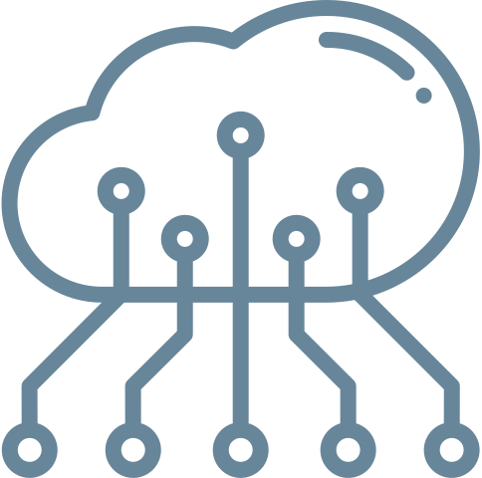
Evaluate your situation.
Time
Change
Data

Slide 9
T
What "free time"?
I
  The implementation team must have time to devote to a long-term project
  Time commitments go beyond implementation
  Plan for weekly internal meetings once implementation is over
M
E

Slide 10
C
What is it good for?
H
  Prepare for internal resistance and external embrace
  People that love paper, REALLY love paper
  Be prepared to show the benefits of this change and how much end-users love it
A
N
G
E

Slide 11
D
My precious, precious data
A
  Get familiar with your forms and data elements within them
  Go in knowing what you want
  Make any form updates prior to implementation
  Start thinking of new ways to use form data
T
A

Slide 12

How to prepare for the transition.
First
Next
Then
Find the department with the most forms or greatest need and identify 5-6 forms to tackle during implementation.
Make sure your forms are up-to-date so you know exactly what should be included on your new Dynamic Forms.
Evaluate your forms to determine if any information on the form can be pulled-in from your SIS through an API connection.

Slide 13
O
H
Don't post-implementation panic!
Once your weekly implementation meetings end, you still have support. Dynamic Forms has a well-developed help site, a support email, and there is a listserv.
N
O
!

Slide 14

Questions?
Thank you!

