Slide 1
Administrative Banner Access and Security
Mary Grace Winston

Slide 2

Session Rules of Etiquette
Please turn off your cell phone.
If you must leave the session early, please do so discreetly.
Please avoid side conversation during the session.

Slide 3
Goals for this Session
Discuss Administrative Banner Requests lifecycle and process.
Guidelines for distributing access.
Protecting confidential access.
Identify how to speed up downtime.

Slide 4


New Hire Process
New employee starts working for the University.
Employee needs access to Administrative Banner to perform specific job duties.
Most schools using Banner, including MSU, will use the form PPAIDEN to input new users into the system. This generates a 9-digit ID for the user.
Administrators for Admin Banner will go through the process of ensuring the employee gets the access they need. MSU uses eForms for this process.

Slide 5

BANNER ACCESS REQUESTS
Paper Form Process or Electronic Forms?

Slide 6
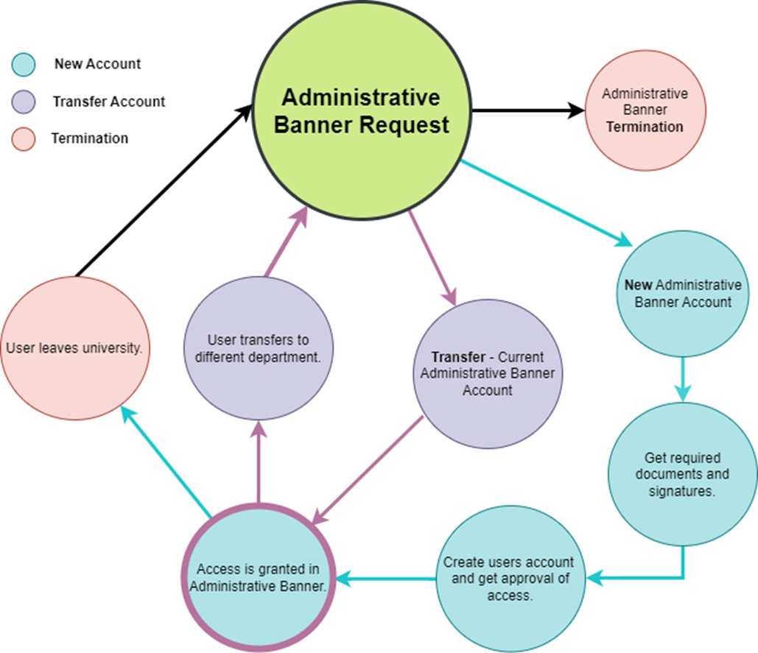
Lifecycle

Slide 7
Admin Banner Accounts
Requirements:
Process for users Admin Banner account will begin on or after effective start date.
Set of Policy and Procedures for University.
Provide optional training.
Establish an approval process for high-risk access.
Follow-up e-mail after creation of account, notifying user.

Slide 8
MSU Policy and Procedures for New Admin Banner Accounts
Employee Checklist:
Student-Worker Checklist:
InfoSec IQ Training: Information Security Training completed yearly by users.
Code of Responsibility: MSU’s Policy for Security and Confidentiality of Records, Files, and Databases.
  Must be signed if eForm is not initiated.
InfoSec IQ Training: Information Security Training completed yearly by users.
Code of Responsibility: MSU’s Policy for Security and Confidentiality of Records, Files, and Databases.
  Must be signed if eForm is not initiated.
TrueScreen: Background-check by HR.

Slide 9
Users Transferring Departments
Most users transferring departments, who submit a request for access, already have a current Administrative Banner Account.
Users must provide complete list of all access needed in the new department, even if this access was granted in their previous department. Remaining access on the account that was not listed to be granted, will be revoked.
PWRTRAN – Transfer Report
Process that runs weekly to notify multiple departments (mainly ITS) of users transferring that still retain access from prior departments.

Slide 10
Terminating Users Accounts
Department’s will request for a user’s Administrative Banner to be terminated.
When a termination is submitted, we must check the user’s access to notify departments of certain access being revoked. We also double check that the user is not transferring, if they are, we revoke access from their previous department.
PWRTERM – Termination Report
Process that runs daily to notify multiple departments (mainly ITS) of users leaving the university to be terminated.

Slide 11
Access Approvals
Specific access requests are sent for approval to department Directors, Assistant Directors, or Business Managers.
  This includes departments such as:
    Admissions & Scholarships
    Controller/Treasurer
    Human Resources
    Information Technology Services
    Procurement & Contracts
    Sponsored Projects
These approval requests are for:
Classes
Roles
Master Org
Business Profiles

Slide 12
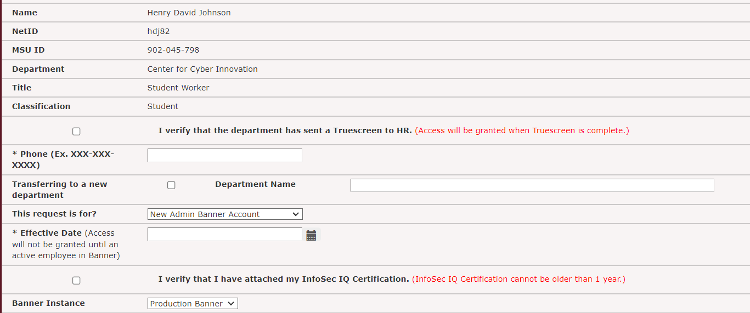



Admin Banner Request eForm
There are 2 classifications:
Students and Employees
Only Student-Worker users will receive this check-box.

Slide 13
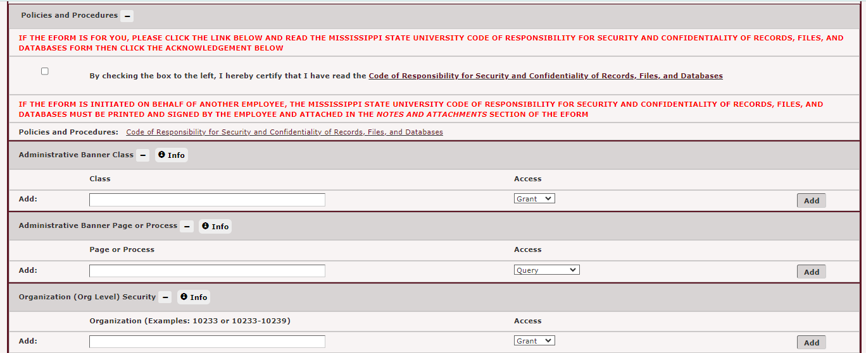
Admin Banner Request eForm Cont.
MSU Code of Responsibility Section
Section for users to request access to be granted or revoked

Slide 14
Automated Processes
Create user script
  Creates user and grants specific classes, roles, and business profiles.
Delete user script
  Deletes user and terminates all access on Administrative Banner.
Trigger for class grants and revokes.
  Emails certain users in ITS when users are granted specific classes or have specific classes revoked.

Slide 15
What We Can Improve
Reduce number of classes
  Over 400 classes are in GSASECR.
Automate InfoSec IQ Training
  Pull InfoSec IQ Training from Administrative Banner into eForms automatically when user is entered.
Implement trigger for PWRTRAN
  E-mail users to submit new Administrative Banner eForms to get access for their new departments.

Slide 16
Summary
Admin Banner Access has a lifecycle:
  Account Creation, Transfers, and Terminations
To administer access, you must follow guidelines that provide security.
Automated processes can be used to speed up downtime.

Slide 17
Questions?

