Slide 1

MBUG 2022
Text Messaging for Student Success and Engagement
Drew Boyles
Mississippi State University
September 12, 2022

Slide 2
Session Rules of Etiquette
Please turn off your cell phone
If you must leave the session early, please do so discreetly
Please avoid side conversation during the session

Slide 3
Goals for this Session
What's driving the adoption of text messaging in higher education?
How is Mississippi State approaching it?
What solutions are there for Banner schools?
Recommendations and best practices

Slide 4
Why text messaging?
Objective: better communication with student population
  timely
  interactive, conversational
  personalized, relevant
Why not text messaging?
  don't treat it like email 2.0

Slide 5
txt @ msu
Distance Education, Student Success
  and more!
Key stakeholders:
  Deans and VPs
  Directors and department heads
  SMEs in departments / divisions
  Information Technology

Slide 6
Requirements and Use Cases
Web-based interface
Separate from emergency alert system
Two-way communication
Prospective students
  send personalized text about a document missing from an application packet
  auto-reply to incoming questions containing the word "deadline"
Current students
  respond to a question from a student
  message freshmen with > 5 absences in the first two weeks of class with a personalized message

Slide 7
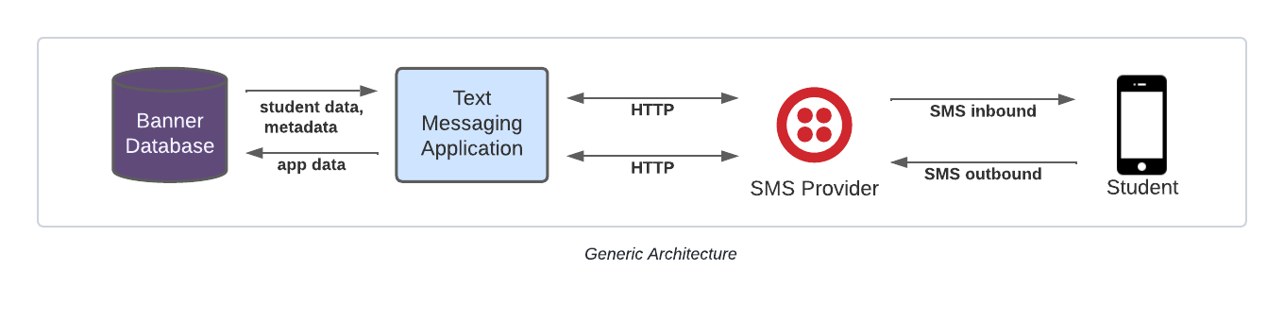
Technology Overview

Slide 8
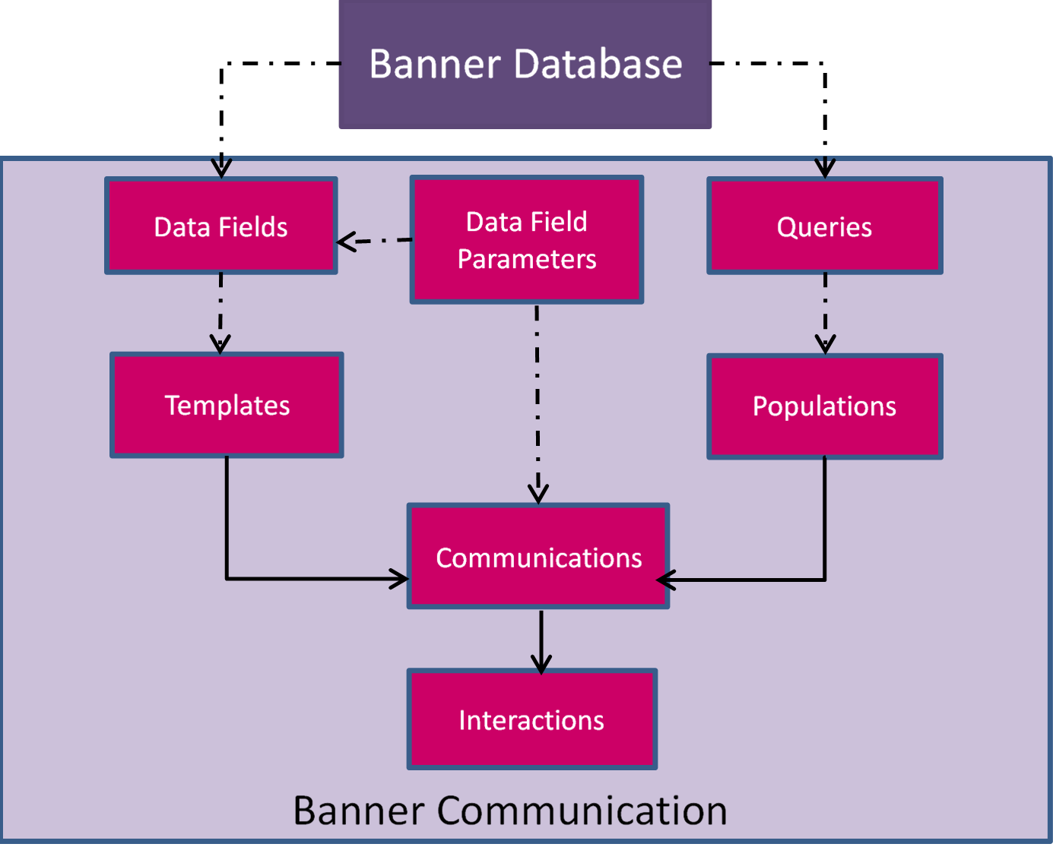
Banner Communication Management

Slide 9
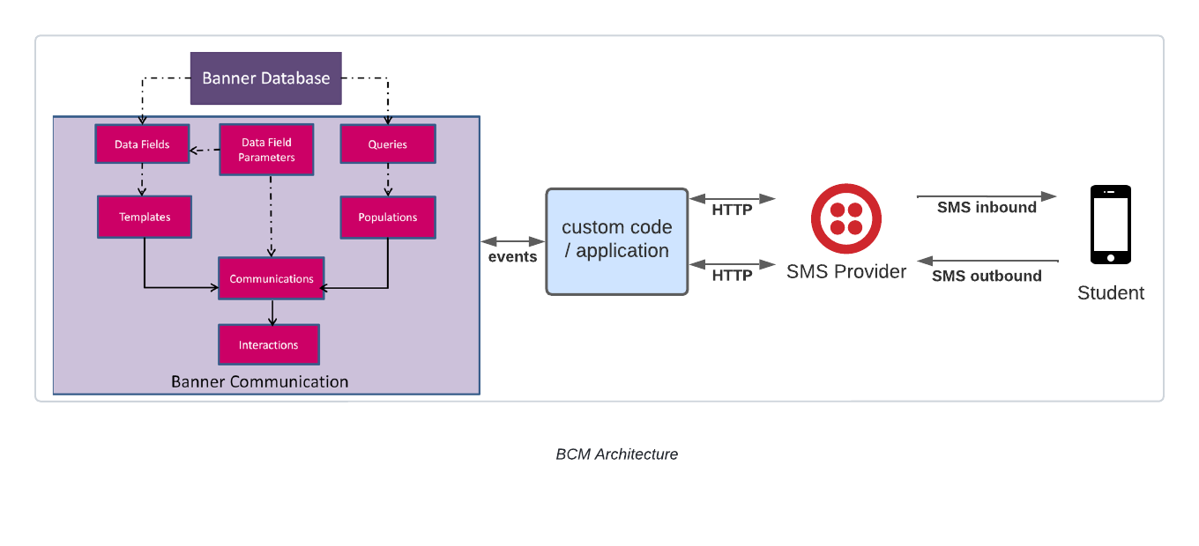
Banner Communication Management Architecture

Slide 10
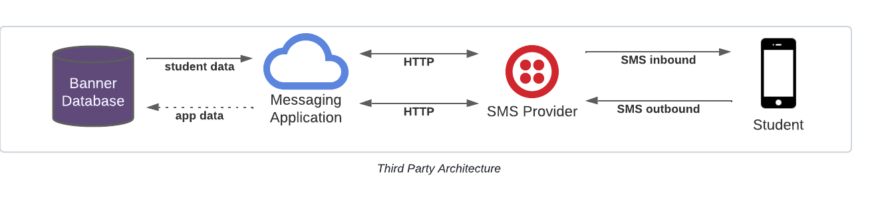
Third Party Architecture

Slide 11


Providers and Features
Providers
  cloud-based, SaaS
  CRM-like approach
Features
  autoreplies (keywords)
  phone number validation
  scheduled messages
  opt-in/opt-out
  single sign-on for staff users

Slide 12
Banner integration
"We can integrate with any system"
  institution responsible for defining, supplying data
  data quality is critical
batch file transfer
APIs

Slide 13
Governance
Communication policy
  don't make specific to a single application
  establish a protocol to handle exceptions
Who administers the system and its use?
Who ensures compliance with policy?

Slide 14
FAQ
Can we use a university phone #? How many numbers?
What about mass/batch texts?
MMS?
The vendor has a mobile app. Do students need it?

Slide 15
Strategies and Recommendations
recognize distinction between email and text
establish metrics… and actually track them!
form a task force or committee to ensure all stakeholders represented
establish use cases and requirements before the sales pitch
create and evolve policy as you go

Slide 16
Questions and Discussion

