Slide 1
MBUG 2022
Session Title: Streamlining the Class Cancellation Process
Presented By: Mikhail Collins and Kelvin D. Davis
Institution: Delta State University
September 12, 2022

Slide 2
Session Rules of Etiquette
Please turn off your cell phone
If you must leave the session early, please do so discreetly
Please avoid side conversation during the session

Slide 3
What is the Class Cancellation Process?
The purpose of the Class Cancellation Process (formerly and commonly known as the purge process) is to ensure satisfactory payment or financial clearance for all classes provided by the college is made by the payment deadline.
When students are not financially cleared by the payment deadline, they are removed from the courses due to non-payment.
Satisfactory payment or financial clearance includes but is not limited to enrolling in the University’s deferred payment plan, a zero balance or financial aid award exceeding the semester charges.

Slide 4
Common Challenges and Problems With the Class Cancellation Process
Push back from Administration
Difficulty getting out the communication
Returning students often do not handle their business
No clear or specific date
Poor advertisement
Isolated process (only one department involved)

Slide 5
DSU restructured its class cancellation process and implemented a comprehensive plan for Fall 2015 that was similar to the plan adopted at the University of Arkansas at Little Rock.

Slide 6
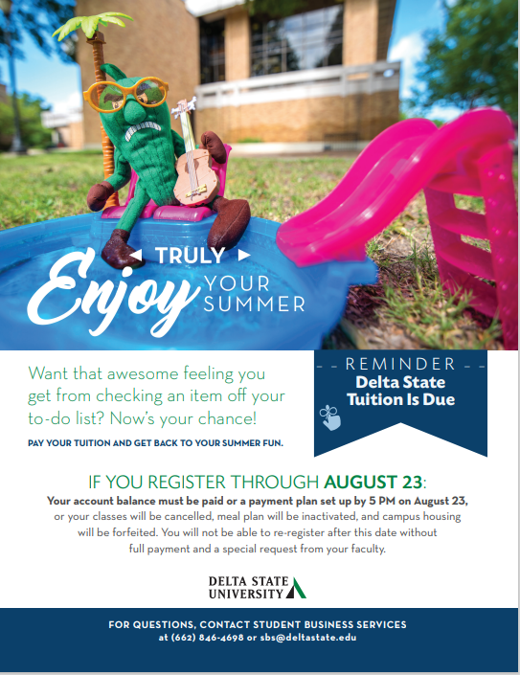
Communication Plan
Personalized Postcard
Personal “Due Now” Letter
Payment & Registration Guide
Orientation
E-Bills
Webpage Announcement
Text Messaging
Email Campus Stakeholders

Slide 8
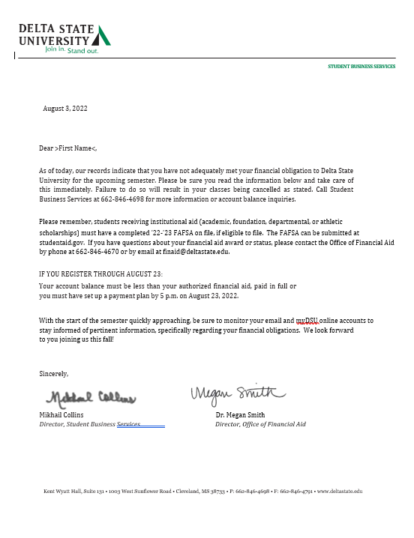

Slide 9
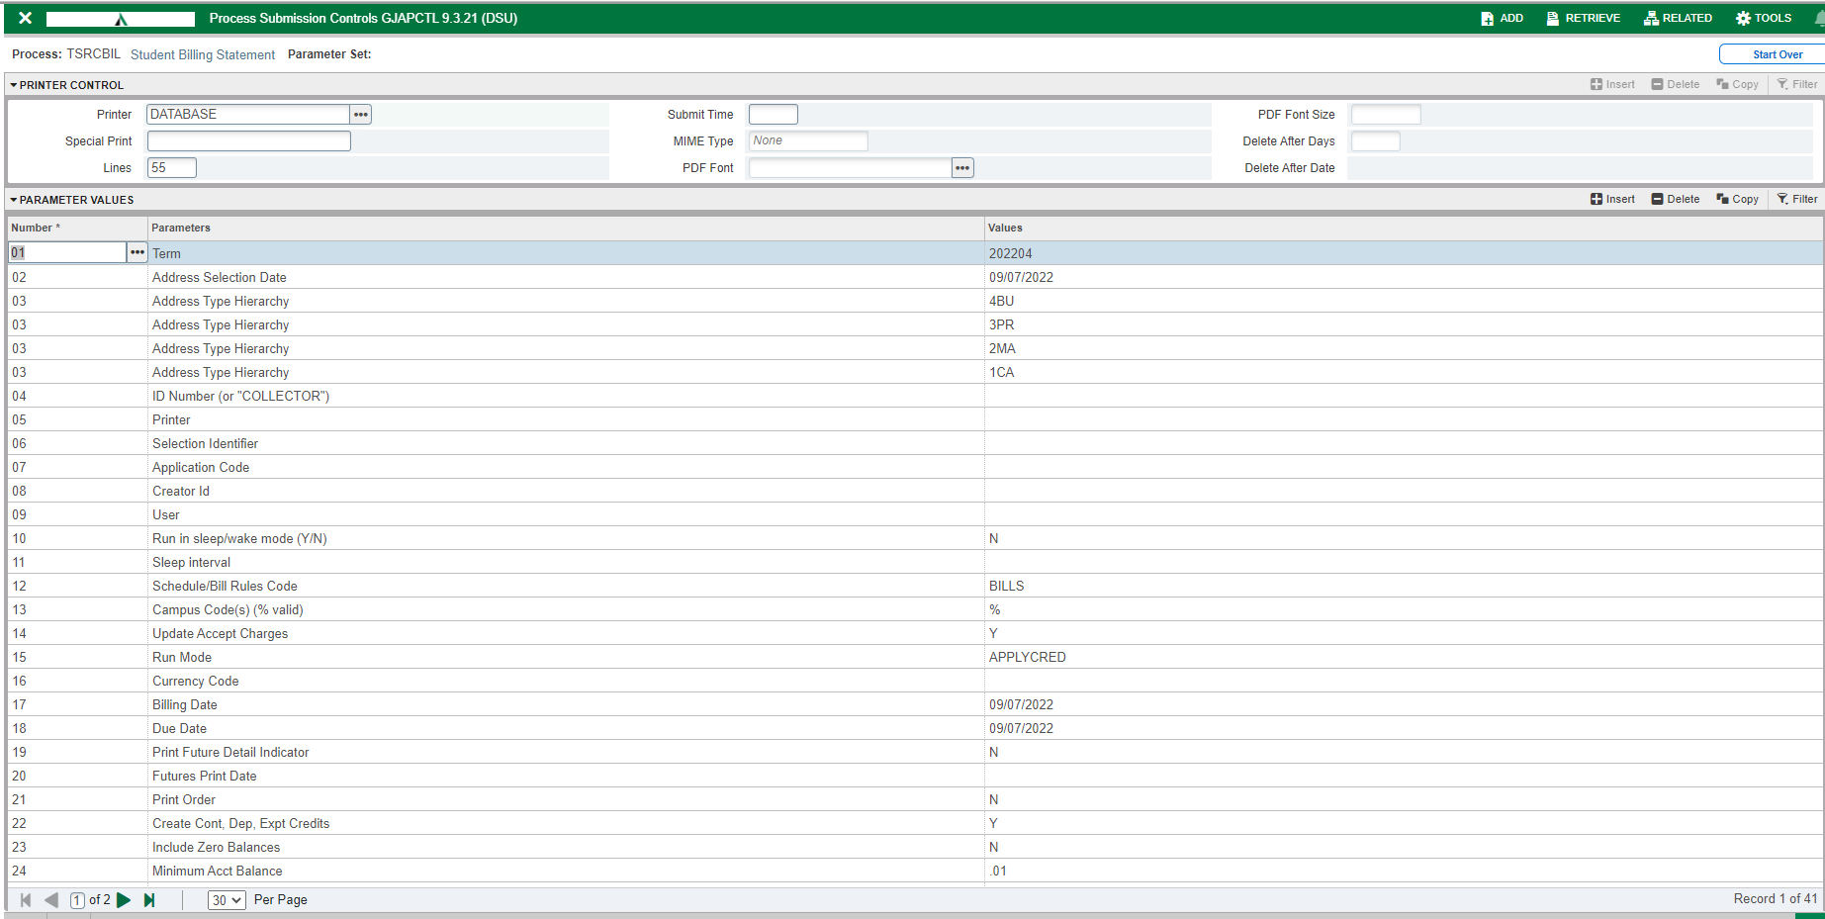
Generating Class Cancellation Listing
TSRCBIL – apply waivers/exemptions

Slide 10
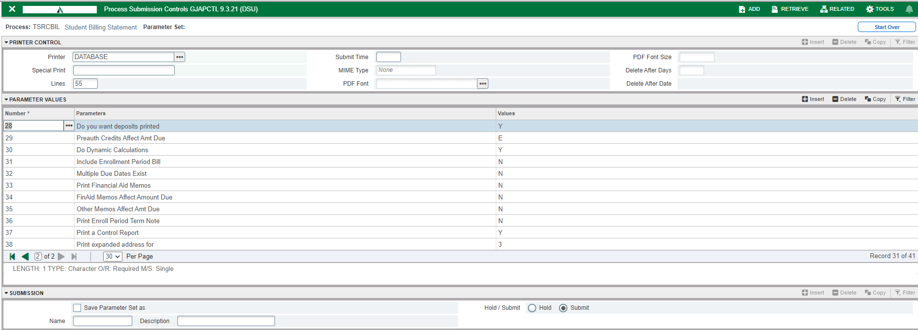
Generating Class Cancellation Listing
TSRCBIL – apply waivers/exemptions (continued)

Slide 11
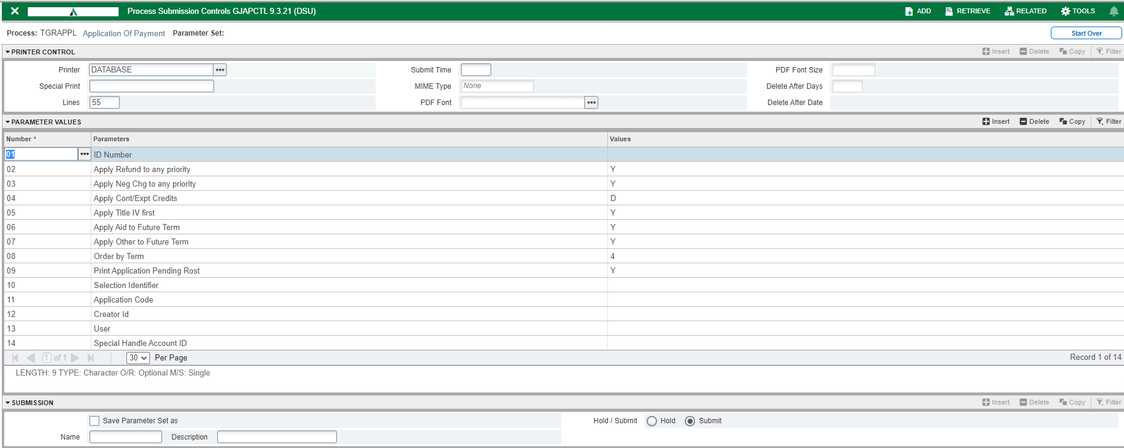
Generating Class Cancellation Listing
TGRAPPL – Application of Payment

Slide 12
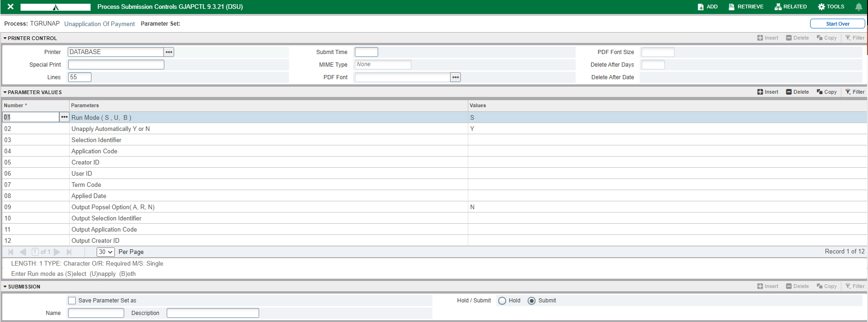
Generating Class Cancellation Listing
TGRUNAP – Unapplication of Payment

Slide 13
Generating Class Cancellation Listing
TGRAPPL – Application of Payment

Slide 14
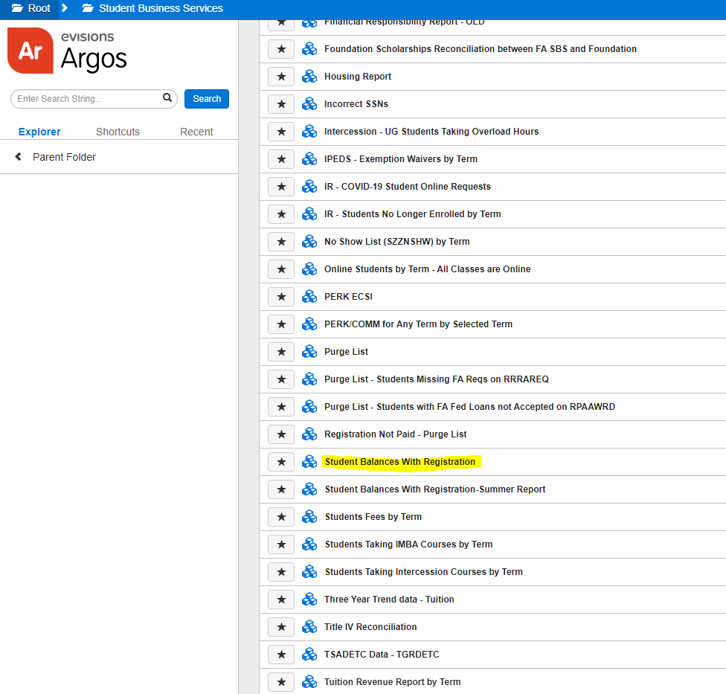
Generating Class Cancellation Listing
Argos Report - Student Balances with Registration

Slide 15
Generating the Class Cancellation Listing
Argos Report - Student Balances with Registration

Slide 16
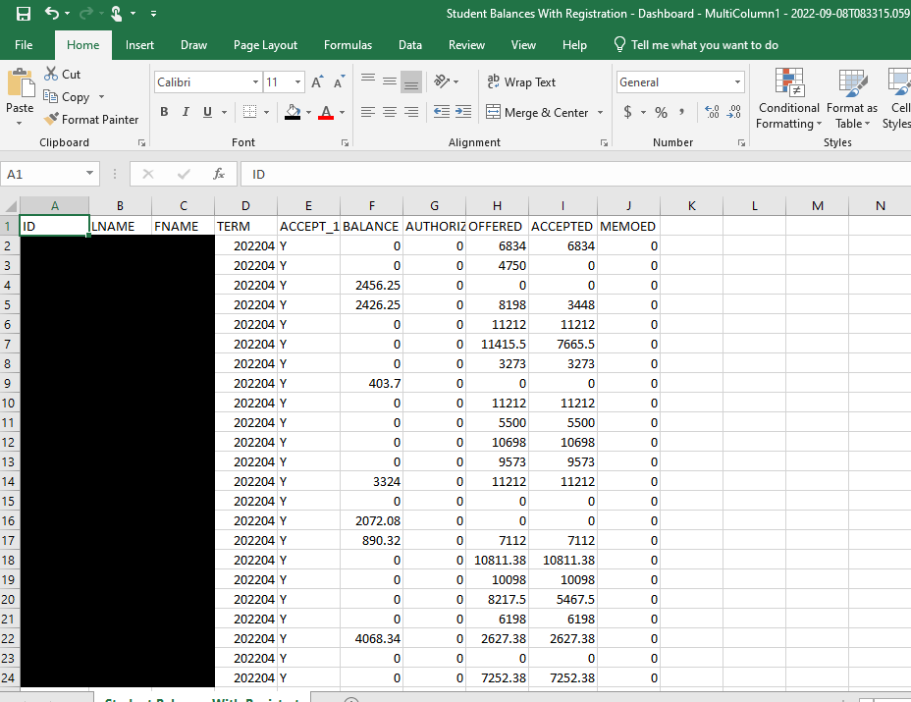
Generating the Class Cancellation Listing
Argos Report - Student Balances with Registration (continued)

Slide 17
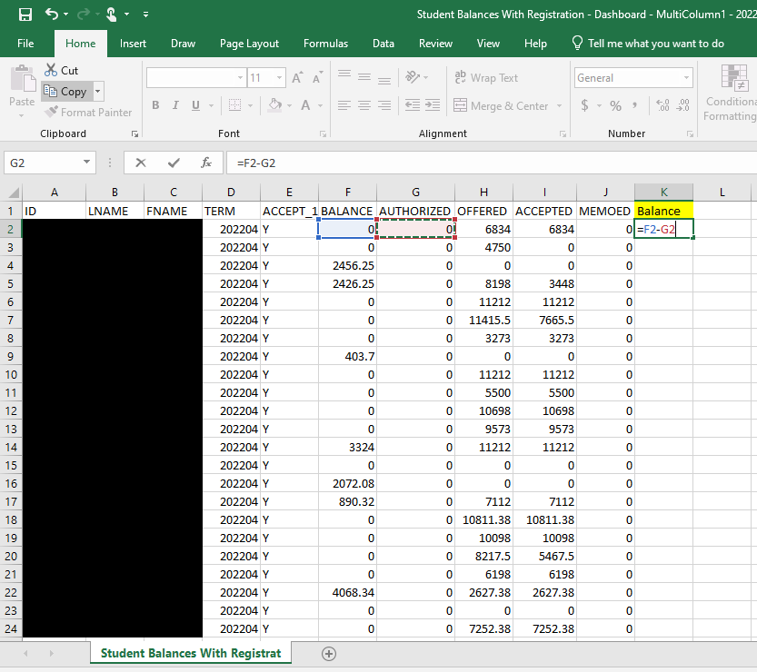
Generating the Class Cancellation Listing
Argos Report - Student Balances with Registration (continued)

Slide 18
Generating the Class Cancellation Listing
Argos Report - Student Balances with Registration (continued)

Slide 19
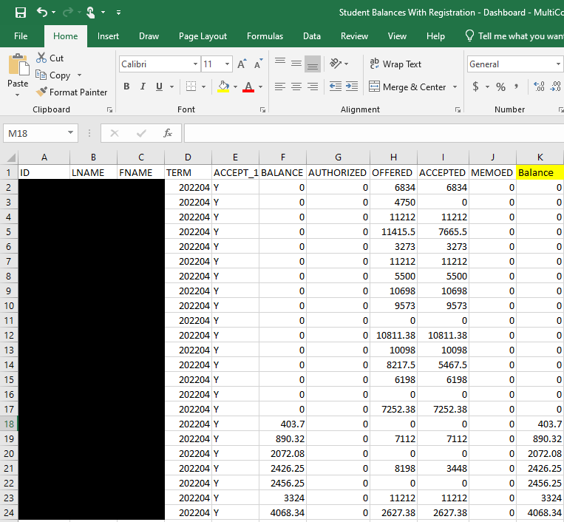
Generating the Class Cancellation Listing
Argos Report - Student Balances with Registration (continued)

Slide 20
Generating the Class Cancellation Listing
(After OIT cleans up list) Argos Report – Purge List
Send daily preliminary list to faculty/staff stakeholders

Slide 21
Final Class Cancellation
Run Argos Reports for contact list (Purge List), cancelled/saved list (Student Balances with Registration) and Course Listing (Registration Not Paid – Purge List)

Slide 22
Final Class Cancellation
SFRRNOP (Parameter 2 – N for report only, Y to delete registration and back out charges)

Slide 23
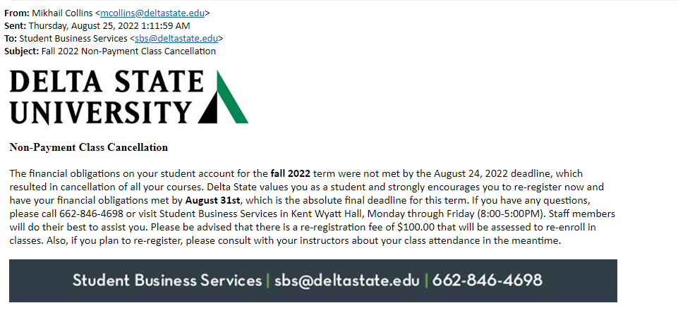
Final Class Cancellation
Notify dropped students of final class cancellation via email

Slide 24
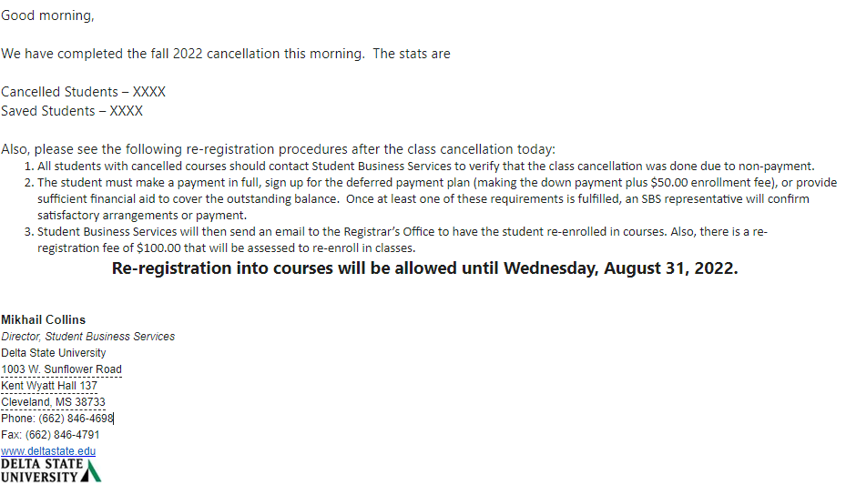
Final Class Cancellation
Notify key faculty/staff of final class cancellation via email

Slide 25
Final Class Cancellation
Notify key faculty/staff of final class cancellation via email

Slide 26
Questions, Comments or Discussion?

Slide 27
Thank You
Mikhail Collins
Delta State University
Director, Student Business Services
mcollins@deltastate.edu
Kelvin D. Davis
Delta State University
Director, Financial Reporting/University Liaison to Food Service & Bookstore
kddavis@deltastate.edu

