Slide 1
MBUG 2022
Session Title: Ellucian CRM Recruit
Presented By: Georgia Ryle
Institution: Delta State University
September 12, 2022

Slide 2
Session Rules of Etiquette
Please turn off your cell phone
If you must leave the session early, please do so discreetly
Please avoid side conversation during the session

Slide 3
Ellucian CRM Recruit
Ellucian CRM Recruit (Recruit) is software that helps create and foster relationships with prospective students.
From an inquiry to admission, CRM Recruit tracks the student throughout the recruiting life cycle.
Recruit can be used for collecting names and information about prospective students, communicating with prospective students, submitting applications, and admitting students.
This presentation is to go through Recruit to show some of the features of Recruit.

Slide 4
Features of Baseline Recruit
Dashboards
Create Account
Application
Workflows
Reports
Communications
Integration with Banner and Banner Document Management (BDM)

Slide 5
Baseline Dashboards
Recruitment Home – shows tasks due
3 Records – Person, Opportunity, Application
Communication Plans – shows active/suspended
Imports – used to import names, test scores, applications, etc.
Operations Home – shows applications
Travel & Events Home – shows upcoming events

Slide 6
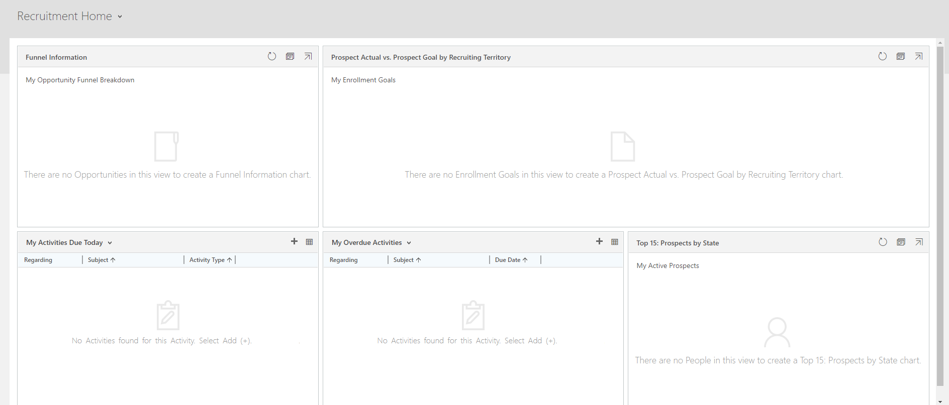
Recruitment Home Dashboard

Slide 7
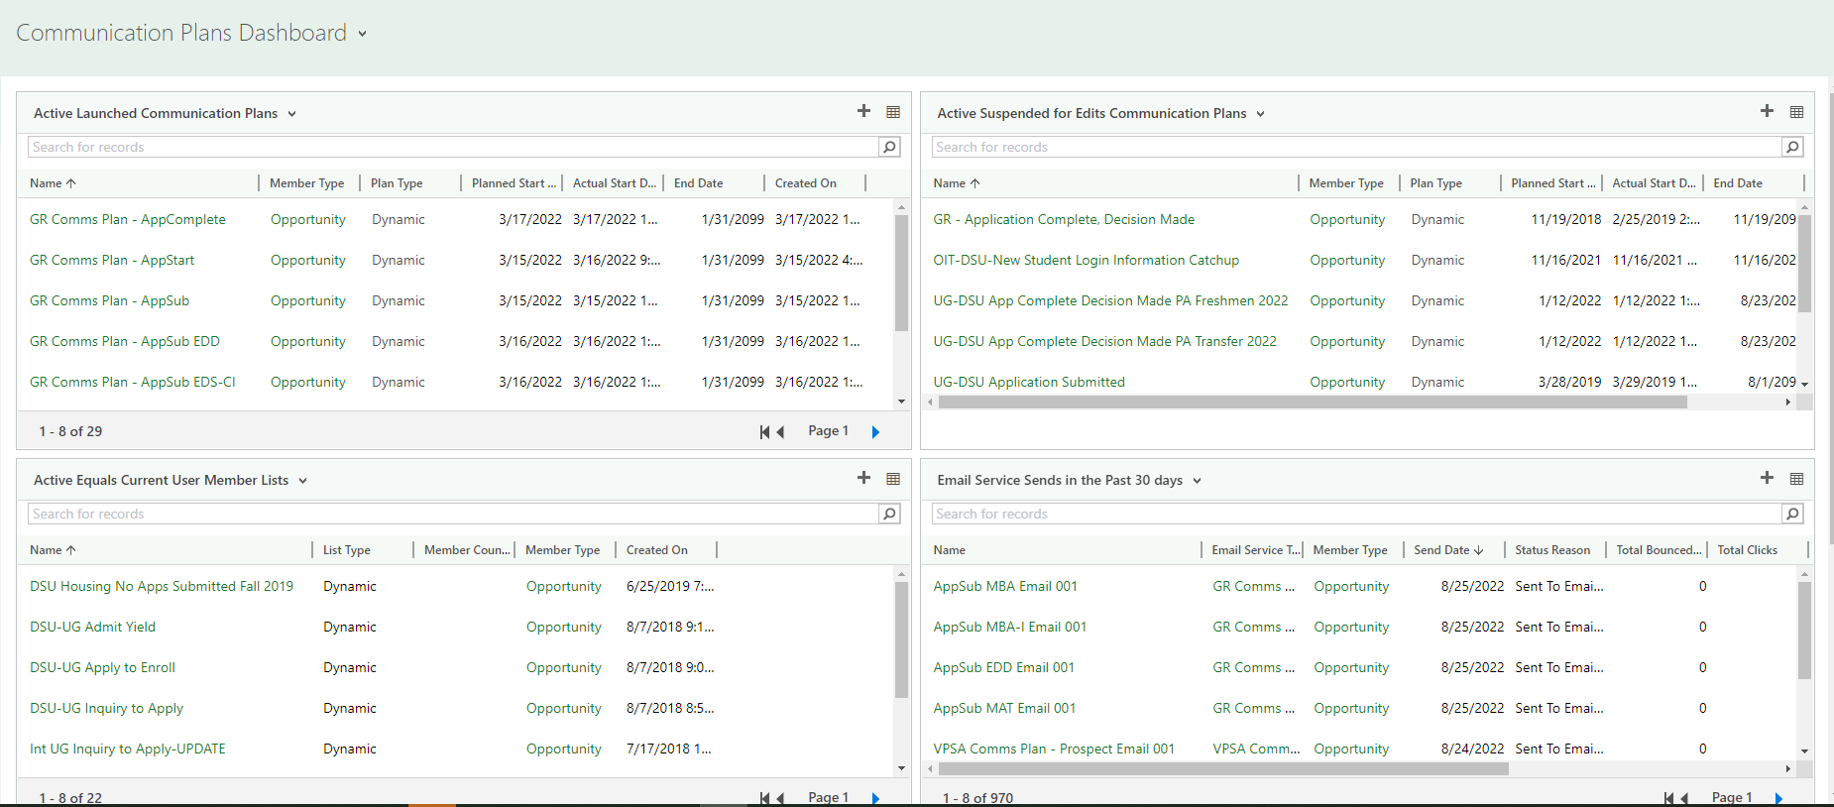
Communication Plans

Slide 8
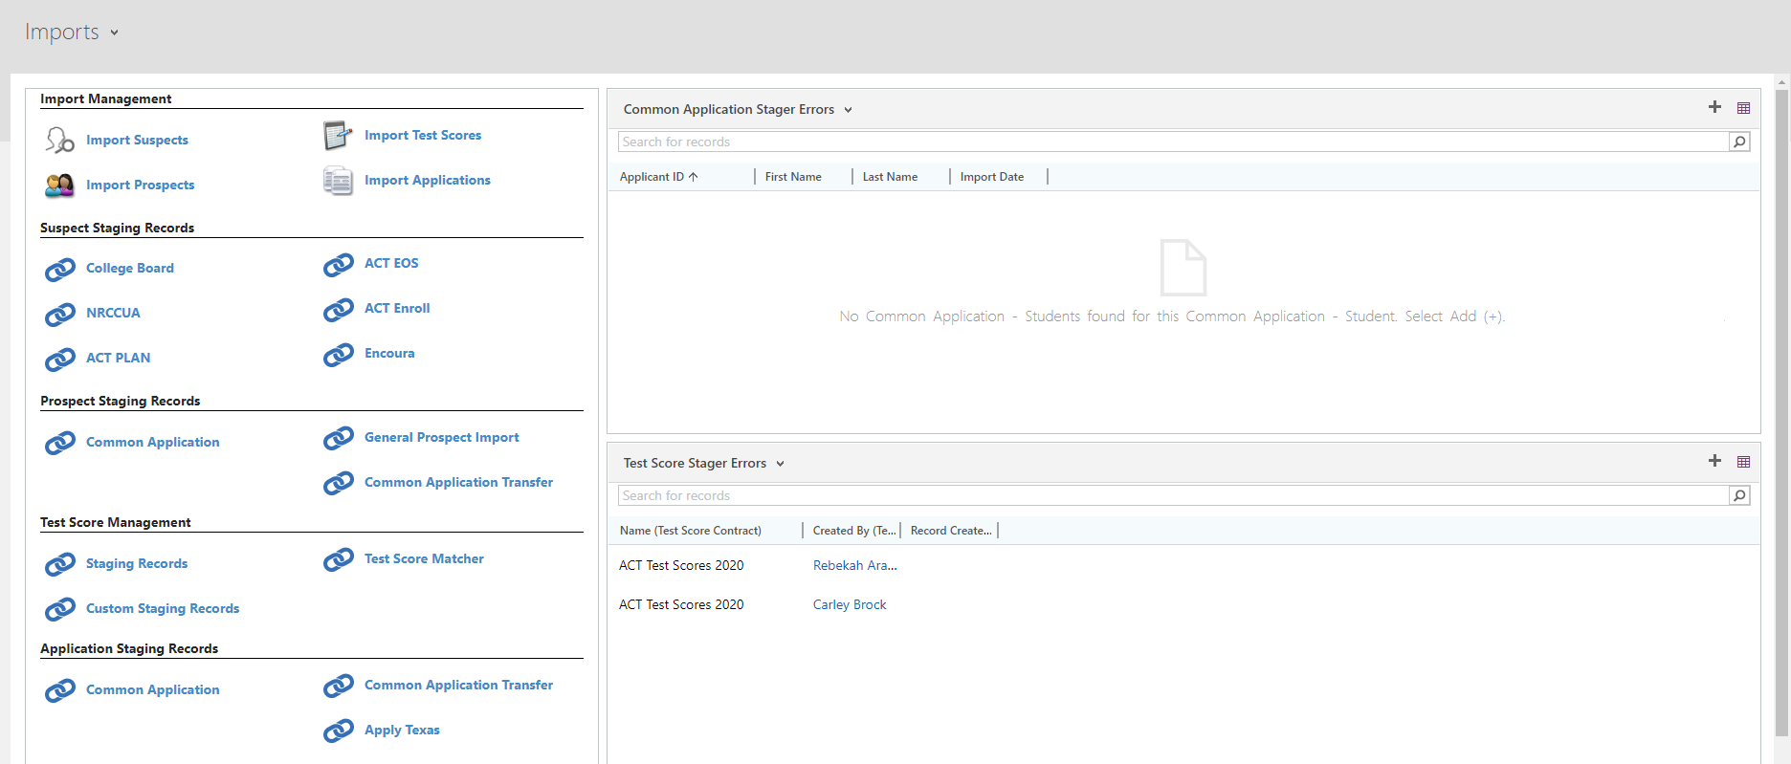
Imports

Slide 9
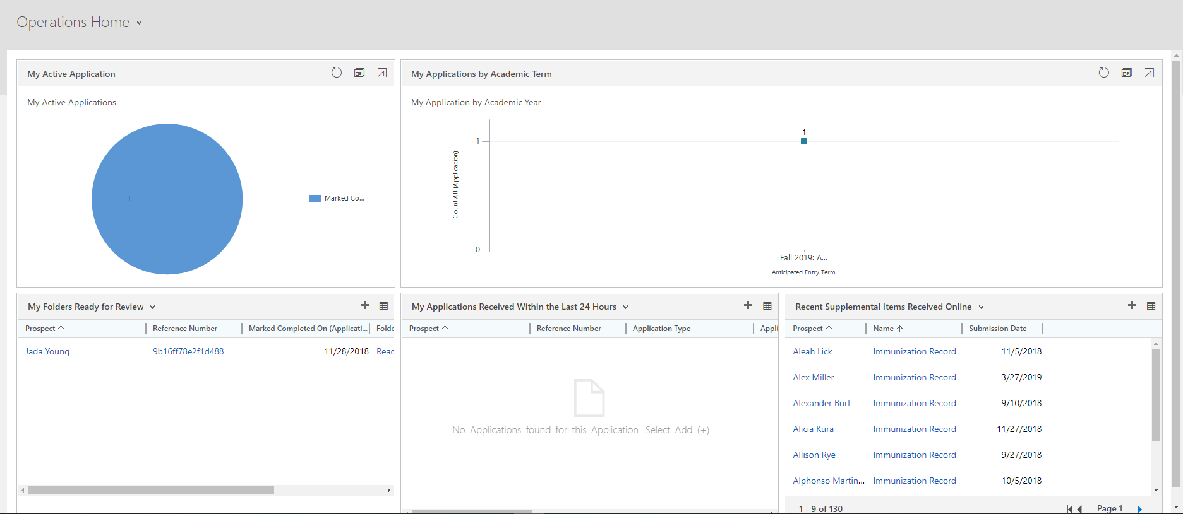
Operations Home

Slide 10
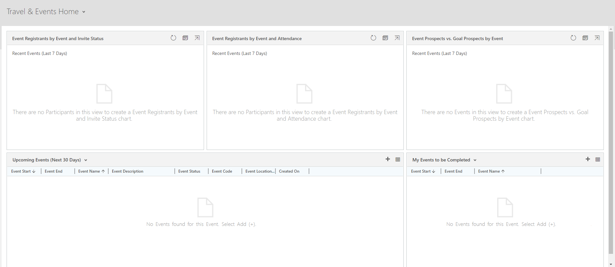
Travel & Events Home

Slide 11
Baseline Create Account
Baseline Create Account
Has everything needed to create an account with a password
Name
Email address
Home Phone, Cell Phone
Address
Entry Term
Academic Level
Academic Program
Password

Slide 12
Baseline Application
Baseline Community College Application
(joan@test.edu)
Baseline Undergraduate Application

Slide 13
Baseline Workflows
These workflows run in the background to complete common tasks such as
Converting an imported prospect into a Person Record and Opportunity Record
Populating fields after any type of import
Creating logs
Merging duplicate records
Many more

Slide 14
Baseline Reports
Active People
Active Opportunities (Terms and Programs)
Active Applications
Active Academic Programs
Active Recruiting Territories
Active Users
Many more

Slide 15
Integration with Banner & BDM
The integration between Recruit and Banner allows them to send data back and forth
An application is sent to Banner from Recruit
Banner returns the ERP (student) ID
An admission decision is made in Banner.
Banner returns the admission decision and the admission date
The integration between Recruit and BDM allows Recruit to send documents from Recruit to BDM without having to submit documents manually to both

Slide 16
Features of Customized Recruit
Custom Create Account
Custom Application
Custom Workflows (processes) to auto-populate fields or do tasks in the background
Custom Reports through Advanced Finds
Custom Dashboards
Custom Communication Plans
Ad Hoc Reports and Communications
Enrollment Goals
Third-Party Integration

Slide 17
Custom Create Account
Custom Undergraduate Create Account Link
Custom Graduate Create Account Link
Custom International Undergraduate Create Account Link

Slide 18
Custom Application
Custom Undergraduate Application
Custom Graduate Application
Custom International Undergraduate Application

Slide 19
Custom Workflows
Populate Admit Type (Student Type in Banner)
Populate Decision Plan (Admit Type in Banner)
Assign a Recruiter
Assign a Recruiting Territory
Add Supplemental Items (Checklist in Banner)
Clear fields that are no longer needed
Populate fields that are new
Many more

Slide 20
Custom Reports through Advanced Finds
Information for Director of Admissions
Reports for Stages of Applications
Reports for Communication Plans
Reports for Freshmen
Reports for Transfers
Reports for Specific Academic Programs
Many more

Slide 21
Custom Dashboards
System – available to everyone or by security roles
Graduate Active Applications
International Graduate Active Applications
International Undergraduate Active Applications
DSU Communications Home
Undergraduate Active Applications
You can make your own personal custom dashboards just for yourself

Slide 22
Custom Communication Plans
Use Communication Plans to send a series of emails and activities such as phone calls or texts.
Can be created for
Each Academic Level
Each Academic Program
Each Admit Type (Student Type in Banner – Freshmen, Transfers, Graduates, etc)
Each Application Stage (after creating an account, started, submitted, admitted, etc)
Many more

Slide 23
Ad Hoc Reports and Communications
Finding an individual person, opportunity, or application
Finding how many have applied for a particular academic program for a specific term
Finding how many people have registered for an event
Send individual text messages or emails

Slide 24
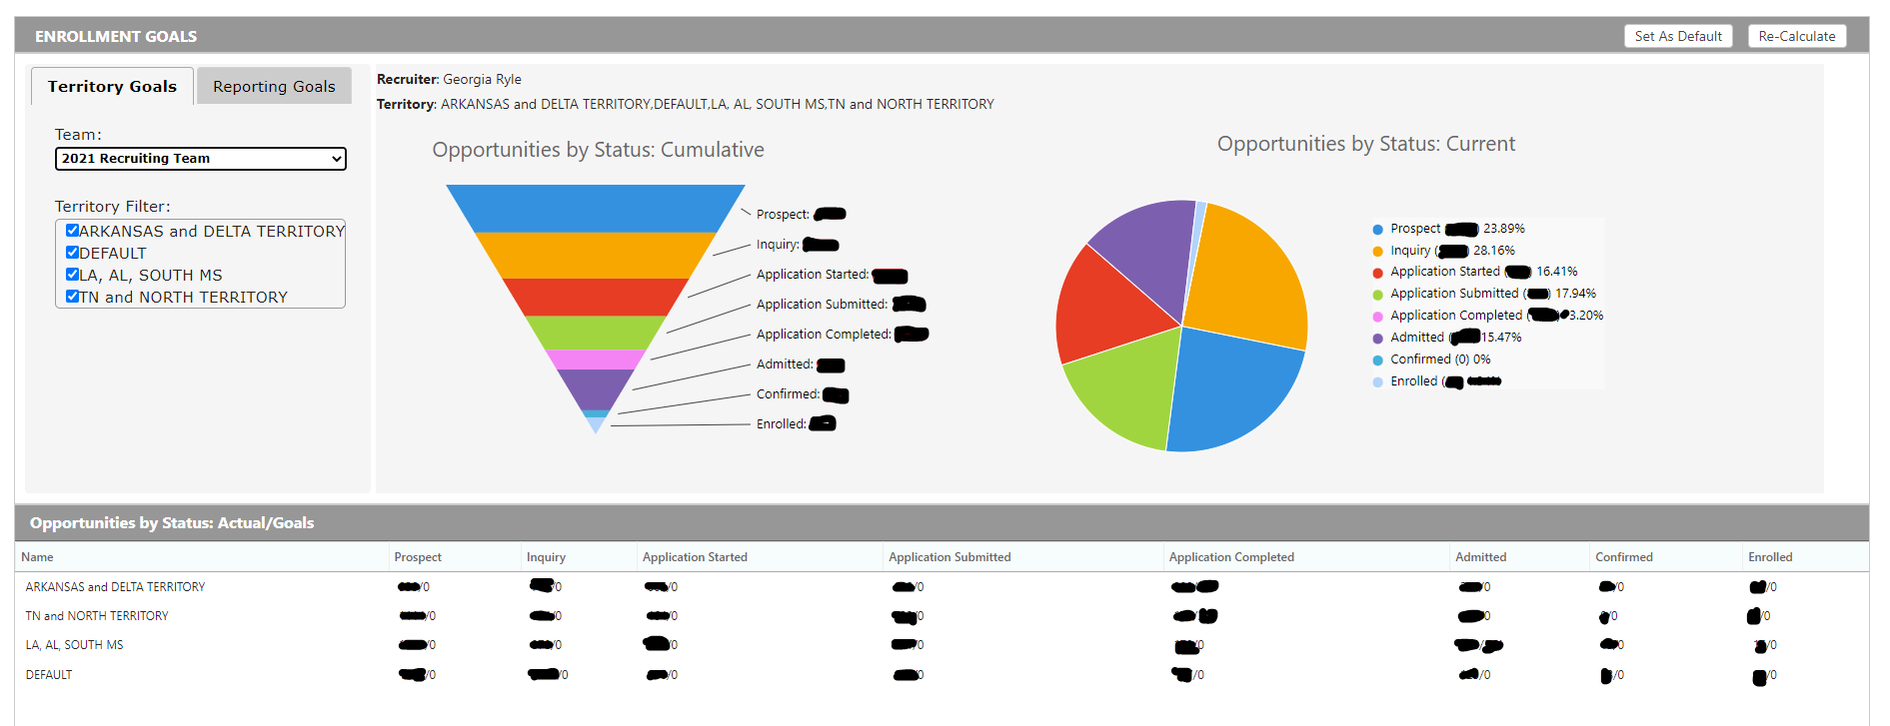
Enrollment Goals

Slide 25
Third-Party Integration Examples
Twilio for text messaging
Sparkpost for bulk emailing
EventBrite for events
Touchnet for application payments

Slide 26
Questions & Answers Time
Q & A

