Slide 1
BANNER COMMUNICATION MANAGEMENT
Version 9.7

Slide 2
SIG Introduction
^{Industry Commitment} SIG was established in 1987 serving higher education with IT initiatives that enhance services for students, faculty, staff and alumni.
^{Ellucian® Partner} SIG is one of the largest privately held higher education consulting firms in the U.S., and we have been a long-standing partner with Ellucian for many years.
^{More than}
¹⁰⁰
^{People}
^{More than}
³⁴
^{Years Serving Higher Education}
^{Consulting Continuity} Powered by more than 100 professionals, with an average tenure of 9.5 years, SIG can provide consulting continuity to keep your goals on task.
^{Agility to Respond} SIG provides a full lifecycle of services from strategy through managed services, and our ability to move quickly is what we do best. We can respond to uncertainty with flexibility as new opportunities arise.
Notes:
Today’s webinar is being presented by “Strata Information Group”.
SIG has been in business for more than 34 years supporting transformative change in the higher education landscape. We help colleges and universities leverage the full potential of their IT ecosystems to offer digital experiences that support student engagement and success, fosters administrative productivity and efficiency, and facilitates a culture of data informed decision-making.
During our tenure, SIG has provided services to over 500 colleges in more than 38 states spanning 5 countries

Slide 3
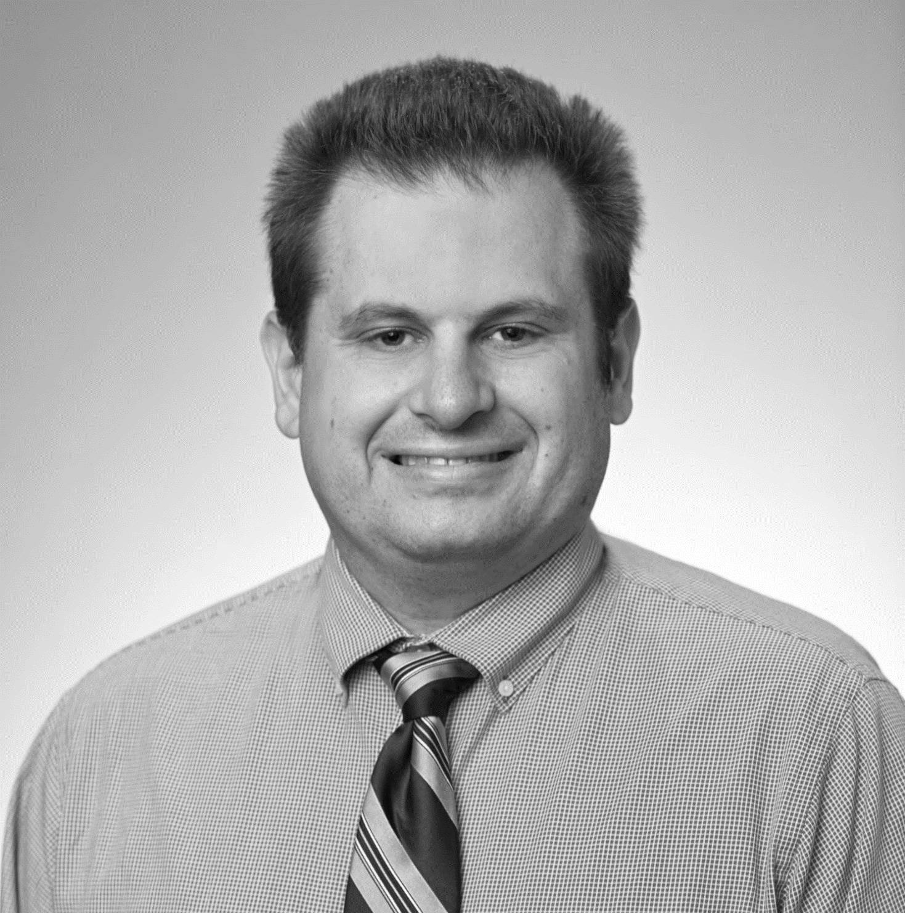
Presenter
Brian Regan
Senior Consultant
Specializes in CRM process implementation and management
Focuses on business intelligence and analytics to enhance business processes
Notes:
I’d like to introduce today’s presenter, Brian Regan.
Brian is dedicated to client strategic goals using business intelligence and aspects of data collection including warehousing, analytics, dashboards, performance management, and data cleanliness to enhance business processes. . His technical expertise includes CRM, process management, recruitment, admission policies, document imaging, and much more.
At this time, I’m going to hand the floor over to Brian to get us started….

Slide 4
What is banner communication Management (bcm)?
ACCESS Setup
AGENDA
Template Organization
Population Selection
Sending Messages
Triggers
Recurring Communications

Slide 5
BCM BACKGROUND:
What is it and what do I need to know?
01

Slide 6
Banner Communication Management
01
02
03
Communications to printer, email, SMS, and mobile apps
One-off in nature
Scheduled for a future date or recurring
04
05
Tracking capabilities
Tracks date & time, department, sender, communication type
Has manual interactions
Notes:
BCM is not a full CRM: for example there is no campaign system or workflow

Slide 7
General Uses for BCM
Admissions Letters
Missing Item letters (Admissions and Fin Aid)
Fin Aid Award Letters
Registration Communications
ACA Communications
Time and Leave Reminders
Advancement Communications
Bursar Communications
Event Management
Notes:
Anyone that has a Person Record (SPAIDEN) and e-mail address in Banner could have a message sent to them.

Slide 8
What Can BCM Replace?
Letter-generation (GLRLETR)
And all associated forms
Email for Student (SOAMAIL)
Email for Fin Aid (ROAMAIL)
Pop Sels for communications only
GLRSLCT
GLAEXTR
Notes:
BCM is not a full CRM: it can’t read an e-mail reply or track that someone replied

Slide 9
ACCESS SETUP:
Main Configuration Tasks
02
Notes:
This is a very high-level overview of how-to setup users.

Slide 10
Technical Pre-Requisites
01
Always check installation guide for requirements!
04
Web Application Server
Tomcat or WebLogic
02
05
DBEU
ESM (optional)
03
Single Sign On
06
Banner general 8.11.2 and Database Upgrade 9.18 for BCM 9.6
NOTE: BCM is a Prerequisite for Action Item Processing (AIP) and some Banner 9 HR functionality.
Notes:
In general, the Requirements are typical of all Banner 9 Self Service applications. This one is not necessarily a self service application, but it has the same technical architecture.

Slide 11
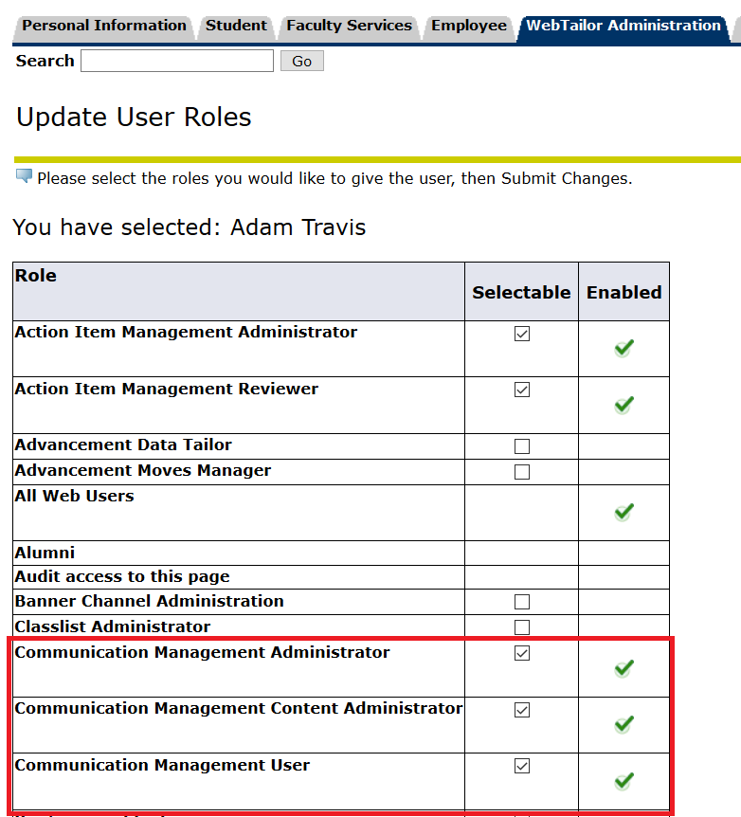
Levels of Access
Communication User
Can view and send communications.
Communication Content Administrator
Can create content and send.
Communication Administrator
All features and administration.
Notes:
These are configured in Banner 8 Web Tailor user roles.

Slide 12
BANNER SECURITY
GSASECR Seed Data
Delivered objects
CMQUERY
CMQUERYEXECUTE
Delivered Oracle roles
BAN_DEFAULT_CMQUERY_M
BAN_DEFAULT_CMQUERYEXECUTE_M
Delivered user class
BAN_CMQUERY_C
GSASECR config
Needed user class
USR_CMQUERYEXECUTE_C
Or similar appropriate name
Create Custom Oracle Role by copying BAN_DEFAULT_CMQUERYEXECUTE_M and then modifying grants.
Details in BCM Configuration and Administration Guide
ALWAYS SYNCHRONIZE after any change!
Notes:
These roles control when the user can query from within Banner. You can assign BAN_DEFAULT_M to allow access to most baseline tables.

Slide 13
Communication User
View folders
Run queries
Add new populations
View templates
View and test data fields
View data field Parameters
Create messages

Slide 14
Communication ContentAdmin
All permissions are user-specific:
View and create folders
Run queries and add new queries
Add/delete new populations
View/copy/create and publish templates
View/create and test data fields
View/create data field parameters
Create messages

Slide 15
Communication Admin
All permissions global:
View and create folders
Run queries and add new queries
Add/delete new populations
View/copy/create and publish templates
View/create and test data fields
View/create data field parameters
Create messages
Create organizations
See error log and communication log

Slide 16
Why Can’t I Create Something?
Ability to query the tables is limited to the tables the Banner user can access. If missing a table, the SQL will fail even if the SQL is valid.
Notes:
This may also cause the Validate Button to be grayed out.
Security setup did change in BCM 9.3. This advice doesn’t apply to the earliest releases, and I don’t recommend using anything earlier than 9.5.

Slide 17
Organization Creation
Root Organization
Create Sub Organizations
HR
Admissions
Registrar
Configure 2 emails per organization and might want 4 if test and prod are different
Notes:
Root organization is not typically used to send, but contains configurations like SMTP server settings and Mobile App end point URL.
Sub Organizations control the From address of an e-mail. This means every separate sending address needs an organization. If the Registrar has an office e-mail, but also a separate one for graduation and another one for transcript requests, that would be 3 total.
Each one has a Sender (or From Address) which will receive any bounces; and a Reply-To address. These can be the same.

Slide 18
POPULATION SELECTION:
Where do we find the people?
03

Slide 19
Queries
SQL Queries
Paste SQL directly into the editor
Can used any table (depending on security)
Complex queries without the headache of Pop Sels
Funky techs required and possible IT involvement
The rules!
Must select PIDM as only column.
No semi-colon at end.
Cannot use anything but a select statement (No Drop, Execute, Insert, Create, Order by, etc.)
Use Select Distinct to be safe
Notes:
Queries can have versions, and Populations can be tied to a version.

Slide 20
Populations
MANUAL SELECTION
Search for IDs
Import FROM A THIRD-PARTY SOURCE
For example, an Argos or Cognos report spreadsheet
Must have a Banner ID column
BANNER Admin POPSELS
Can be used, but not dynamically refreshed.
Notes:
You can search by name in a manual selection, but it doesn’t work they way you might expect.
Import from Excel spreadsheet or CSV
If you have Pop Sels in Banner that do what you need, you can keep using them and don’t have to reinvent the wheel.

Slide 21
TEMPLATES:
What should we say?
04

Slide 22
Templates
To and Subject are required
Full HTML Capabilities
EMAIL
LETTER (PDF)
Can set the margins.
MOBILE APP
SMS TEXT MESSAGE
Push Notifications to Ellucian Mobile Go or 3rd party compatible apps
Tools to compose SMS with variables. Must have compatible SMS provider.
Can associate with GTVLETR code for GURMAIL
Notes:
Each template can only have one type. If you want to send and e-mail and a Mobile notification, you need two templates.
All types support variables. $ denotes a variable. If you want a $ to appear use \$.

Slide 23
Data Fields
Database fields are the equivalent of variables in the old letter-generation system. They are formatted items for things like the following:
Email
Address
Checklist items
Advisor Name
Create your own:
It is possible to create your own fields

Slide 24
Communications
Trigger-Based Communications
Exist for HR Time and Leave Reporting only.
Recurring Campaigns
Schedule in the following ways: Yearly, Monthly, Weekly, Daily, Hourly, Minutes, and Advanced (Cron).
Must enable Yearly, Hourly, Minutes, and Advanced in GUACONF, if desired.
Must select regenerate population list upon send.
Will send the same population repeatedly
Queries can check the BCM tables GCRGSIM (check the state of the campaign for the given pidm)

Slide 25
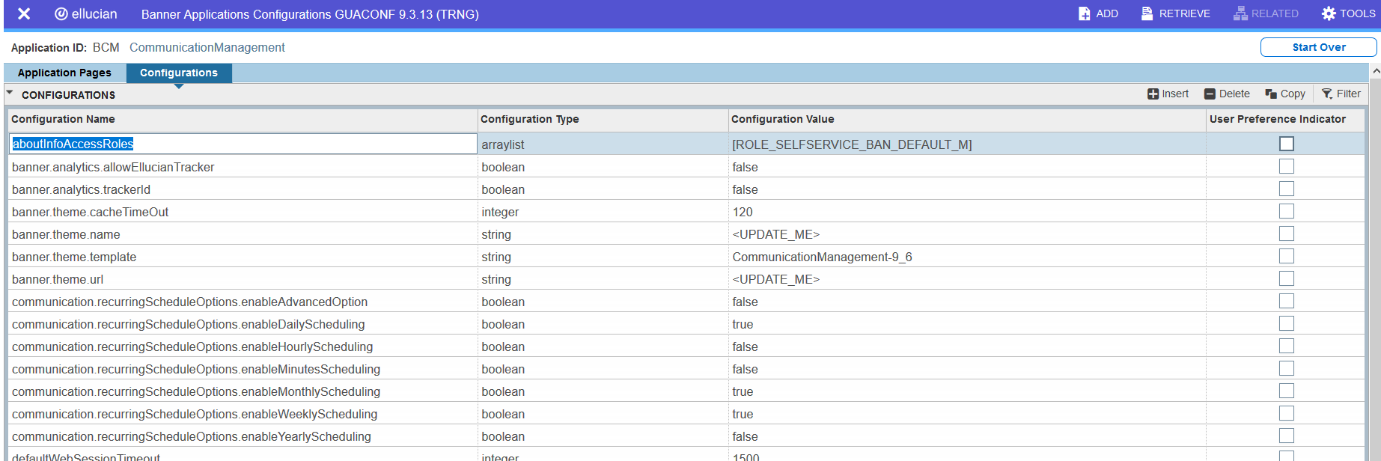
Recurring Schedule Settings (GUACONF)
Notes:
This slides shows default settings.

Slide 26
BCM BASELINE:
What is available now?
05

Slide 27
Ellucian Delivered Functionality
Ellucian delivers some seed data for you to use, including the following. All Ellucian-delivered pieces start with CM_.
This data cannot be deleted.
05
FOLDERS
56
DATA Fields
DATA FIELD PARAMETERS
19

Slide 28
Delivered Folders
CM_Financial_Aid
CM_General
CM_Human_Resources
CM_Student
CM_BACS –Bank Automated Clearing System
Folders institutions may want:
Admissions
Advancement
Advising
Can get even more specific:
Admissions Letters
Admissions Events
Advising Appointments

Slide 29
Sample of Delivered Data Fields
CM_Address_City
CM_Address_City_State_Zip
CM_Address_County
CM_Address_Nation
CM_Address_State
CM_Address_Street_Line1
CM_Address_Street_Line2
CM_Address_Street_Line3
CM_Address_Zip_Code
CM_Advisor_Primary
CM_Aid_Year_Description
CM_Application_Received_Date
CM_Banner_ID
CM_Current_Date
CM_Email_Address
CM_HR_Salutation_Name
CM_HR_Signature_Name
CM_HR_Time_Entry_Approval_Deadline
CM_First_Last_Name
CM_First_Name
CM_Holds
CM_Intro_First_Name_With_Salutation
CM_Last_Name
CM_Mailing_Address
CM_Name_Prefix
CM_Name_Suffix
CM_Parent1_First_Name
CM_Parent1_Last_Name
CM_Parent2_First_Name
CM_Parent2_Last_Name
CM_Pay_Year_ID_Number_Returned
CM_Person_Title
CM_Preferred_Email_Address
CM_Preferred_First_Name
CM_HR_Time_Entry_Return_Reason

Slide 30
Data Field Parameters
These are prompt options for communications for things like the following:
Term Code
Aid year
Holds as of a certain date
Address, mailing address, and email type
Address as of a certain date
Category Code (AR)
Job Suffix and Position Number
Pay Year, Pay ID, and Pay Number

Slide 31
.
SUMMARY
Great use for ad hoc communications
End user emails that can take the burden off IT
Easy to extend with SQL knowledge

Slide 32
QUESTIONS?
www.sigcorp.com
Notes:
We are now going to hand it over to Shannon to field any additional questions you may have, and I’ll do my best to answer. Shannon??

Slide 33
USING BCM
06
Notes:
ADAM

Slide 34
BONUS CONTENT:
Might not take time to cover this but wanted to put it in the slides!
*

