Slide 1
Cloud Services … Explained
Presented by:
Digi Edwards
Senior Vice President and Chief of Staff
July 20, 2022

Slide 2
Key Discussion Concepts
Cloud common terms and concepts
Three cloud models to consider
Private versus public cloud and which is best for your institution

Slide 3
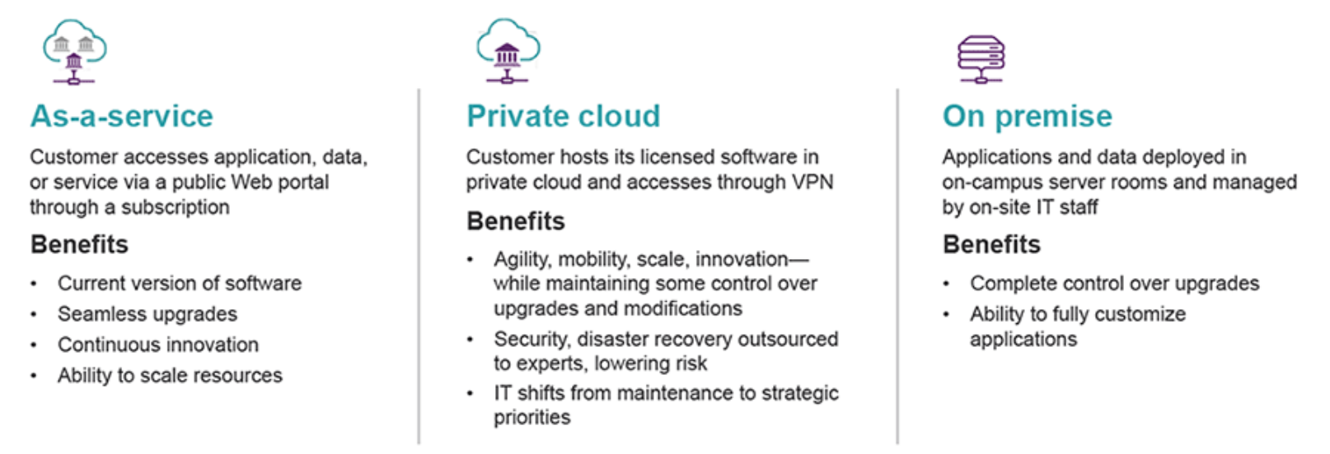
Cloud Options Explained

Slide 4
Cloud Models Explained
As-A-Service
Private Cloud
Hybrid
Notes:
As – A - Service

Slide 5
As-A-Service
Software hosted and maintained by vendor and delivered over the Internet via subscription

Slide 6
Private Cloud
For institutions looking to maintain a bit more control over their applications and data, there is private cloud.

Slide 7
Hybrid Cloud (Most Popular)
Institutions can take advantage of cloud where it makes sense for business (either SaaS or private cloud), while also keeping certain solutions on premise – in prep for add’l moves to cloud

Slide 8
Public Cloud
PUBLIC
The hardware—servers, storage, computing power—is owned and operated by your cloud provider and shared by multiple customers.
PRIVATE
The hardware—servers, storage, computing power—is dedicated entirely to one customer and hosted either on-site or in the cloud provider’s data center.

Slide 9
Public Cloud Offers
SINGLE-TENANT
MULTI-TENANT

Slide 10
Private Cloud Offers
Delivers the agility, scalability and efficiency of public cloud, but also provides greater levels of control and security for customers with strict data, regulation, and governance obligations.

Slide 11
Cloud Options Explained
“Lift and Shift” Cloud Services
Institution manages, maintains and runs 100% of their own ERP system on their own.
They purchase and maintain infrastructure and hardware. 100% of all responsibilities are on the client.
Ellucian has no responsibility or liability or SLA requirements.

Slide 12
Cloud Options Explained
“Lift and Shift” Cloud Services (cont’d)
This would more of an IaaS model.
Where an institution is just leveraging external Infrastructure (Ex. AWS Self Deploy).
This is a very risky model for many schools who choose to deploy in MCSFT/AWS/Google on their own.
This would require extensive Cloud skill sets and no ability to project future cost

Slide 13
Ellucian Cloud Options Explained
Managed Cloud
Allows institution to get ERP into a cloud deployment.
Ellucian manages the ERP system with some support from the client side.
Updates are not “automatic” but rather jointly scheduled.
Some customizations are still allowed and these are worked towards extensions to for a more SaaS-ready state.
This is an intermediate step of being in the cloud, run and managed by Ellucian, but not “True SaaS”.
The workload remains higher and typically the cost is higher than True SaaS as there is a lot more Ellucian labor involved in this intermediate deployment model. It is a good place to be, but not as ideal as SaaS.

Slide 14
Ellucian Cloud Options Explained
Full-SaaS
Proposed to new and Non-Ellucian clients exclusively.
This is the preferred and recommended approach for existing clients if they are able to retire customizations as part of the migration.
This is the “end state”. This is where every client wants to get to.

Slide 15
Ellucian Cloud Options Explained
Full-SaaS (cont’d)
100% SaaS run and managed by Ellucian. Updates are automatic and we deploy Banner SaaS at scale using additional AWS tooling.
Less work for the client and Ellucian. Ideal scenario. Banner becomes Ellucian’s responsibility.
Client sleeps easy at night

Slide 16
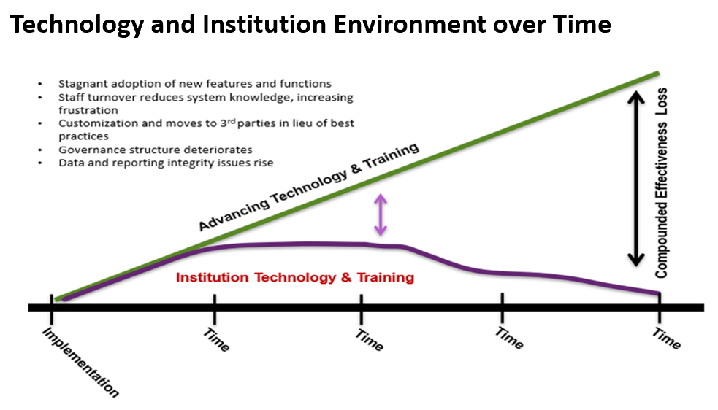
Decision Making Input

Slide 17
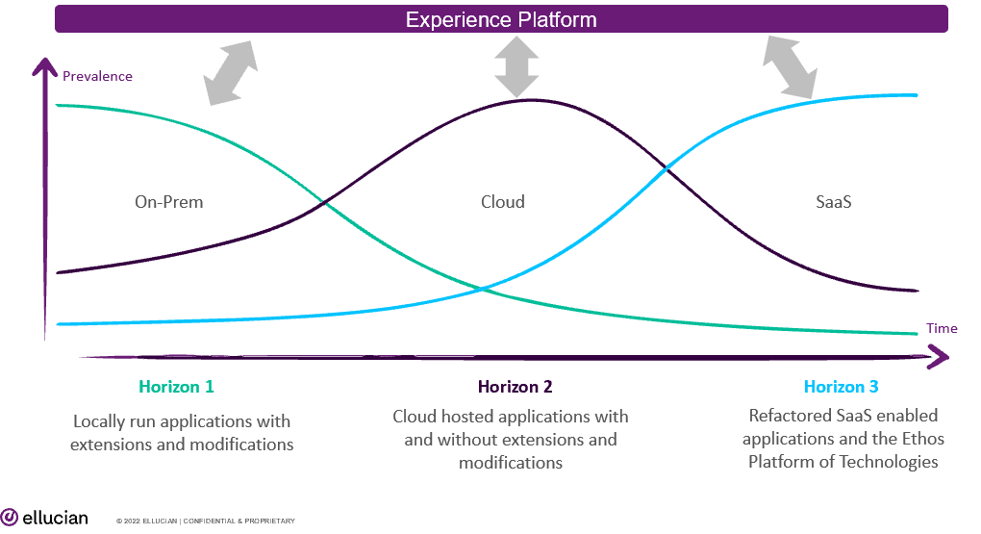
Ellucian Cloud as it Relates to Ellucian Experience - **Bonus Info

Slide 18
What’s Happening On Your Campus and Why?
Seeking Options???

Slide 19
Thank You for Your Time Digi Edwards, PMP, CMC (407) 314-9179 digi@4ucit.com

