Slide 1
MBUG 2019
Session Title: ROAR Application in Wildcat Web
Presented By: Leah Balli & Mary DeGraw
Institution: Pearl River Community College
September 10, 2019

Slide 2
Session Rules of Etiquette
Please turn off your cell phone
If you must leave the session early, please do so discreetly
Please avoid side conversation during the session

Slide 3
School Facts
1909, Pearl River College began as the state’s first county agricultural high school.
1924, the school became the first public two-year college in the state.
Total Enrollment: 4836*
Retention for First Time
Students: 66% FT, 35% PT*
*NCES.ed.gov website

Slide 4
What is ROAR?
Ready
Orient
Advise
Register
Outcome from QEP (2015)
Program is hosted/run by our “Office of Student Success”
3 Campuses
10 FT employees
80 -100 support faculty and staff
18 Full Sessions
2 Days of Mini Sessions
http://www.prcc.edu/qep
http://www.prcc.edu/roar

Slide 5
Current (New) Picture
Student registers online in Wildcat Web (Banner Student Self Service)
Registrations can be managed and viewed for Event Staff in Wildcat Web (Faculty Self Service)
Student receives reminder emails 5, 4, 3, 2, & 1 day out from their reservation through automation in ARGOS.
Reservations are moved into a Population Selection for coding Folders, Attendance, Etc.
Check-in is managed through ARGOS ROAR Dashboard.

Slide 6
ROAR Application (SSB)

Slide 7
ROAR Application (SSB) cont.

Slide 8
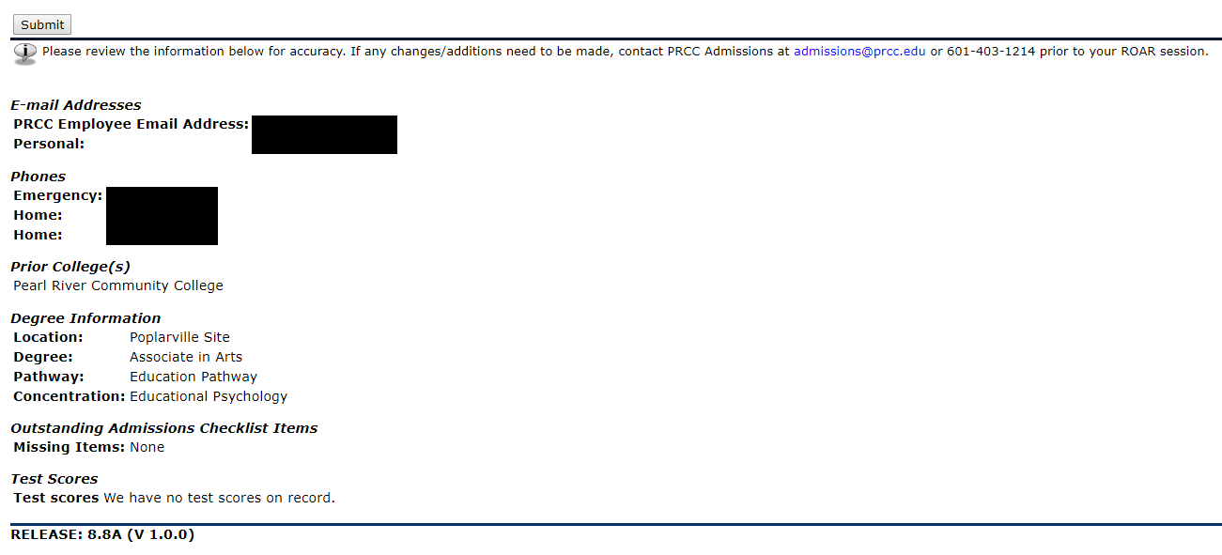
ROAR Application (SSB) cont.

Slide 9
ROAR Application (SSB) cont.

Slide 10
ROAR Registration (Faculty)

Slide 11
ROAR Registration (Faculty) cont.

Slide 12
ROAR Registration (Faculty) cont.

Slide 13
ROAR Registration (Faculty) cont.

Slide 14
SGASTDN ROAR Indicator

Slide 15
Argos Check-in Dashboard

Slide 16
Argos Check-in Dashboard cont.

Slide 17
Technical Summary
6 Custom Scripts (BZLKRSTA)
5 Custom Scripts (BZLKRSES)
2 Custom SSB Roles (Student & Faculty)
2 Custom Triggers to manage Student SSB role
3 Custom Tables
SZBRAPP
SZVCAMPUS
SZVRSES

Slide 18
Future Adjustments
Ability for Staff to Add & Drop reservation records. (put into place as an adjustment almost immediately after implementation)
Allow students to adjust their historical reservations.
Minimize more of the human efforts of processing the registrations, Population Selections, assigning advisors, etc.
Move ROAR Application to Page Builder.

Slide 19
Questions?
Leah Balli, Applications User Liasion @ Pearl River Community College
lballi@prcc.edu
Mary DeGraw, Director of Application Services @ Pearl River Community College
mdegraw@prcc.edu

