Slide 1
Cleaner Data
Cleaner Audits
Less Findings
More $$$
Presented to the Mississippi Banner Users Group
(MBUG)
September 9th, 2019
Tupelo, Mississippi

Slide 2
OVERVIEW
Research and Effectiveness, and Monitoring
o Key considerations
State law mandates us to Count and Audit enrollment
Reimbursement is based on enrollment and attendance
State law has strict definitions for who is In-State
Only In-State students can be reimbursed
except for ADN (nursing) students
Additional funds are provided for Career/Tech students
even more for some high cost CTE programs
Two types of credit data are reported
Audited – needed for reimbursement calculations
LifeTracks – all students even if disallowed for reimbursement

Slide 3
Assumptions
FY19 Appropriation $187,975,679
15% base $28,196,355
FY20 Appropriation $193,875,054
FY20 Available $165,678,699
Two Admissions Findings in Fall 2018, and zero in Summer 2018 and Spring 2019.
Attendance findings are automatically removed, as are the ‘excluded’ hours & students
Weights
1 for Academic & DE/DC & NDS
1 for Technical
1 for Career
PLUS
1.19 for ADN or
1.19 Allied Health
PLUS
0.75 VCC Host – crossed
0.25 VCC Provider - crossed

Slide 4
Weighted FTE Enrollment
Adjusted** FTE^^
Academic = 37,208.8
Non-Degree (mainly DE/DC) = 4,670.4
1 X (37,208.8+4,670.4)
Technical = 1 X 9,933.5
Career = 1 X 3,941.7
ADN = 1.19 X 2,786.76
AH = 1.19 X 1,737.563
VCC Host = 0.75 X 495.137
VCC Provider = 0.25 X 495.120
This equals 61,633.54 FTE
** Adjusted implies that efficiency has been applied
^^ These FTE are based on Student Curriculum, taking any type of courses (A, T or C)
Detail of FTE Costs
Academic, Technical or Career:
1 X $165,678,699 ÷ 61,633.54 = $2,688.13
Or $89.60/hr
ADN or AH:
1.19 X $165,678,699 ÷ 61,633.54 = $3,198.87
Or $106.63/hr
VCC Host:
0.75 X $165,678,699 ÷ 61,633.54 = $2,016.09
Or $67.20/hr
VCC Provider:
0.25 X $165,678,699 ÷ 61,633.54 = $672.03
Or $22.40/hr

Slide 5
Funding – Approximate Reimbursements**
Finance computes college reimbursements for Academic Year 2020, based on AY 2019 data.
Summer 18 = No admissions findings
Fall 18 = Two admissions findings
Spring 19 = No admissions findings
** Spring Attendance audit has not been completed, thus the attendance findings have not been removed from uploaded data; that is the reimbursements shown here are approximates

Slide 6
CTE Assumptions
FY20 Appropriated $26,655,473
7.5% base $1,999,155
FY20 Available $ 24,656,318
Weights
1 for Technical or
1 for Career
PLUS
0.25 for High Cost level 1 or
0.50 for High Cost level 2 or
0.75 for High Cost level 3

Slide 7
Weighted CTE Enrollment
Detail of FTE Costs
Technical:
1 X $24,656,318 ÷ 12,901.10 = $1,911.18
Or $63.71/hr
Career:
1 X $24,656,318 ÷ 12,901.10 = $1,911.18
Or $63.71/hr
High Cost 1:
0.25 X $24,656,318 ÷ 12,901.10 = $477.79
Or $15.93/hr
High Cost 2:
0.50 X $24,656,318 ÷ 12,901.10 = $955.59
Or $31.85/hr
High Cost 3:
0.75 X $24,656,318 ÷ 12,901.10 = $1,433.38
Or $47.78/hr
Adjusted** FTE
Technical++ = 1 X 7,649.58
Career++ = 1 X 3661.66
High Cost 1^^ = 0.25 X 477.79
High Cost 2^^ = 0.50 X 955.59
High Cost 3^^ = 0.75 X 1,433.38
This equals 12,901.10 FTE
** Adjusted implies that efficiency has been applied
++ These FTE are based on T or C course types
^^ High Cost programs are based on student’s CIP; there are 19 CIPs

Slide 8
CTE Funding – Approximate Reimbursements**
This is also based on AY 2019 data.
** Spring Attendance audit has not been completed, thus the attendance findings have not been removed from uploaded data; thus the reimbursements shown here are approximates

Slide 9
So… Where does the ‘efficiency’ comes from?
All ‘Included’ hours
‘Excluded’ students have all their hours ‘Excluded’ as well
These are the Requested hours
eARS generates a statistical sample of ‘Included’ student headcount at the 95% confidence level
The sampled students take a varying number of hours, depending of whom is actually sampled, this the sampled hours
Take the exception hours and divide by the sampled hours to obtain an Error Rate
The inverse is the Efficiency

Slide 10
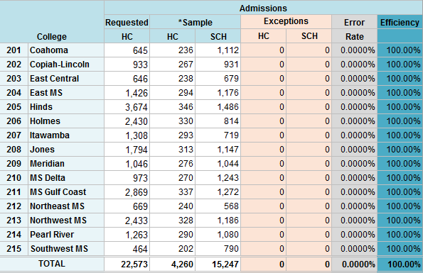
Efficiency (Summer 2018)

Slide 11
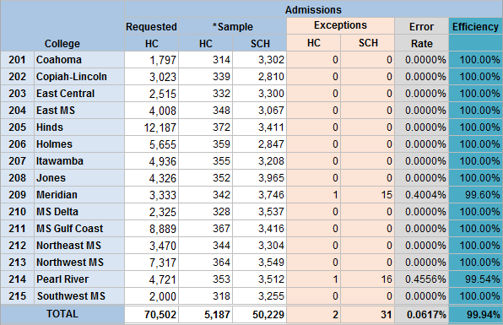
Efficiency (Fall 2018)

Slide 12
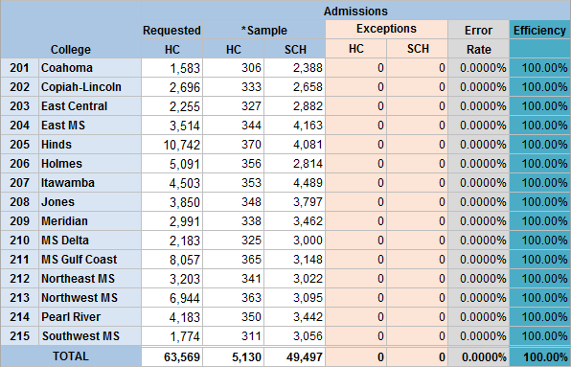
Efficiency (Spring 2019)

Slide 13
Why is the cost of my finding more expensive than my comparable?
The number of hours in a sample varies greatly
Depending on the hours taken by the sampled students
Let’s take a peek at this hypothetical case
Holmes sample of 356 students
Case 1: sampled students add up 2,814 credit hours
Case 2: sampled students add up 3,500 credit hours
So, for a given student exception…
Less hours sampled
= Greater Error Rate
= Less Efficiency
More hours sampled
= Smaller Error Rate
= More Efficiency

Slide 14
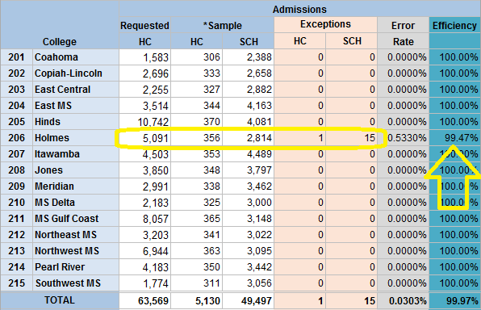
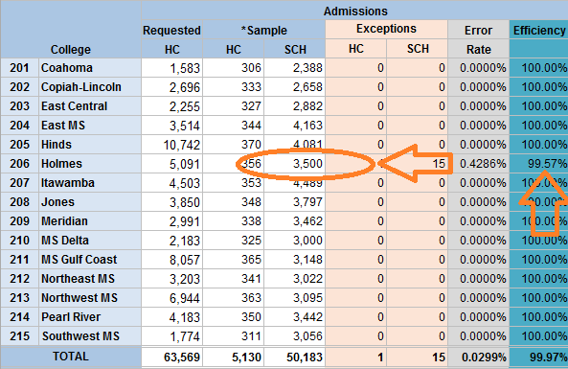
Efficiency (Spring 2019) – Hyphotetical
Case 1:
356 students
2,814 credit hours
One 15-hours finding equals 99.47% efficiency
Case 2:
356 students
3,500 credit hours
One 15-hours finding equals 99.57% efficiency

Slide 15
Cost of a hypothetical 15 credit hour finding
Based on the actual sample sizes
This shows the impact to the annual reimbursement if there was an Audit finding on a given term for a given college
And since, it is only one money pie, the cost is a gain for the other 14 colleges
This is based on a plain ‘academic’ student. Cost are higher if student is in a CTE, program, even higher in a High Cost, or ADN program

Slide 16
Clean Data Uploads & Consistent Audits have saved the Colleges TONS of $$$
How is that?

Slide 17
Validations and Verifications
Allows college to review student records in great detail
Clean up student folders prior to generating the audit sample
Data submitted to nSPARC, Report Cards, LifeTracks, SREB, etc. is more consistent
Ensures more accurate counts of Dual Enrollment, First-Time, GED’s, etc.
Since starting to validate with eARS and the Secondary Verifications
The Number of Findings have
Decreased Tremendously

Slide 18
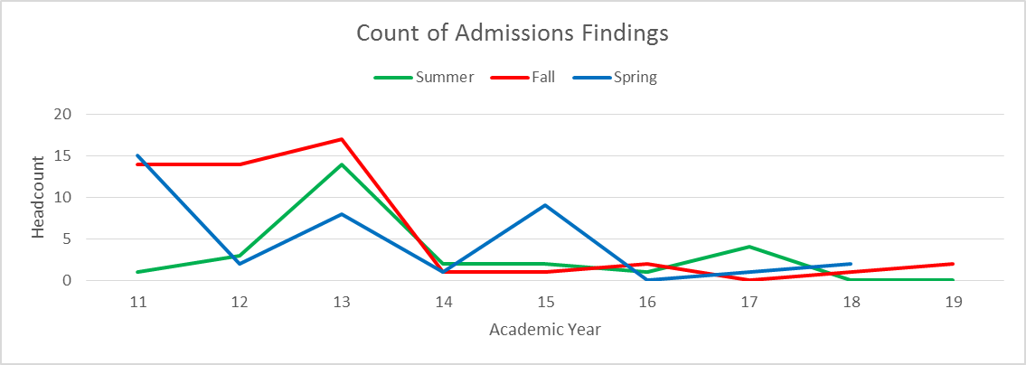
Admissions Findings – A Count !
Yikes!!
Ouch!

Slide 19
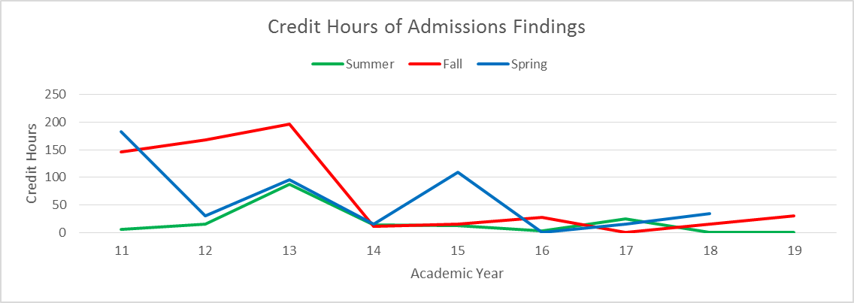
Admissions Findings – Same but in Credit Hours!
Geez!!
Owie!

Slide 20
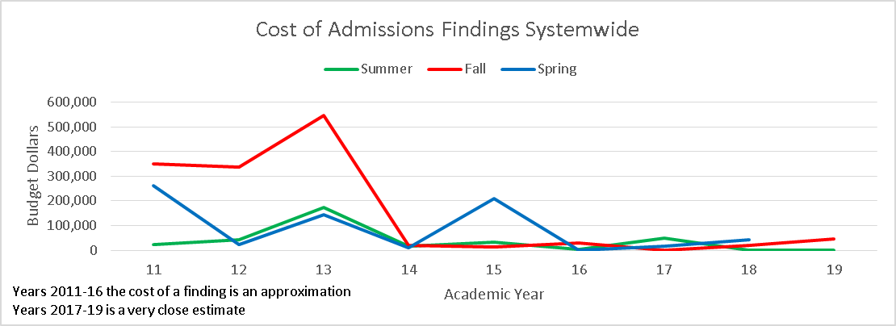
Admissions Findings – In Real Money $$$
Ouch it hurts !!
That’s gotta hurt!

Slide 21
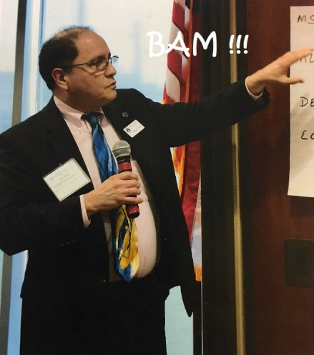
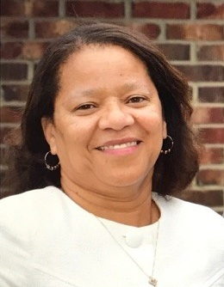
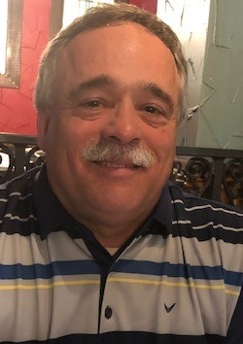
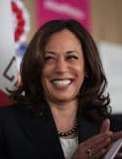
DA’ TEAM !
Da’ Most Awesome Team
RAUL FLETES
DAVITA WEARY
BEVERLIN GIVENS
ED ROBERSON
Assistant Executive Director
Director
Of Monitoring
Specialist
Specialist

Slide 22
QUESTIONS ?
THANK YOU !

