Slide 1
Institutional Effectiveness Solving the “Equation*”
Digi Edwards
Vice President of Professional Services
Ferrilli
People
Process
Technology
* Equation is defined as containing one or more variables.
Notes:
The old adage, “people, process and technology” is as old as I am – probably you too. In fact I suspect we will all likely call on this adage in at least one work-related meeting or dialog every week or so. We are told, over and over, that everything comes down to, “people, process and technology.

Slide 2
Institutional Effectiveness Solving the “Equation”
Technology
Process
People
The “Variables”
Notes:
The old adage, “people, process and technology” is as old as I am – probably you too. In fact I suspect we will all likely call on this adage in at least one work-related meeting or dialog every week or so. We are told, over and over, that everything comes down to, “people, process and technology.

Slide 3
People
Staff Training & Awareness
Professional Skills and Qualifications
Competent Resources
People
Notes:
The original Iron Triangle was Defined with shifting Gears
People = User Needs / consumers of BI solutions / ineffective -> processes not in place

Slide 4
Process
Process
People
Management Systems
Governance Frameworks
Best Practice
IT Audit /Assessment
Departmental process map
Notes:
Process = business goals
The processes refer to business goals that must be considered to help drive successful changes in business.
The People and the Process must also be considered in order for a holistic solution to exist. The people part of the equation represents the user needs. These are the ultimate consumers of business intelligence solutions. The people, however, are ineffective in their application of Business intelligence data and solutions if the processes are not in place to support data-driven decisions.

Slide 5
Technology
Technology
Process
People
Machinery and equipment
Software
Systems
Notes:
Interestingly the technology implementation requires the most hard dollar costs, and returns the least in terms of ROI.
The real value in Holistic BI is in garnering the corporate buy in, or in other words training the people to make better data-driven business decisions based on the data.
These three important aspects, the people, process and technology must be in alignment for a business intelligence solution to be effective and holistic.

Slide 6
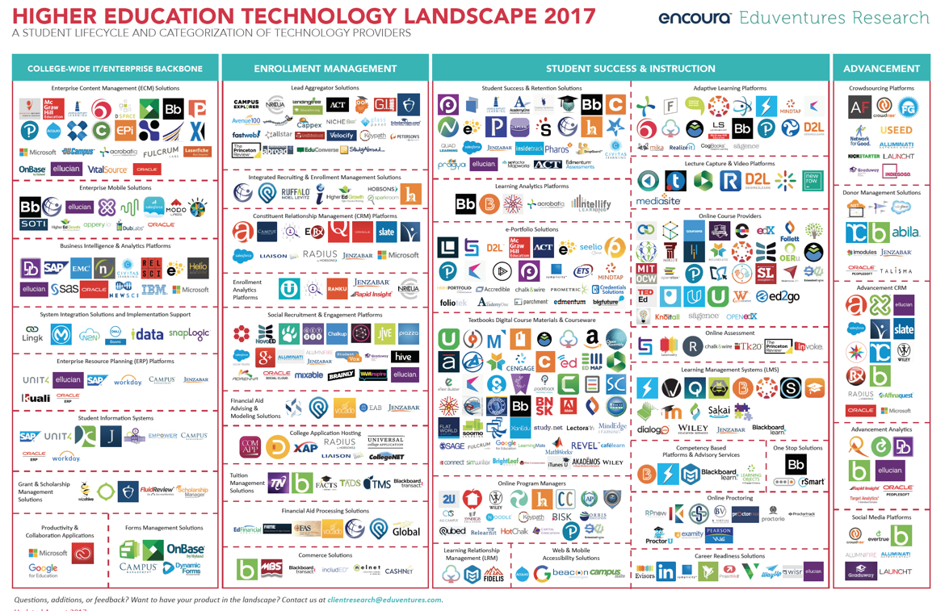

Slide 7
The Technology “Triad”
isosceles
scalene
Equilateral
Notes:
Iron triangle = scope, time, dollars
Here we discuss people, process, technology in alignment

Slide 8
People
Key Roles
Notes:
Always start with the people – Identify your key role players & understand what each of them brings to the table. – Confirm that you have senior management buy-in (right from the start), because without it you will fail. – Ensure that your team consists of the right people with the right skills, experience and attitude to help you solve this problem.

Slide 9
Consider the Process
Actions & Steps
Notes:
Once your people are committed to the cause, consider the process – A process is defined as a series of actions or steps taken in order to achieve a particular end. So with that in mind, ask the question: What processes do we need in order to solve this business problem? – A good place to start is by identifying the big, key steps. Once those are in place you can then focus on a more detailed level by looking at process variations, exceptions, interdependencies and supporting processes. – Now review these processes with your stakeholders. Ensure that they’re aware of what’s expected from them and let them guide you with regards to possible gaps and issues.

Slide 10
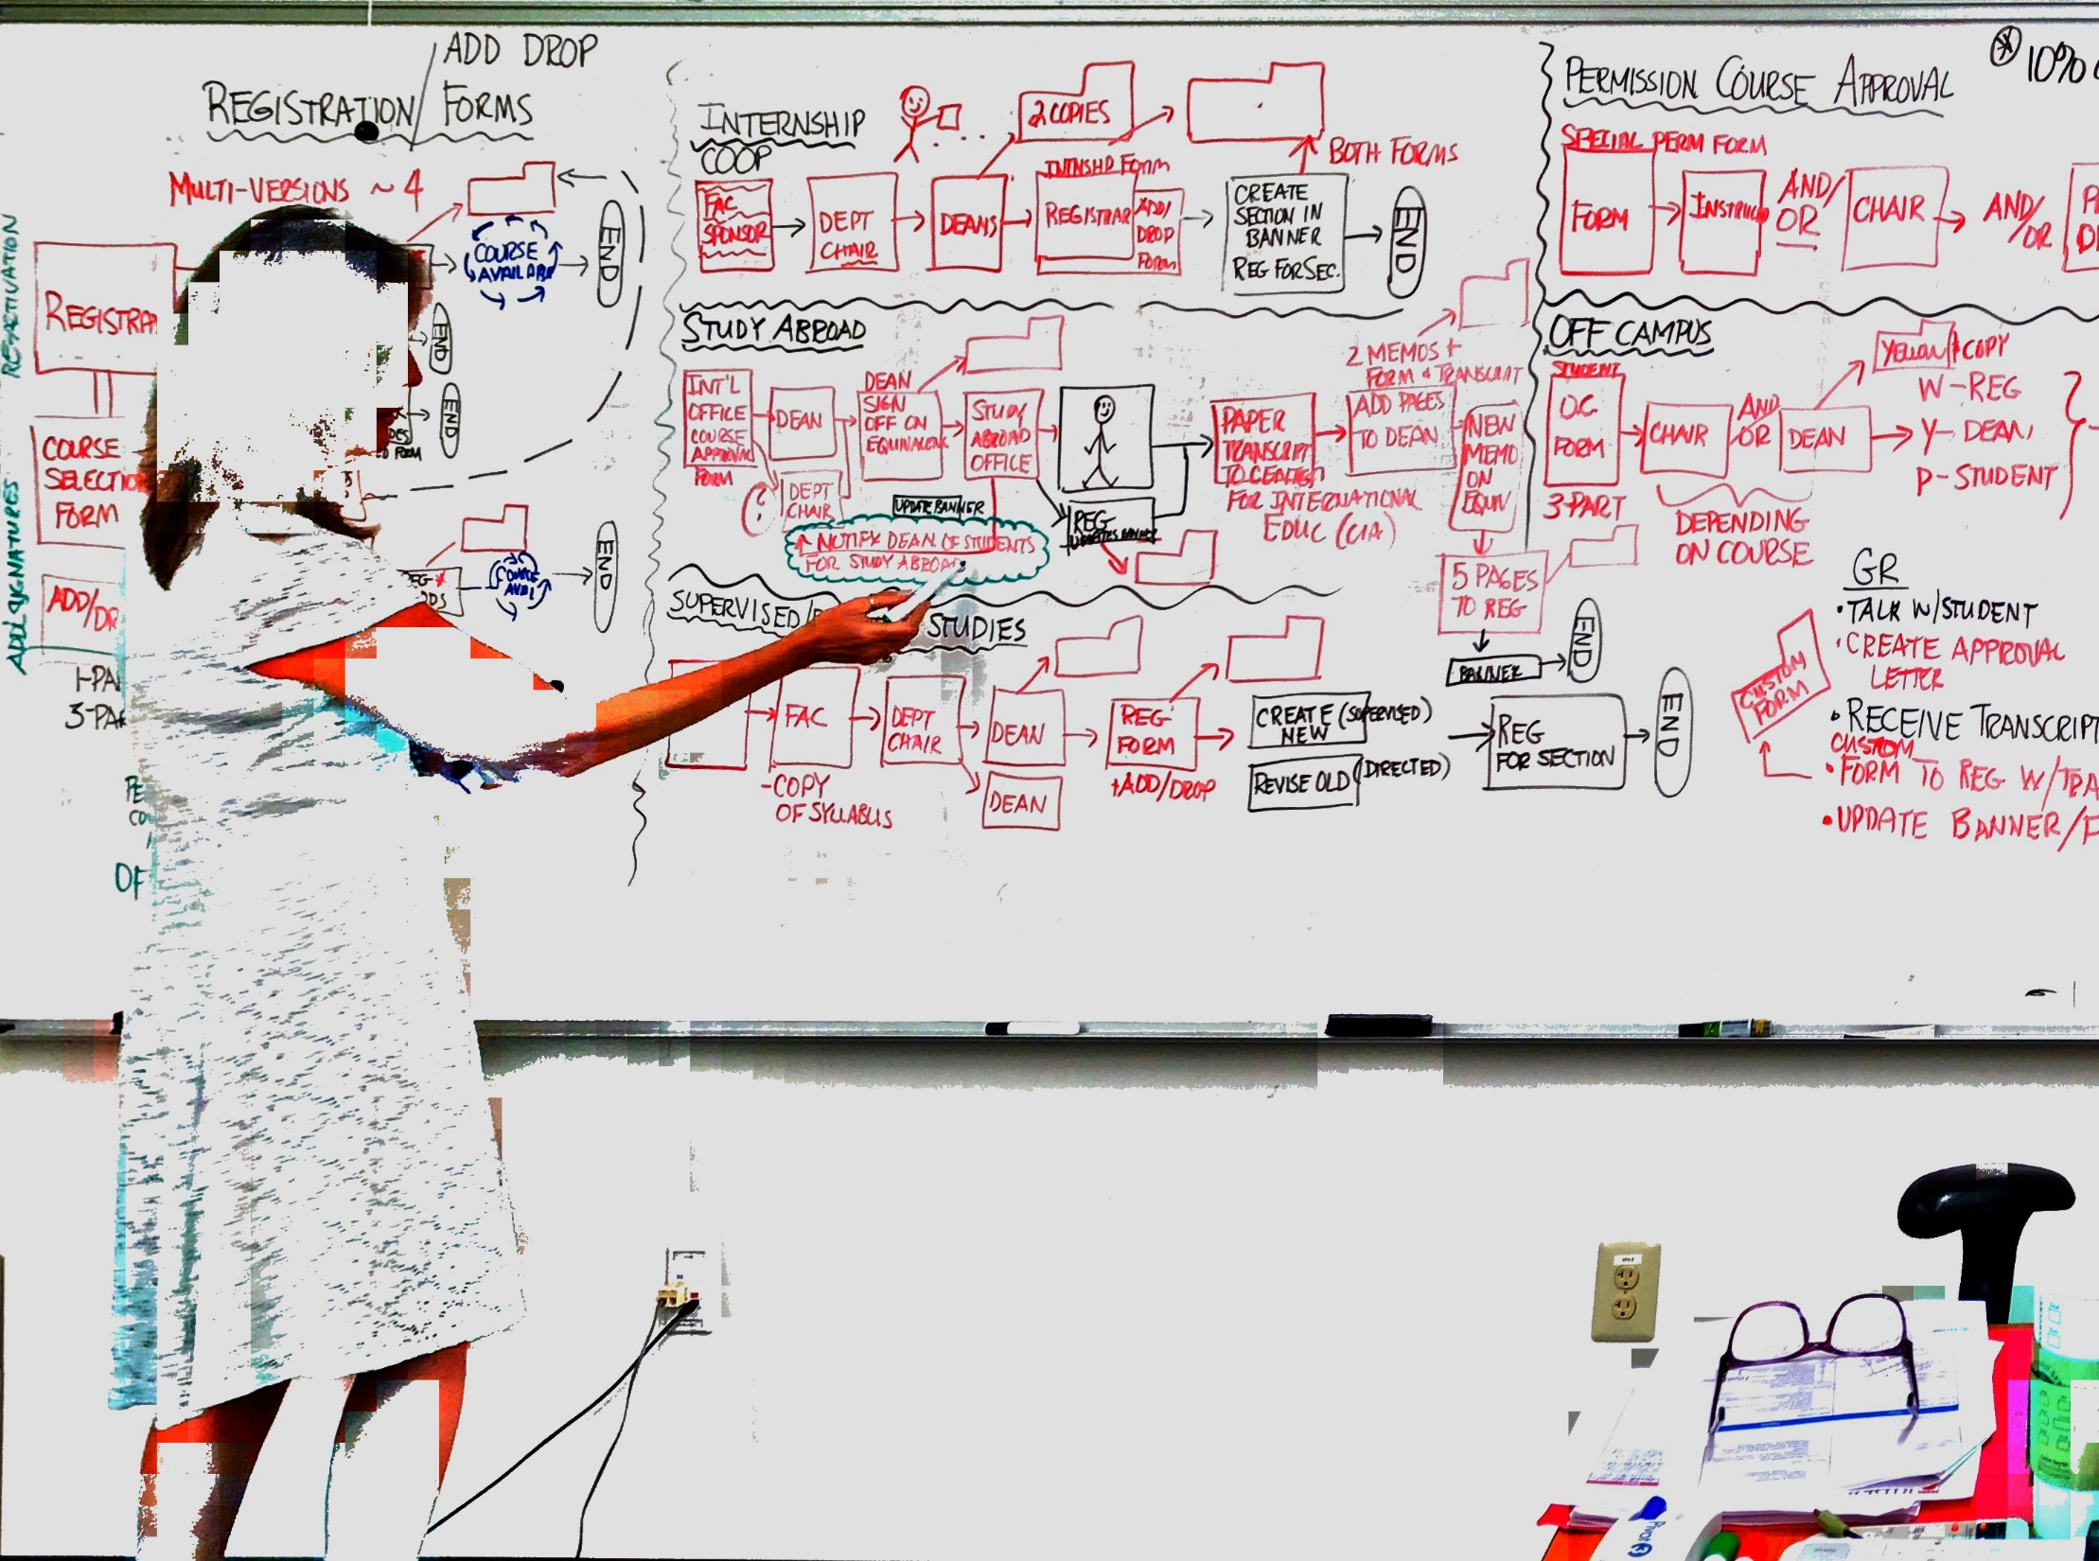
Recent Process Review
Process

Slide 11
Technology
Biggest $$$
Notes:
Finally select the technology – With your people and processes in place, you can now look at technologies which will support them. – It’s never a good idea to force a technology and then attempt to retrofit the people and processes around it. – Technology should always be the final consideration once the problem is clearly understood and the solution requirements have been clearly defined.

Slide 12
Notes:
But how do you get the balance just right?

Slide 13
A Road Map To Change
4. Improve
3. Analyze
2. Define
1. Focus
Notes:
The focus of process management is on the management of the company’s business processes for long-term continuous improvement. Its logic in anchored in only doing the “right” things and doing those things effectively and efficiently. That is, serving the customer over time at a profit. To do this effectively the company must adopt a longer-term view of management and adopt a methodology for creating and maintaining the organization’s effort so as to deliver change on a continuing basis. Our suggested methodology is systematic and has four phases.
Focus - There is a familiar story about a blind man feeling around the side of an elephant attempting to determine what it is. Thinking about process management in a company is a similar experience. The first step in the methodology is to start to “chunk down” the business processes within the company (assuming you have them defined), identifying those areas where you believe there is opportunity for improvement. Identifying these areas is a big step, for from there you can begin to identify business issues related to the opportunities and to identify who should be responsible for the further investigation.
Define - This second phase in the methodology suggests that the group you have assigned responsibility for further investigation bounds the opportunity for improvement. This means the group more fully describes the designated business process and how it fits across the organization, identifying what the inputs and outputs are, what a standard of performance might be, and what measures would be best to determine if the performance standards are being achieved.
Analyze - This phase is where the suggestions for change arise and are implemented.
Improve - This phase is the continuous improvement phase. The enhanced process is monitored and further opportunities for improvement are identified.

Slide 14
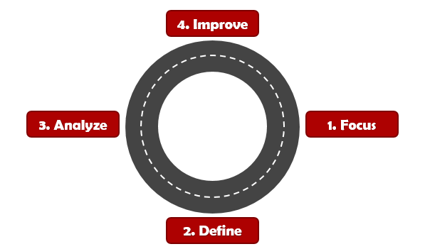
A Road Map To Change
1. Focus
2. Define
3. Analyze
4. Improve
For a managed process, describe the process
Establish boundaries of responsibility
Identify standards that address requirements
Develop measures with respect to standards
Identify business concerns and opportunities
Obtain input and determine issues
Prioritize issues
Determine processes that effect the issue
Determine responsibility for processes
Deploy to appropriate area of responsibility
Streamline/standardize the process
Design data-gathering procedures
Collect data
For each measure, is the process consistent
If inconsistent, address special causes
If consistent, evaluate process acceptability
If acceptable, monitor for opportunities
If unacceptable, monitor for opportunities
Maintain continuous feedback
Notes:
The key elements of each of the high-level road map steps in the process management methodology are illustrated above. (This methodology assumes you have your business processes mapped.) Changing the way a company does business through impacting business processes is not a two week exercise.
This truly represents a change in the way business is viewed and conducted on a day-in and day-out basis.
As seen in the diagram, the underlying logic in this way of doing business is as simple as the four steps described and as complex as all the communications and cultural change that underlies the effort. When considering all of the dimensions of change for the company, this undertaking will likely seem daunting. As daunting as it may seem, there is likely not an alternative.

Slide 15
The Three C’s
Culture
Collaboration
Capabilities

Slide 16
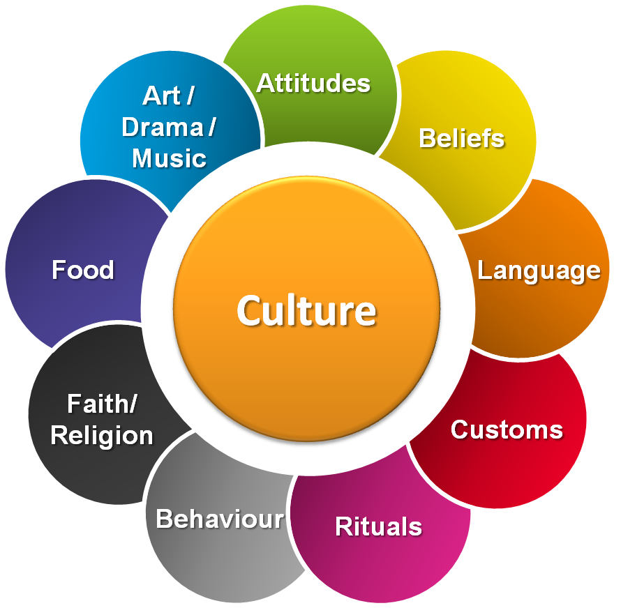
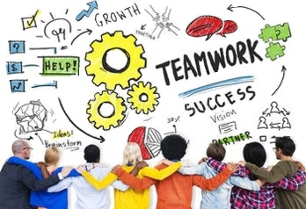
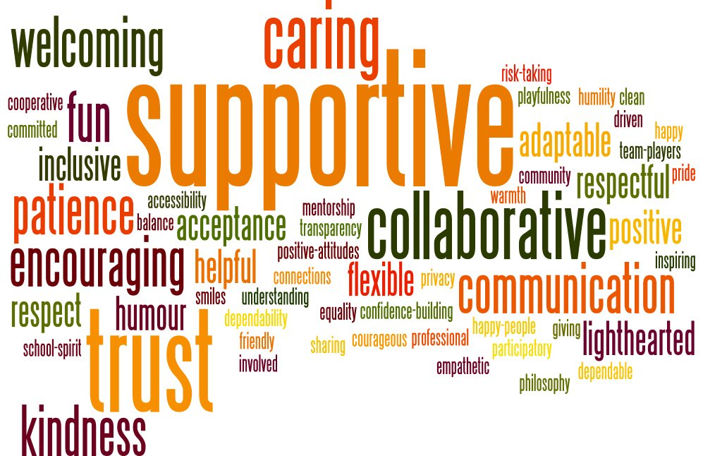
Notes:
Improved CULTURE
When we talk about ‘people’, we are really not talking about individuals, but about cultures. The culture of a team, department or organisation has a more significant impact on how people collectively perform than anything else.
Changing culture is hard: for a ‘bad’ culture caught early enough, it may be possible to simply replace the most senior person who is (consciously or not) leading the creation of the undesirable cultural characteristics. But once a culture is established, even replacing senior leadership does not guarantee it will change.
Changing culture requires the willing participation of most of the people involved. For this to happen, people need to realise that there is a problem, and they need to be open to new cultural leadership. Then, it is mainly a case of finding the right leadership to establish the new norms and carry them forward – something which can be difficult for some senior managers to do, particularly when they have an arms-length approach to management.
Typical ‘bad’ cultures in a (technology) organisation include poor practices such as lack of testing discipline, poor collaboration with other groups focused on different concerns (such as stability, infrastructure, etc), a lack of transparency into how work is done, or even a lack of collaboration within members of the same team (i.e., a ‘hero’ based approach to development).
Changing these can be notoriously difficult, especially if the firm is highly dependent on this team and what it does.

Slide 17
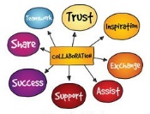
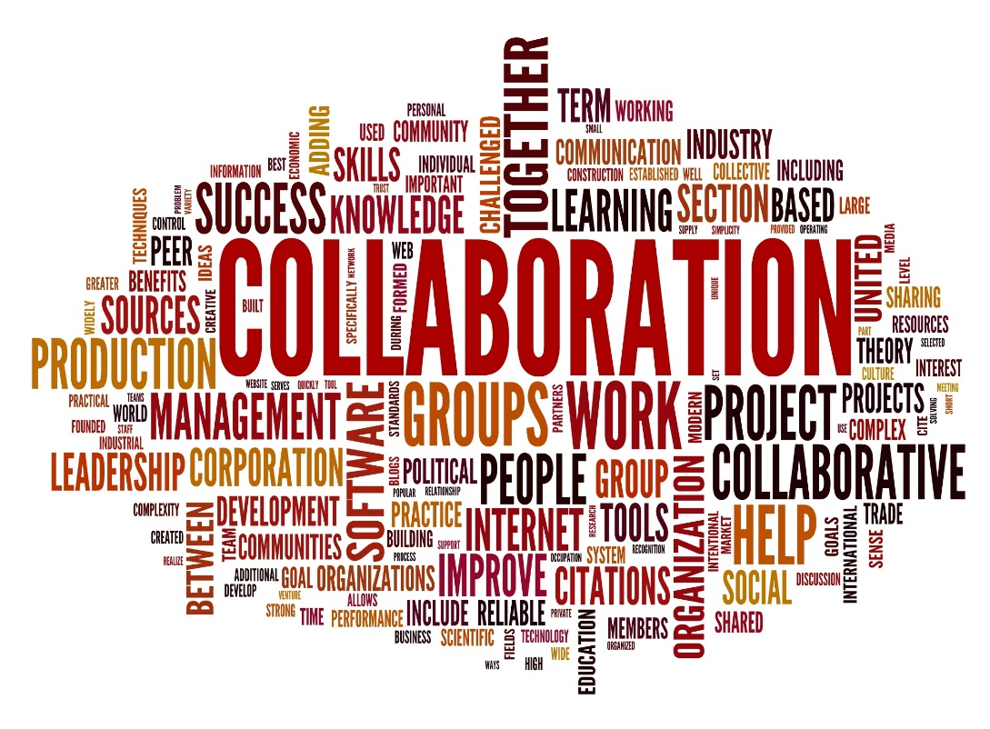
Notes:
COLLABORATION
Processes are, ultimately, a way to formalise how different people collaborate at different times. Processes formalise collaborations, but often collaborations happen before the process is formalised – especially in high-performance teams who are aware of their environment and are open to collaboration.
Many challenges in teams, departments or organisations can be boiled down to collaboration challenges. People not understanding how (or even if) they should be collaborating, how often, how closely, etc.
In most organisations, ‘cooperation’ is a necessity: there are many different functions, most of which depend on each other. So there is a minimum level of cooperation in order to get certain things done. But this cooperation does not necessarily extend to collaboration, which is cooperation based on trust and a deeper understanding of the reasons why a collaboration is important.
Collaboration ultimately serves to strengthen relationships and improve the overall performance of the team, department or organisation.
Collaborations can be captured formally using business process design notation (such as BPMN) but often these treat roles as machines, not people, and can lead to forgetting the underlying goal: people need to collaborate in order to meet the goals of the organisation. Process design often aims to define people’s roles so narrowly that the individuals may as well be a machine – and as technology advances, this is exactly what is happening in many cases.
People will naturally resist this; defining processes in terms of collaborations will change the perspective and result in a more sustainable and productive outcome.

Slide 18
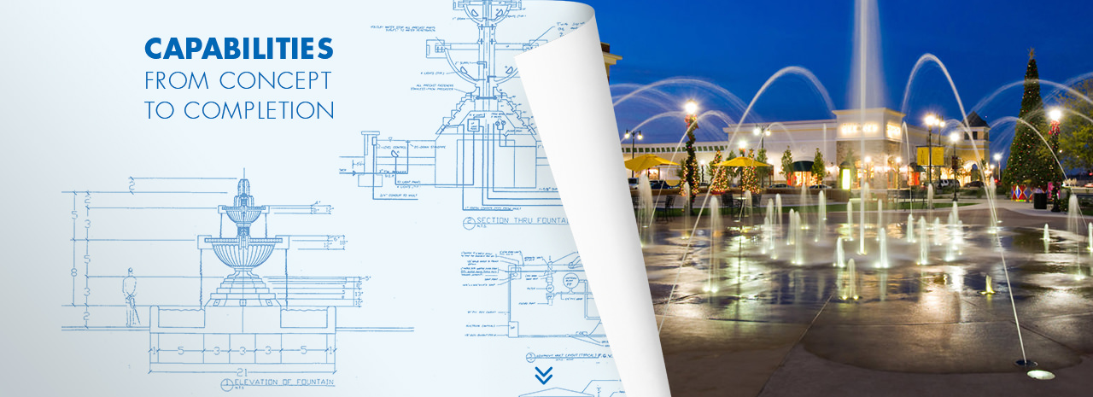
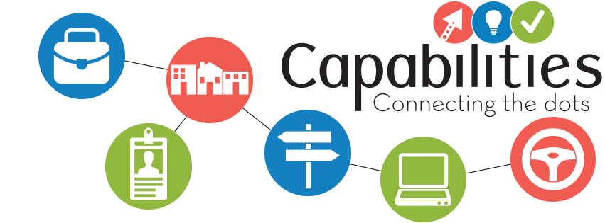
Notes:
CAPABILITIES
Much has been written here about ‘capabilities’, particularly when it comes to architecture. In this article, I am narrowing my definition to anything that allows an individual (or group of individuals) to perform better than they otherwise would.
From a technology perspective, particular technologies provide developers with capabilities they would not have otherwise. These capabilities allow developers to offer value to other people who need software developed to help them do their job, and who in turn offer capabilities to other people who need those people to perform that job.
When a given capability is ‘broken’ (for example, where people do not understand a particular technology very well, and so it limits their capabilities rather than expands them), then it ripples up to everybody who depends directly or indirectly on that capability: systems become unstable, change takes a long time to implement, users of systems become frustrated and unable to do their jobs, the clients of those users become frustrated at people being paid to do a job not being able to do it.
In the worst case, this can bring a firm to its knees, unable to survive in an increasingly dynamic, fast-changing world where the weakest firms do not survive long.
Technology should *always* provide a capability: the capability to deliver value in the right hands. When it is no longer able to achieve that role in the eyes of the people who depend on it (or when the ‘right hands’ simply cannot be found), then it is time to move on quickly.

Slide 19
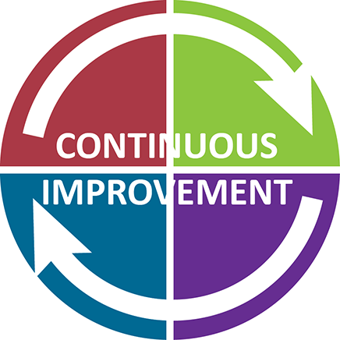
Notes:
CONCLUSION
Many of todays innovations in technology revolves around culture, collaboration and capabilities. An agile, disciplined culture, where collaboration between systems reflects collaborations between departments and vice-versa, and where technologies provide people with the capabilities they need to do their jobs, is what every firm strives for (or should be striving for).
For new startups, much of this is a given – this is, after all, how they differentiate themselves against more established players. For larger organisations that have been around for a while, the challenge has been, and continues to be, how to drive continuous improvement and change along these three axes, while remaining sensitive to the capacity of the firm to absorb disruption to the people and technologies that those firms have relied on to get them to the (presumably) successful state they are in today.
Get it wrong and firms could rapidly lose market share and become over-taken by their upstart competitors. Get it right, and those upstart competitors will be bought out by the newly agile established players.

Slide 20
Digi Edwards
Vice President of Professional Services
Ferrilli
dedwards@ferrilli.com
(856) 857-7263

