Slide 1
MBUG 2019
Session Title:
Presented By:
Institution:
Date:
IHL Update
Jim Hood
MS Institutions of Higher Learning (IHL)
September 9, 2019

Slide 2
IHL Update
Jim Hood, Ph.D.
Assistant Commissioner for Strategic Research
MBUG 2019 Conference – September 9, 2019
@MSPublicUniv www.mississippi.edu #AdvancingMS

Slide 3
IHL Activity
Fall2018 Students – 79,193¹ (82,654*²⁰¹⁶)
AY2018 Students – 94,137 (95,857*²⁰¹⁷)
AY2018 Degrees – 18,248*
AY2019 Avg Annual In-State Tuition - $7,729*
FY2018 Research Dollars – $464M ($586M*²⁰¹⁰)
Fall 2018 Employees – 28,148 (28,616*²⁰¹⁶)
Part-Time, UMMC (35%), MSU-Ag & Extension
¹November 1st Census (normally 10-15 day window)
*System Records
Notes:
THIS SLIDE SHOWS SOME OF IHL’S ACTIVITY
YOU CAN SEE HEADCOUNT ENROLLMENT IS AT --- OR JUST BELOW --- RECORD LEVELS
WE EXPECT DEGREE PRODUCTION WILL HIT ANOTHER RECORD YEAR IN 2019 --- AND TUITION WILL CONTINUE TO RISE
RESEARCH DOLLARS ARE CONTINUING TO RISE BACKT TO 2010 LEVELS --- MOST OF THAT IS DRIVEN BY FEDERAL DOLLARS
OUR TOTAL EMPLOYEES ARE ALSO AT --- OR JUST BELOW --- RECORD LEVELS

Slide 4
Transfer Outcomes--Communication
There is an opportunity to collaboratively develop—in conjunction with the community colleges—a formal transfer outcomes report (i.e. Transfer Feedback Report)
Report must reasonably compare native and transfer students on a variety of academic variables

Slide 5
Transfer Outcomes--Framework
Current metrics need refinement -- many metrics lump all transfers together – do not consider transfer hours (6 vs 36), level (FR vs SO), course grades (LO-UG vs UP-UG), etc.
GPA metrics rely on final GPA at graduation (excludes all those who do not graduate)
Comparing transfers with native students has been avoided due to a lack of a comparative framework

Slide 6
Fall Transfer Activity
Fall 2014 through Fall 2018; excludes UMMC
Two columns by University:
5-Year Averages
5-Year Change
0.5 = 50%
Notes:
THIS SLIDE INTRODUCES THE NEXT TABLE YOU WILL SEE
THAT TABLE LISTS EACH COMMUNITY COLLEGE AND UNIVERSITY ALONG WITH TWO COLUMNS ---
5-YEAR AVERAGE OF ENROLLMENT
5-YEAR PERCENT CHANGE -- 0.5 MEANS 50% TO SAVE SPACE
THE UNIVERSITIES ARE SEPARATED BY RESESARCH AND REGIONAL INSTITUIONS

Slide 7
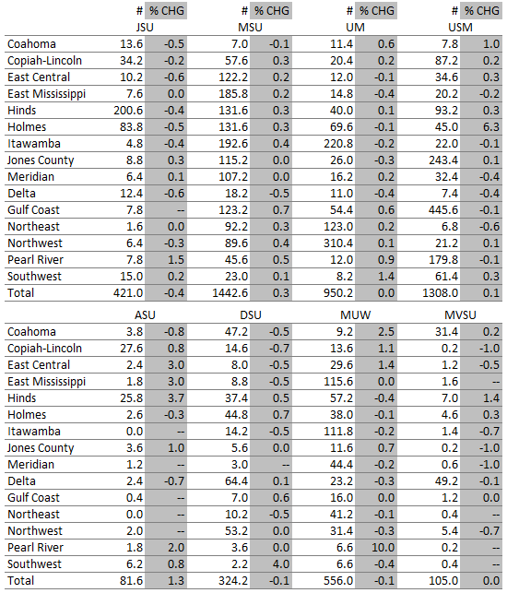
Notes:
TAKE A LOOK AT THIS TABLE FOR A MINUTE AND LET THIS SINK IN….
LOOK AT THE 200.6 FOR HINDS AND JSU IN THAT FIRST COLUMN
THIS MEANS --- FOR THE LAST 5 FALL TERMS --- ON AVERAGE --- HINDS SENDS 200 STUDENTS TO JSU ---
BUT THAT TREND IS DECLINING BY 40 PERCENT (229 DOWN TO 146)
LET’S FOCUS ON JUST THE RESEARCH UNIVERSITIES AT THE TOP….
(1) MSU SEEMS TO BE THE OVERALL FAVORITE --- LARGER NUMBERS ACROSS THE CJC SYSTEM AND ALL THE TRENDS SEEM POSITIVE
MORE SCHOLARSHIP MONEY??
THE REST OF THE RESEARCH UNIVERSITIES SEEM TO BE WHAT YOU’D EXPECT --- MORE REGIONAL ENROLLMENT
NOW LET’S LOOK AT THE REGIONAL UNIVERSITIES
LOOK AT MUW HAVING SIMILAR STATEWIDE ACTIVITY
MUW’S TOTAL OF 556 IS MORE THAN ALL THE OTHER REGIONALS COMBINED
MOST OF THIS ACTIVTY IS DUE TO GEOGRAPHIC LOCATION BUT I THOUGHT THIS WAS INTERESTING
MUW IS ATTRACTING MORE STUDENTS FROM MS DELTA THAN ANY OF THE RESESARCH INSTITUTIONS

Slide 8
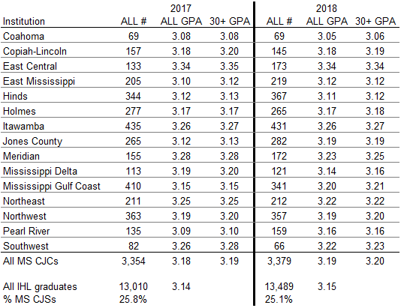
MS CJC Transfer Completion GPAs
Notes:
THIS TABLE LOOKS AT TRANSFER GPAS AT GRADUATION FOR THE LAST TWO YEARS
YOU CAN SEE EAST CENTRAL IS DOING VERY WELL….I ALSO NOTED ITAWAMBA’S GPA WHEN CONSIDERING THEIR LARGER ENROLLMENT
THESE FIGURES SUGGEST ….
TRANSFER STUDENTS WITH MORE HOURS TEND TO HAVE SLIGHTLY HIGHER GPAS
TRANSFER STUDENTS TEND TO PERFORM AT THE SAME LEVELS AS THEIR IHL PEERS
ONE CAVEAT IS THESE FIGURES ARE LIMITED TO THOSE STUDENTS WHO COMPLETE THEIR DEGREE AND EXCLUDE OTHER STUDENTS

Slide 9
Transfer Outcomes—Defining Cohorts
Metrics should clearly define transfer and native cohorts for comparison
1. Native Cohort
IHL junior-level student
2. Traditional Transfer Cohort
Comparable to IHL junior-level student
3. Transient Transfer Cohort
Limited transfer activity

Slide 10
Studying Census Dates
IHL historically captured (froze) enrollment between 10-15th class day
In late Fall 2018 the CAOs questioned that practice – detrimental to outcome metrics
IHL research conducted a detailed study of census dates across three time periods: (1) 10-15th day, (2) Oct 1st, and (3) Nov 1st

Slide 11
Studying Census Dates
IHL study had three objectives:
Examine change in data metrics over the three time periods
Survey the census practices of peer groups across the nation
Project 1-year retention rates for the three time periods using logistic regression

Slide 12
Studying Census Dates
Results suggested:
Data metrics changed very little across the three census dates – due to “swirl” (students coming & going) and mini-terms
The 10-15th day window was consistent with most peers (54% of responses)
The projected retention rates for the three time periods showed minimal differences

Slide 13
Census Practices for Other States
Category | Census Date | N | % | Cum. %
Term date | 6th class day | 1 | 2.9% | 2.9%
 | 10th class day | 5 | 14.3% | 54.3%
 | 11th class day | 1 | 2.9%
 | 12th class day | 2 | 5.7%
 | 14th class day | 2 | 5.7%
 | 15th class day | 8 | 22.9%
 | 10th-15th class day | 1 (MS) | 2.9%
 | 20th class day | 1 | 2.9% | 14.3%
 | 25th class day | 1 | 2.9%
 | Mid-term | 1 | 2.9%
 | End of term | 2 | 5.7%
Calendar date | October 1st | 1 | 2.9% | 8.6%
 | October 7th | 1 | 2.9%
 | November 15th | 1 | 2.9%
Other | Institution-defined | 7 | 20.0% | 20.0%

Slide 14
Projected 1-Year Retention Rates by Census Date using Logistic Regression
Institution | Most Recent 5-Year Average¹ | Fall 2018-2019 (Projected)
 |  | 10-15th Day | Oct. 1 | Nov. 1 | ChangeT1-T3
ASU | 73.4% | 78.7% | 78.7% | 78.7% | 0.0%
DSU | 66.9% | 67.1% | 67.2% | 67.4% | 0.3%
JSU | 72.6% | 61.8% | 62.0% | 62.1% | 0.3%
MSU | 80.0% | 82.7% | 82.8% | 82.9% | 0.2%
MUW | 68.3% | 72.3% | 72.3% | 72.6% | 0.3%
MVSU | 61.0% | 65.3% | 65.4% | 64.7% | -0.6%
UM | 85.5% | 85.7% | 85.8% | 85.9% | 0.2%
USM | 72.7% | 74.1% | 74.2% | 74.4% | 0.3%
IHL System | 78.3% | 79.1% | 79.2% | 79.4% | 0.3%
¹ Source: IPEDS (Fall 2012 through Fall 2016). IHL projected figures do not account for exclusions.
Logistic Regression Model variables include Gender, Ethnicity, Residence, ACT Composite, and HS GPA.

Slide 15
Studying Census Dates
Fall 2018--University presidents voted to use November 1st at the official census date moving forward
Official IHL data for Fall 2018 uses November 1st (not 10-15 class day)
That decision did receive pushback from several university constituent groups (SACS, full-time status related to fin’l aid)
In Spring 2019, decided Fall 2019 will undergo a similar process using Oct 15 and Nov 1

Slide 16
Shorelight
Institutions are always seeking ways to find students and increase enrollment
Historically focused on attracting non-residents from other states – now expanding focus to international students
Universities are contracting with Shorelight to leverage its global network to identify, recruit, and retain international students – increasing international footprint

Slide 17
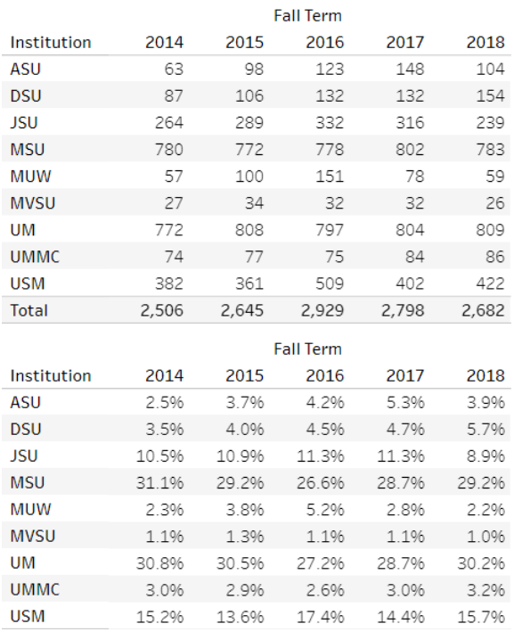
International Enrollment
MSU and UM account for 60% of international enrollment
Research universities account for 84% of international enrollment
3.4% of total enrollment
Notes:
MUW—SPIKE IN STUDENTS FROM NEPAL
2015—89 STUDENTS
2016—138 STUDENTS
2018—40 STUDENTS

Slide 18
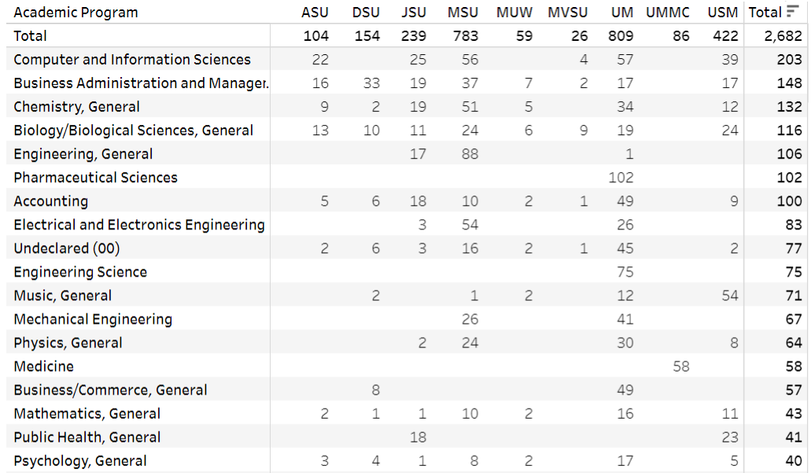
International Enrollment
Top Degree Objectives (All Academic Levels):
Notes:
WHAT DO THE RED BOXES REFLECT? STEM-RELATED MAJORS…

Slide 19
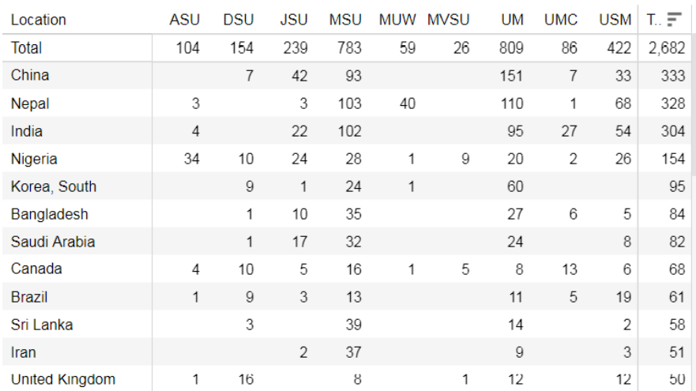
International Enrollment
Top Feeder Countries (All Academic Levels):
1.34B
0.03B
1.39B
Notes:
Nepal…29.3 million
MOST ARE MAJORING IN COMPUTER SCIENCE

Slide 20
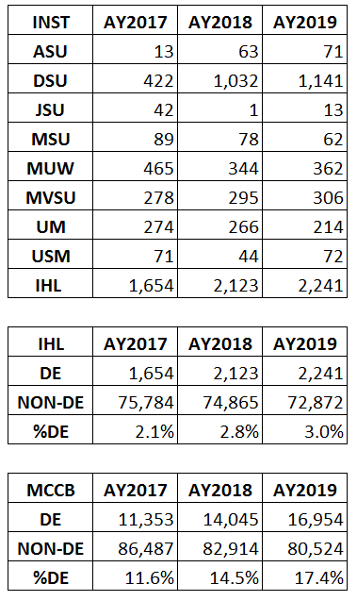
Dual Enrollment
Increase in high school students taking college courses
Primarily at regional institutions competing for students (51% at DSU; 84% at regional university)
Dual Enrollment more significant at MCCB community colleges

Slide 21
Identifying Student Groups
Growing need to identify special groups within our student population (C2C, military, etc.)
Now collecting a special “supplemental” student file on these groups (identified by special coding) at end of academic year
The file is duplicated by term and not bound by census dates—intentional to collect “every” student

Slide 22
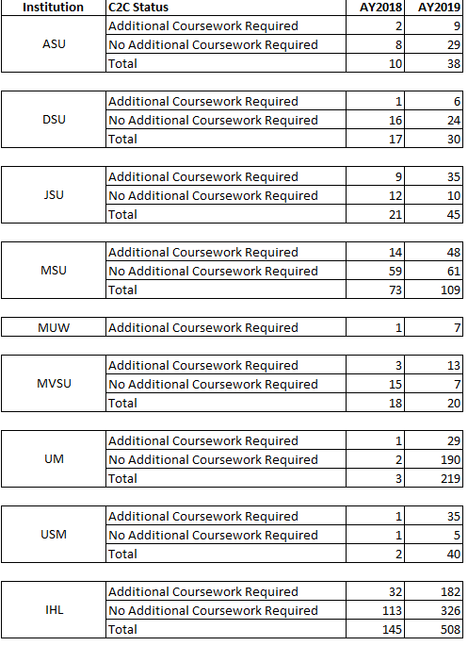
C2C Degrees Awarded
Really started in Spring 2018
64% (2 of 3) did not require any additional coursework
43% of activity is at Ole Miss

Slide 23
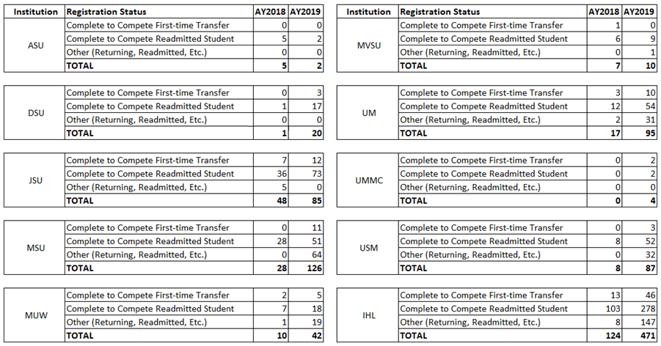
C2C Headcount Enrollment
First-Time (10%) vs Readmitted Enrollment (90%)

Slide 24
Military Credit Policy Task Force
Spring 2019—IHL created task force for developing a policy framework for accepting military credit
Developed in conjunction with SB2053 that requires Mississippi’s public community colleges and universities to award educational credit for military training and service

Slide 25
Military Credit Policy Task Force
Figures include both military service members and dependents—which is inflating military numbers
System-wide institutions do not have a reliable way of identifying military students—primarily through student aid

Slide 26
Lifetracks Workforce Outcomes
Third year of Lifetracks Workforce Outcomes report
ALL STUDENTS
Retention Percentages (After Graduation):
Metric (Students) | 1 Year | 3 Years | 5 Years
All Graduates – Total (13K) | 58.7 | 52.9 | 50.6
All Graduates – MS (10K) | 72.9 | 63.7 | 60.8
All Graduates – Non-MS (3K) | 14.6 | 10.3 | 8.5
All Graduates – Male (5K) | 51.2 | 44.8 | 43.1
All Graduates – Female (8K) | 63.6 | 58.3 | 55.5

Slide 27
Lifetracks Workforce Outcomes
Median Annual Earnings (thousands):
Metric (Students) | 1 Year | 3 Years | 5 Years
All Graduates – Total (13K) | 34.7 | 37.9 | 41.6
All Graduates – MS (10K) | 34.8 | 37.9 | 41.5
All Graduates – Non-MS (3K) | 33.6 | 38.6 | 43.6
All Graduates – Male (5K) | 36.0 | 42.0 | 47.5
All Graduates – Female (8K) | 34.4 | 36.4 | 39.3
Notes:
These figures suggest the earning potential of postsecondary degrees starts to make a difference 3-5 years following graduation in most instances

Slide 28
Other Activities
Focus on University of Mississippi Chancellor search
Ongoing data security activities--breach would have statewide implications
Complete College America (CCA) data sharing is on pause due to their new data collection methodology

Slide 29
Thank You!
Jim Hood, Ph.D.
Assistant Commissioner for Strategic Research
jhood@mississippi.edu – 601.432.7011
@MSPublicUniv www.mississippi.edu #AdvancingMS

