Slide 1
MBUG 2019
Banner Boot Camp
Presented By:
Hannah Miller
Pearl River Community College
September 8, 2019

Slide 2
Session Rules of Etiquette
Please turn off your cell phone
If you must leave the session early, please do so discreetly
Please avoid side conversation during the session

Slide 3
Main Dashboard

Slide 4
Search Banner Page:

Slide 5
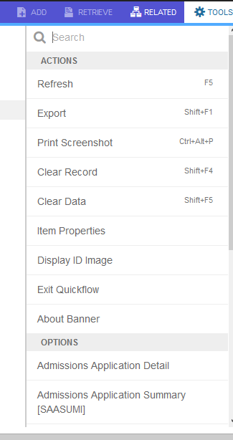
Tools:

Slide 6
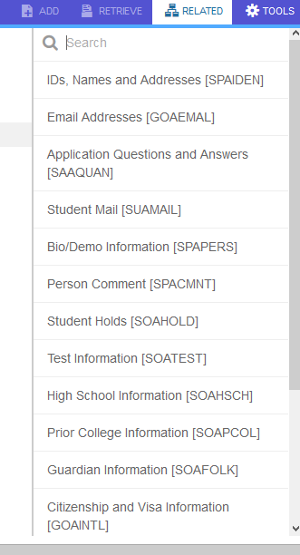
Related:

Slide 7
Wildcard Searches
Any searchable field will have three dots located directly beside it.
Once in the search field you can search by:
Percentage (%) or Underscore (_)
% is any or a set of characters
_ represents one character but can be used multiple times

Slide 8
Person Searches
SOAIDEN (First and Last Name)
GUIALTI (Alternate DOB)
GUISRCH (Email or Phone #)

Slide 9
SOAIDEN
First and Last Name
Wildcard Searches
All screens generally give you access to this screen without having to go directly to it. Just click on the three dots next to the name.

Slide 10
GUIALTI
Can search by DOB or SSN
DOB – must be entered as DD-MON-YYYY

Slide 11
GUISRCH
Can search by phone number or email.

Slide 12
SHADGMQ
Good degree summary screen.
Shows all degree transactions in one place.

Slide 13
Where do I find?
Business Office Account Detail – TSICSRV
Addresses – SPAIDEN or SOADDRQ
Admission Status – SAAADMS
Advisor – SGAADVR
Student Course Information – SFASTCA
Class Roster – SFASLST
Colleges Attended – SOAPCOL
Courses Taken (Institutional) – SHACRSE
Courses Taken (Institutional and Transfer)–SHATERM

Slide 14
Where do I find? Cont.
Date of Birth – SPAIDEN or SPAPERS
Dorm Information – SLARASG
Ethnicity – SPAIDEN or SPAPERS
GPA – SHATERM
High School Information – SOAHSCH
Holds – SOAHOLD
Major (Curriculum) – SGASTDN
Student Schedule – SFAREGQ
Telephone Numbers – SPAIDEN or SPATELE
Test Scores - SOATEST

Slide 15
New Keyboard Shortcuts (Banner 9)
Next Section – Alt + Page Down
Print – Ctrl + P
Insert Record – F6
Previous Section – Alt + Page Up
Refresh or Rollback – F5
Save – F10
These are just some of the many Keyboard Shortcuts. More are listed on the Supplemental Document.

Slide 16
Questions? Discussion?
Hannah Miller
Assistant Director of Admissions and Records
Pearl River Community College
hkmiller@prcc.edu
Thank you!

