Slide 1
MBUG 2019
Session Title: Allied Health Applications through Banner Surveys
Presented By: Leah Balli
Institution: Pearl River Community College
September xx, 2019

Slide 2
Session Rules of Etiquette
Please turn off your cell phone
If you must leave the session early, please do so discreetly
Please avoid side conversation during the session

Slide 3
Prior Process
Each program had a PDF on their website that contained their application
Students would print, fill out, and mail the application to the respective department
Program departments operated with paper files and manually processed applications
Communication was done via email manually

Slide 4
Changes-Online Application
Created an “application” for each department in GUASRVY

Slide 5
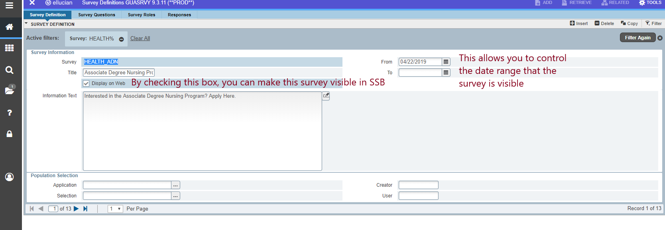

Slide 8
Allied Health Applications (SSB)

Slide 9
Allied Health Application (Student Access Point)

Slide 10
Allied Health Application Preview

Slide 11
Application Follow-Up Communication

Slide 12
Application Follow-Up Communication

Slide 13
Response Reports

Slide 14
Excel Report

Slide 15
Cover Letter Report

Slide 16
New Process
Only students who have already applied to PRCC can access AH applications
Within 24 hours of submitting the application, students receive an email with follow-up information
Departments are able to access responses and pull all desired biographic information
The request for duplicate information from PRCC is reduced
Departments no longer need to manually validate student responses against banner information

Slide 17
Maintenance Moving Forward
Update term/year for question #1 once a year
Same report moving forward since it allows specification of year
Same letter moving forward since the dates provided were not year specific

Slide 18
Ideas for Enhancements
Recruiting-Develop an invitation report and letter. Pull a report of applicants who chose an AH pathway and send them an automatic letter with invitations to apply
Ongoing communication from departments to AH students during their pre-requisite year.
Utilize Page Builder to Customize the SSB Survey Page
Documentation Management to allow the additional documents to be uploaded

Slide 19
Any Questions?
Contact Info:
Leah Balli
lballi@prcc.edu

