Slide 1
MBUG 2019
Session Title: Loading Time From a Third Party Time Clock to PHRMTIM to be used in Payroll Processing.
Presented By: Ken Westerburg
Institution: ULM (University of Louisiana at Monroe)
September 10, 2019

Slide 2
Session Rules of Etiquette
Please turn off your cell phone
If you must leave the session early, please do so discreetly
Please avoid side conversation during the session

Slide 3
Session Rules of Etiquette
Unauthorized use of your cell phone may result in local civil unrest, meteorological disturbances and volcanic eruptions resulting in the earth falling out of its planetary orbit and plunging into the sun!
Seriously, the organizers of this conference assume no liability for any consequences resulting from your stupid, unthinking, greedy and careless operation of a cell phone!

Slide 4
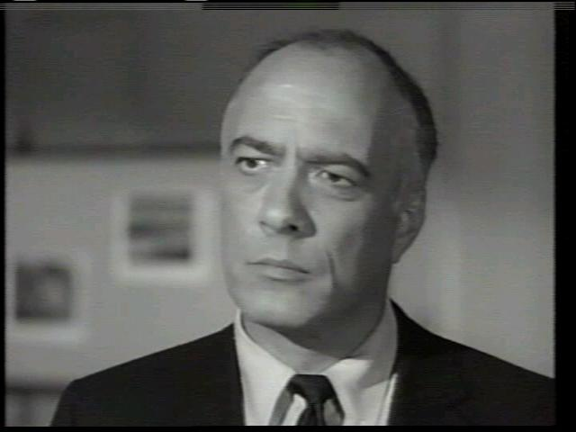
SORRY ABOUT THAT!

Slide 5
INTRODUCTION
This presentation will take a look at the fields within PHRMTIM (The Table behind PHAMTIM), and describe exactly what is required to successfully load the data.
From there we will look at the specific process that we use at ULM.
We will look at the data that we download from the Third Party Time Clock, and how we take that data and ensure that it matches the specific Jobs that are entered on NBAJOBS from HR.
The procedure that loads the data to PHRMTIM can be run in non-update mode as much as necessary to ensure the correctness of the data, and then run in update mode to actually load the data.

Slide 6
What is PHRMTIM?

Slide 7
PHRMTIM
It is a Temporary Table – The data is deleted from the table as soon as the Payroll updates.
All the data is fed into the Payroll with the Mass Time Entry Process (PHPMTIM).
As long as it is formatted properly, if the data submitted contains errors, they WILL load into the Payroll Process, but can be quickly corrected during the Payroll Process.

Slide 8
OTHER USES
Load time that is tracked with spreadsheets
Other Special Rate Earnings including:
Bonuses
One Time Pays
Deductions

Slide 9
PHRMTIM FORMAT

Slide 10
PHRMTIM FIELDS
PHRMTIM_YEAR – Payroll Year
PHRMTIM_PICT_CODE – Pay ID (BW,9M,MN,ST)
PHRMTIM_PAYNO – Payroll Number
PHRMTIM_CHANGE_IND – “Y”
Yes - Process through Payroll
Field is not visible on the Form PHAMTIM

Slide 11
PHRMTIM FIELDS (cont’d)
PHRMTIM_ACTIVITY_DATE – Date of Data Load
PHRMTIM_ID – Banner ID (Not PIDM)
Only validated field in Table
PHRMTIM_POSN – Position Number
PHRMTIM_SUFF – Position Suffix

Slide 12
PHRMTIM FIELDS (cont’d)
PHRMTIM_EARN_CODE – Earnings Code
PHRMTIM_SHIFT – “1” (Required even if you do not use SHIFTS)
PHRMTIM_HRS – Hours or Units
PHRMTIM_SPECIAL_RATE (Optional)– Special Rate
Only required if an earnings code is entered that requires a special rate

Slide 13
PHRMTIM FIELDS (cont’d)
PHRMTIM_BEGIN_DATE – Begin Date (Must be within the Payroll Period)
PHRMTIM_END_DATE (Optional) – End Date (Must be within the Payroll Period)
PHRMTIM_EFFECTIVE_DATE – ALWAYS NULL!!!
All Labor Fields Are OPTIONAL
Labor Fields defaults in from the Position on NBAJOBS
Can be used to Override Labor

Slide 14
HR JITTERS

Slide 15
Our Process at ULM
An extract file is created early Saturday morning after the Pay Period has ended.
This file is created from the Third-Party Time Clock and is used as the input for the load program to check against NBAJOBS and load the data to PHRMTIM.

Slide 16
EXTRACT FILE FROM TIME CLOCK
8 digit Campus Wide ID

Slide 17
EXTRACT FILE FROM TIME CLOCK
8 digit Campus Wide ID
FOAP (NULL) for Federal Student Workers

Slide 18
EXTRACT FILE FROM TIME CLOCK
8 digit Campus Wide ID
FOAP (NULL) for Federal Student Workers
FOAP for State Student Workers

Slide 19
EXTRACT FILE FROM TIME CLOCK
8 digit Campus Wide ID
FOAP (NULL) for Federal Student Workers
FOAP for State Student Workers
FUND
ORGN
PROG
ACCT

Slide 20
EXTRACT FILE FROM TIME CLOCK
8 digit Campus Wide ID
FOAP (NULL) for Federal Student Workers
FOAP for State Student Workers
Hours Worked

Slide 21
EXTRACT FILE FROM TIME CLOCK
8 digit Campus Wide ID
FOAP (NULL) for Federal Student Workers
FOAP for State Student Workers
Hours Worked
Beginning Date of Pay Period

Slide 22
EXTRACT FILE FROM TIME CLOCK
8 digit Campus Wide ID
FOAP (NULL) for Federal Student Workers
FOAP for State Student Workers
Hours Worked
Beginning Date of Pay Period
Ending Date of Pay Period

Slide 23
Comparison to NBAJOBS
The load procedure uses the FOAP from the input file to select the current POSN for the employee.
Run the procedure in Non-Update mode to ensure that the data is correct. It writes out a .csv file to identify any issues.
If data matches it prints the data to the .csv as it would be stored in PHRMTIM
If the data does not match, the .csv file will show that the data will not load and will display pertinent information to determine the issue.

Slide 24
CSV File

Slide 25
Process (Cont’d)
Once the file runs with every job processing, you can run the procedure in UPDATE mode to post the data to PHRMTIM to be used in the Payroll Process.

Slide 26
PHAMTIM

Slide 27
Payroll Process
The Mass Time Process (PHPMTIM) inserts the data into the Payroll Tables
When the record is inserted PHRMTIM_CHANGE_IND is changed from “Y” to “N”. If for some reason the record is re-extracted then it is switched back to “Y”.
When the Payroll is completed the record is deleted from PHRMTIM.

Slide 28
WEB TIME ENTRY
If you are using Web Time Entry, it uses PHRMTIM also.
Data from Web Time Entry will not load, if you have already loaded data for the same person.
Web Time Entry must be pulled into PHRMTIM before data is loaded for the same person.
*** This is not a problem for the way that we use the process. Our student worker load from the Time Clock is in lieu of Web Time Entry.

Slide 29
Payroll ERRORS!!!
Usual errors include:
Incorrect Positions and Suffixes
Incorrect Earnings Codes
Incorrect Dates
*** ALL THESE ERRORS ARE HEADED OFF IN ADVANCE WITH THE WAY WE RUN THIS PROCESS
If you are loading data through another means, the errors can be identified on PHIDERR. Then the errors can be corrected by the Payroll clerk during the normal payroll process.

Slide 30
SUMMARY
PHRMTIM is a quick and easy way to add employee time from a Third Party Time Clock.
This process allows for all errors to be identified before the data is actually loaded.
Details can both be viewed on the report produced from the Procedure or on PHAMTIM.

Slide 31
QUESTIONS???

Slide 32
KEN WESTERBURG
University of Louisiana at Monroe (ULM)
westerbu@ulm.edu

