Slide 1

MBUG 2018
Banner Workflow Boot Camp
Doru Pacurari, Ellucian TM @ JSU
September 11, 2018

Slide 2
Session Rules of Etiquette
Please turn off your cell phone
If you must leave the session early, please do so discreetly
Please avoid side conversation during the session

Slide 3
Why would you use a Banner Workflow(WF)?
Simplifies and directs the flow of work throughout your entire organization:
  Replace paperwork
  Send electronic notifications
Provides timely movement of work between role players
Perform repetitive tasks – update records using PL/SQL
Promotes process improvement within your organization

Slide 4
Banner WF Features
Sequential/Parallel processing
Directed activities
Proxy support
Banner integration
Activity types
  Interactive
  Manual
  Automated
  Email
  Custom
  Approval

Slide 5
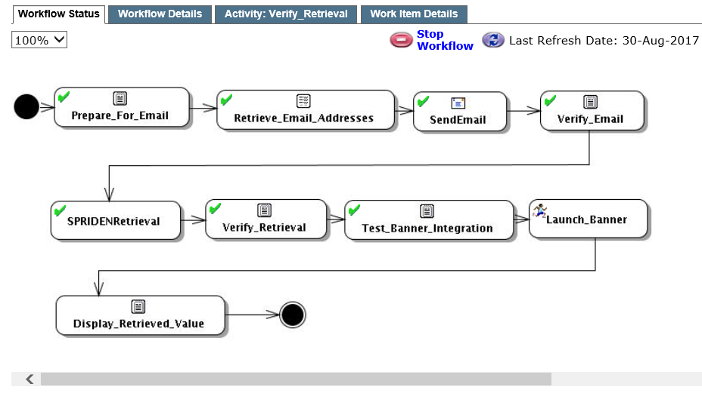
Example: System Verification Workflow
Manual
Custom
Email
Automated

Slide 6
Examples of WFs at JSU
Employees termination notification
Admissions Checklist item notification (received, added)
Admissions decision notification (Grad and Ugrad)
Graduation Clearance Denial notification
Next approver notifications for Requisitions and Budget Transfers
Supervisor Timesheet Approval notice
Change of Major workflow

Slide 7
WF Administrative tasks
MIF/Organizations
User/Role Management
Security Management
On-Line Users
Business Components
Workflow Alerts
In-process Monitoring
Deleting Workflows

Slide 8
WF Admin tasks (cont’d)
Supports Multiple Institution Functionality (using Oracle VPD)
User Management
  Identified by User accounts
  ID/Password
Role management – groups of skills - more complex, since one user can have more than one role
  Types – Primary, Proxy
  Determines which activities you see on your worklist

Slide 9
WF Admin tasks (cont’d)
Security Management
  There exists a security group for all administrative tasks
  Access is handled by adding roles to security groups
On-Line users
  Ability to view who is currently logged into the workflow system

Slide 10
Business Components
Are reusable units of work: launch a Banner form; run a SQL procedure or query; launch a desktop application
Define the data to be used and the work that will be performed
Are organized logically, i.e. Student, Finance, HR
Each component in a category is unique by name, product type, and release ID combination

Slide 11
Business Components (cont’d)
Component Types – Internal
  Runs on the WF server
  No user interaction required
  Examples: SQL query, SQL procedure
Component Types – Interactive
  Runs on the client’s machine
  Requires user interaction
  Examples: Banner form, desktop application

Slide 12
Business Components (cont’d)
Technology Types
  Tells Worklist how to launch
  User-defined technology types
  Delivered technology types
    Desktop application, i.e. Word, Excel
    Web application – default browser with URL populated
    Banner forms – i.e. SPAPERS
    SQL query
    SQL procedure – most common

Slide 13
Business Components (cont’d)
Component Parameters
  Used for data communication between component and workflow
  Can be used in launch parameter values
  Examples: Stored procedure, Banner form

Slide 14
Workflow Alerts
Used to notify workflow owner that a workflow instance has entered a stalled or error state
Monitor on a daily basis
Workflow alert examples:
  Single guard condition not satisfied
  User in directed activity not found
  Error in automatic activity

Slide 15
Workflow Alerts (cont’d)
Workflow Maintenance
  Looks like workflow status
  Contains the alert
  Allows the following activities
    Change context parameter values
    Force transitions
    Release alert
    Stop workflow
    Force complete on activity
  Workflow alert will go away once it is handled

Slide 16
In-Process Monitoring
Report of running workflow instance for a specified workflow model
Applies to workflows with an ‘Active’ status and ‘Test’ status
Example

Slide 17
Deleting Workflows
Uses constraints to minimize search results
Completely removes these workflow instances from the system
Use extreme caution when deleting!
Example

Slide 18
Workflow/Banner Events – Objectives
Event Overview
Set Up: Five-step process
External Events

Slide 19
Event Overview
A business event is an action that will eventually launch an instance of a workflow
Examples of when to capture a business event in Banner
  A change to a table in the Banner database
  Specific conditions are met in PL/SQL code

Slide 20
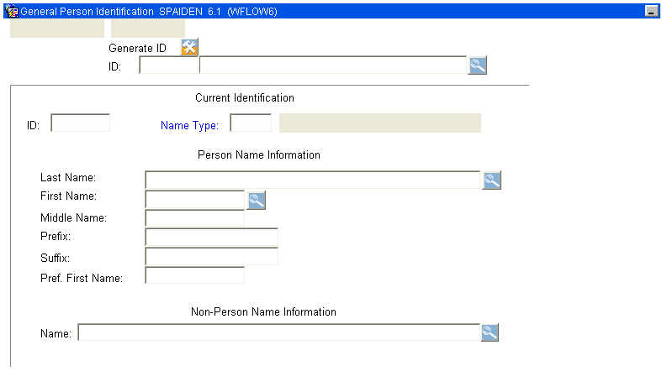
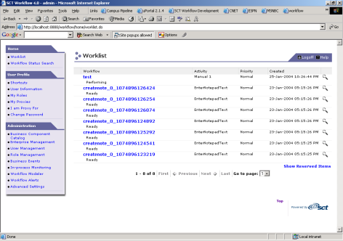
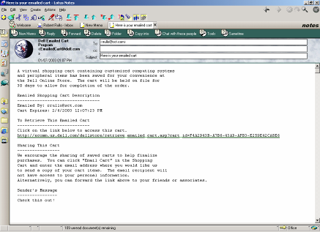

Event Overview
Banner Form
Workflow
Event Dispatcher
External Events
Oracle
Business
Processes
Mapped
workflows
Worklist
Email

Slide 21
WF Setup: Five-step process
Define event in Banner
Create trigger/procedure that fires an instance of the event
Model the WF that event will launch
Define event in WF
Define business process in WF

Slide 22
Step 1 – Define Banner Event
Uses five forms/tables:
      GTVEQNM – Event Name Validation
      GTVEQPM – Parameter Name Validation
      GTVEQPG – Parameter Group Validation
      GOREQPG – Parameter Group Definition
      GOREQNM – Event Definition

Slide 23
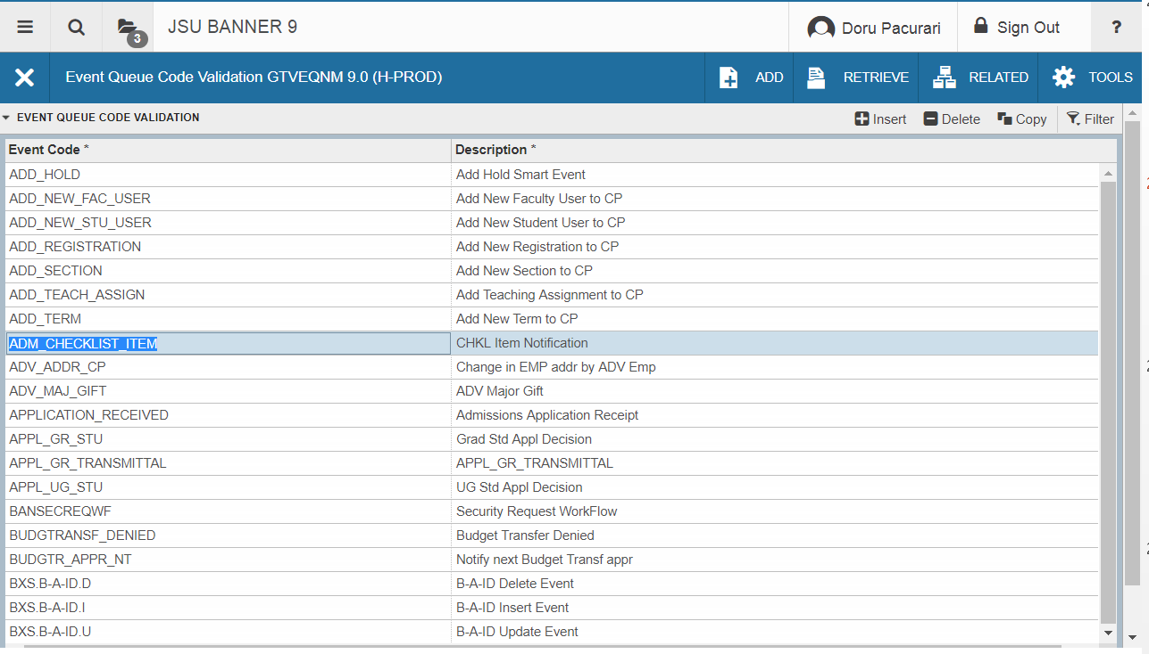
Step 1 – Define Banner Event (cont’d)
GTVEQNM – Event Name Validation

Slide 24
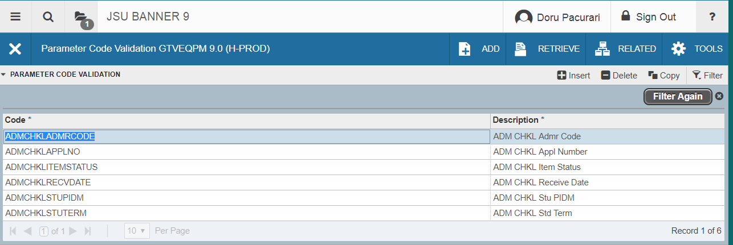
Step 1 – Define Banner Event (cont’d)
GTVEQPM – Parameter Name Validation

Slide 25
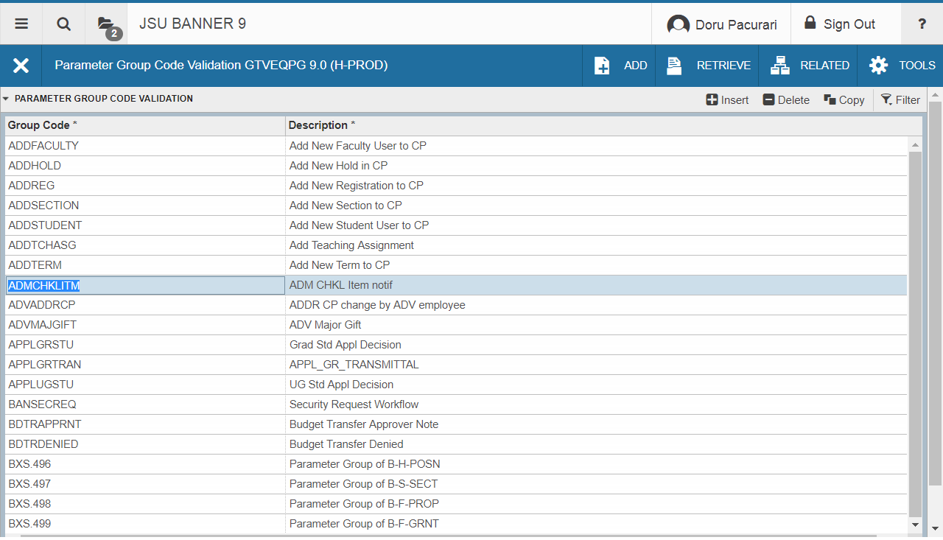
Step 1 – Define Banner Event (cont’d)
GTVEQPG – Parameter Group Validation

Slide 26
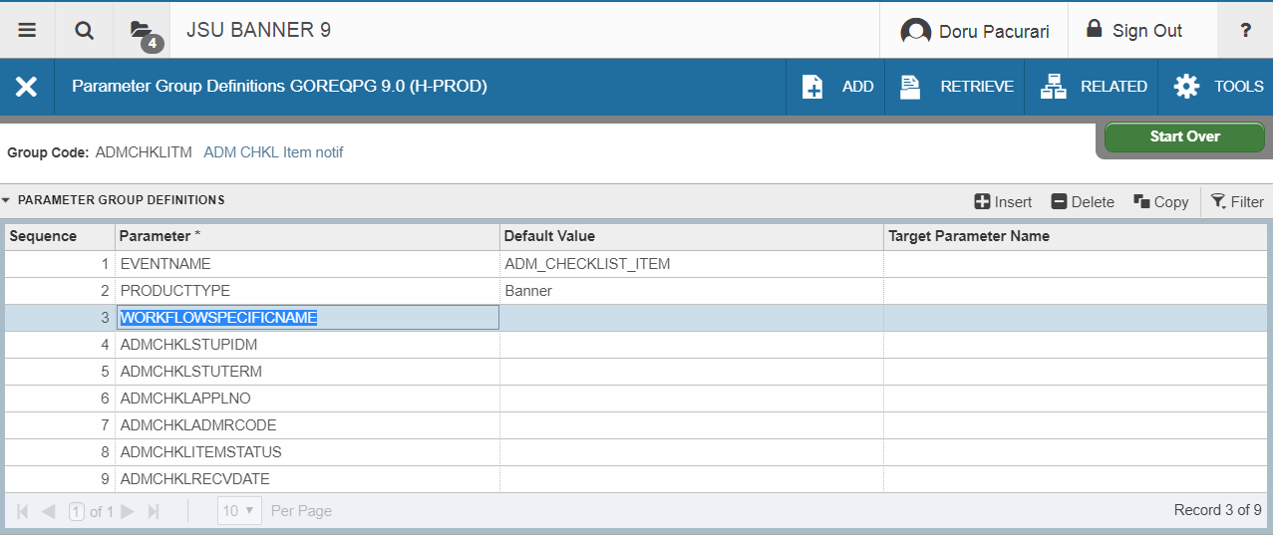
Step 1 – Define Banner Event (cont’d)
GOREQPG – Parameter Group Definition

Slide 27
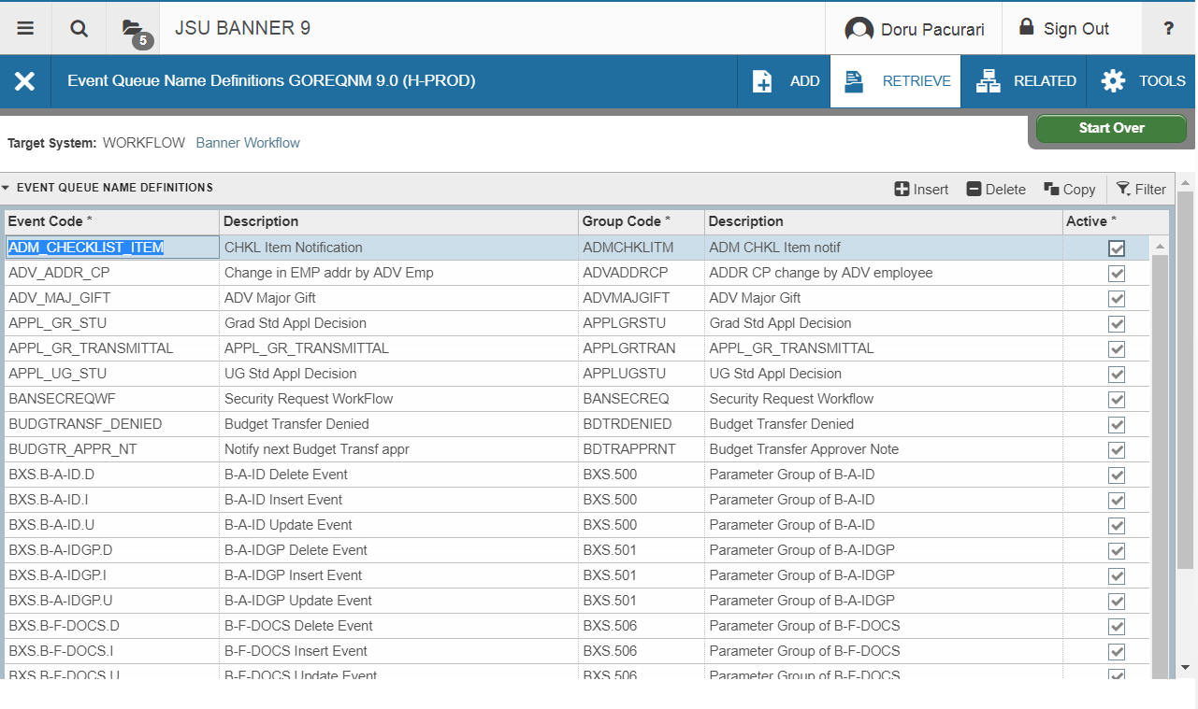
Step 1 – Define Banner Event (cont’d)
GOREQNM – Event Definition

Slide 28
Step 2 – Create trigger/procedure that fires an instance of the event
Most events are fired via a trigger
Can also fire in a procedure or package
Uses GOKPARM / GOKEVNT packages

Slide 29
Step 2 – Create trigger/procedure that fires an instance of the event (cont’d)
CREATE OR REPLACE TRIGGER BANINST1.JSU_WF_FIN_FOBAPPH_INS
AFTER INSERT
ON FIMSMGR.FOBAPPH
REFERENCING NEW AS NEW OLD AS OLD
FOR EACH ROW
WHEN (
NEW.FOBAPPH_QUEUE_ID = 'DENY'
)
BEGIN
SUBMIT_WF_EVENT ('REQUISITION_DENIED',
'Requisition ' || :NEW.FOBAPPH_DOC_CODE || ' Denied',
:NEW.FOBAPPH_DOC_CODE);
END JSU_WF_FIN_FOBAPPH_INS;
/
--------------------------------------------------------------- SUBMIT_WF_EVENT package calls GOKEVNT and GOKPARM

Slide 30
Step 3 – Create the WF in Modeler
Create the workflow model using the Workflow Modeler
  Building blocks:
    Start
    Activities: component, email, manual, approval, custom
    Transitions
    Branching
    Timer activity
    Parallel activity
    Stop
Example

Slide 31
Step 3 – Create the WF in Modeler (cont’d)
Parameters
  Parameters are the data used in a workflow
  Parameters are passed to the workflow when it starts
  Parameters are passed to and from workflow activities
Parameters types:
  Context parameters (need to be created)
  Component parameters (define data fields used by an activity)
  Attributes (Originator; WF specific name)
  Event parameters
    *discussed with Business Events

Slide 32
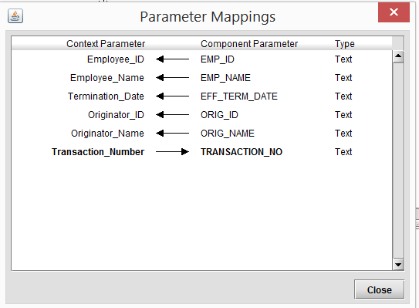
Step 3 – Create the WF in Modeler (cont’d)
Parameter Mapping
FROM context TO component
  ->input (IN)
FROM component TO context
  <-output (OUT)
WF Modeler Demo

Slide 33
Step 4 - Define event in WF
Workflow event names must match the Banner event names
Workflow parameter names must match the Banner parameter names
Wizard provides ability to get events from Banner -> Example
Events are global
Associate workflows that MAY get launched when workflow gets this event
  Map event parameters to workflow parameters

Slide 34
Step 5 - Define business process in WF
Defines the evaluation process to use when events get posted to workflow
Events can be part of multiple business processes
A business process can have multiple events
Each business process can only launch one workflow instance per organization
  If an event should launch more than one workflow for an organization, create multiple business processes
  Can associate more than one workflow and organization with a business process for different periods of time only

Slide 35
WF Reports
Workflows and specific tasks are reportable.
– Report summary statistics
– Time to completion
– Workflow status
– And more

Slide 36
WF Report example
SELECT A.WORKFLOW_NAME "WF_NAME",
(SELECT C1.VALUE
FROM WORKFLOW.ENG_PROPERTIES_VALUES C1
WHERE C1.NAME = 'ADMS_APP_NUM_IN' AND A.WF_ID = C1.ID)
"APP_NUMBER",
C.VALUE "TERM",
A.NAME "LOCATION",
B.FIRST_NAME || ' ' || B.LAST_NAME "PERFORMER",
( TO_DATE ('1970-01-01', 'YYYY-MM-DD')
+ start_date / (1000 * 60 * 60 * 24)
- (6 / 24))
"RECEIVED DATE"
FROM WORKFLOW.VWORKITEMS A,
WORKFLOW.WFUSER B,
WORKFLOW.ENG_PROPERTIES_VALUES C
WHERE A.PD_ID = 7183086
AND A.STOP_DATE IS NULL --not completed
AND A.RUNNING = 'Y'
AND A.WORKLIST_OWNER = B.ID
AND C.NAME = 'ADMS_TERM_IN'
AND A.WF_ID = C.ID
ORDER BY 4, 5, 1, 2

Slide 37
Banner WF/Ellucian WF comparison
Feature | Banner Workflow | Ellucian Workflow
Availability | Now | Now
Location | On Prem or Hosted | Cloud only
Data Integration | Integrated with Banner, query stored procedures and Banner data | Integrated with Ethos
Modeler | Visual tool, Java applet (JNLP) | Visual tool, cloud-based, runs in browser
Data Storage | Resides in Banner database | Resides in Ellucian Cloud; source data resides in Banner DB
Methods for starting a Workflow | Triggers in DB, Custom SSB, Page Builder, Manual, SOAP, API | Triggers in BEP, hyperlink, manual, API
Web forms development | Visual designer in modeler | Visual designer with drag-and-drop elements
Javascript needed for advanced web forms | Yes | Yes
Assign work | Can assign work to person or role | Flexible; roles, groups exist in directory

Slide 38
Banner WF/Ellucian WF comparison
Feature | Banner Workflow | Ellucian Workflow
Seed models provided | A few samples | Workflow templates currently available
3rd party integration | Can connect to any JDBC Datasource | PM Connectors and REST API
Open Pages/Forms In Banner | Yes | Not built in, but can be programmed. (Banner 9 only)
Log-in | Workflow account must be provisioned. Banner, CAS and SAML2 supported for SSO | Workflow account must be provisioned. LDAP supported, SAML2, supported for SSO
Banner 9 Compatibility | Workflow version 8.4 and above is compatible with Banner 9 because they now support integration through Application Navigator. | Yes

Slide 39
Review/Wrap Up
Questions
Contact:
  Doru Pacurari
  Sr. Programmer Analyst
    Ellucian TM @ JSU
    (601) 979-4001
    (304) 685-4451
    Doru.Pacurari@jsums.edu

