Slide 1

MBUG 2018
Procurement Card Updates
Presented By: Symone Bounds
Institution: State of MS – Dept. of Finance of Administration,
Office of Purchasing, Travel and Fleet Management
September 10, 2018

Slide 2
Session Rules of Etiquette
Please turn off your cell phone
If you must leave the session early, please do so discreetly
Please avoid side conversation during the session

Slide 3
Procurement Card Staff
Symone Bounds, Director
Marketing and Audit
Office of Purchasing, Travel and Fleet Management
601-359-9373
601-359-3910 (fax)
symone.bounds@dfa.ms.gov
Jametta Gregory
Procurement Card Administrator
Office of Purchasing, Travel and Fleet Management
601-359-3409
601-359-3910 (fax)
Jametta.gregory@dfa.ms.gov
Ross Campbell, Director
Office of Purchasing, Travel and Fleet Management
601-359-3409
601-359-3910 (fax)
ross.campbell@dfa.ms.gov
Candice Hay
Travel Coordinator
Office of Purchasing, Travel and Fleet Management
601-359-5099
601-359-3910 (fax)
candice.hay@dfa.ms.gov

Slide 4
Laws and Policy
MS Code,1972, Annotated, Section 7-7-23
  The State Fiscal Officer established a general rule to allow state agencies to make certain purchases without first issuing a purchase order
MS Code, 1972, Annotated, Section 31-7-9
  Gives OPTFM the ability to develop regulations to oversee the use of the p-card program
Notes:
How are we able to have a procurement and travel card program?
MS code 31-7-9
The Office of Purchasing, Travel and Fleet Management may adopt purchasing regulations governing the use of credit cards, procurement cards and purchasing club membership cards to be used by state agencies, governing authorities of counties and municipalities, school districts and the Chickasawhay Natural Gas District. Use of the cards shall be in strict compliance with the regulations promulgated by the office. Any amounts due on the cards shall incur interest charges as set forth in Section 31-7-305 and shall not be considered debt.

Slide 5

Key Terms
Procurement Card (P-Card)
Procurement Card Administrator
Program Coordinator (PC)
Merchant Category Codes (MCC Codes)
Notes:
The Procurement Card (sometimes referred to as the p-card) offers an
alternative method to purchasing services and/or commodities
2. Procurement Card Administrator- person who is the liaison between the Program Coordinator and the bank.
3.Program Coordinator (PC) is the individual that is responsible for overseeing the use of procurement cards in your “specific” agency.
4. MCC codes (Merchant Category Code) are codes or a number that has been assigned to retail outlets which helps identify types of business.

Slide 6
Procurement Card Program Purpose
Speed
Ease of use
Used for both Commodities/services
Used for a large number of small purchases
Allow departmental personnel (State Agencies and Governing Authorities) to make small dollar purchases ($5,000 & under)
Notes:
Most of a department’s purchases are under $5,000. Its so much easier and quicker with the card.
Almost everybody nowadays has some type of personal credit card they use and they realize its just so much easier with a card.
The future of purchasing is changing and the paper process is slowly vanishing.

Slide 7
Benefits of the P-card Program
Replaces the traditional purchasing method of requisition, purchase order, delivery, invoicing, check disbursement and storage.
Reduction in issuing small dollar PO’s
Reduces process time spent processing large number of requisitions
Increase in processing efficiency
Increase in purchasing flexibility
The procurement card program provides an easy purchase method which can improve customer service
Suppliers benefit from prompt payment
Fewer duplicated invoices
Notes:
Also important to point out, program coordinators have “real time” access to see exactly what each p-card user is doing
Can see the amount of the purchase, the vendor, time and date, etc.
What are some of your agency’s concerns for using the p-card?

Slide 8
P-Card Guidelines
Serve as a source of information about the State of Mississippi Small Purchase Card Program
Include information such as:
  Useful Contact Information
  Prohibited Purchases
  Maximum Threshold Amount for p-card usage
  Forms for agency p-card program maintenance
  Directions on how to become a part of the p-card program
Can Be found on OPTFM website at:
http://www.dfa.ms.gov/media/7135/procurementcardguidelinesrevised10-30-2013.pdf
Notes:
I suggest any p-card user to print out and make themselves familiar with the p-card guidelines.
Might want to go to the guidelines and highlight what is inside of it.

Slide 9
Minimum Requirements
While using a p-card, the cardholder/program coordinator must be mindful of the following:
  The prices of products or services are fair and reasonable
  Available budget authority exists to cover expenditures
  No capitol equipment – asset items
  Purchases comply with purchasing laws
  Items are not on the prohibited list
  State contract items can be purchased with the p-card
  Reconciliation process should be conducted by cardholder and program coordinator
  Any updates/request to the card or card information must be submitted to the program administrator on the appropriate forms found at: http://www.dfa.ms.gov/dfa-offices/purchasing-travel-and-fleet-management/marketing-and-audit/procurement-card-services/procurement-card-forms/
Notes:
Let’s not forget we are purchasing agents and we should always find the best price.

Slide 10
Prohibited Purchases Examples
Fuel
Gifts
Generators
Entertainment
Motorized vehicles
Alcoholic beverages
Cash Advancements
Reoccurring Monthly Charges
Items on back order
Items for personal use
Travel related expenses
Camera and Camera Equipment (greater than $250)
Televisions (greater than $250)
Radioactive, Explosive, or other Hazardous material
Contractual Services to an Individual, Sole Proprietor, Partnership or LLC-Partnership
Computer and Computer equipment (greater than $250) (central processing unit, terminal, printer, external hard drive)

Slide 11
Food Purchases on P-Card
Food may be purchased in restaurants, grocery stores or any location that food is sold
  The food may be purchased for pick-up, delivery or dine-in
Food purchases for business meetings may be purchased on the procurement card provided the following requirements are met:
  An agenda is needed
  The purchase of food must serve a legitimate business purpose
  More than one person must be present for the purchase of food
  No alcohol may be purchased
  Any gratuity over 20% requires a written
  Complete Food Form located on the OPTFM website at:
http://www.dfa.state.ms.us/Purchasing/ProcurementCardServices/UMBFoodPurchaseForm.pdf
Notes:
Show food form and explain it.

Slide 12
Miscellaneous Purchases
The Procurement Card may be used for the following:
Conference Registrations
Memberships
Software, provided you are not signing a Licensing Agreement Auto Rentals regardless of the provider (not while in Travel Status) Freight/Shipping Charges
Postage/Post Office Box Rental Subscriptions/Publications Reprints
Advertising
Space Rental at Conferences/Conventions
Space Rental at Hotels
Charter Buses – for group tours/university trips including the reservation

Slide 13
Hotel Charges
No hotel charges are allowed on the P-Card for State of Mississippi employees
  Only use the travel card for travel related expenses
Only hotel charges that can be allowed on the P-card are for the following:
  Visitors of the state
  For conference rooms/meeting spaces within a hotel

Slide 14
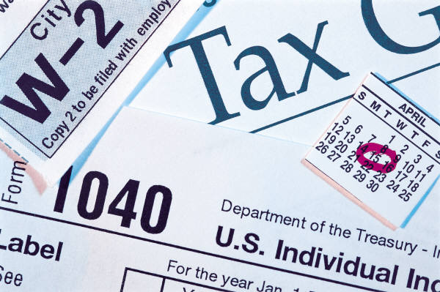
SALES TAX
State of MS sales tax should not be charged to the procurement card
  Out-of-state purchases are exempt from the no sales taxes rule
  This exemption does not apply to sales of airfare
It is the responsibility of the cardholder to inform the vendor of the card’s tax-exempt status
If charged tax, user should obtain a credit
  If no credit is obtained, the cardholder must submit payment to the agency for the total tax amount charged during that transaction
Notes:
This is very important. This is one of the great benefits of using the card. Tax can add up if you are not using the card properly.

Slide 15
Surcharges
MS Code section 31-7-9 (1) (d) prohibits a vendor from imposing a surcharge on the P-Card
Surcharge is when the vendor is charging an extra fee just because the form of payment is credit card and not cash
If a surcharge occurs during a transaction, the card user should obtain a credit from the vendor
Notes:
MS Code
(d) In a sale of goods or services, the seller shall not impose a surcharge on a buyer who uses a state-issued credit card, procurement card, travel card, or fuel card. The Department of Finance and Administration shall have exclusive jurisdiction to enforce and adopt rules relating to this paragraph. Any rules adopted under this paragraph shall be consistent with federal laws and regulations governing credit card transactions described by this paragraph. This paragraph does not create a cause of action against an individual for a violation of this paragraph.
Surcharge is when the vendor is charging you an extra fee just because you are using a card and not cash.
******Give P-card activity here.******

Slide 16
Itemized Receipts/Invoices
Obtain an itemized receipt/invoice for each purchase
If receipts cannot be obtained, complete a Missing Document Affidavit Form can be found on the OPTFM website at:
  http://www.dfa.ms.gov/media/3106/umbmissingdocumentaffidavitform.pdf

Slide 17
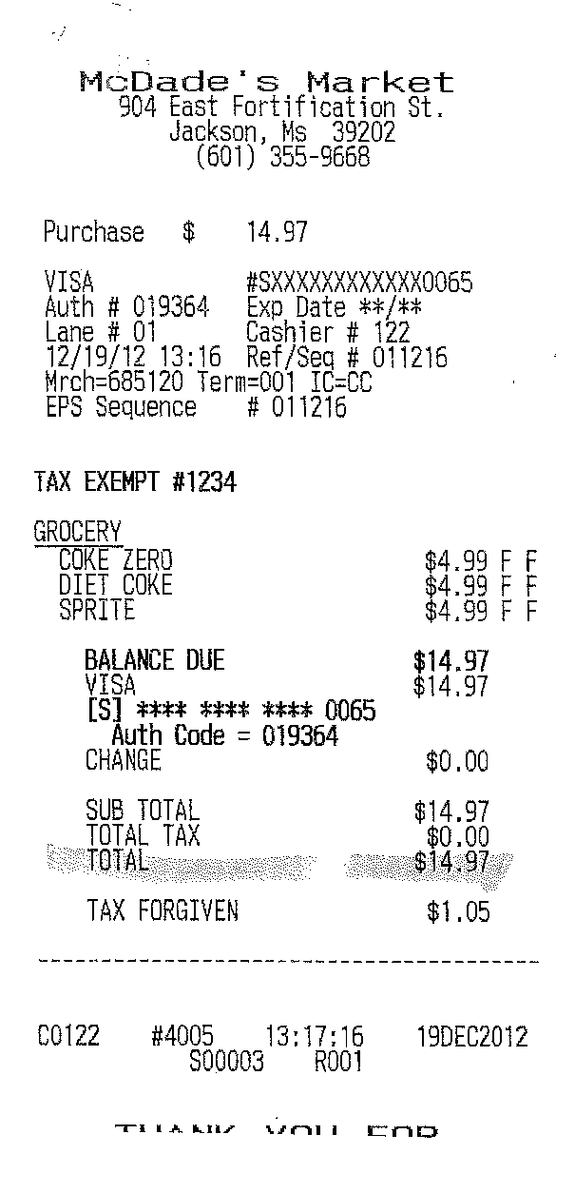
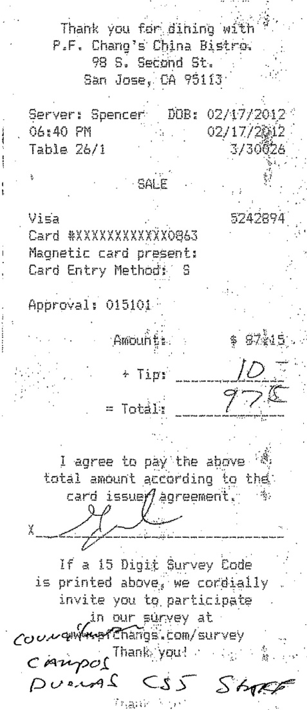
GOOD
BAD
Notes:
Ask the class why one receipt is good and why one receipt is bad.

Slide 18
Reasons For A Card To Be Declined
The most common reasons for the card to be declined include:
  Monthly spending limit exceeded
  Incorrect expiration date
  Incorrect card number
  Restricted vendor
  Single transaction limit exceeded
  Incorrect MCC code
  Blocked MCC code

Slide 19

Security Issues
Keep the procurement card in a secure location (e.g. locked file cabinet or office safe)
Require users to sign the office procurement card out and in after use
Do not carry the procurement card on vacations, weekends or holidays
Keep the procurement card separate from personal credit cards.
Always double check receipts against bank statements

Slide 20
Balances on Accounts
Balances should not be carried over to the next month
Balances on the procurement card shall be paid at the receipt of the monthly statement, once statement(s) have been reconciled for accuracy
Per Section 31-7-305, MS Procurement Manual, amounts shall incur an interest rate of 1 ½ %

Slide 21
Liability
The State of Mississippi will not accept any liability or financial responsibility for state employees’ charges that have not been authorized and exceed any specified limits and violate any of the MCC code restrictions pursuant to current card association rules and regulations.

Slide 22
Rebate
Based on the State’s entire p-card/travel card overall spend and the amount of time it takes for agencies to pay their bills, a rebate is awarded to all agencies participating on the state p-card/travel card program
The more the cards are used the higher the rebates
Notes:
The state is based on a sliding scale basis. It takes into consideration how fast we pay the bill and how much spend is on the ENTIRE state of MS p-card program, not just your agency. Everyone benefits with the p-card is used. This year the state of MS is on pace to bump up to the next tier on the rebate schedule.
If your having a hard time justifying the p-card program to your supervisor or agency head use this. Explain to him you are already saving money using the card and you get money back on top of that. That rebate money could be used to send your employees to this class or other training classes.

Slide 23

Upgrades to Our Program
Platform Upgrade
Program Onboarding Training
Individual Cardholder Training/Certification
Online Certification
Form Upgrades
Program Guideline Update

Slide 24

Join Our Program Today!!
If you would like to join our program, please do not hesitate to contact our office
Our Process:
  Initial Contact
  Submit the necessary information to OPTM
    All Forms
    Tax-ID
    Last Fiscal Year Audited Financial Statement
  Participate in an on-site training
    Our office comes to you
  Cards are shipped to your entity

Slide 25


