Slide 1
MBUG 2018
Session Title: NIST 800-171 in Higher Education
Presented By: Thomas Ritter – Security & Compliance Officer
Institution: Mississippi State University
September 3rd, 2018

Slide 2
Session Rules of Etiquette
Please turn off your cell phone
If you must leave the session early, please do so discreetly
Please avoid side conversation during the session

Slide 4
Economic Impact of Cybercrime
Latest Center for Strategic and International Studies (CSIS) report says $600 Billion – Feb. 2018
Title is: Economic Impact of Cybercrime – No Slowing Down
Helped by black markets, digital currencies and new technology

Slide 5
Higher Education Particularly Attractive
Hackers want faculty, staff, student and institutional DATA!!!
Passwords
Financial Aid Information
Health Information
Intellectual Property of all kinds
Library journals and periodicals
Research Data

Slide 6
National Institute of Standards and Technology
NIST recommends security controls for federal information systems.
800 Series documents describe the US federal government computer security policies, procedures and guidelines
NIST is a part of the Dept. of Commerce
NIST 800-53 is the standard used by Federal Information Security Management Act (FISMA)

Slide 7
NIST 800-171
Protection standards for Controlled Unclassified Information (CUI) in non-federal information systems
CUI is essentially anything that must be protected that is not “classified”
Higher Education: research data, export controlled research data, personally identifiable information (PII) and student financial aid information
14 families of security requirements

Slide 8
Why do Higher Education care?
Defense Contracts
Defense Federal Acquisition Regulation Supplement (DFARS)
Federal Acquisition Regulation (FAR) – expected December
https://er.educause.edu/blogs/2018/5/cui-requirements-in-federal-contracts-arent-far-away
“Since all higher education institutions must sign a PPA in order to participate in federal student aid programs, as well as have an SAIG agreement in place to exchange data with FSA systems, integration of CUI Rule requirements based on 800-171 into those agreements would have far-reaching implications for EDUCAUSE members.”

Slide 9
Dear Colleague Letter – July 2016
Reminded institutions that student financial aid information is subject to the security requirements of Gramm-Leach-Bliley Act (GLBA)
“Strongly encourages” institutions to review and understand NIST 800-171
Audits will begin to incorporate GLBA requirements into its annual audit guide

Slide 10
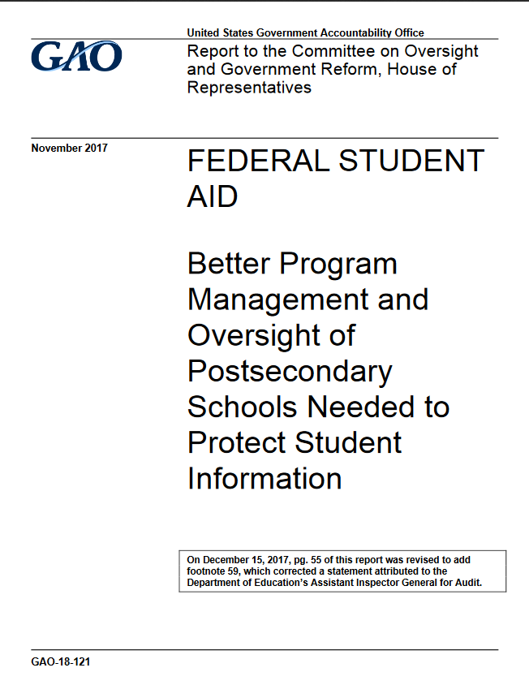
GAO – Report Dec 2017
Title Says it all…
“Until Education ensures that information security requirements are considered in program reviews of schools, FSA will lack assurance that schools have effective information security programs.”

Slide 11
Are you already required?
https://library.educause.edu/resources/2016/4/an-introduction-to-nist-special-publication-800-171-for-higher-education-institutions
“A higher education institution must review its contracts with federal agencies carefully. There must be a document (contract) referencing both (1) the data the federal agency is sharing that it has specifically identified as CUI, and (2) that the institution must follow the terms of NIST 800-171.”

Slide 12
NIST 800-171 Control Families
Family | Family
Access Control | Media Protection
Awareness and Training | Personnel Security
Audit and Accountability | Physical Protection
Configuration Management | Risk Assessment
Identification and Authentication | Security Assessment
Incident Response | System & Communications Protection
Maintenance | System and Information Integrity

Slide 13
Security Requirement Structure
Basic Security Requirements: (Configuration)
Establish and maintain baseline configurations and inventories of organizational information systems (including hardware, software, firmware, and documentation) throughout the respective system development life cycles.
Establish and enforce security configuration settings for information technology products employed in organizational information systems.

Slide 14
Security Requirement Structure
Derived Security Requirements:
Track, review, approve/disapprove, and audit changes to information systems
Analyze the security impact of changes prior to implementation.

Slide 15
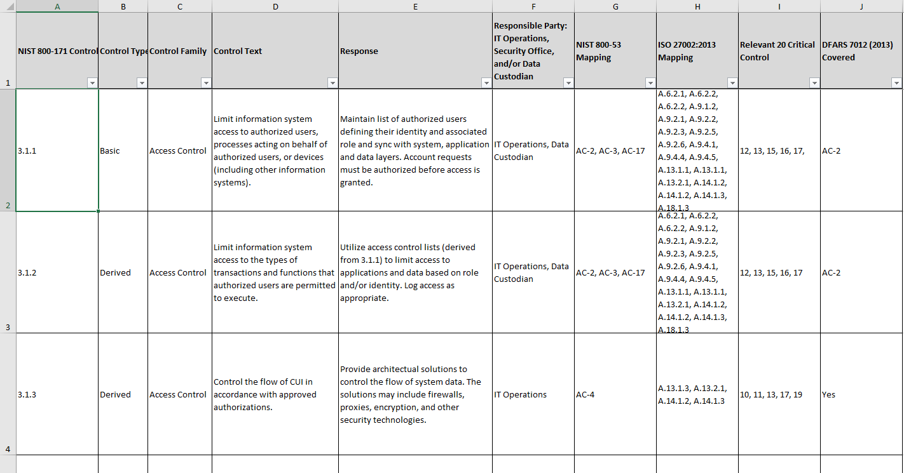
NIST 800-171 Compliance Template
https://library.educause.edu/resources/2016/9/nist-sp-800-171-compliance-template

Slide 16
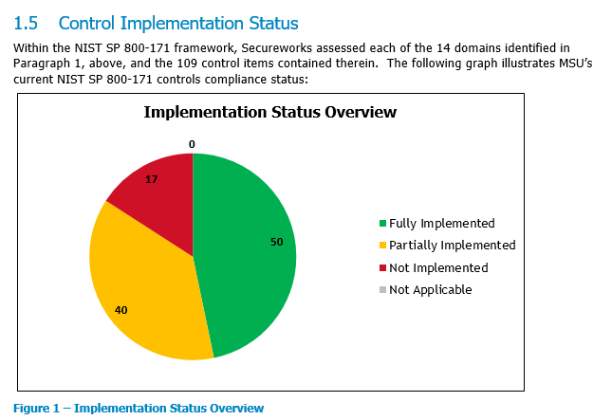
NIST 800-171
Dell SecureWorks – NIST 800-171 Security Controls Assessment – July 2018
Units Financial Aid/Registrar and a research unit
*major cultural change
*significant long-term effort
*scoping critical

Slide 17
Two – Factor Authentication

Slide 18
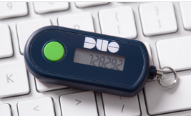
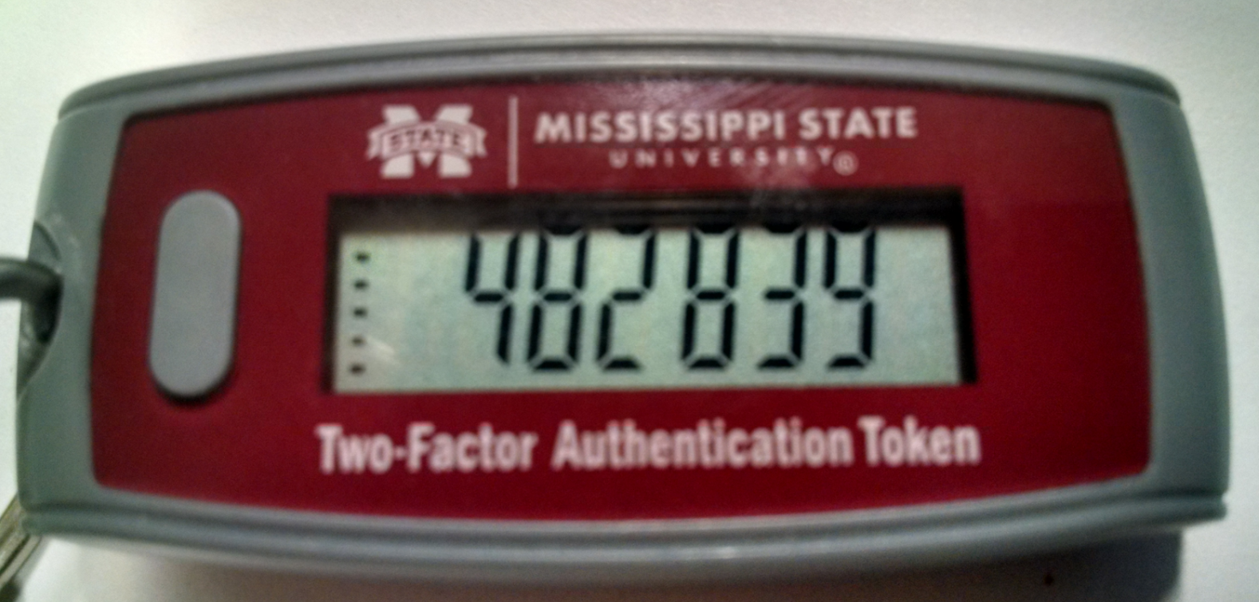
Two – Factor Authentication

Slide 19
DUO is REQUIRED@MSSTATE
To access university information staff are required to use two factor authentication (2FA) per the Information Security Program infosecurity.msstate.edu
Student requirement has been approved and will be implemented in Spring 2019
To folks that complain, students have lost financial aid funds and staff have lost paychecks…

Slide 20
Keystroke Logger

Slide 21
Conclusions
Don’t have exact timelines but it is clear that NIST 800-171 is coming and will be required.
Institution Security Programs need to be reviewed and it should start now.
Questions?

