Slide 1
MBUG 2018
Session Title:
Presented By:
Institution:
Date:
IHL Update
Jim Hood
MS Institutions of Higher Learning (IHL)
September 10, 2018

Slide 2
IHL Update
Jim Hood, Ph.D.
Assistant Commissioner for Strategic Research
MBUG 2018 Conference – September 10, 2018
@MSPublicUniv www.mississippi.edu #AdvancingMS

Slide 3
IHL Activity
Fall2017 Students – 81,378 (82,654*²⁰¹⁶)
AY2018 Students – 94,137 (95,857*²⁰¹⁷)
AY2018 Degrees – 18,248*
AY2019 Avg Annual In-State Tuition - $7,729*
FY2017 Research Dollars – $421M ($586M*²⁰¹⁰)
Fall 2016 Employees – 27,976 (28,616*²⁰¹⁶)
Part-Time, UMMC (35%), MSU-Ag & Extension
*System Records

Slide 4
IHL Metrics
1 of 5 MS HS graduates meet ACT benchmarks in Math and Science
Nearly 1 of 3 entering freshmen need remediation
40 percent of entering freshmen are on Pell
Almost 1 of 2 entering freshmen are nonresident
In 5 years: Education enrollment decreased 37%; STEM enrollment increased by 28%
On average 1 of 2 graduates were at-risk students (Pell and/or ACT<19)
46.1% of all baccalaureate graduates leave the state in five years

Slide 5
IHL Update & Discussion of Issues
Data Suppression
MSGRADJOBS.COM Initiative
Lifetracks Workforce Report
Complete to Compete Initiative
MS Data Management Working Group
Cybersecurity Insurance
Recent IHLMIS Data Changes

Slide 6
IHL Update & Discussion of Issues
Data Suppression
MSGRADJOBS.COM Initiative
Lifetracks Workforce Report
Complete to Compete Initiative
MS Data Management Working Group
Cybersecurity Insurance
Recent IHLMIS Data Changes

Slide 7
Data Suppression
What is data suppression?
In education, data suppression is the process of withholding or removing selected information -- usually in public reports and datasets -- to protect the identities and personal information of individuals.

Slide 8
Data Suppression
No formal standards or guidelines for handling data suppression
IPEDS and SREB do not suppress data in their reporting
Reporting typically varies from no suppression at all – to limits of 5 or 10 students (most common) – Lifetracks and Complete College America (CCA) use 10 students

Slide 9
Data Suppression
Some entities produce two reports:
(1) suppressed report for public use
(2) unsuppressed report for internal use
This approach seems to be inefficient (duplicative) and problematic (potential for inconsistencies).

Slide 10
Data Suppression
What is the best way to handle data suppression – in a way that produces useful reports and protects the personal identification of individuals?
In reporting, what should be protected, and what can be released as directory-level information?
There doesn’t seem to be a clear answer

Slide 11
Data Suppression
IHL is currently working on a data suppression practice (not policy) that will hopefully maintain the usefulness of reports while protecting the sensitive personal information of individuals.
This practice is relatively new and still under review.

Slide 12
Data Suppression
Data on student performance (graduation rates, retention rates, ACT, etc.) and student wealth (Pell, etc.) will be redacted when reported by any combination of ethnicity, gender, or residency.
The redaction will occur when any grouping reaches 10 or fewer students.
All other aggregate data (enrollment, degree, etc.) will not be redacted.

Slide 13
IHL Update & Discussion of Issues
Data Suppression
MSGRADJOBS.COM Initiative
Lifetracks Workforce Report
Complete to Compete Initiative
MS Data Management Working Group
Cybersecurity Insurance
Recent IHLMIS Data Changes

Slide 14
MSGRADJOBS.COM
Website dedicated to helping current and former university students find MS jobs
Developed for the MS Department of Employment Security (MDES) by NSPARC at MSU
Students are encouraged to visit the website and develop online profiles to facilitate job matching

Slide 15
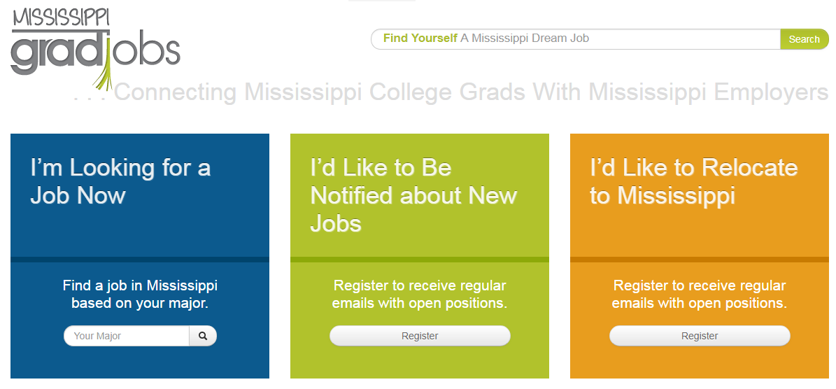
MSGRADJOBS.COM

Slide 16
MSGRADJOBS.COM
Issues:
Website listed jobs not applicable to university graduates (cooks, drivers, technicians, etc.)
The website was not being effectively communicated to university students – very few students were enrolling

Slide 17
MSGRADJOBS.COM
Solutions:
Website being updated to reflect jobs appropriate for university graduates
IHL working with universities to notify students of the website and its services (2 approaches based on FERPA)
MDES is taking a similar approach with the community colleges

Slide 18
IHL Update & Discussion of Issues
Data Suppression
MSGRADJOBS.COM Initiative
Lifetracks Workforce Report
Complete to Compete Initiative
MS Data Management Working Group
Cybersecurity Insurance
Recent IHLMIS Data Changes

Slide 19
Lifetracks Workforce Report
Report on Workforce Outcomes for IHL Graduates
Standing Annual Report from
Third year of report
Workforce Outcomes by
-Residency -Ethnicity
-Gender -Degree Level
-Program of Study: Baccalaureate
-Program of Study: Graduate & Professional

Slide 20
Lifetracks Workforce Report
61% of resident baccalaureate graduates remain in state 5 years after graduation ($37K)
8% of nonresidents remain after 5 yrs ($37K)
Discipline | 5 Year Retention | Median Annual $$
Business | 46.4% | $39.5K
Education | 72.8% | $36.3k
Engineering | 35.6% | $69.9K
Liberal Arts | 54.0% | $29.5K
Nursing | 70.1% | $56.8K
Social Services | 73.5% | $29.6K
Notes:
HERE ARE A FEW RESULTS FROM OUR SECOND REPORT FROM THIS SPRING….
YOU CAN PROBABLY BEGIN TO FORMULATE SOME POLICY QUESTIONS JUST FROM THESE NUMBERS…

Slide 21
IHL Update & Discussion of Issues
Data Suppression
MSGRADJOBS.COM Initiative
Lifetracks Workforce Report
Complete to Compete Initiative
MS Data Management Working Group
Cybersecurity Insurance
Recent IHLMIS Data Changes

Slide 22
Complete2Compete (C2C)
Statewide initiative to reclaim former students who never earned their degree
http://www.msc2c.org/

Slide 23
Complete2Compete (C2C)
MS adults (21+) with some college and no degree
- Improve college attainment goals
- Strengthen state workforce
- Improve personal incomes and state tax base
Data for the initiative went back 15 years
Collaborative effort between IHL and MCCB

Slide 24
Complete2Compete (C2C)
Defined Target Groups
- Removed Degree Holders (NSClearinghouse)
- Addressed Barriers (Financial, Academic)
- Provided grants to eligible students
Updated Campus Adult Services (ALFI Toolkit)
Re-engaged former adult students with direct marketing

Slide 25
C2C - Students
Universities enrolled 116 C2C students in AY2018 (87.9% in Spring)
Regional institutions accounted for 19%; research institutions accounted for 81%; JSU accounted for 37% of the total
56.5% female; 60% were of Black ethnicity
83% returned to their original institution
40% below age of 35; 10% over age 55

Slide 26
C2C - Degrees
Universities awarded 145 C2C degrees during AY2018 (77.9% awarded with no additional coursework)
Regional institutions accounted for 32%; research institutions accounted for 68%; MSU accounted for 50.3% of the total
46.2% female; 60% were of Black ethnicity
13 degrees went to students in other states
39% below age of 35; 15% over age 55

Slide 27
IHL Update & Discussion of Issues
Data Suppression
MSGRADJOBS.COM Initiative
Lifetracks Workforce Report
Complete to Compete Initiative
MS Data Management Working Group
Cybersecurity Insurance
Recent IHLMIS Data Changes

Slide 28
MS Data Management Working Group
HB649 – Initial Meeting in July 2017
9 members (ITS, DFA, PEER, LBO, MDH, IHL)
Identify all structured and unstructured data
Degree of accessibility and volume
Legal requirements that impact access (FERPA)
All files and records shall become work files of PEER Committee
Final report to Legislature by Dec 2018 with policy recommendations

Slide 29
MS Data Management Working Group
Administered online survey to over 120 state agencies (including universities & IHL office)
Survey collected a variety of information (data dictionaries, audit procedures, frequency of updates, maintenance costs, security efforts)
Distributed on May 4th and was due on June 21st (100% response rate)
On track to have initial draft developed by late October (due 12/18)

Slide 30
MS Data Management Working Group

Slide 31
IHL Update & Discussion of Issues
Data Suppression
MSGRADJOBS.COM Initiative
Lifetracks Workforce Report
Complete to Compete Initiative
MS Data Management Working Group
Cybersecurity Insurance
Recent IHLMIS Data Changes

Slide 32
Cybersecurity Insurance
Did you know the universities have cyberinsurance that helps protect them in the event of a cyber breach incident?
Services include forensic response, fines and expenses, breach response, remedial breach response expenses

Slide 33
Cybersecurity Insurance
This year--there have been multiple fraud attempts that involve payroll redirects in BANNER, meaning an unauthorized third party has provided false bank information
Typically related to poor employee credentials or improper handling of phishing email
Other incidents have involved the release of sensitive employee information through phishing attacks and ransomware

Slide 34
Cybersecurity Insurance
Responses include a coordinated effort among internal offices (risk management, technology, legal, media, etc.) AND external offices (attorney general, forensics contractor, insurer, etc.)
Always a good idea to be proactive with cybersecurity rather than reactive – ask questions on campus about patches, third party assessments, employee training, etc.
Never trust email (or phone calls) dealing with sensitive information

Slide 35
IHL Update & Discussion of Issues
Data Suppression
MSGRADJOBS.COM Initiative
Lifetracks Workforce Report
Complete to Compete Initiative
MS Data Management Working Group
Cybersecurity Insurance
Recent IHLMIS Data Changes

Slide 36
IHLMIS Data Files
File | Beginning Year | Collection | Records
Student | 1986 | Sum, Fall, Spr | 5.32M
Degree | 1986 | Academic Year | 443K
Scholarship | 1989 | Fiscal Year | 5.78M
Employee | 1992 | Fall | 1.32M
Course | 1994 | Sum, Fall, Spr | 995K
Intermediate | 2004 | Sum, Fall, Spr | 85.8K
Grade | 2010 | Sum, Fall, Spr | 6.59M

Slide 37
Recent IHLMIS Data Changes
Data Dictionary
Adopted semi-annual update schedule (Jul & Jan)
Added supplemental student file to capture C2C enrollment (C2C data mentioned today was from supplemental file)
Reviewing differences between Double Majors and Double Degrees (this Fall)

Slide 38
Recent IHLMIS Data Changes
Student File
Updated latest ACT-SAT concordance table and process
Intermediate
Reviewing coding for intermediate and co-requisite courses (ongoing work)

Slide 39
Other IHL Activities
Studying IHL website and making revisions
Analyzing enrollment census dates and how they impact various data metrics
Commissioner Rankins in process of making listening tours at each university
Two presidential searches pending (ASU and MUW)
Connecting all universities to the state’s MissiON optical network.

Slide 40
Thank You!
Jim Hood, Ph.D.
Assistant Commissioner for Strategic Research
jhood@mississippi.edu – 601.432.7011
@MSPublicUniv www.mississippi.edu #AdvancingMS

