Slide 1
MBUG 2018
Degree Works Implementation
Where Do We Begin?
Presented By: Cindy Hampton and Elizabeth Milner
Institution: Mississippi College, Clinton, MS
September 10, 2018

Slide 2
Session Rules of Etiquette
If you must leave the session early, please do so discreetly.
Please avoid side conversation during the session.
Please raise your hand if you have a question.

Slide 3
Lessons Learned
Make sure you have a top level champion for the project.
Review your catalogs well in advance to identify any curriculum errors or issues that need to be addressed.
Include graduation analysts, advisors and departments early in the vetting process – you need their input and buy-in.
Set up excel file with all active program codes, degrees, majors, and minors for each catalog year you are implementing.

Slide 4
Lessons Learned (con’t)
Join eCommunities “Degree Works and Transfer Equivalency” and sign up to receive the daily email.
Search online to see examples of how others set up their degree programs and their help aids.
Attend the Degree Works Forum-this is a very good conference to attend. Network with as many people as possible.
APRIL 7-10, 2019
NEW ORLEANS, LA

Slide 5
Implementation
Began working with consultants the in summer 2016 and went live in fall 2017 with our undergraduate programs.
We had one onsite visit with a functional consultant and one onsite visit with a technical consultant. Worked via email/calls for additional assistance.
We scribed two full catalog years for undergraduates, 16-17, 17-18 and added all the curriculum changes for the 18-19 catalog. Anyone in a catalog prior to 2016 would still use CAPP for their degree evaluations.
Next we scribed our graduate programs for the same catalog years.
Our implementation team consisted of our Registrar, Assistant Registrar, and myself. We did all of the scribing of the programs.

Slide 6
Roll Out
Went live with the Degree Audits only.
Registrar presented DW to the Academic units and advisors.
Provided training via help aids and in our training lab.
Incoming freshmen and new faculty are introduced to DW in Orientation.

Slide 7
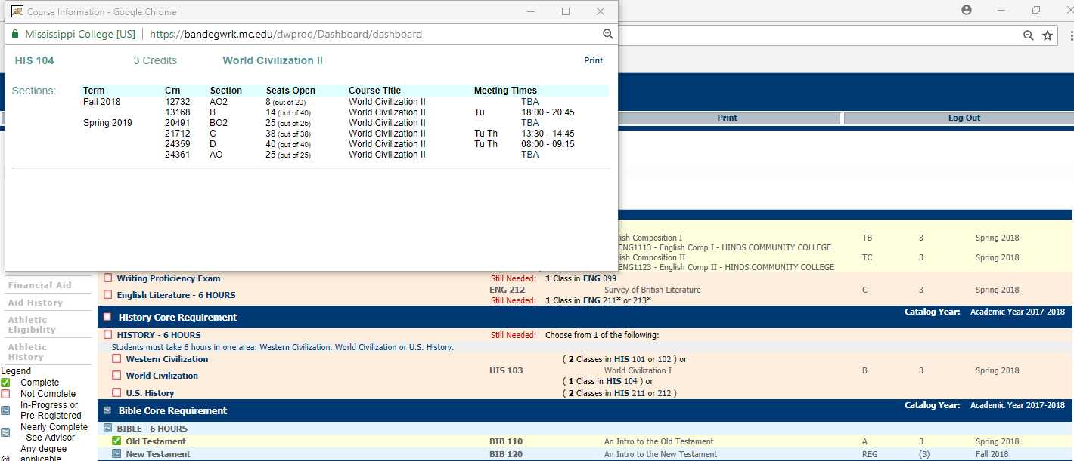
Best Parts I
Course Link-displays class schedule

Slide 8
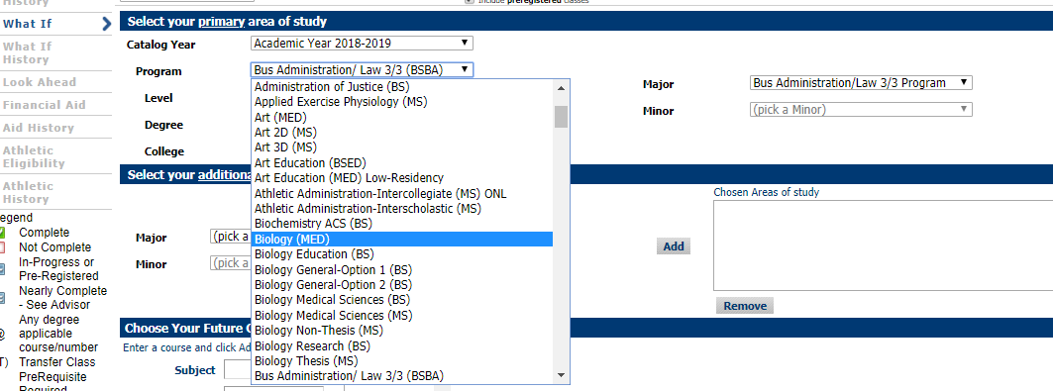
Best Parts II
What-if
Allows students and advisors to see how credits would apply toward a different program, minor, etc. in the current catalog they are assigned or can view requirements in a newer catalog.

Slide 9
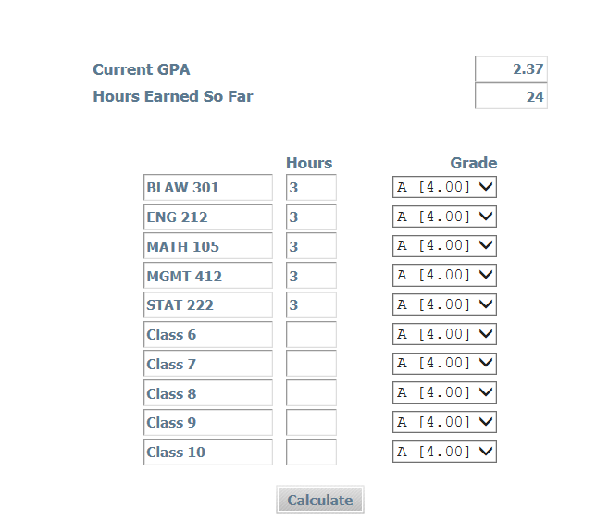
Best Parts III
GPA Calculator

Slide 10
Best Parts IV
When advisors login to Degree Works, all of their advisees are automatically loaded for them.
No looking up IDs or names, unless necessary for a student that is not their advisee.
Advisors can add notes to the audit that will appear at the bottom of the audit. This is beneficial to the student and the advisor. You can save the audit as a PDF and email that to the student which is helpful as well.

Slide 11
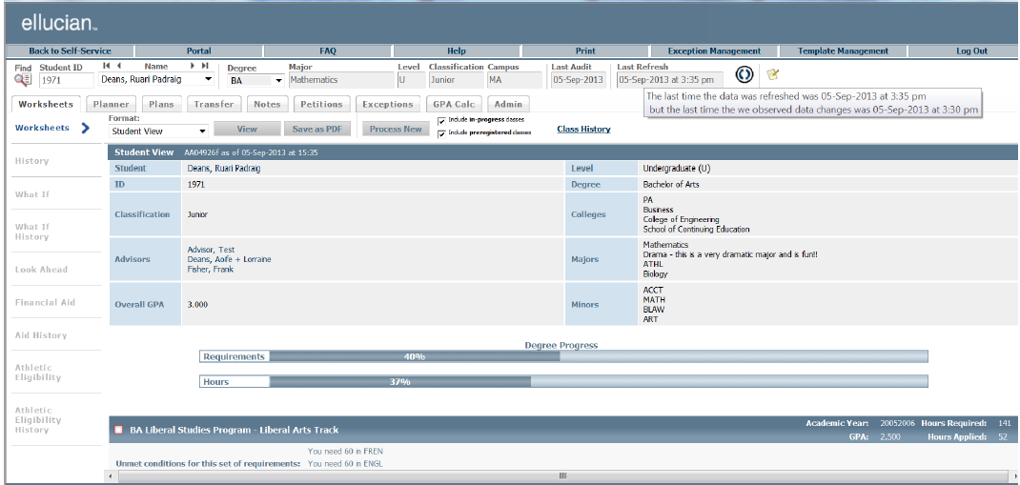
BEST OF ALL
We Wanted to Modify the Audit Header

Slide 12
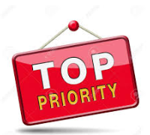
Important Tip Regarding Modifications
To make modifications of any kind to DW, you need a technical person who has a good knowledge of CSS and XSL or can learn it.
Modifications have to be done in multiple places and can present challenges.

Slide 13
We Ended up with A Better View

Slide 14
Other Modifications You have to “brand” all of Degree Works for your institution

Slide 15
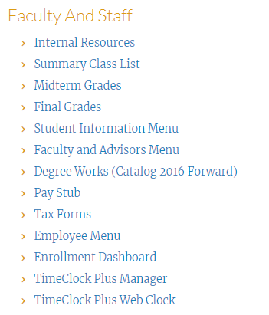
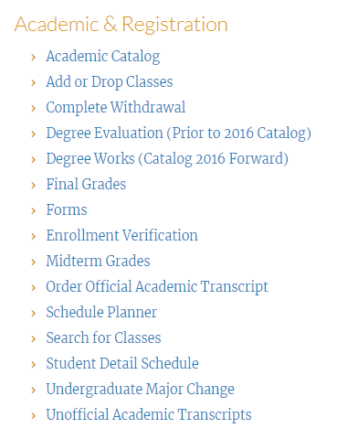
Accessing Degree Works
Our faculty and students access Degree Works through our single sign on portal.

Slide 16
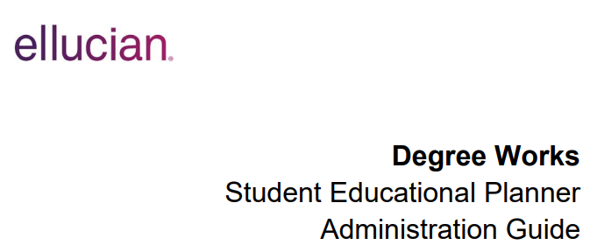
What is Next?
We will begin implementing the Student Educational Planner this fall.
We are going live with Banner 9 in October.

Slide 17
Questions
Cindy Hampton Systems Analyst
Hampton@mc.edu
Elizabeth Milner Assistant Registrar
Milner01@mc.edu

