Slide 1
MBUG 2018
Session Title: Business Process Analysis Used at ULL
Developing a Workflow
Presented By: Paula Breaux, Associate Director
Enterprise Application Services
Pauline Badeaux, Senior Systems Integration Analyst
Enterprise Application Services
Institution: University of Louisiana at Lafayette
September 10, 2018

Slide 2
Session Rules of Etiquette
Please turn off your cell phone
If you must leave the session early, please do so discreetly
Please avoid side conversation during the session

Slide 3
What is a Business Process?
A collection of related, structured activities or tasks that produce a specific service or product (serve a particular goal) for a particular customer or customers.

Slide 4
What is a workflow?
“…the automation of a business process, in whole or part, during which documents, information, or tasks are passed from one participant to another for action, according to a set of procedural rules.”
Workflow Management Coalition

Slide 5
What is Banner Workflow by Ellucian?
A toolkit that graphically depicts and automates a business process
Automates the flow of work throughout the entire organization
Analyze the process selected using the Business Process Analysis Model (BPA)
Creating the Workflow Process Analysis Model (WPA).

Slide 6
Advancement ‘MA’ Address Change Notification
I. Select a Process
The Advancement Services would like to know via email when the Mailing Address (MA) changes, compare it to the current Advancement Mailing Address (AM) to update their records if they choose to.
II. Perform Business Process Analysis
Step1: Capture the ‘Current’ State
a) Receive address changes only when Alumni/Donor notifies Advancement Services
- Mail, fundraising efforts, pledges, donations

Slide 7
Advancement ‘MA’ Address Change Notification Business Process Analysis
Step 1: ‘Current’ State continues
b) Identify the stakeholders
- Human Resources, Finance, Admissions,
Registrar, and Advancement Services
c) Identify participants
- Employees
d) Improvements
– Keeping ‘AM’ address current

Slide 9
Advancement ‘MA’ Address Change Notification Business Process Analysis
Step 1: Captured the ‘Current’ State
Step 2: Defined the ‘Ideal’ State
Step 3: Negotiate the ‘Best Practice’ State
a) Verify the reporting of address
changes with the process owner
b) Satisfy the Auditing Department

Slide 10
Advancement ‘MA’ Address Change Notification Business Process Analysis
Step 4: Analyze the ‘Best Practice’ State
Converting the Business Process
Model to a Workflow Model

Slide 11
What is a Workflow Process Analysis (WPA)?
A clarification of the Business Process Analysis (BPA) so that ALL business process details are understood
A process by which we
1. Describe the business process to be modeled
2. Sketch the model
3. Type each activity in the model
4. Identify all data elements
5. Identify activity details
6. Walk through final sketch

Slide 12
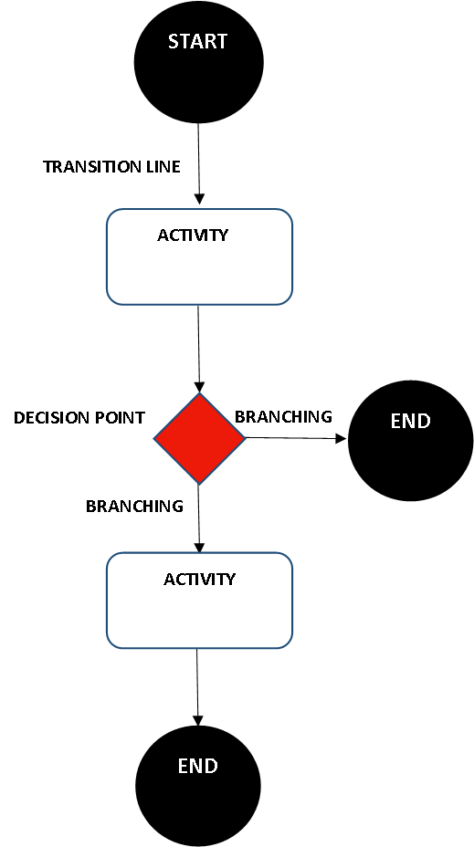
BASIC FLOW OF A WORKFLOW MODEL

Slide 13
WPA for ADVANCEMENT MA CHANGE NOTIFICATION
Objective:
To automate the email notification to
ADVANCEMENT for current MA address
changes and allow them to compare
them side-by-side to evaluate if they
want to update their current AM.
The Workflow starts with a triggered event resulting from a newly inserted MA.
The Workflow ends with a formatted email notification to ADVANCEMENT.

Slide 14
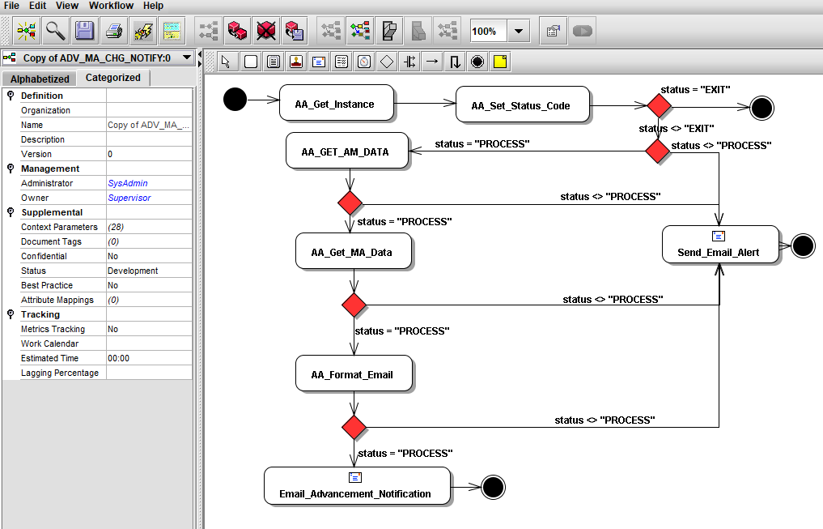
Converting the Business Process Model to a Workflow Model

Slide 15
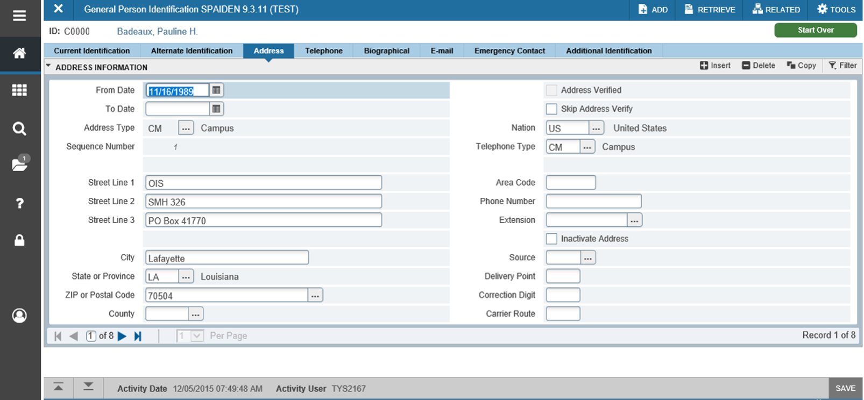
What triggers this Workflow?

Slide 16
Activities and Descriptions
Component Internal Activities
Get_Instance – gets the instance(TEST or PROD) to inform the email recipient.
Set_Status_Code – decides whether this individual’s SPRADDR record has an AM address type.
Get_AM_Data – gets all of the data needed for the formatted email body.
Current AM data
Name/ID of the addressee
Multiple lines of the address
City, State, Zip, County, Nation of the address

Slide 17
Activities and Descriptions continued
Component Internal Activities
Get_MA_Data – gets all of the MA data needed for the formatted email body.
Current MA data
Name/ID of the changer of the address
Name/ID of the addressee
Multiple lines of the address
City, State, Zip, County, Nation of the address

Slide 18
Activities and Descriptions continued
Email Activities
Email_Advancement_Notification – creates and sends a formatted email notification to ADVANCEMENT.
Send_Email_Alert – In case of an unsuccessful workflow process, this provides error information in an email to the workflow team to research problem.

Slide 19
ADVANCEMENT ‘MA’ CHANGE NOTIFICATION
ADVANCMENT is extremely satisfied with the workflow results. They can now evaluate MA changes and decide whether to use for their own current AM.
Metrics
Time and Work saved by ADVANCEMENT is a great advantage.
This Workflow runs successfully between 10 and 20 times per day.
This Workflow and Email Notification takes seconds to complete.

Slide 20
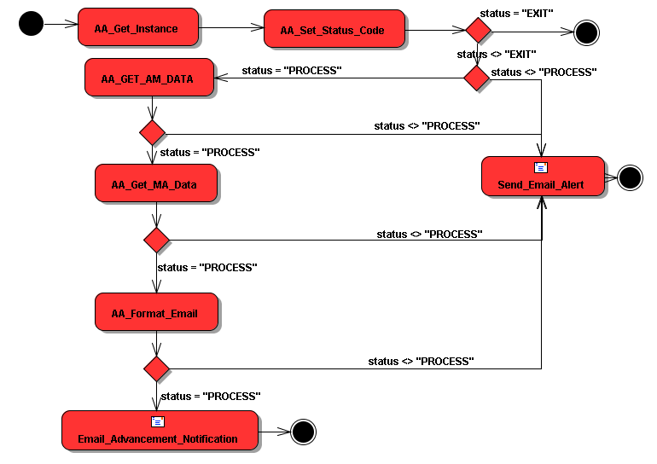
MODEL FOR ADVANCEMENT WF

Slide 21
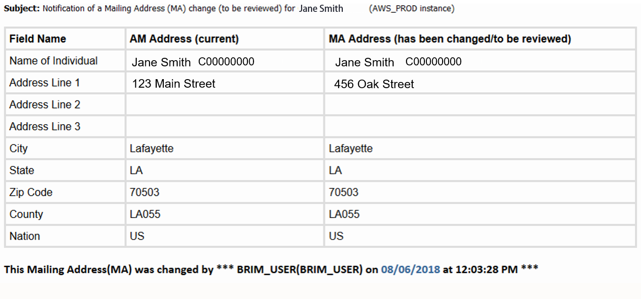
Workflow Ends with an Email Notification to Advancement

Slide 22
WRAP UP and Q&A
Choose a business process
Model the Process
Perform Business Process Analysis (Process Model)
1. Captured ‘Current’ State
2. Defined the ‘Ideal’ State
3. Negotiate the ‘Best Practice’ State
4. Perform Workflow Process Analysis (Workflow Model)

Slide 23
QUESTIONS?

