Slide 1
MBUG 2018 Batch Loading ACT Scores
Amy Cable, Executive Director, Enrollment Management Support
Leslie Holmes, Enrollment Support Specialist
Institution: Louisiana Community and Technical College System
September 10, 2018

Slide 2
Session Rules of Etiquette
Please turn off your cell phone
If you must leave the session early, please do so discreetly
Please avoid side conversation during the session

Slide 3
Objectives
Overview of LCTCS
Problem with loading ACT scores
Solution
ACT Process

Slide 4
Changing LIVES, CREATING FUTURES
The Academic and Student Affairs staff are responsible for creating and maintaining student-centered curriculum and learning environments that promote student success across all colleges.

Slide 5
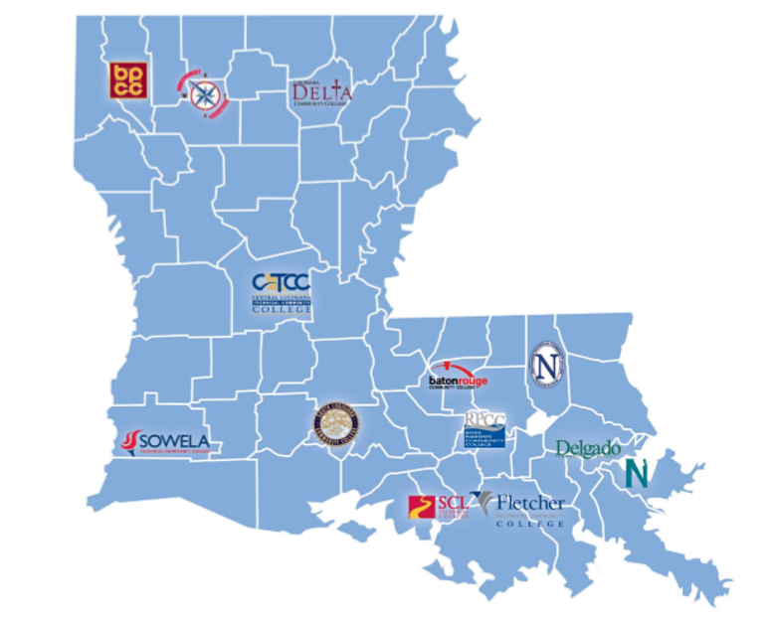
Enrollment Management Division
Notes:
Talk about travel…State wide tour to meet with everyone and introduce team

Slide 6
The problem
(58%)
(60%)
(63%)
(27%)
(73%)
(42%)
(40%)
(37%)
* Projected actual tuition revenue collected
** Estimate of State Funds from amended Executive Budget amount level

Slide 7
The solution
12
Admission Offices
12
Financial Aid Offices
12 Records Offices
Common Work Done Across All Offices
1
Enterprise Service Office

Slide 8
Enrollment Management Support
Normalize and streamline requirements for full admission
Ensure applicants and admits receive the same treatment in the admission process across all colleges
Remove unnecessary obstacles preventing students from taking classes
Developing a more applicant-oriented online application for all students served
Remove burden of routine tasks from college personnel
Hired System Office staff to conduct “behind the scenes” processing to free up college personnel for more “high touch” interactions with prospective and current students
Create a communication center
Execute college-developed communication campaigns for prospects, applicants, students, and graduates

Slide 9
The PROBLEM
ACT CDs
Not being loaded
Not being loaded timely
Antiquated
Created duplicate records
Inability to recruit

Slide 10
The SOLUTION
Purchase ACT Internet Reporting Option (AIRO)
Portal to access ACT Scores submitted to any of the 12 LCTCS colleges
Purchase PGP Email Encryption Software
Notes:
The ACT Internet Reporting Option (AIRO) provides the quickest and most frequent method for receiving score report data. Data are produced and provided to you up to three times weekly, as soon as the scores become available.
ACT uses PGP encryption to ensure secure transfer of the data to your institution. There is a one time $675 start-up fee for AIRO service that covers the establishment of your account, PGP process verification, and the automated email notification system

Slide 11
Part 1: Receive file from ACT
1. Receive email with link to ACT
Start PGP encryption software
Download the file in the email
2. Excel
Excel macro file saves in the correct format
3. ACT Tracking Workbook
Lookup field to return college acronym
Save file as .csv
Open in PGP to extract data to ACT folder
4. Upload file to Recruiter
Filter for each college and save as separate files
Each college has a separate server
Upload files and check for record matching issues
5. Part 2 process
Recruiter/Banner for an application/account and sends email to remind them to apply
Corrects Recruiter records with email address, etc.
Recruiter sends ACT scores to Banner
One file contains multiple records for each college based on college code
Automatically creates file name ensures all filenames are consistent
Filenames provide a way to eliminate errors in # records, college
Notes:
AIRO will send a link three times a week to notify EMS that scores are available.
Jennifer manipulates the file (how?)
The scores are loaded into Recruiter via EMS

Slide 12
Step 1. Receive Email with link to AIRO
Your data is ready for ACT Assessment Cycle C72520 YOU HAVE 00009 RECORDS The URL (Uniform Resource Locator) is https://airo.pearson.com/neon/sampdata/$actairo.htm
ENTER CYCLE NUMBER C72520
Your user name is AWB0914
If you need assistance with the download of AIRO records please do not reply to this email but contact ACT Institutional Services at <ACT-REPORT@ACT.ORG> or call 319/337-1360

Slide 13
Step 1a. Login to Portal Site
Notes:
Downloading the file.

Slide 14
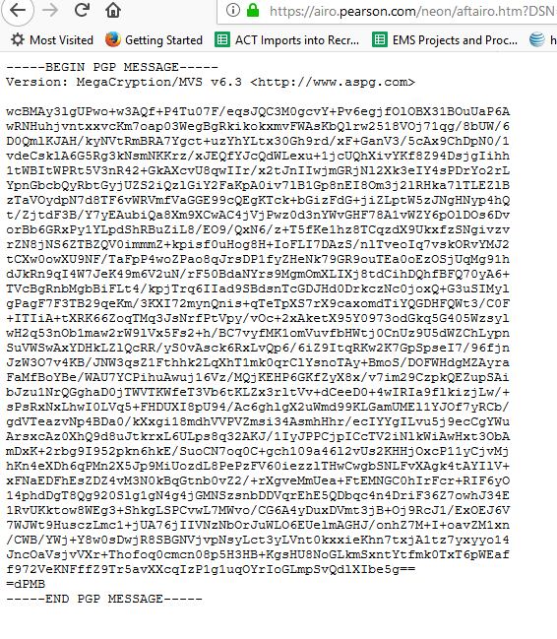
Step 1b. Retrieve encrypted file
Notes:
Save the encrypted file to computer
Change the extension to .pgp to extract the data.
The software will extracted the data into .txt format.

Slide 15
Step 2. Excel File with data
Notes:
Once you have the txt file, you open the macro file and it will format the file for Recruiter.
Note: the macro file was created by our IT department

Slide 16
Step 3. ACT Load Tracking Workbook
Used to track when we load the file
Filter for each college and create separate file
Lookup field to return college acronym
Automatically creates file name ensures all filenames are consistent
Save file as .csv for each college
Notes:
The file contains data for all colleges so we need to basically divide the data into separate files.

Slide 17
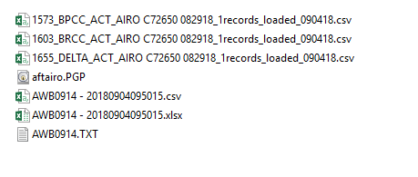
Example ACT Load Tracking Workbook

Slide 18
Step 4. Load file into Recruiter
Each college has a separate server
Filenames provide a way to eliminate errors in # records, college
Upload files and check for record matching issues
Notifications are sent to applicants.

Slide 19
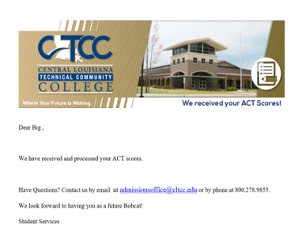
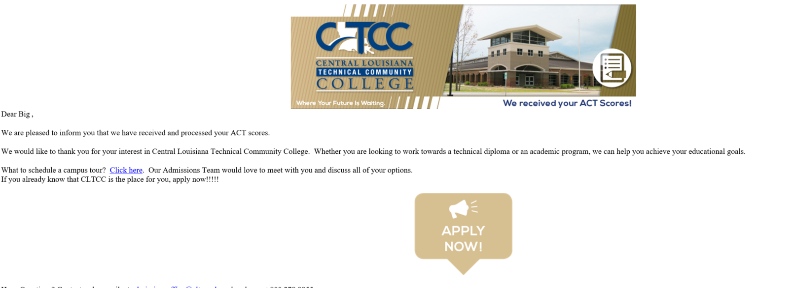
Notifications
Received ACT Scores (with application)
Without an Application
Notes:
Student already has status of applied or enrolled in Recruit
Student gets email stating that scores are received and have been added to their record
Scores get sent to Banner
Student has status of prospect or inquiry
Scores sit in recruit
Waits 3 days to see if status gets updated
If status stays prospect or inquiry-email goes out stating scores are received and encourages them to apply
Cognos report runs daily (every 2 hours during peak) that will identify prospects, inquiry in Recruit with scores who now have an application
Report goes to EMS
EMS loads into Recruit which changes the status to applied or enrolled
Once status changes to applied or enrolled, test scores get sent to Banner
Scores can manually be sent to Banner. All Recruit users will receive instructions on how to send test scores across.

Slide 20
Part 3: Import Update Status
ACT scores are loaded into Recruit
Cognos report runs nightly looking for match between prospects in Recruit and students in Banner.
Receive email with a link to an Excel report for each college
Upload file to Recruiter
Save file as .csv
Process
Records that do match are compiled in a report.
Imported into Recruit and updates status in Recruit to match what is in Banner
Check for record matching issues & correct the errors
Changes the statues of the prospect in Recruit to admit/enrolled to match the status in banner
If their isn’t a match the ACT record will remain in Recruit until the student status is updated.

Slide 21
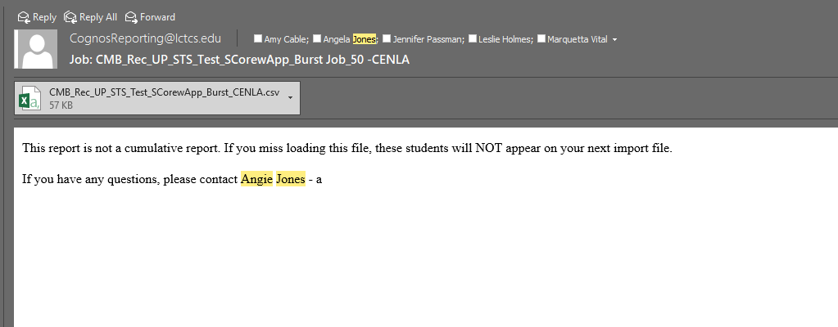
Sample file
Step 1. Receive the Report

Slide 22
Step 2: Load file to Recruit
RECRUIT URL: https://recruit-admindev.lctcs.edu/NUNEZ/main.aspx#930762779

Slide 23
Step 3: Status Updates
Changes the status of the prospect in Recruit to admit/enrolled to match the status in Banner
If their isn’t a match the ACT record will remain in Recruit until the student status is updated.

Slide 24
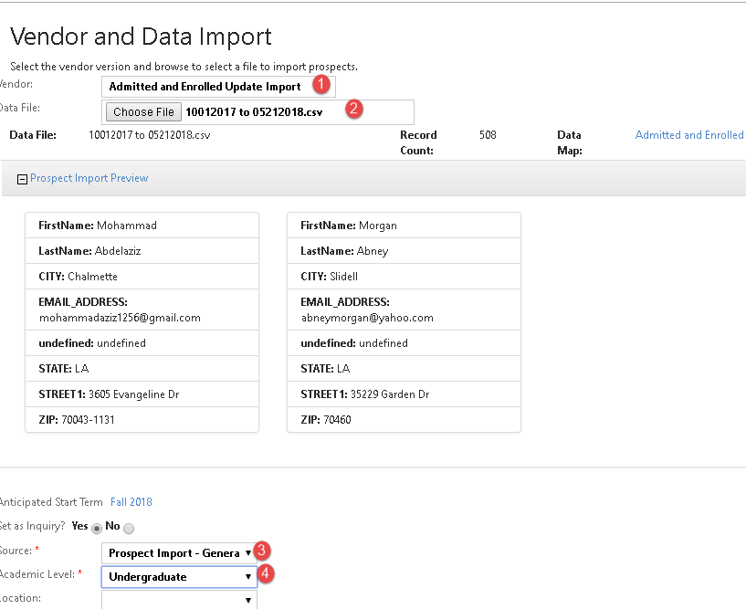
Click Submit

Slide 25
Part 4: SRIPREL: Suspended ACT Records

Slide 26
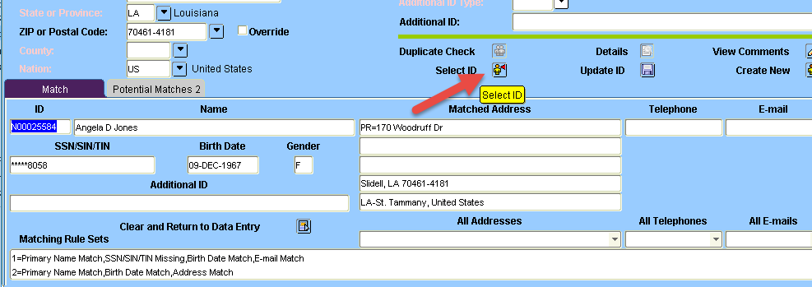
Part 4: SRIPREL: Suspended ACT Records

Slide 27
Recruitment initiatives
Students who listed the college as choice 1 but have not yet applied

Slide 28
ACT Loads, to date (07/26/2018)
College | ACTs Loaded | ACT Sent to Banner
BPCC | 1687 | 51
BRCC | 2794 | 721
CENLA | 395 | 56
DCC | 3080 | 649
DELTA | 2183 | 182
FTCC | 1086 | 192
NSHORE | 522 | 90
NUNEZ | 535 | 98
NWLTC | 49 | 5
RPCC | 607 | 137
SLCC | 2185 | 331
SOWELA | 1444 | 198
LCTCS | 16567 | 2710

Slide 29
Q & A
Amy Cable
Executive Director, Enrollment Management Support
amycable@lctcs.edu
Leslie Holmes
Enrollment Support Specialist
leslieholmes@lctcs.edu

