Slide 1
MBUG 2018
Banner 9 Requisition Entry and Approvals
Marie C. Frank
Assistant Vice President of Finance and Chief Procurement Officer
University of Louisiana at Lafayette
September 10, 2018

Slide 2
Session Rules of Etiquette
Please turn off your cell phone
If you must leave the session early, please do so discreetly
Please avoid side conversation during the session

Slide 3
Introduction
This presentation will show:
How UL transitioned from a pure paper requisition process to Banner 9.
What helped to make it successful.
How we became experts.
Nothing is Perfect!
Benefit to you is not to make the same mistakes!

Slide 4
Agenda
1 | Requisitioning and Approval Before Deployment
2 | Requisition Entry Pilot Group
3 | Deployment Preparation
4 | Go LIVE!
5 | Challenges and Common Problems
6 | Things to Remember

Slide 5
Requisitioning and Approval Process Before Deployment

Slide 6
Requisition and Approval Process Before Deployment
Legacy system was paper driven.
Approvals were hard signatures.
No consistency or regulation in who would approve requisitions.
Paperwork was lost creating an inefficiency in the workflow.
Department requisitioners did not understand the chart of accounts.
Spent lots of time searching for requisitions in process.

Slide 7
Why we chose Banner 9
Ease of use for end user.
Landing page provides a great summary of easy to find information.
Open typing space for Public Comments.
Able to track where documents are in the approval process.
Standardized approvals.
Standardized vendor information.
Ability to attach documents by using BDM

Slide 8
Pilot Group

Slide 9
Procurement Staff as the Pilot Group
Departments routed hardcopy signed requisitions.
Purchasing staff would enter information into Banner.
Worked out many of the kinks by DOING IT first.
Provided Purchasing staff first hand knowledge of what end users would be working with and potential challenges.
Approvals were not turned on until University Go Live. Scan of hard copy served as proof of approvals. Both pro and con.

Slide 10
Deployment Preparation

Slide 11
General Preparation
Build Excitement on Campus
“You will be able to see that information in real time.”
“Never lose a document again.”
“Find out who is holding up the approval.”
Training BEFORE Go Live
Individual Open Session Training – Purchasing Department staff rotated staffing a computer lab.
Group Training Sessions – Session presented by Purchasing staff.
Had to teach the departments how to manage their Budgets.

Slide 12
Preparing for Change in Vendor Procedures
Made it mandatory to have a vendor entered in requisition to submit.
Created a manual process for requesting a new vendor so the vendor ID could be entered into Banner.
Provided a link to search for vendors in Banner 9.
Banner 9 can filter the query where as Banner 9 SSB cannot.
(EX: “Smith” would result in thousands to look through)

Slide 13
Engage the Campus
Requisitions
Establish cut off date for submitting hard copy requisitions.
Begin educating departments on requisition entry in a Banner format. (no “See Attached”)
Introduce end users to the chart of accounts.

Slide 14
Engage the Campus
Approvals
Departments must understand the approval workflow in order to establish realistic queues.
Evaluate if every purchase must be approved at all levels or only up to a certain level.
Decide if budget review is done by the system and requisition stopped or a warning is given when NSF.

Slide 15
Go LIVE!

Slide 16
Ready or Not…
Requisitions and approvals rolled out together.
Approvals were tested in limited groups prior to deployment.
Beware of bypassing approvals due to requisition transaction date before Go Live Date.
Beware of multiple FOAP approval workflows.

Slide 17
Training, Training, Training
Training Sessions
Open computer lab time for real time production help.
Group training sessions led by Purchasing staff.
Monthly training sessions for refreshers or new staff.
Department training with over 5 attendees.
Videos and short instructions available online.

Slide 18
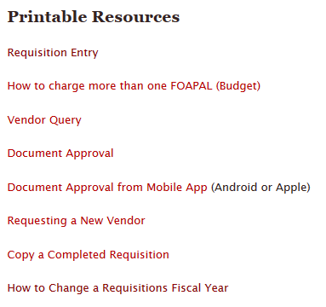
Printable Training Resources
Requisition Entry
How to charge more than one FOAPAL
Vendor Query

Slide 19
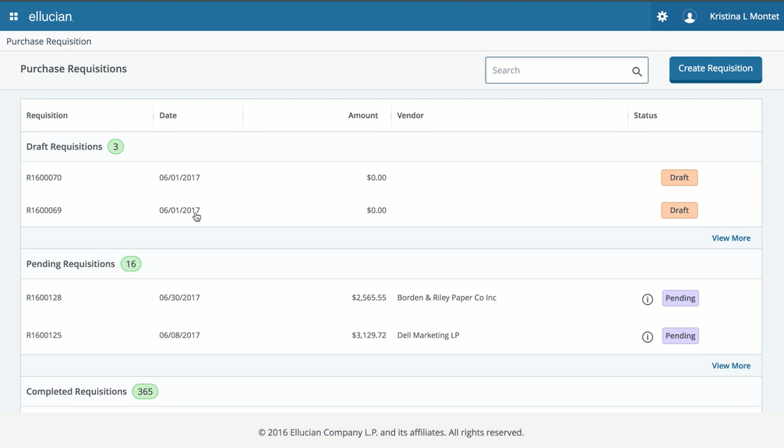
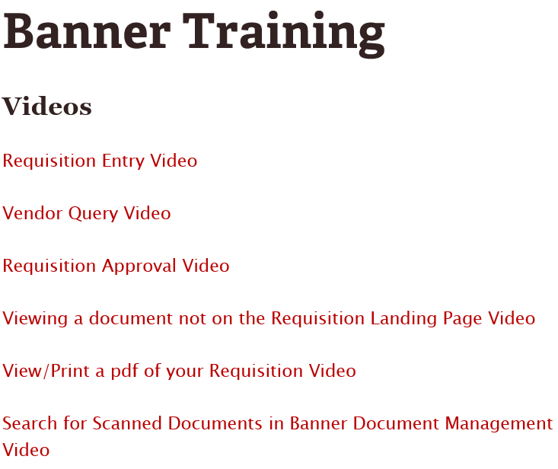
Video Training Resources
Requisition Entry Video

Slide 20
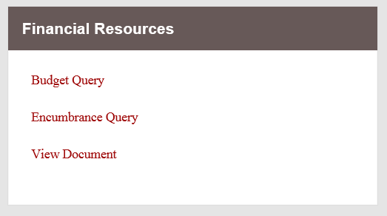
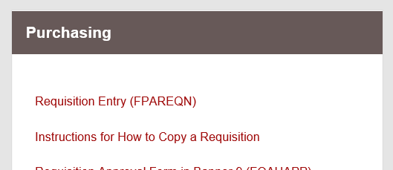
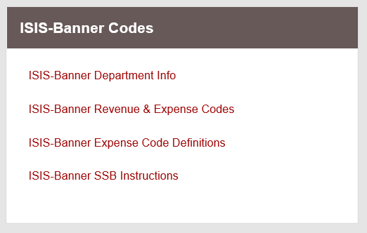
Employee Portal Links
Direct links to most common forms on secure employee portal.
Crosswalks for legacy system information.

Slide 21
Access to Help
Have a clear plan for how end users will obtain assistance.
Appointed a Purchasing Staff member to handle daily questions.
Provide scripts to on campus Help Desk with answers to common questions.

Slide 22
Challenges and Common Problems

Slide 23
Reality of Go LIVE.
Changing a campus culture.
Move from full service to DIY specialty!
Teaching end users to take control of their own records.
It has been Love It or Hate It.
Purchasing staff is also learning as we go.
Access is a BIG issue!

Slide 24
Challenges
Learning curve was steep.
Using Purchasing staff as pilot group failed to account for most end users lack of total process understanding.
Departments wanted to “do it like we used to” with “see attached” instead of itemizing on requisition.
Did not incorporate approvals, leaving all troubleshooting to be done after Go LIVE.
Access is typically the answer when the question starts with “I can’t”.
Recommend giving end users budget query access along with Requisition Entry.

Slide 25
Approval Challenges
Approvers did not attend training and did not understand the process.
Approvals could be “jumped”.
Approvers in multiple queues at high levels will override approvals of lower level in second queue.
Just because a person could approve, did not automatically mean they had access to view/use that same FUND/ORG.
Approval process needs VERY CAREFUL PLANNING!

Slide 26
Common Requisition Problems
“I can’t submit my requisition.”
Check all items for 100% funding.
“I keep getting thrown back to the landing page.”
Special characters will not work in Commodity Description.
Ex.: / & @
“My file won’t upload.”
In BDM, file will not upload if it has a special character in the name.
“I changed the transaction date to put it in correct fiscal year, it still shows in the wrong year.”
Transaction dates stay with accounting even when recalled. Item has to be deleted.

Slide 27
Common Approval Problems
“I am getting an error when trying to retrieve documents from BDM.”
Approver might not have the requisition number highlighted on Details, or due to multiple queues, they might not have access.
“I can’t see all the details, isn’t there a better view?”
For a summary view try “View Document” from Banner SSB. Will not include attachments.
“It was on my list this morning, now its gone.”
Check the approval history to see if a higher level in your queue approved the document.
“Why can’t I see attachments in SSB?”
BDM attachments cannot be directly viewed from SSB.

Slide 28
Summary
Things to Remember
Understand the capabilities of your end user.
Do not downplay the importance of training.
Transaction dates matter…some of the time.
Commodity Level vs Document Level accounting issues.
Have a plan for incomplete documents.
Teach end users to understand the information they see.
Have a mechanism to update end users on new information.

Slide 29
Questions
Banner 9 (XE) Requisition & Approvals

Slide 30
Thank you!!!
Marie C Frank, MPA, CPPB
Assistant Vice President for Administration & CPO
Office of Purchasing
Administration and Finance
University of Louisiana at Lafayette
PO Box 40197
Lafayette, LA 70504
(phone) 337-482-2148
(email) mfrank@louisiana.edu

