Slide 1
MBUG 2018
Session Title: Admissions Applications
Presented By: Mary DeGraw & Hannah Miller
Institution: Pearl River Community College
September 11, 2018

Slide 2
Session Rules of Etiquette
Please turn off your cell phone
If you must leave the session early, please do so discreetly
Please avoid side conversation during the session

Slide 3
Online Application

Slide 4
Online Application

Slide 5
Online Application

Slide 6
Online Application

Slide 7
Online Application

Slide 8
Online Application

Slide 9
Online Application

Slide 10
Validation Forms
STVAPLS STVASTA STVWSCT STVWSCF STVWAPP STVEGRP STVXLBL STVADMR STVAPST STVAPDC SAWWUDQ SAAWADF | SAAWAPP SOAATRM SAAWATR SAAWAAD SAAWADP SAAWCUR SOAXCUR SAAERUL GTVLETR SOAELTL SOAELTR
* Instructions with forms are included on the supplemental document.

Slide 11
Data Coming In…
Before… After…
Paper Application Online Application*
Admission Staff Database
Database Reporting
Reporting
*No Manual Entry by Staff

Slide 12
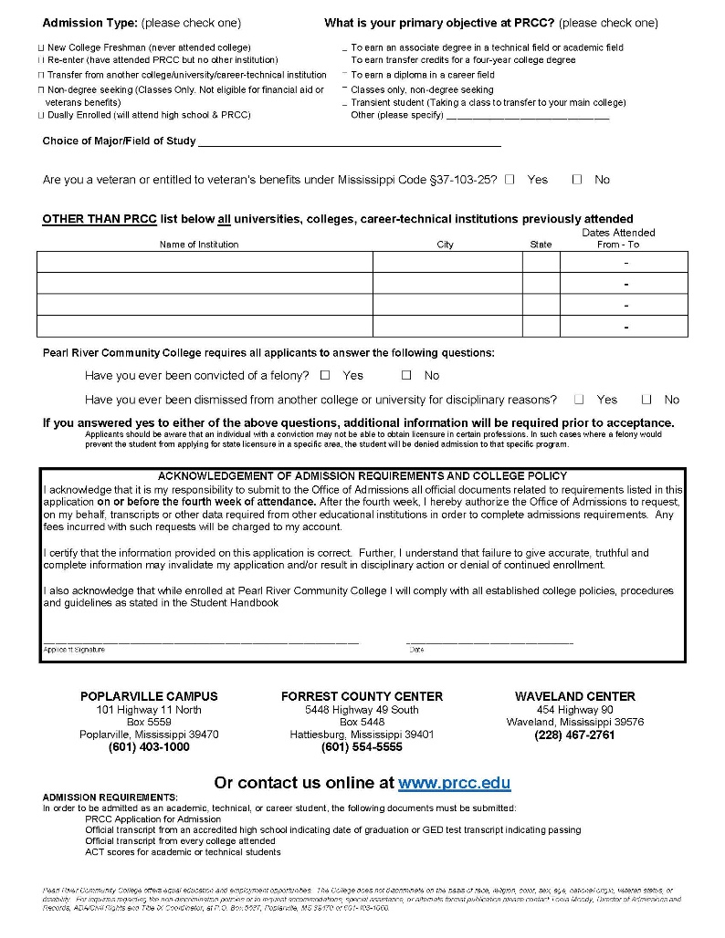
Old Paper Application

Slide 13
Results
Cleaner Data
Reporting
100% Baseline

Slide 14
Questions?
Mary DeGraw, Administrative Applications Director @ Pearl River Community College
mdegraw@prcc.edu
Hannah Miller, Data Management Coordinator @ Pearl River Community College
hkmiller@prcc.edu

