Slide 1

MBUG 2016
Session Title: Travel and Expense
Presented By: Keilani Vanish
Institution: Jackson State University
September 11, 2017

Slide 2

Session Rules of Etiquette
Please turn off your cell phone
If you must leave the session early, please do so discreetly
Please avoid side conversation during the sessions

Slide 3
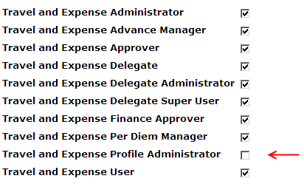
Assigning User Roles
The Web Tailor Administrator set the user roles.

Slide 4
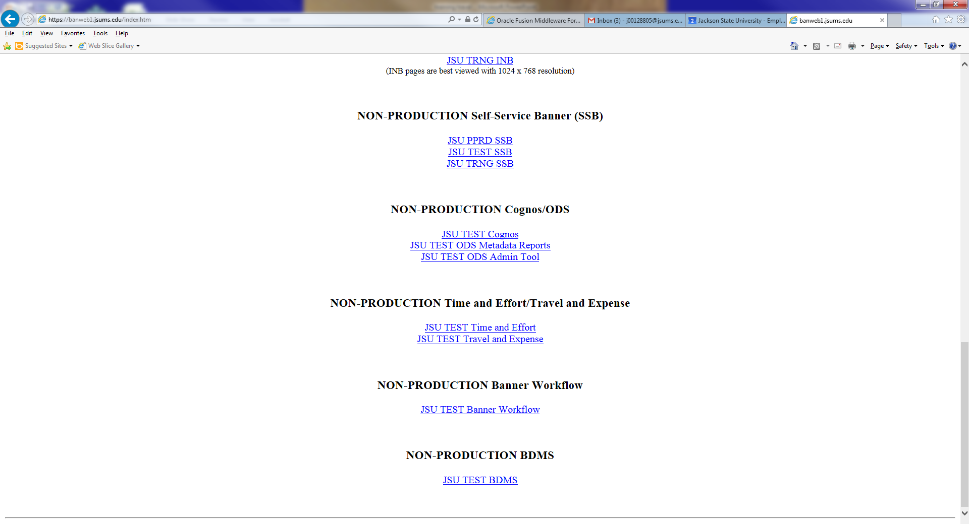
Logging into travel & Expense
WWW.JSUMS.EDU/BANNER

Slide 5
Administration

Slide 6
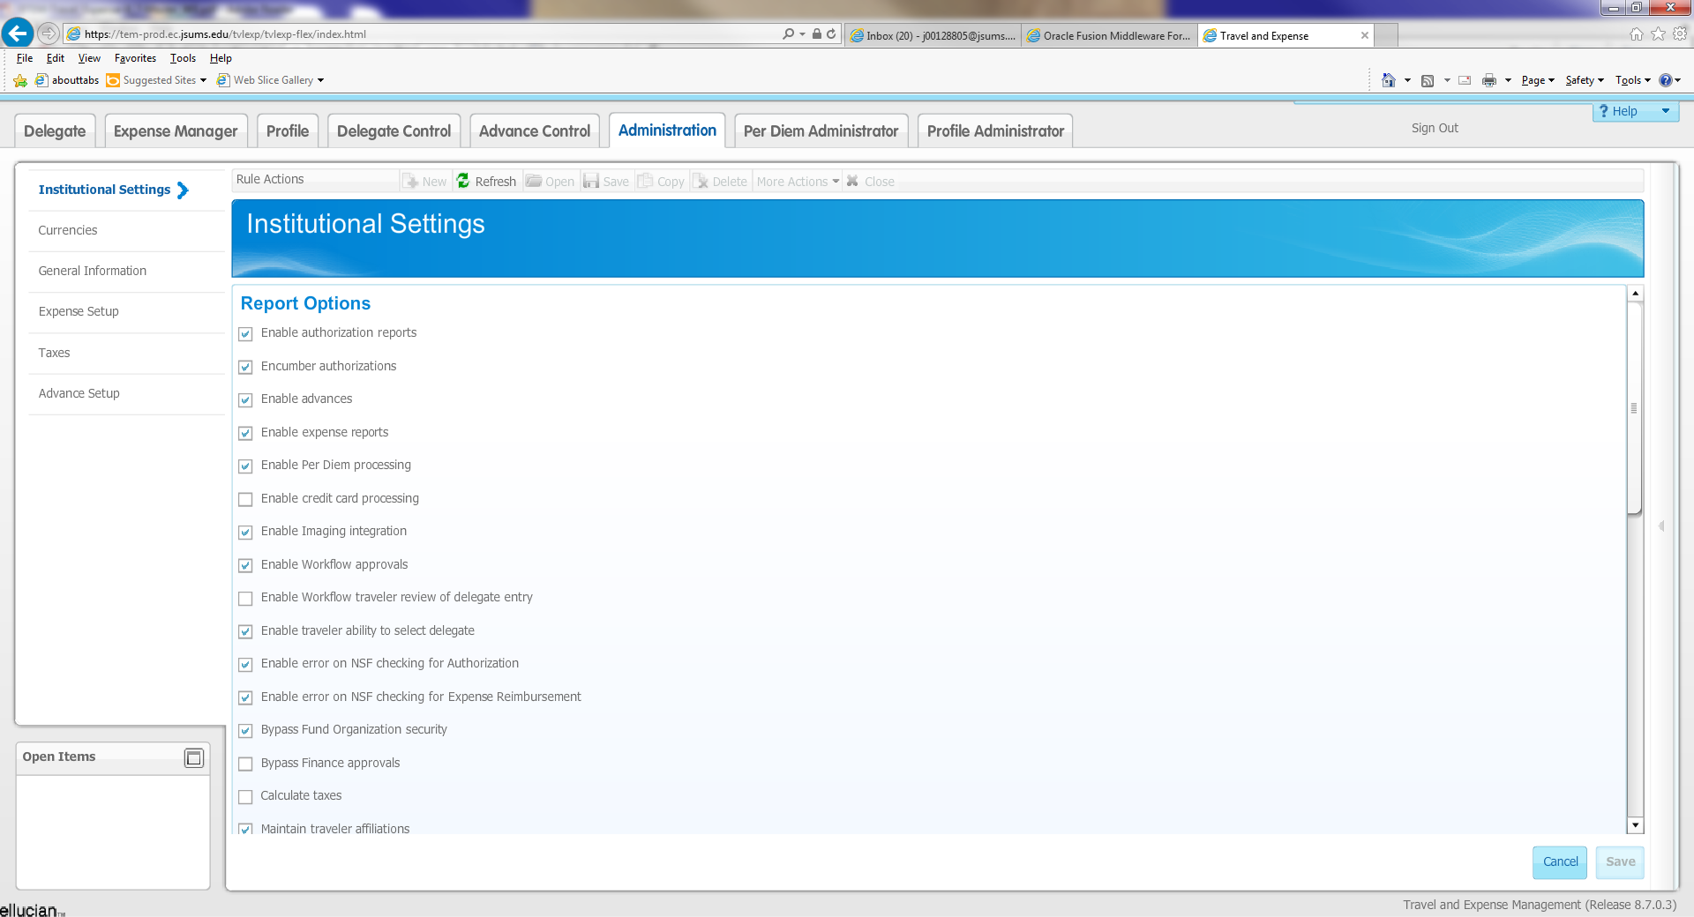

Slide 7
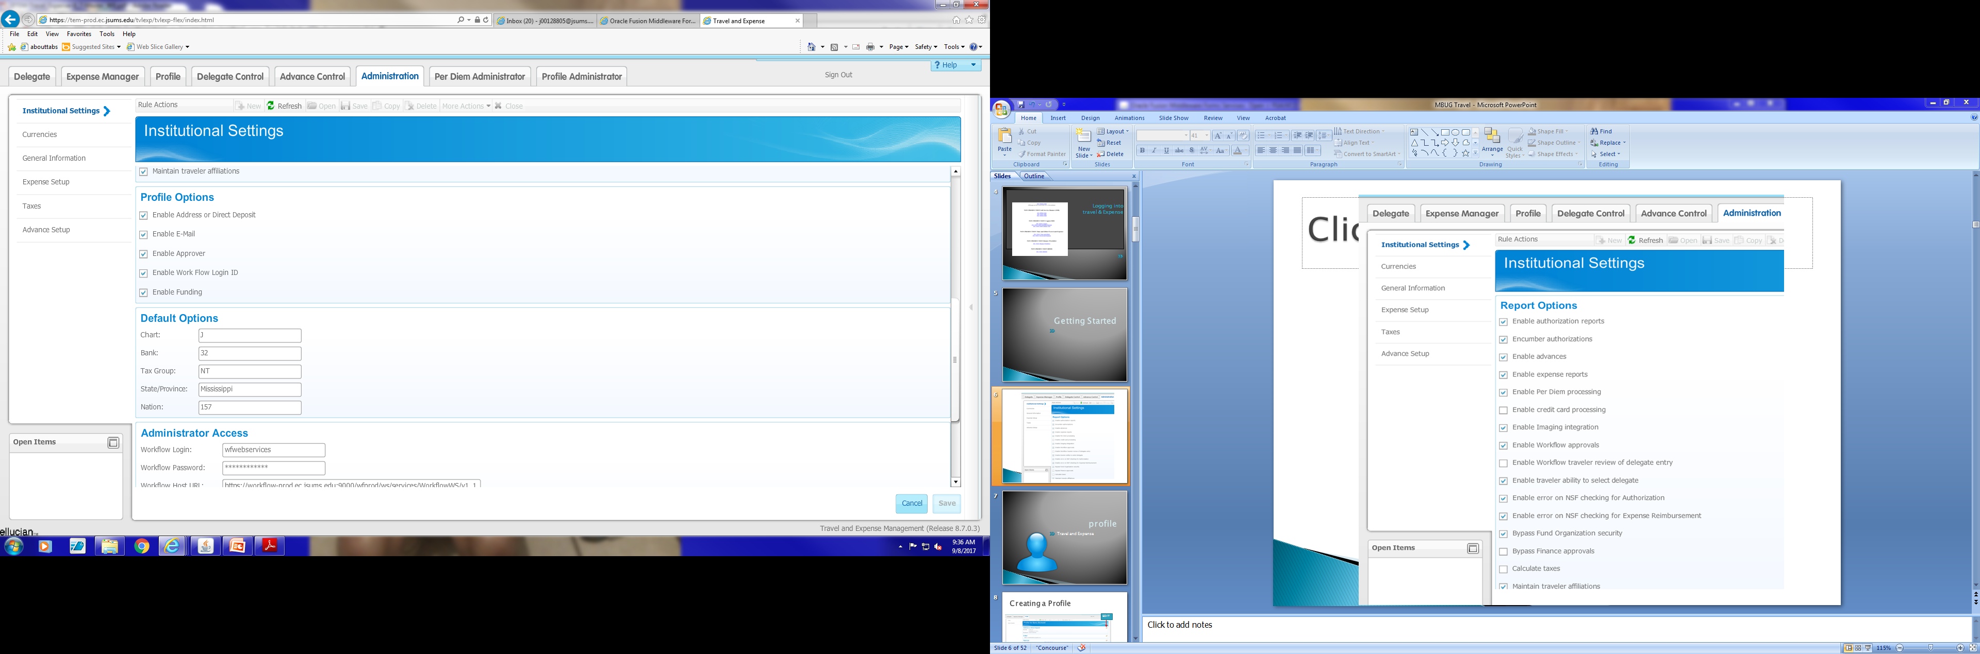

Slide 8
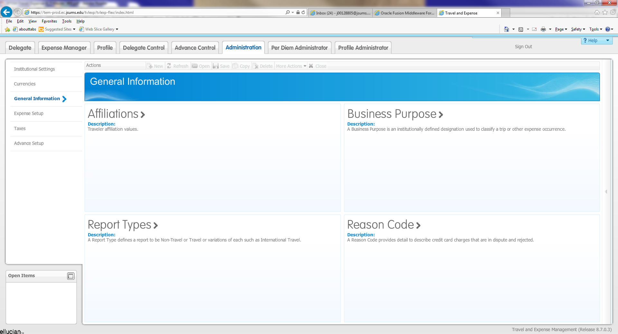

Slide 9
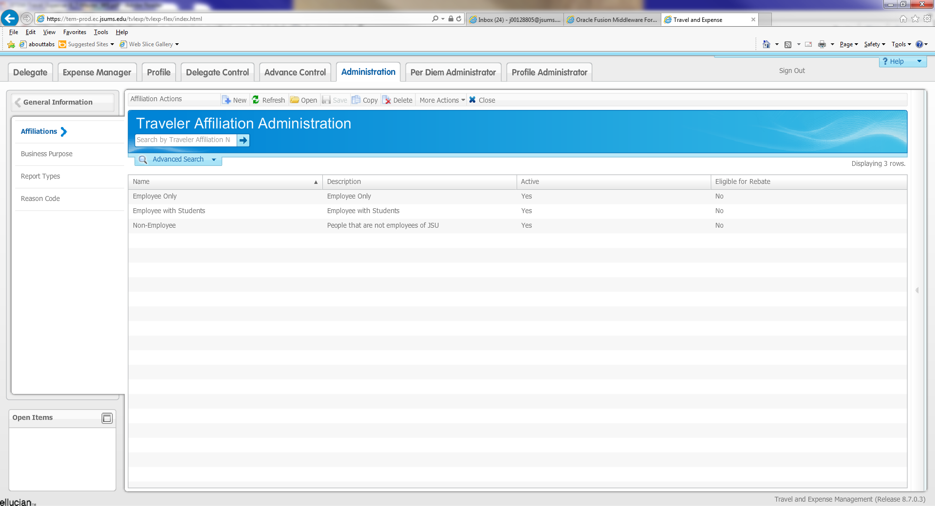
Affiliation
Click new to add an affiliation

Slide 10
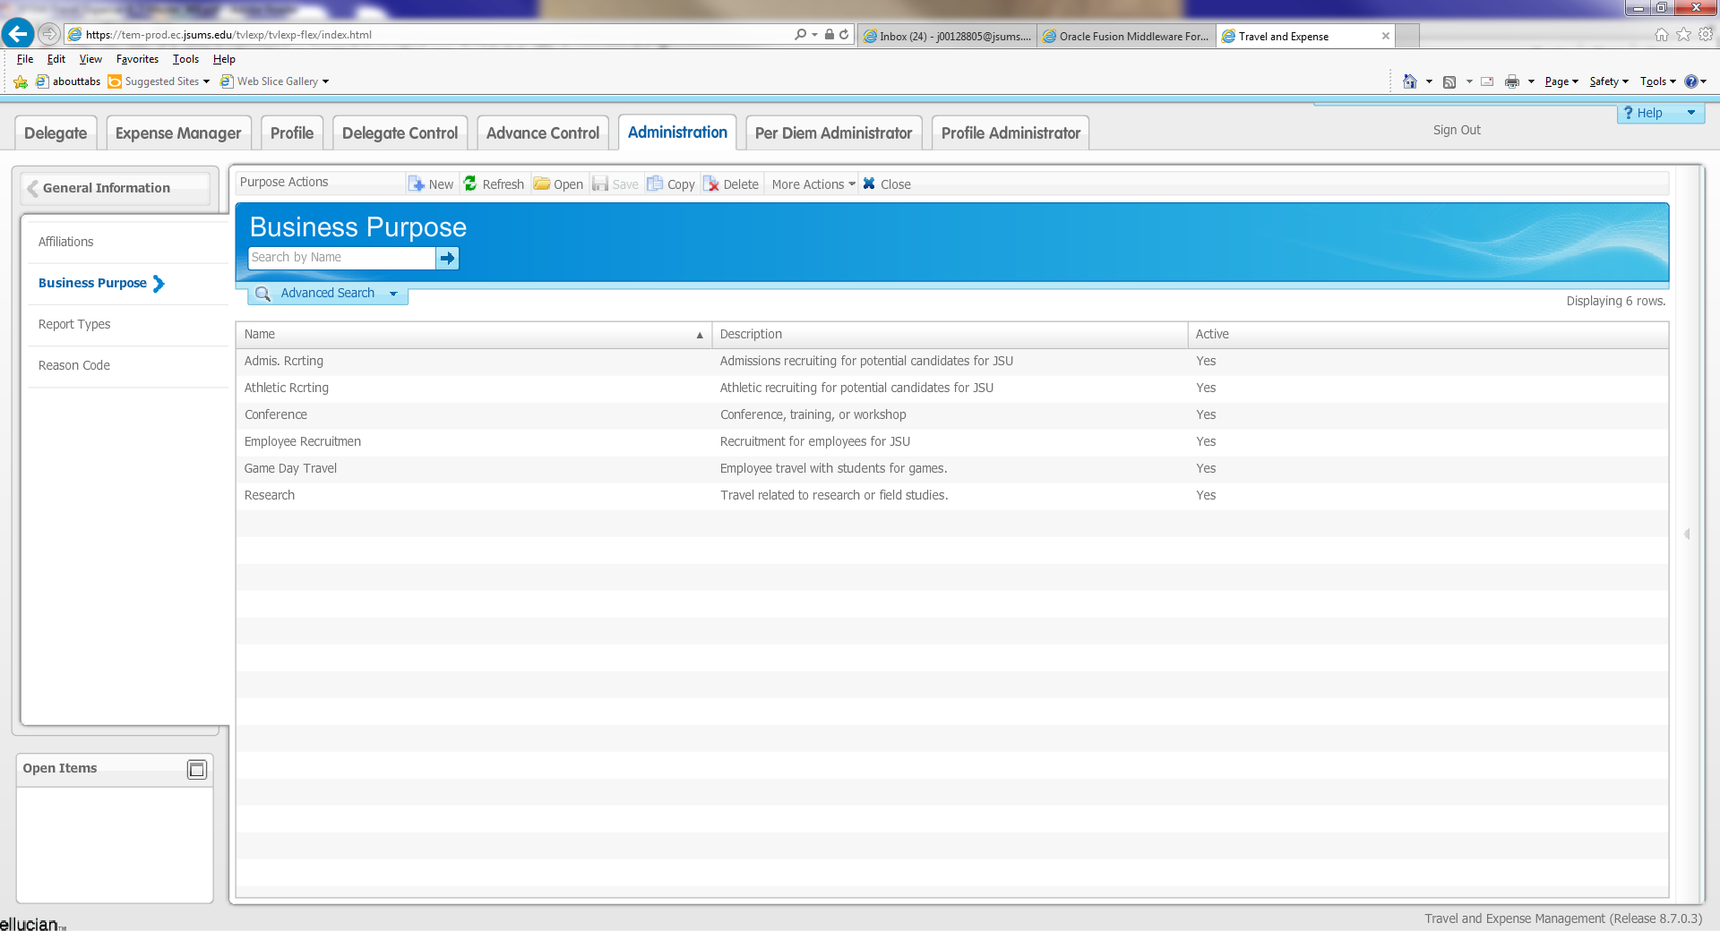
Business Purpose
Click new to add a business purpose

Slide 11
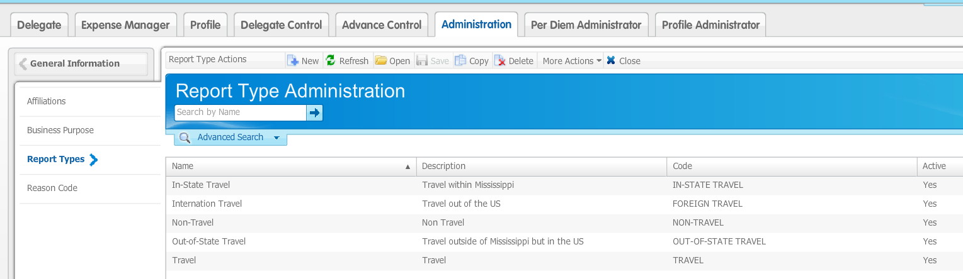
Report Types
Click new to add a report type

Slide 12
Expense Set Up

Slide 13
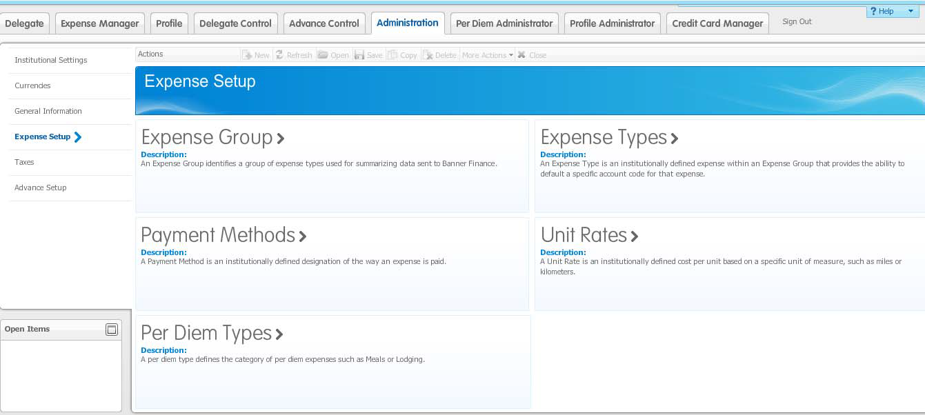

Slide 14
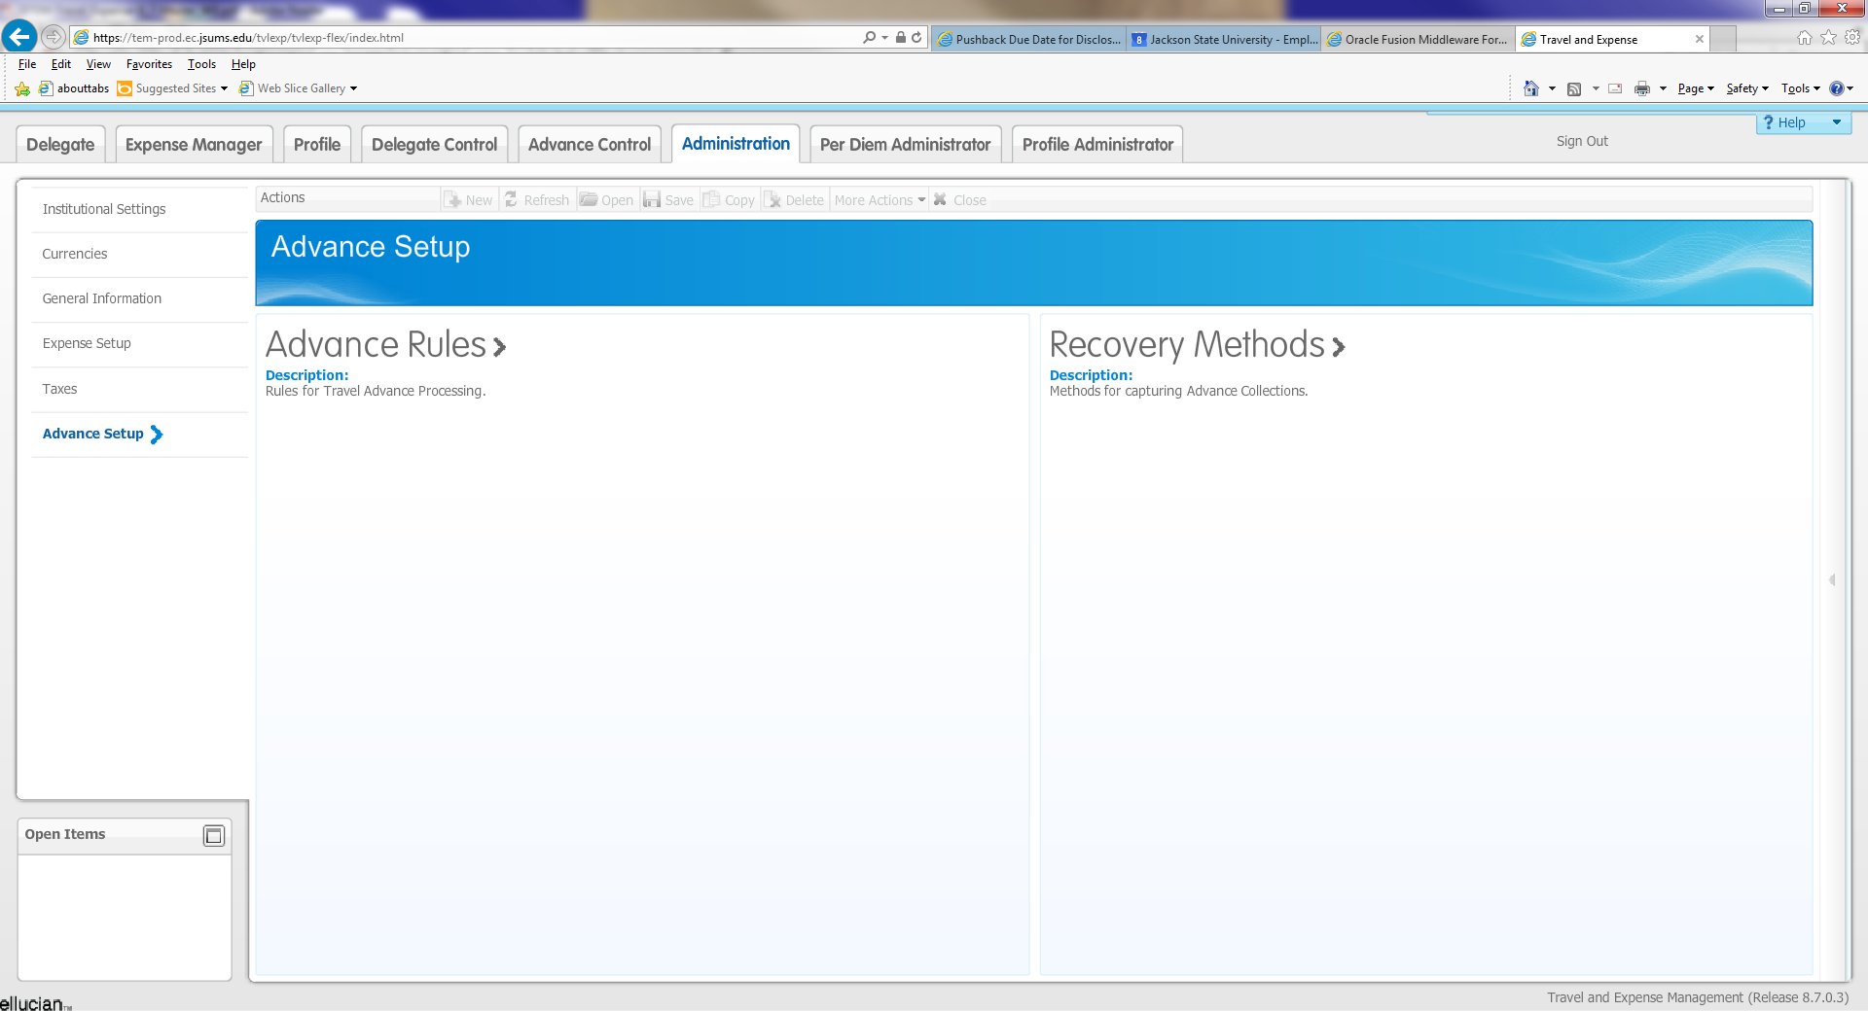

Slide 15

Profile
Travel and Expense

Slide 16
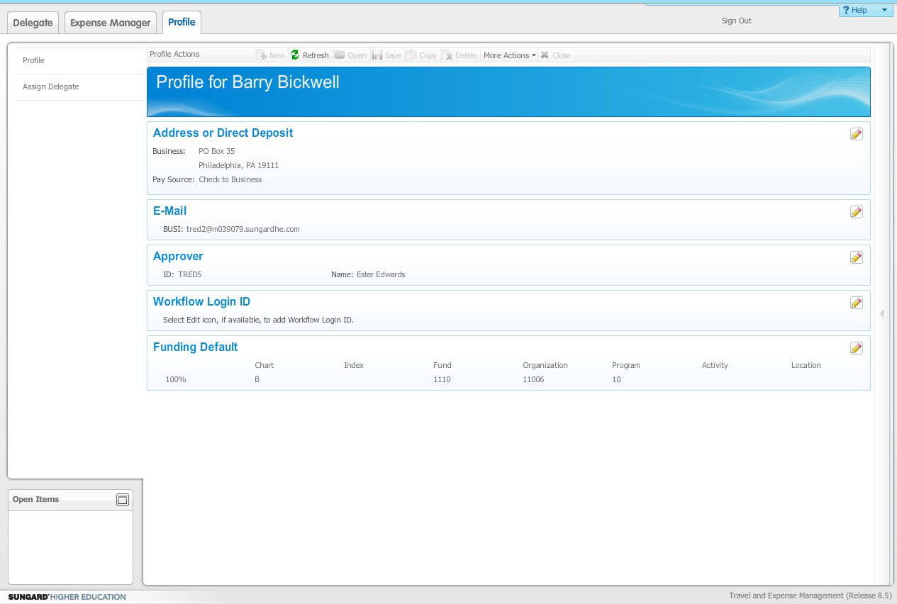
Creating a Profile
EDIT

Slide 17
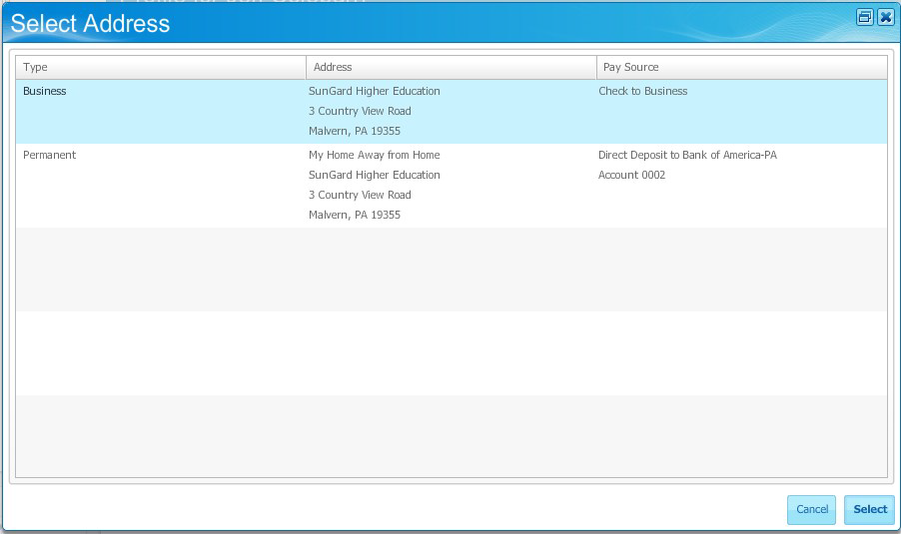
Click the Profile tab.
2. Click the Edit icon for the item you want to change.
3. Click any item in the list to select that item.
4. Click the Select button.

Slide 18
EDIT

Slide 19
EDIT

Slide 20
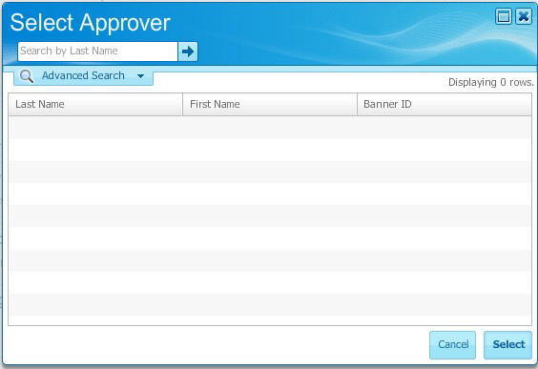
1. Click the Profile tab.
2. Click the Edit ( ) icon for the Approver item.
3. Enter a name or partial name in the Search by Last Name field.
****Note: If you did not know how to spell the name, you could enter the partial name followed by a percent sign (%). The percent sign (%) is Wildcard character.
4. Click the arrow button to start the search.
5. Click any item in the results list to select that item
6. Click the Select button.

Slide 21
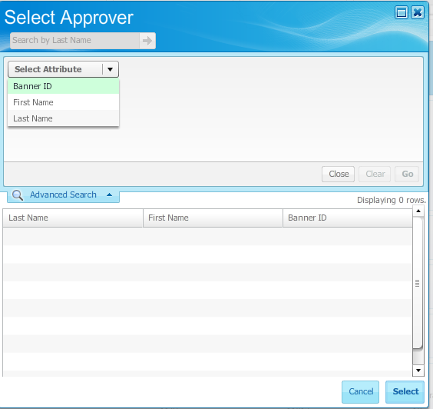
Click on the Advanced Search tab to expand the window.
Click on the Select Attribute field.
Select an attribute from the list. (Banner ID = J#)
Enter the information.
Click the Go button.
Highlight the approver’s name
Click Select

Slide 22
EDIT

Slide 23
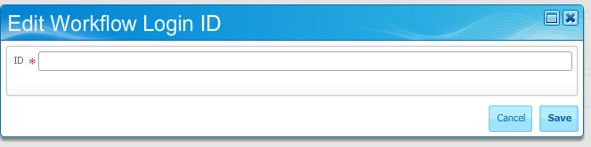
Click the Profile tab.
Click the Edit ( ) icon for the Workflow Login ID item. (Workflow Login ID is your J00000000)
Enter the Workflow ID in the ID field. This ID must be set up in Workflow by the Workflow Administrator. You must also be assigned the Workflow Approver role. This is not searchable or validated here but must be valid.
Click the Save button.
NOTE: You will only need to add your Workflow ID to your profile if you will be approving travel authorizations or travel reimbursements.

Slide 24
EDIT

Slide 25
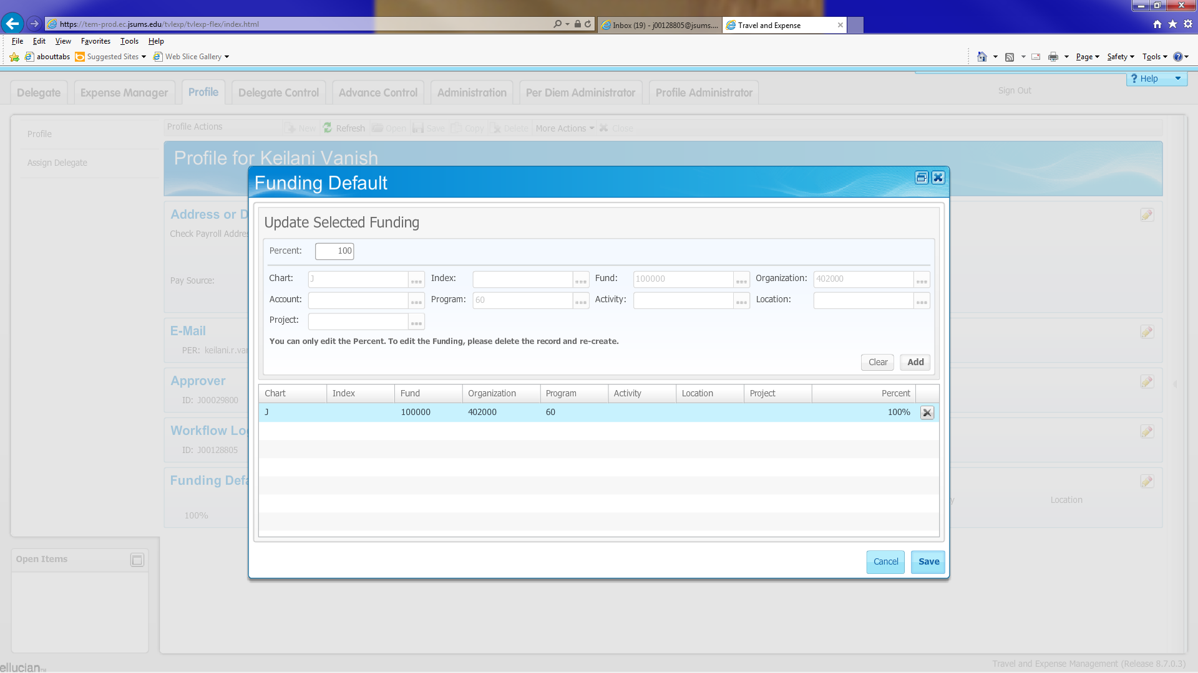
1. Specify the percentage of the funding to be added in the Percent field. The total percentages should add up to 100%.
2. Chart is always J
3. Fill in additional fields (such as Index or Fund, Organization, and Program). Note that the Account field is grayed out because it will be filled in by the Expense Type during processing.
4. Click the Add button to add the funding to your selections.
5. You may now add additional funding to your selections by repeating steps 1-4 as necessary.
6. If you wish to remove a funding from your selections, click the Delete icon in its row.
7. When you are satisfied with your selections, click Save to save them as the default funding or Cancel to exit without saving.

Slide 26

Authorization report (TA)
Travel and Expense

Slide 27
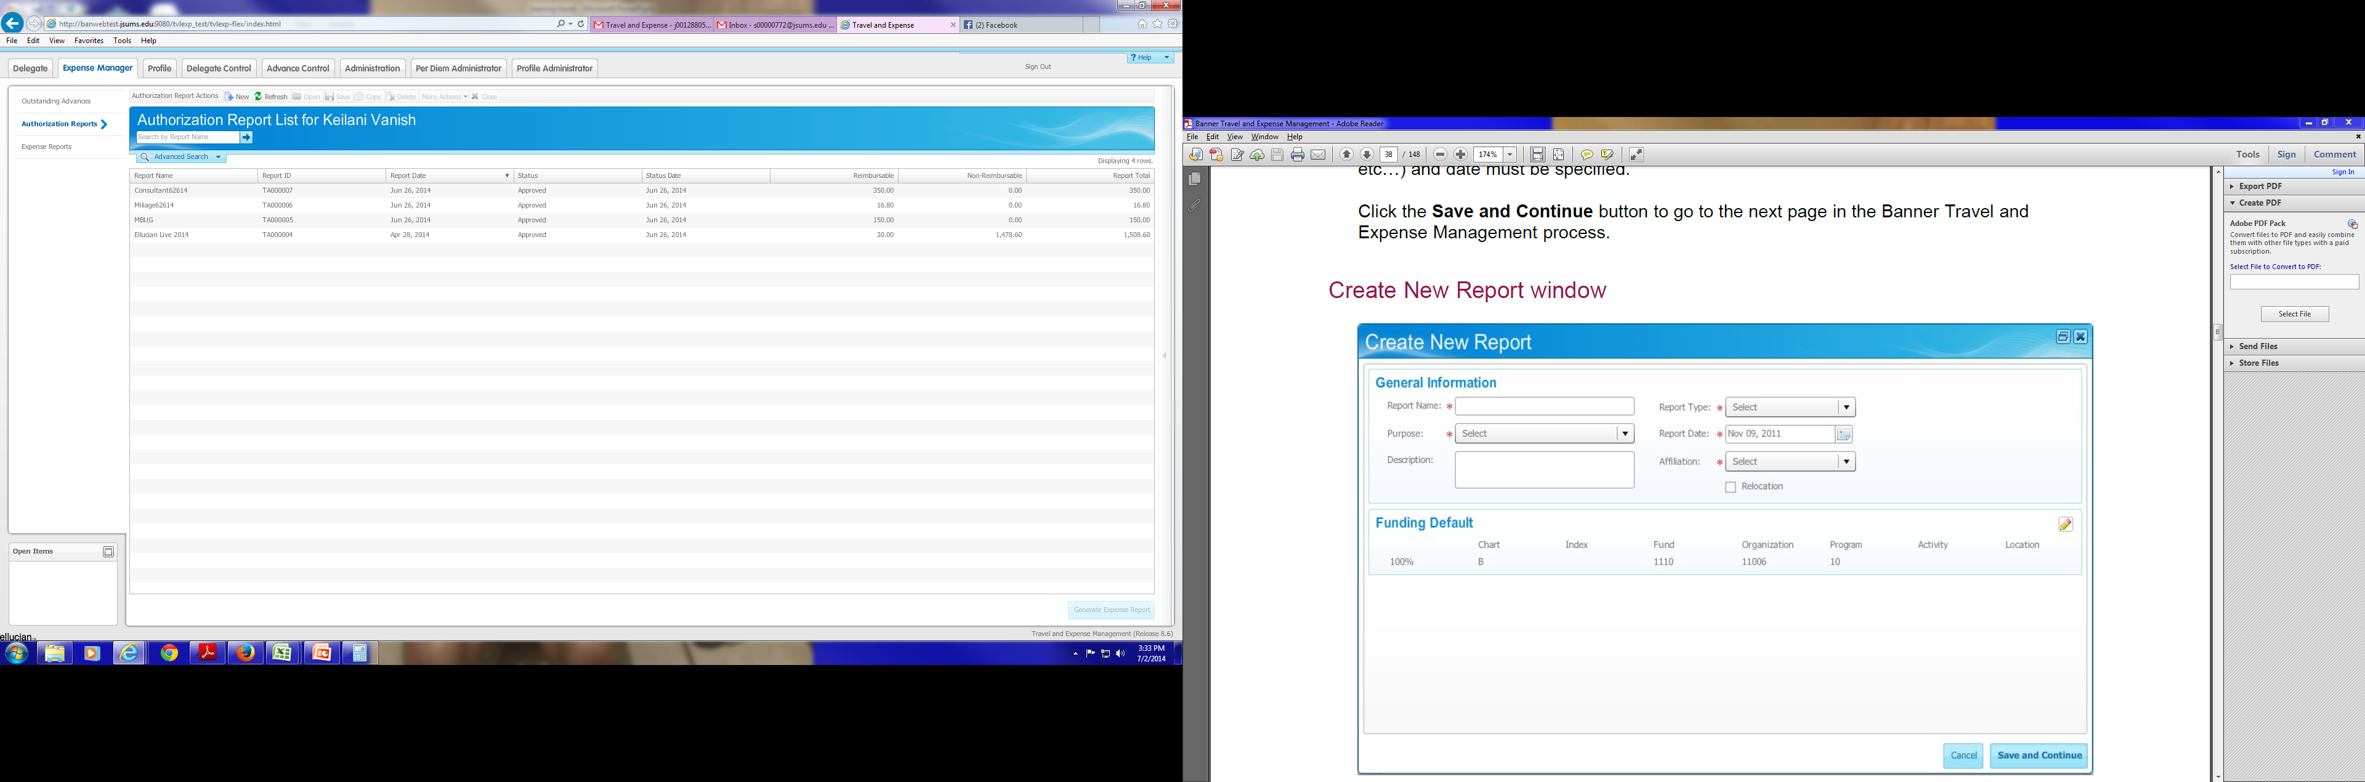
Creating Authorization Report
Click on Expense Manager
Click Authorization Report
Click New

Slide 28
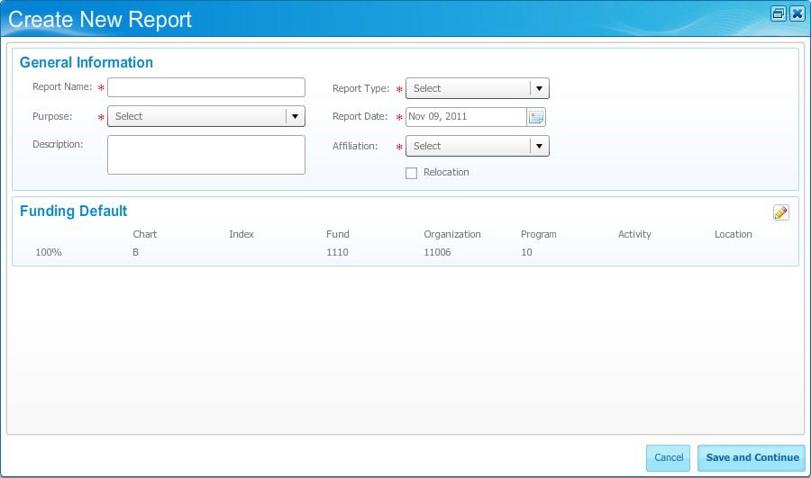
1. Enter a unique name in the Report Name field.
Note: You may want to include a date in the report name to distinguish this report from another if you make multiple trips to the same city or conference.
2. Select a business purpose, such as Conference, in the Purpose field.
3. Enter a description of the authorization report in the Description field. (OPTIONAL)
4. Select a report type (such as travel) as the report type in the Report Type field.
5. Today's date will default in the Report Date field.
6. Select an affiliation in the Affiliation field.
7. Notice that the Funding Default is populated from your Profile tab entry, if one exists.
If you wish to change this funding, click on the edit icon, make changes, and click save
8. Save and Continue in the next step.

Slide 29
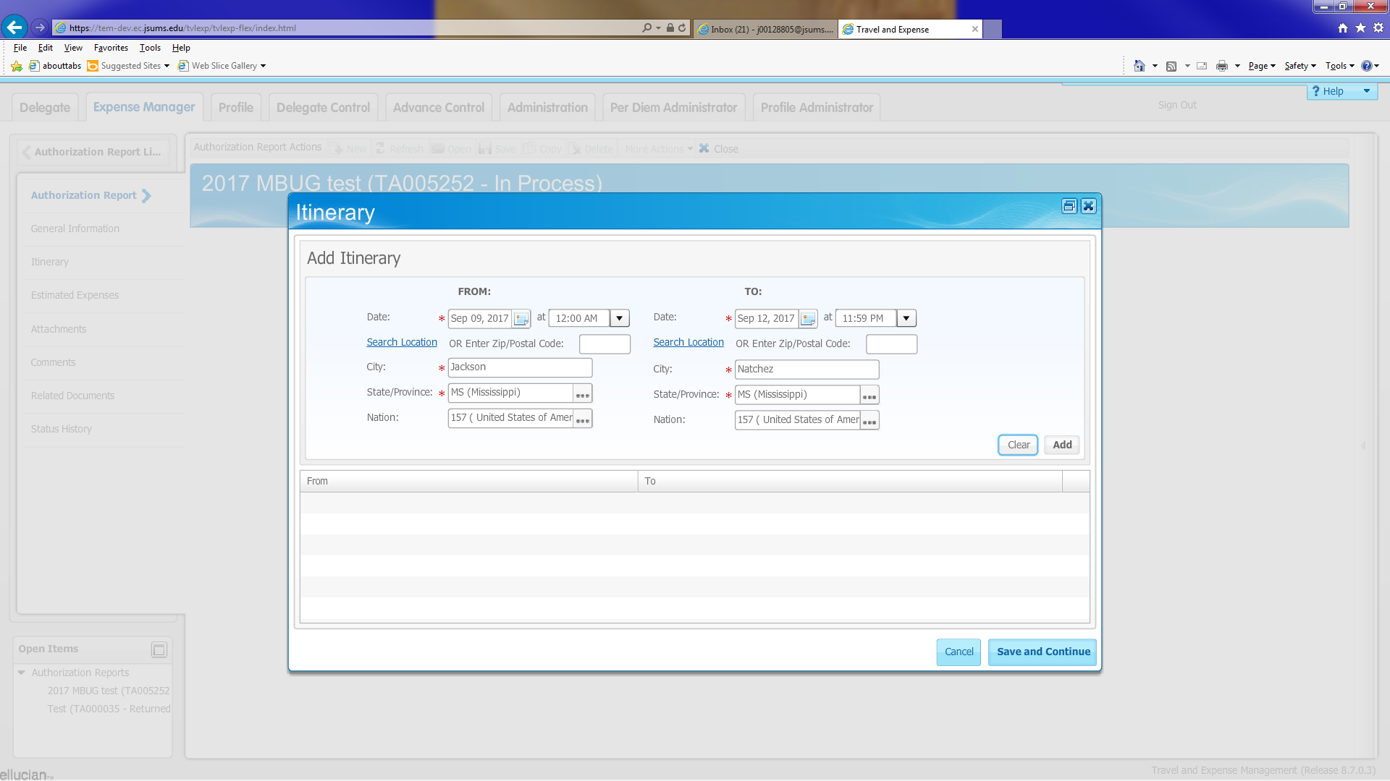
1. Click the Calendar icon in the From: Date field to select a starting date.
2. Click on Select Location Enter the proper city name. Use the Search Location if that helps.
3. Click the Calendar icon in the To: Date field to select an arrival date.
4. Click the Time field drop-down arrow to select an arrival time in half-hour increments.
5. Click on Select Location. Enter the destination city name.
6. Click the Add button to add the first portion of the trip to the itinerary.
7. Click the Save and Continue button to go to the next window.
Repeat steps 1-7 for the addition of other cities that will be visited on the same trip

Slide 30
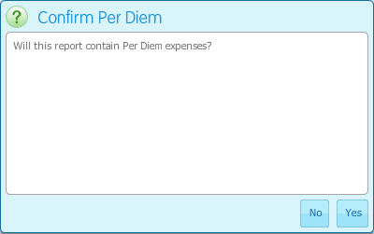
Click YES/NO if your report will contain Per Diem expenses for meals.

Slide 31
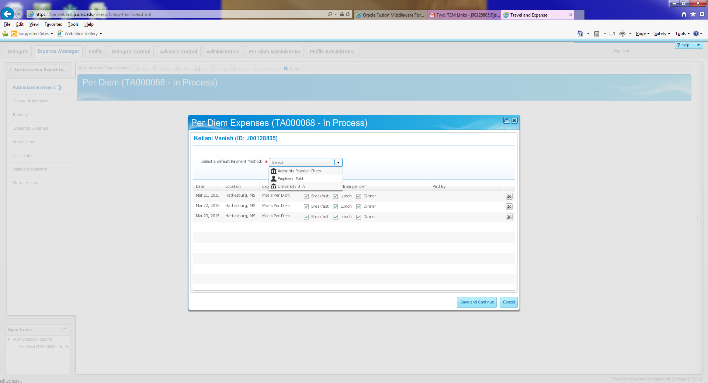
Select Employee Paid
Deselect any meals that will be provided by the conference

Slide 32
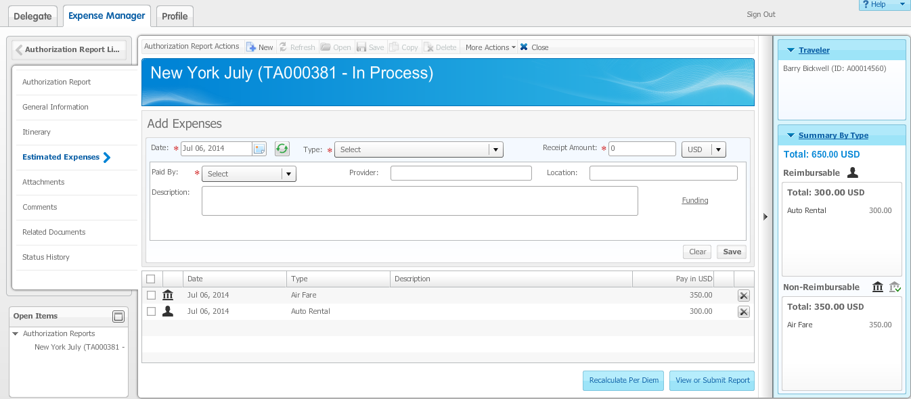
From an open authorization report, click the Estimated Expenses link, if needed.
Select the date the expense is expected to occur using the Calendar icon in the Date field.
Select the expense type in the Type field.
Enter the amount of the expense in the Receipt Amount field.
Note: If you selected a calculated amount type such as Mileage in the Type field, you will not be able to enter an actual amount in the Receipt Amount field.
Select how the expense will be paid in the Paid By field.
Make sure every field with and * is filled in
Click the Save button to save the expense.

Slide 33
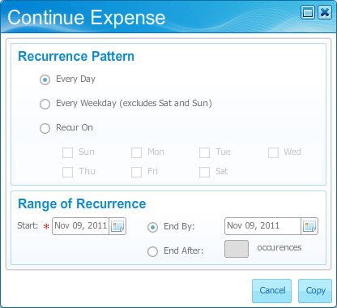
Note: For repeating expenses, you can click the Recurring icon before or after entering the Expense Type and Amount. The resulting window gives you several options for showing how many consecutive days a charge was made.
Examples of repeating expenses…hotel charges, car rental fees, per diem, etc

Slide 34
Paid By Options
What will happen with each “Pay By Option”
Accounts Payable Check – a requisition MUST be completed and a PO assigned before an Accounts Payable Check can be issued
Employee Paid – employee will pay for the expenses and get reimbursed with a completions of a travel reimbursement report
University BTA – the travel agent will pay for the expenses with the University’s credit card.
Departmental Transfer – mostly used for JSU Vehicle

Slide 35
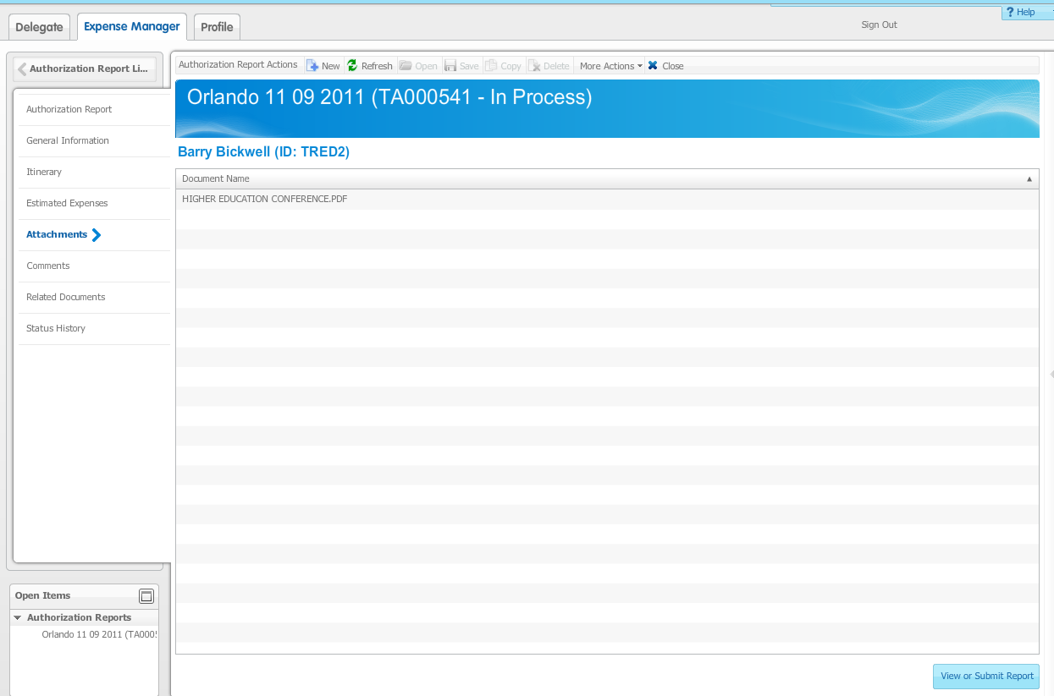
Save the documents on your computer first
From an open authorization report, click the Attachments link.
Click the New icon to add an attachment.
Click the Browse button to navigate to the file you want to attach.
Click the Attach button. The following box will appear if the upload is successful.

Slide 36
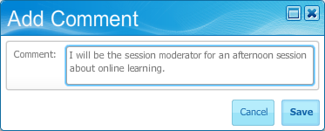
Follow these steps to add a comment to an authorization report.
From an open authorization report, click the Comment link.
Click the New icon to add a comment.
Enter the comment in the Comment field.
Click the Save button.

Slide 37
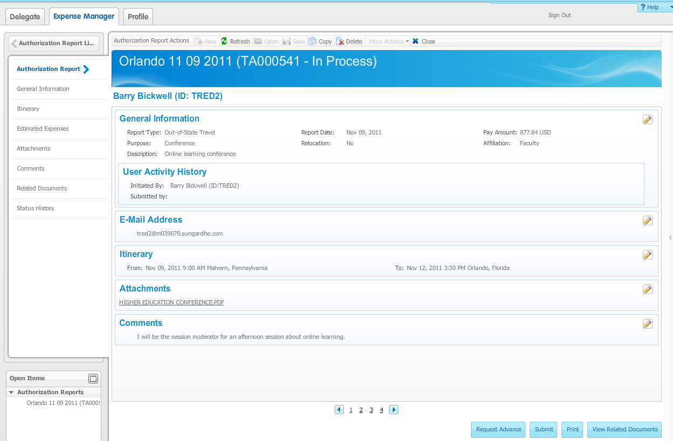

Slide 38
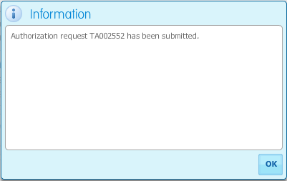

Slide 39
Approving travel authorization
Travel and Expense

Slide 40
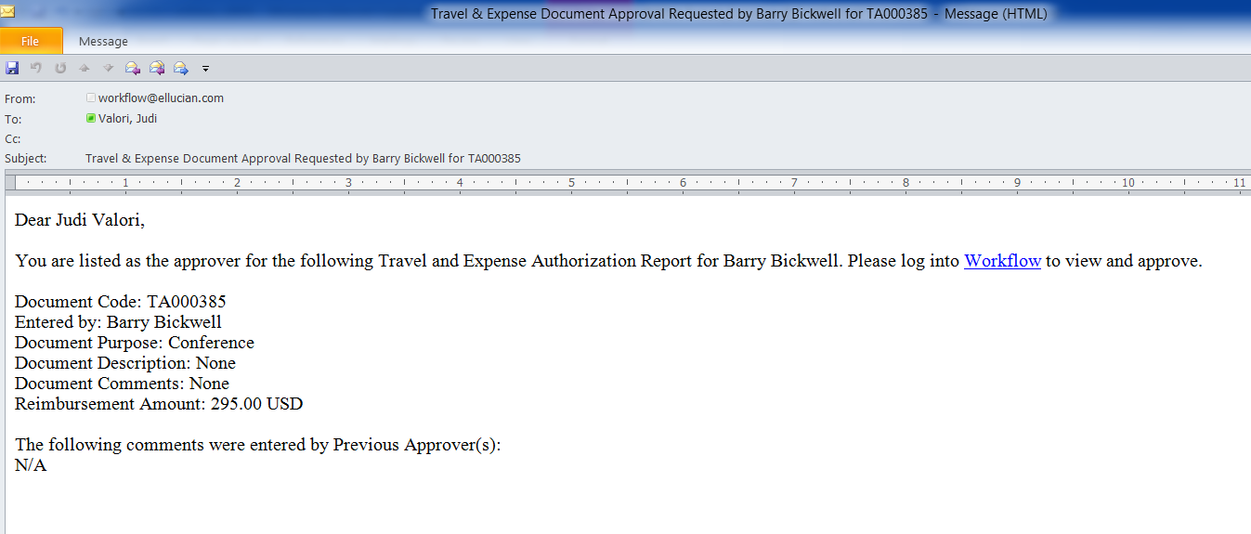
If you are the Approver for an Authorization or Expense Report, you will receive an email similar to the example above indicating you have something to Approve.
Click on the Workflow link in the email to take you to the Workflow Login Page.
Log into Workflow and you will be taken directly to the approval page.

Slide 41
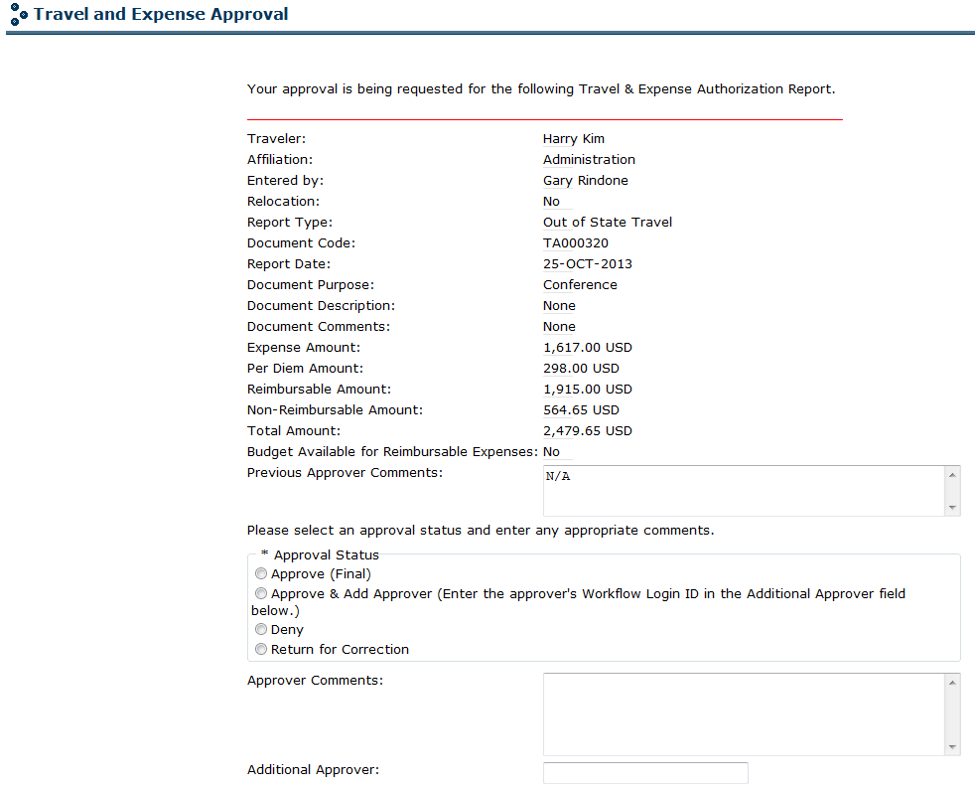
Additional Approver J# is J000#####

Slide 42
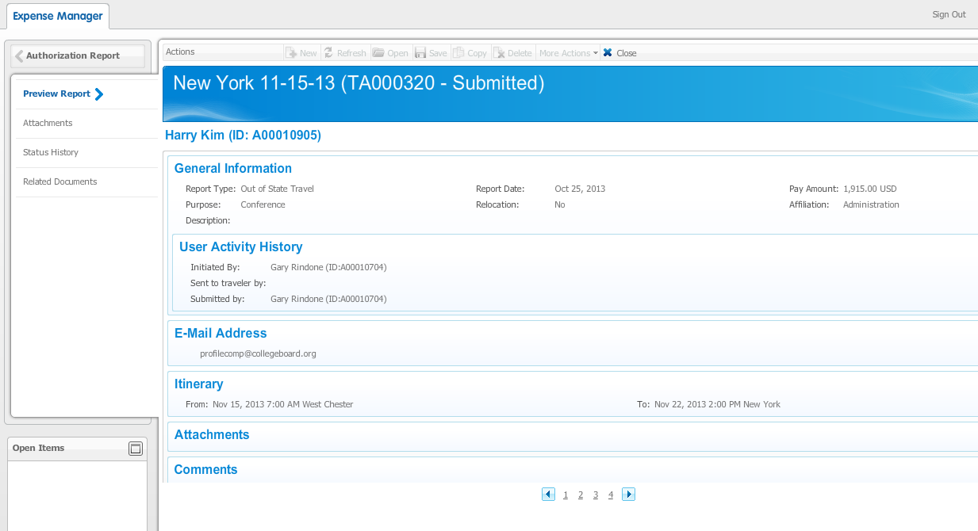
Click on the Travel and Expense Page link on the Workflow page to take you to the report in Travel and Expense Management. You can navigate through this report just like the creator but you cannot modify it except to add attachments and comments. Exit back to your Workflow page to select your approval decision.

Slide 43
Approval Decisions
Approve (Final) – NEVER select this option
Approve Authorization but Not Advance
Approve and Add Approver (enter approver’s J000#####)
Deny
Return for correction (If the report is returned for correction, you must enter a comment to let the traveler know what needs to be changed.)
Click the Complete button to complete your approval process.

Slide 44
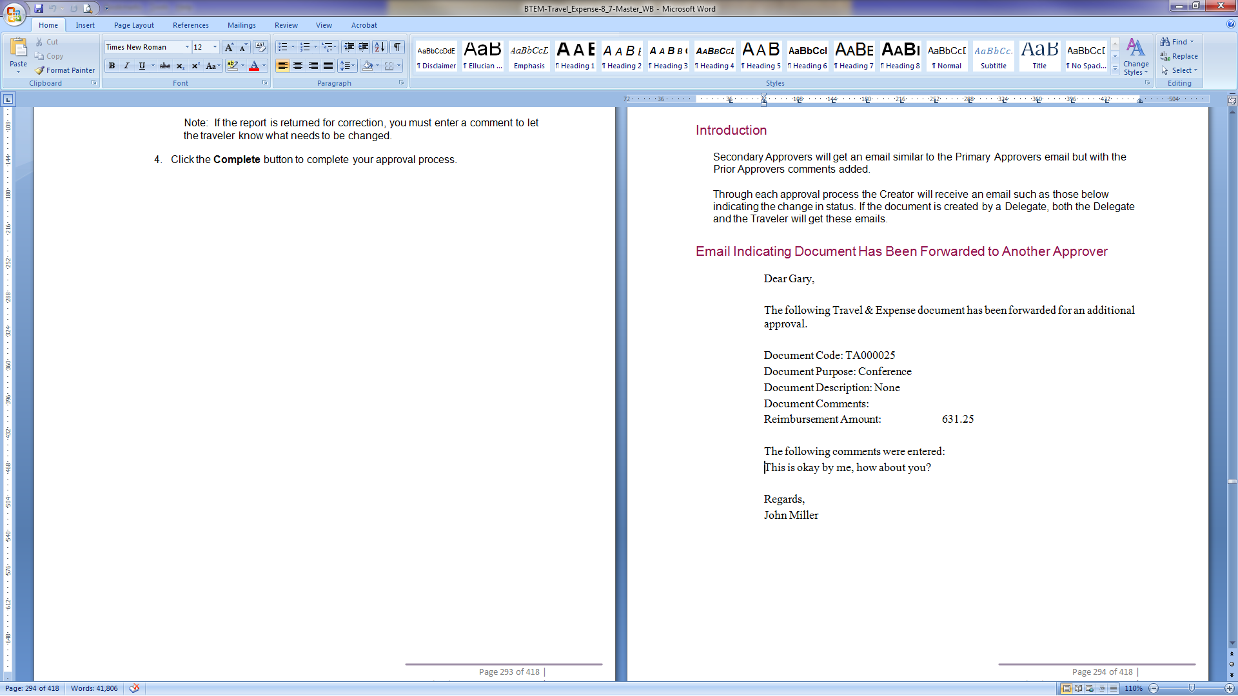
Email to the Traveler

Slide 45
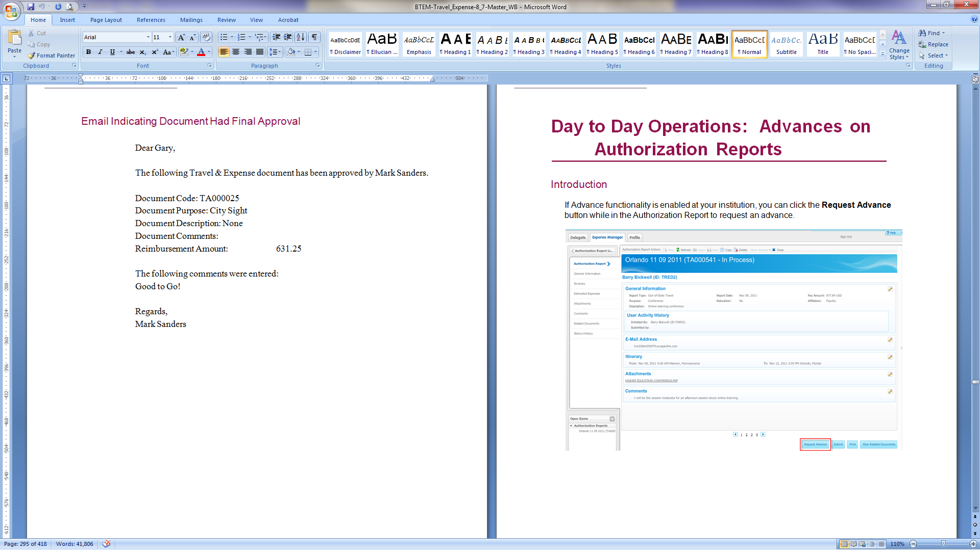
Email to the Traveler

Slide 46

Travel advance
Travel and Expense

Slide 47
Advance Rules
Advance is based on the Employee Paid payment option
Advance must be requested at least 14 days prior to the schedule trip start date
Advance will be paid within 7 days prior to the schedule trip start date
Advance reconciliation must be no more that 14 days after the trip end
NO advances will be allowed after the trip begin

Slide 48
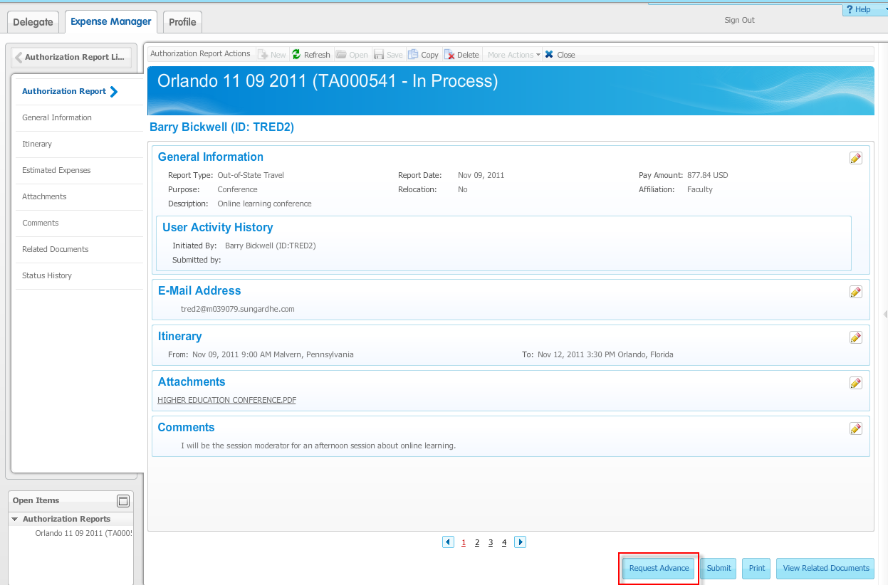
Note that if an advance is to accompany the authorization report it must be requested prior to submission of the authorization report. If the Request Advance button is clicked on a Submitted report that has not yet been approved, an error message will be displayed.
An advance request can also be made on an authorization report after the Authorization has been approved and posted.

Slide 49
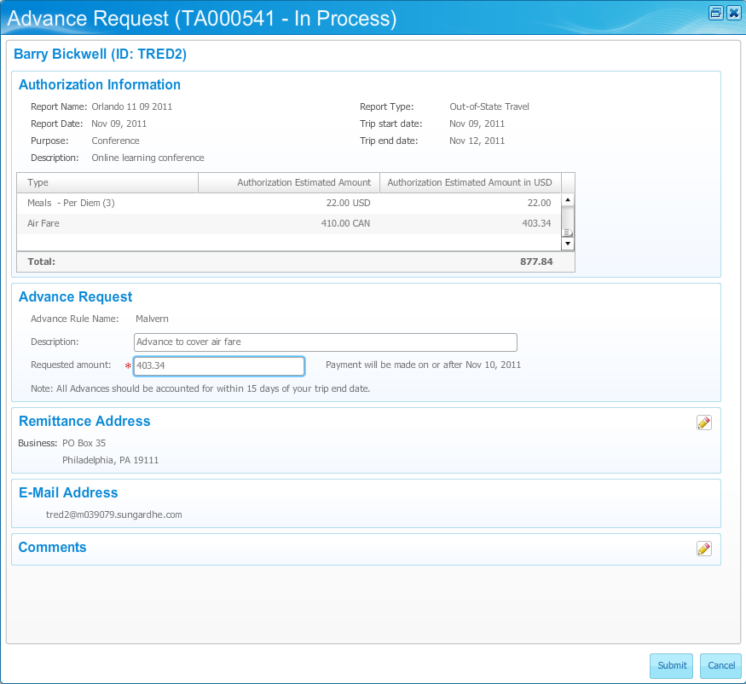
Enter a description of your requested advance in the Description field, if desired.
Enter an amount for your advance request in the Requested amount field.
Add comments, if desired, by clicking the Edit icon for the Comments block.
Click the Submit button to submit your authorization report and your advance request. You cannot return to the authorization after entering advance requests.
Note: If the authorization is returned for correction, the advance is cancelled and must be requested again after correcting the authorization.

Slide 50
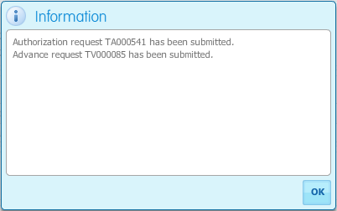

If the submission is successful, this message will display.

Slide 51
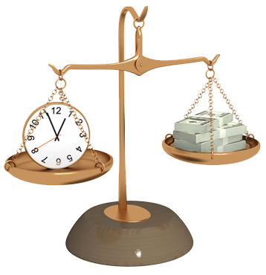
Expense report
Travel and Expense

Slide 52
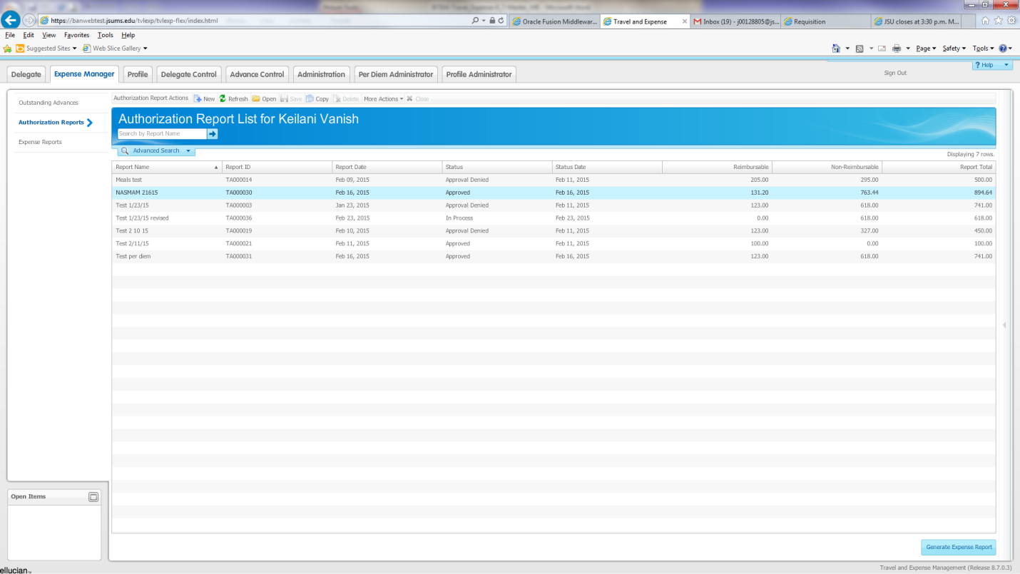
Go to the Authorization tab and highlight the travel authorization that you want to be reimbursed.
Click “Generate Expense Report”

Slide 53
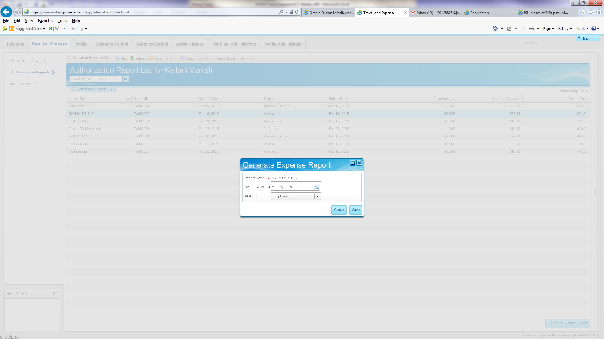
Verify the name on the report
Verify the report date
Click save

Slide 54
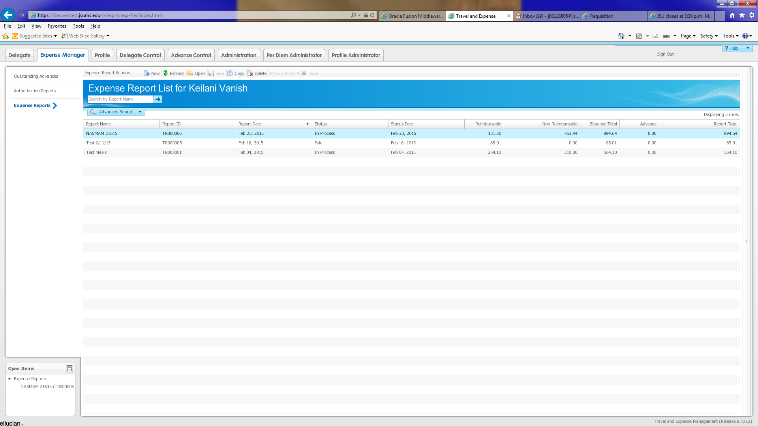

Slide 55

delegates
Travel and Expense

Slide 56
Acting as a Delegate
Indicate on the System Access Authorization for Travel and Expenses Management form (under the TEM Delegate Authorization List) include the names and J#’s of the people you will be a delegate for.

Slide 57
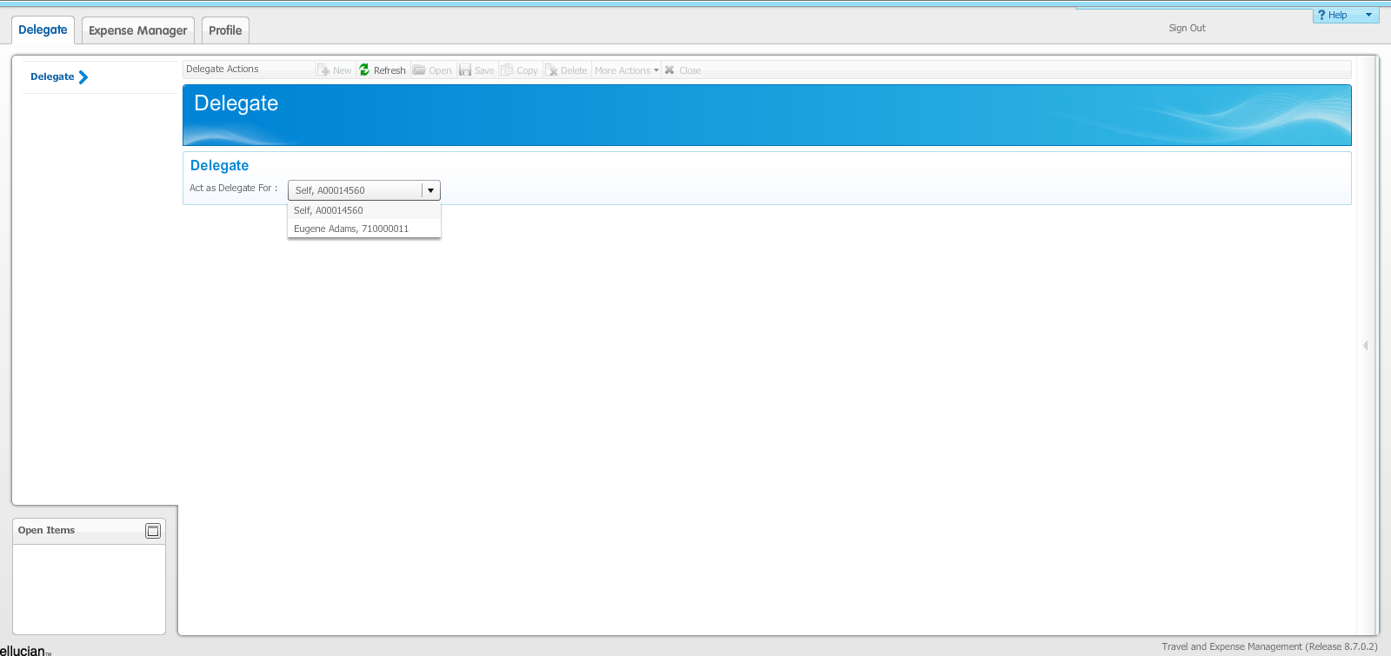
At the “Act as Delegate For” field, select the travelers name
Proceed with the completing the travel authorization or travel reimbursement as if you were the traveler.

Slide 58
Questions/Concerns/Complaints

Slide 59
This has concluded the Travel & Expense training workshop
Happy Traveling

