Slide 1
MBUG 2017
Session Title: Preventing/Correcting Multiple Records
Presented By: Lisa McDaniel
Institution: Mississippi University for Women
September 11, 2017

Slide 2
Session Rules of Etiquette
Please turn off your cell phone
If you must leave the session early, please do so discreetly
Please avoid side conversation during the session

Slide 3
What are multiple PIDMs or records?
A person or non-person is assigned two or more records in Banner with different PIDMs which causes this single entity to be treated as multiple entities.
Multiple PIDMs are caused by data entered into Banner directly or through data loads without matching or searching correctly.

Slide 4
Duplicate Records & PIDMS

Slide 5
Why are duplicates a problem?
Academic work will be on 2 different ID’s which means two transcripts.
Causes confusion for the student, employee, or company
Can result in two W2/1099 forms
Can take hours to combine the 2 records into 1record

Slide 6
Preventing Multiple Records
Search, Search, Search, Search, Search, Search, Search, Search, Search, Search, and Search again!!!!!

Slide 7
SOAIDEN – Person Search
Allows search by ID, last name, first name, and middle name

Slide 8
GUIALTI
Allows search by birthdate.

Slide 9
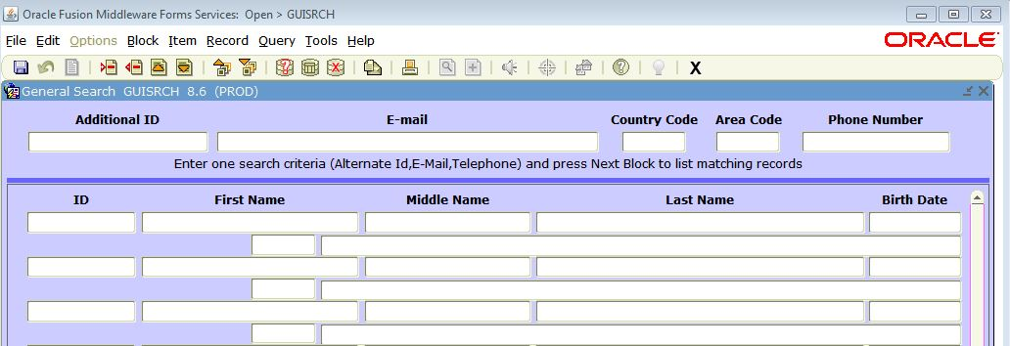
GUISRCH
Allows search of alternate ID, email, or telephone.

Slide 10
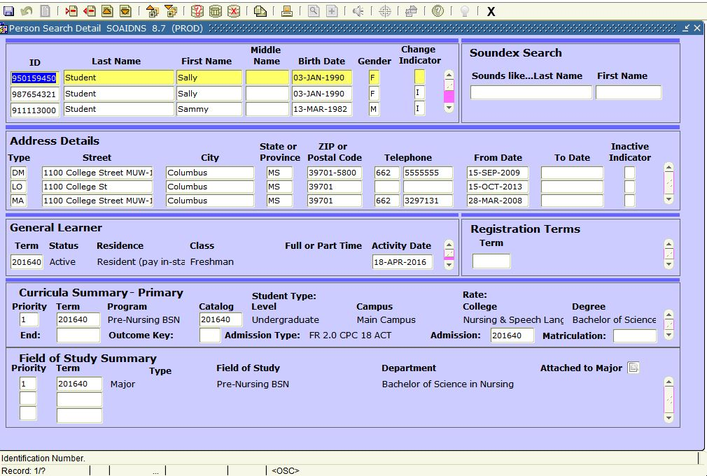
SOAIDNS
More detailed search

Slide 11
Multiple Record Correction
Multiple PIDM issues are easier to resolve if found earlier before additional information is added to the record.
SQL scripts are run to find possible multiple pidm records.
Offices determine if records are truly multiples.

Slide 12
Multiple Record Correction
GUASYST

Slide 13
GUASYST
This form only shows records that are a part of the Banner system and will not show any outside systems that reside in the database such as ID card or Bosscars Parking system.

Slide 14
Which record to keep?
Which pidm has the least/most other information associated with it such as registration, financial aid, or student accounting?
As a general rule, choose to keep the record with the most information associated with it.
Has either id been reported to any outside agency such as IHL?

Slide 15
Merge Records
Some records are moved manually by functional users such as classes and admission records.
Some records are merged by sql scripts.
Sequence numbers should be considered when merging

Slide 16
Delete Record?
The W typically merges the records, and then deletes the “bad” record.
Some schools choose to put “Do Not Use” in the name.

Slide 17
How you can help prevent duplicates!

Slide 18
Search by SSN
Search for the social security number first in SPAIDEN/PPAIDEN/FOAIDEN
Enter ssn and press tab
If a name pops into the box, this person already has a record in Banner.

Slide 19
Search by Full Name
Enter Search
Search Results after clicking F8

Slide 20
Search by Full Name – Method 2
On SPAIDEN, PPAIDEN, or FOAIDEN tab to the name field, enter name in the format last name, first name and tab
If there is only one match, the id number will fill into the block.
If there are several matches, a box will pop up with an option to see all matches.

Slide 21
Search by Partial Name
Use % as a wildcard in searches
Use the underscore (_) key to replace one character at a time

Slide 22
Search by partial SSN
The % wildcard can be used to search ssn’s also.

Slide 23
Understanding Search Results
Each person record should have 2 entries – one with id number and one with ssn
Change Indicator of ‘N’ means there has been a name change. This will be the previous name.
Change Indicator of ‘I’ means id change record. This will be the previous id number. Blank means it is the current record.

Slide 24
Comparing Records
Compare first, middle, and last names
Compare social security numbers
Compare addresses
Compare email addresses
Compare phone numbers
If the records match on several data fields, the record is probably a duplicate.

Slide 25
Steps for Banner Duplicate
Notify supervisor
Student Records with academic history – Supervisor should notify Information Systems director, Registrar’s Office, Admission, Financial Aid, University Accounting, and Institutional Research
Student record without academic history – Supervisor should notify Information Systems, Admissions, and Registrar’s Office
Employee – supervisor should notify Information Systems, Human Resources, and Institutional Research

Slide 26
Questions?

