Slide 1

MBUG 2017
Session Title: Username and Password Security - A Review Of Account Retrieval, Sign In, and Multi Factor Authentication
Presented By: Allen McGehee
Institution: Mississippi College
September 12, 2017

Slide 2
Session Rules of Etiquette
Please turn off your cell phone
If you must leave the session early, please do so discreetly
Please avoid side conversation during the session

Slide 3
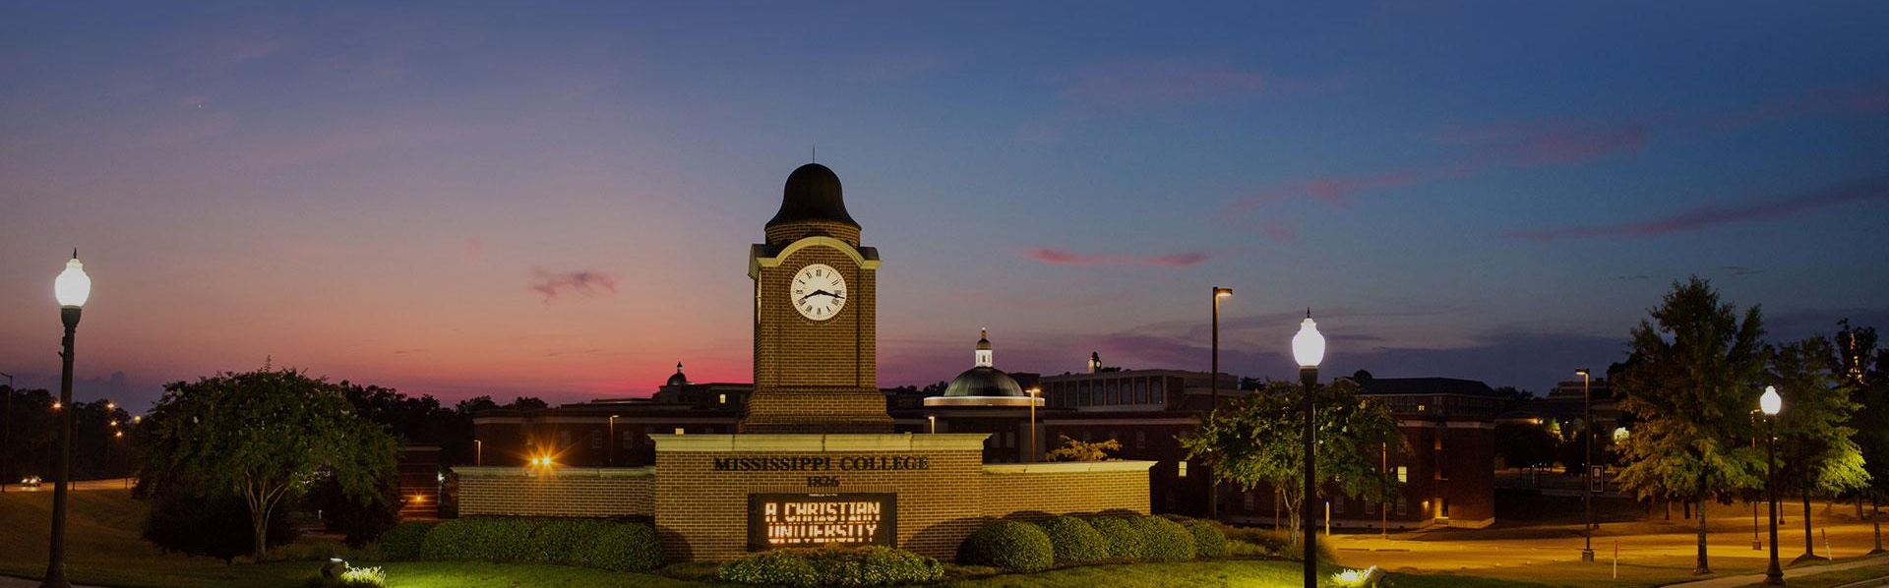
Mississippi College mc.edu
Founded in 1826
FTE = 5,070
Main Systems: Ellucian Banner, Google Apps, Moodle and Canvas

Slide 4
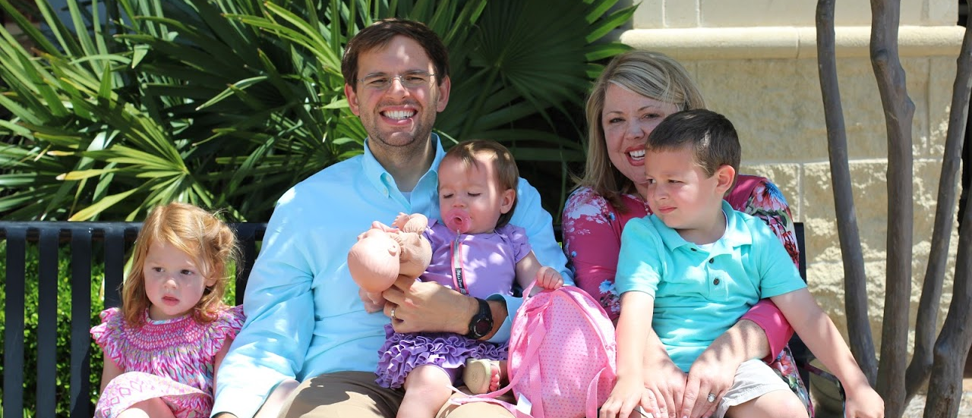
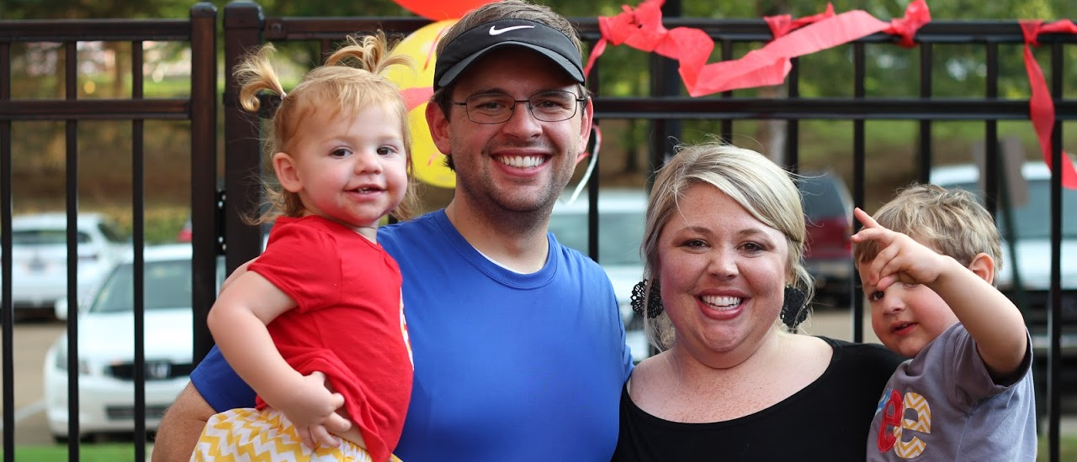
Allen McGehee gmcgehee@mc.edu
Programmer / Analyst
29
Wife and 2 kids

Slide 5
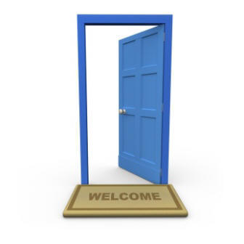
Single Sign On(SSO)

Slide 6
Our Systems
MyMC – Central Authentication Service(CAS)
Ellucian Banner
  Self Service - CAS
  INB – DB Authentication
Google Apps - CAS
  Gmail
  Calendar
  Drive
Moodle And Canvas - CAS

Slide 7
Our Systems - Authentication
Authentication Flow
  Creation
    Banner (Applicants/Enrolled) -> Active Directory(AD)/Google Apps
    AD -> GOBTPAC table
  Authentication to Banner Self Service
    MyMC Username/Passsword against AD
    Redirect to BannerSS Yale PL/SQL CAS Client
    Verify CAS Ticket and cross reference GOBTPAC table for external user id
    Redirect to requested page

Slide 8
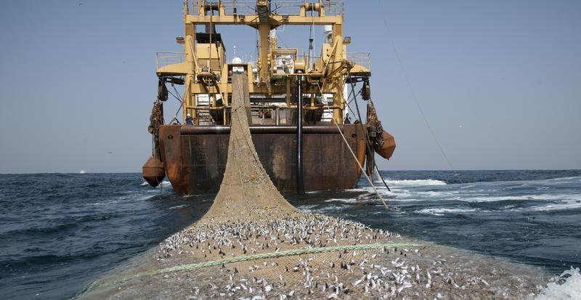
Our Story – Phishing

Slide 9
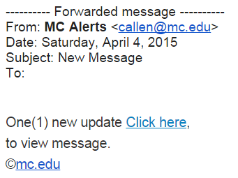
Our Story – Phishing

Slide 10
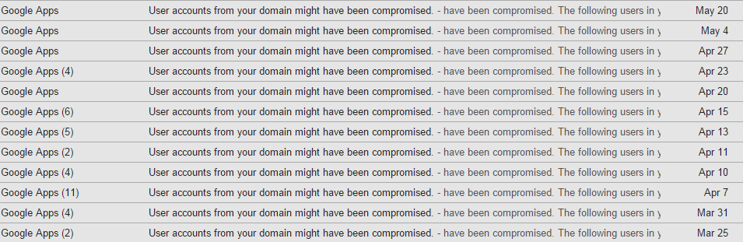
Our Story- Compromised Accounts

Slide 11
MC’s Response
Education
Change Passwords
Block Bogus MyMC URL’s
Tighten Spam Settings in Google Apps
Got Your Back – Delete Emails
Antivirus

Slide 12
MC’s Response cont’d
Block Suspicious IP’s in Africa
Address Robo Login Pattern: reCAPTCHA
Address potential 2 Factor Authentication: Federated Login (Future)

Slide 13

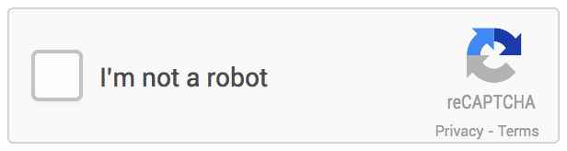
ReCAPTCHA
reCAPTCHA 2.0 – google.com/recaptcha
  Recaptcha 1.0:
  Recaptcha 2.0:

Slide 14
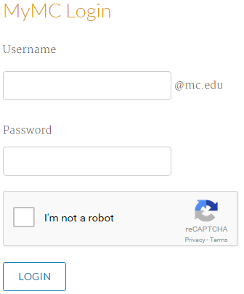
ReCAPTCHA Walkthrough

Slide 15
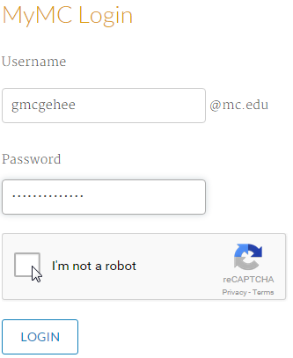
ReCAPTCHA Walkthrough

Slide 16
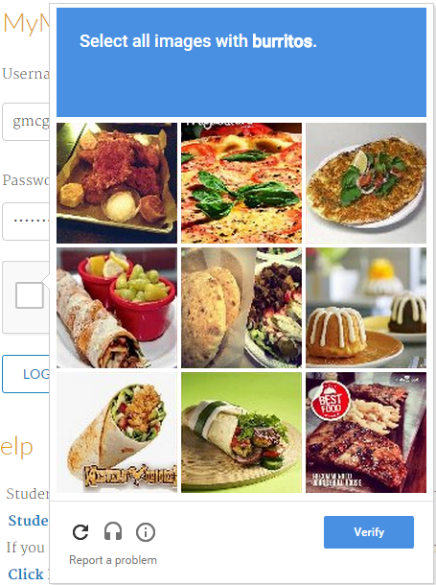
ReCAPTCHA Walkthrough

Slide 17
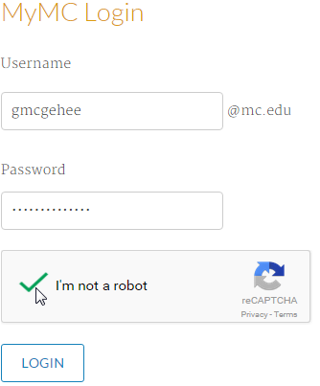
ReCAPTCHA Walkthrough

Slide 18
Federated Authentication
2 Factor Authentication
  Something You Know / Something You Have
Google Apps Security
  Text, Call, Authenticator App, Security Key, Apps Specific Passwords
Hurdles
  Implement Federated Authentication with MyMC
  Google Apps Password Sync (GAPS)
  Figure out how to sync/inject AD Attributes into the SSO/SAML flow (group memberships)

Slide 19
ReCAPTCHA Breakdown
Reasons We Took It Down
High Value Users Received Captcha Too Frequently
Reduced Productivity - Detail Oriented
Free Service - Outtage

Slide 20
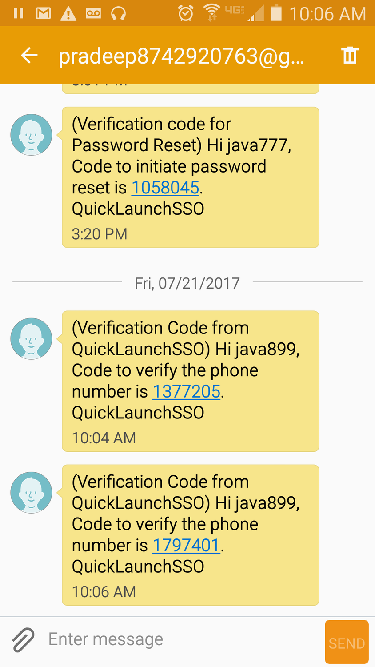
Password Manager
Integrated Solution by Unyfied
Remain in the Portal Ecosystem
Username/Password Self Service Reset
  Lookup
  Reset - After Expiration
  Forgotten
  Change
  Login
Multi Factor an option at each action
  Questions, Email, SMS (Text Message)

Slide 21
Other Colleges
Where are you in this process?
  Attacked?
  Multi Factor in place?
  Banner 9 Opportunity?

Slide 22
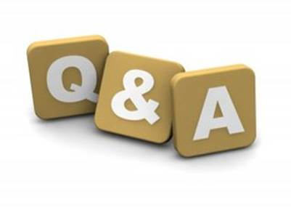
Questions

