Slide 1
Effects of the Include/Exclude flags on the MACJC Funding Formula
Raúl Fletes
MCCB Assistant Executive Director
Research & Effectiveness
Mississippi Banner Users Group Conference
September 11th, 2017
Notes:
This template can be used as a starter file for presenting training materials in a group setting.
Sections
Right-click on a slide to add sections. Sections can help to organize your slides or facilitate collaboration between multiple authors.
Notes
Use the Notes section for delivery notes or to provide additional details for the audience. View these notes in Presentation View during your presentation.
Keep in mind the font size (important for accessibility, visibility, videotaping, and online production)
Coordinated colors
Pay particular attention to the graphs, charts, and text boxes.
Consider that attendees will print in black and white or grayscale. Run a test print to make sure your colors work when printed in pure black and white and grayscale.
Graphics, tables, and graphs
Keep it simple: If possible, use consistent, non-distracting styles and colors.
Label all graphs and tables.

Slide 2
CJC Support Appropriations – Formula Only*
2017
210,990,085
2018
187,941,779
* Additional funds include CTE with about $26.6 M

Slide 3
Formula Weights
Academic
1.0
Technical
Career
1.0
Allied Health
ADN
MSVCC Host
1.0
1.19
1.19
MSVCC Provider
0.5
0.5
Sum of Weights
6.38
Mutually Exclusive
Note, these are ‘additive’, i.e.,
ADN hours are both Academic + ADN
Mutually Exclusive

Slide 4
Effect of additive weights - example
Student is coded as an NUR major in PE F27 (CIP),
takes 6 hrs of NUR and 6 hrs of BIO:
[ 12 Academic x 1.0 + 6 ADN x 1.19 ]
Same student is coded as an LAR (pre-nursing) major
in PE F27 (CIP), takes same schedule:
[ 12 Academic x 1.0 ]
It is critical to properly code students!

Slide 5
Weighted FTE Enrollment
Academic
43,151.16 (Academic+NDS audited FTE * weight)
Technical
Career
10,057.63
Allied Health
ADN
MSVCC Host
4,127.84
3,055.65 (Audited FTE * weight; min 600 hrs)
2,114.63
MSVCC Provider
1,354.53 (Part-time students only)
1,354.52 (Part-time students only)
Total Weighted Enr
65,215.94

Slide 6
FY18 Base Calculation *
From FY17: $ 210,990,085
* 15%
Base Amount: $ 31,648,515
/ 15 Colleges
College Base Amount: $ 2,109,901
* Rounding included

Slide 7
Amount per FTE
Appropriated for FY18: $ 187,941,779
Less Base: $ 31,648,515
Available for Distribution: $ 156,293,264
Divided by weighted Enrollment: 65,215.94
FTE Weight of One: $ 2,396.55

Slide 8
Audits Samples - Attendance
No sample = 100%
Possible sampling in the future

Slide 9
Attendance Cost of 3 Academic hours*
FTE Cost: $ 2,396.55
Hour Cost: $ 79.89
Class Cost: $ 239.66
Remember
CTE, ADN, VCC attendance costs will be higher
* Based on Spring 2017

Slide 10
Concept behind Include/Exclude
Include = auditable, i.e., reimbursable
Exclude = not auditable
Include w/ Out-of-State = will not be audited
Include ADN w/ Out-of-State = auditable
Reimbursement only for auditable students
Findings have a very negative effect!

Slide 11
nSPARC
nSPARC receives all records
Primary Enrollment
Student Schedule
Include/exclude fields are NOT part of upload
Used for LifeTracks & Report Card
  First-Time/Full-Time cohorts extract from upload

Slide 12
MCCB
PE file upload – Include flag
Yes! Please ‘include’ out-of-state
  More accurate reporting of in-state vs out-of-state
  There is no penalty with regards to audits, because out-of-state records are not audited
Does not affect funding
  Out-of-state Residency status supersedes include/exclude flag; thus removed except for ADN

Slide 13
Audits Samples - Student
Sample Excludes:
  Out of state residents (as per Residency field)
  Students flagged as Exclude
Sample Includes:
  Students flagged as Include
  ADN (CIP=513800) in or out of state, unless Excluded
Audit sample = 95% confidence
Summer 190 to 350 samples
Fall/Spring 314 to 371 samples

Slide 14
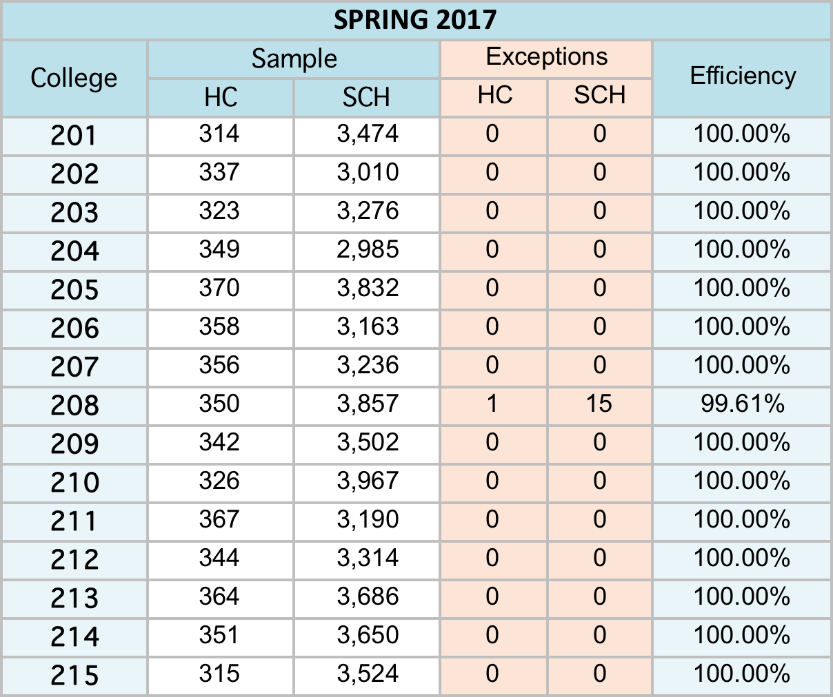
Audit Efficiency

Slide 15
Audit Efficiency
Initial 15 hours, translates to 148.9

Slide 16
One $187,941,779 Pie !
Based on AY17
16

Slide 17
Implication of One Pie
Academic loss 148.9 hours goes back to the pie
That is 148.9 X $79.89 = $11,897
The efficiency also impacts Technical, Career, ADN, Allied Health & MSVCC hours

Slide 18
Support Formula Funding AY 2017 *
$6,115,621.73
$8,633,933.37
$7,385,375.49
$10,826,651.30
$26,215,081.31
$15,115,362.42
$14,531,148.20
$13,187,442.12
Meridian
Delta
Gulf Coast
Northeast
Northwest
Pearl River
Southwest
Coahoma
CoLin
East Central
East
Hinds
Holmes
Itawamba
Jones County
$10,513,684.23
$7,532,700.22
$21,804,160.95
$9,951,094.09
$17,640,199.06
$12,082,324.63
$6,406,999.89
Total $187,941,779
* Summer 2016, Fall 2016 and Spring 2017

Slide 19
Cost of One Finding *
6,863
13,626
10,110
17,776
34,237
23,711
23,556
16,515
Meridian
Delta
Gulf Coast
Northeast
Northwest
Pearl River
Southwest
Coahoma
CoLin
East Central
East
Hinds
Holmes
Itawamba
Jones County
14,945
8,694
34,955
15,344
24,957
16,808
7,976
*Approximate - Based on 15 Academic (not ADN) hrs for Spring 2017
There are other funds that efficiency comes into play, thus net cost
could be higher

Slide 20
There are other Pies
Career-Technical Education
  Also utilizes the efficiency calculation
    Increased effect of findings
  Programs and sites must have prior MCCB approval
  There 19 High Cost programs, i.e., extra weights
    3 levels of High Cost reimbursements
    Student must be Technical or Career
Repairs & Renovation

Slide 21
Career-Technical Education
Indirect State Funds via MDE $ 26,655,473
Base 7.5% or $ 133,277/college
Remaining based on a formula
Utilizes efficiency in its calculations
Must be Technical or Career curriculum
  No Academic
  No ADN

Slide 22
High Cost CTE Programs
Level | CIP | Program
1 | 010601 | Horticulture
1 | 490202 | Construction Equipment
1 | 490205 | Truck Driving
1 | 510707 | Radiological Technology
1 | 510904 | EMT - Paramedic
1 | 510911 | Radiological Technology
1 | 511004 | Clinical/Medical Laboratory
1 | 513901 | Practical Nursing
2 | 120500 | Hospitality Admin/Management
2 | 470303 | Industrial Maintenance
2 | 470399 | Industrial Maintenance
2 | 470607 | Aviation
2 | 470608 | Aviation
2 | 470609 | Aviation
2 | 510803 | Occupational Therapist Assistant
2 | 510901 | Cardiovascular Technology
2 | 510908 | Respiratory Care
2 | 510909 | Surgical Technology
2 | 520901 | Hospitality Admin/Management
2 | 520903 | Hospitality Admin/Management
2 | 520904 | Hospitality Admin/Management
3 | 510601 | Dental Assistant
3 | 510602 | Dental Hygiene
3 | 510806 | Physical Therapy
3 | 510910 | Sonography

Slide 23
CTE Requires Proper Coding
John, PE F9 = 1 Academic Sam, PE F9 = 2 Technical Deb, PE F9 = 1 Academic
MAT 1313, CF F13 = 1 Academic
DDT 1213, CF F13 = 2 Technical
MST 2243, CF F13 = 2 Technical
Only Sam’s hours above are paid through the CTE
Deb missed out due to being coded as Academic

Slide 24
Summary
Include/Exclude flag help reporting
  MCCB – Reimbursements and Budgeting
    Include=Yes
  nSPARC – Lifetracks and Report Card
    Does not care about Include/Exclude flag
Include flag for Out-of-State
  Does not affect reimbursements
  Improves reporting

Slide 25
Summary
Money Pies are shared
    Coding affects college and entire system
  Accurate coding is very important

Slide 26
QUESTIONS
?

