Slide 1
MBUG 2017
Session Title: HR Set up
Presented By: Sharon Foster
Institution: Mississippi University for Women
September 11, 2017

Slide 2
Session Rules of Etiquette
Please turn off your cell phone
If you must leave the session early, please do so discreetly
Please avoid side conversation during the session

Slide 3
Why do HR offices have so many forms?
Federal Government
State Government
IHL Policy
University Policy
Best HR practices
Best department practices

Slide 4
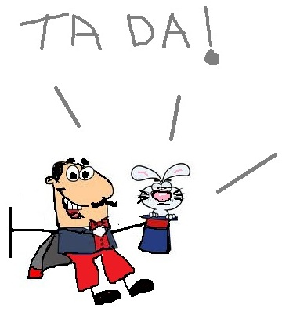
Payroll!
Other reporting as needed.

Slide 5
Essentials
Awesome co-workers
Great boss
Lots of post-it notes & pens that write well
Checklists
Cheat sheets
A clear understanding of your own processes
This can and often will change daily

Slide 6
Audience Poll
How detailed do you want this presentation to be?
Are you new to HR? Are you new to Banner?
Are your new hire forms paper, on-line (links) or a combination of both?

Slide 7
Banner’s role in HR at MUW
Payroll
Employees past and present
Pay and all deductions associated with it
Demographic Info
Benefit deductions
Tracking of received paperwork
Reporting

Slide 8
New Hires
Regular benefits eligible employees
Part-time benefits eligible employees
Student workers
Non benefits eligible temps and adjuncts or employees less than 20 hours per week
Note: your institution’s definitions of employee categories may defer from MUW’s

Slide 9
It all starts with a posting
A hiring manager has a job opening
MUW uses PeopleAdmin for job postings and the approval process
Once a position is approved, the job is posted online
Applicants
Hiring manager reviews applications, interviews and then recommends that a specific candidate be hired

Slide 10
Now, we have a candidate
Applicants job offer is contingent on successful completion of a background check
The candidate completes a background check release form
HR enters the candidates information into the Truescreen background check system and waits
Once a candidate is cleared, they are hired

Slide 11
Now, we have an Employee
Write employment letter or contract & letter is prepared by Academic Affairs
Faculty has extra steps before starting
Employee arrives on or before 1st day to sign I-9 and start documents

Slide 12
HR Forms necessary for Banner
I-9 form
State and federal tax forms
Direct deposit info – account & routing numbers
Benefit forms
Cafeteria plan
Retirement elections
Misc. deductions – fitness center, meal tickets, Foundation

Slide 13
I-9’s: Employment Eligibility Verification – E-Verify
The fun never ends!
The form often changes
Last update was 7/17/2017 N –
New form Must be only form in use on 9/18/2017.
Update those accompanying documents and print the new instructions every time.

Slide 14
HR
B | I | N | G | O
Too busy to complete forms to get paid | Thinks Cafeteria Plan is meal plan for cafeteria | Uses leave they don’t have | Gets married and doesn't tell HR | Not sure of address
Mama accompanies job applicant | Has never seen a W-4 | Mama accompanies New Hire on first day | Doesn't want to pay ANY taxes | No IDs
Wants to stop FICA deduction | Employee walks in and quits | ATTEND HR PRESENTATION AT MBUG (free square) | Wants to know where we have been depositing her paycheck - 3 months later | Changes address and doesn't tell HR
Has baby and doesn't tell HR | Name different than ID | Never shows up after interview | Surprised by deduction for Retirement plan | “Employee” shows up for paycheck - you've never heard of them
Surprise Adjunct | Student Worker drops out and continues to work | Applicant doesn't want to apply online | Surprise Temp | Use Banner so much you think date is 11-SEP-2017

Slide 15
Creating a New Employee in Banner
We have a packet for each type of employee.
Once the employee completes the packet, then we use information from packet to enter employee in Banner.
You must always check to see if the employee is already in Banner. Check both Social security number and by name.

Slide 16
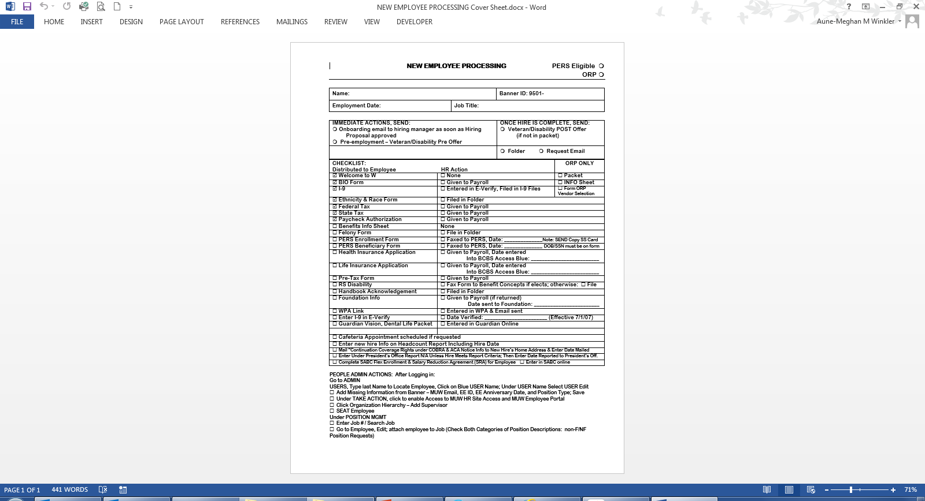

Slide 17
Profiles/permission Banner access
Banner access
Supervisor completes Banner access form for new employee; signed by supervisor and employee. Includes confidentiality statement and privacy information
Access can be query(view only) or update

Slide 18
Banner Hot keys

Slide 19
Top-10 (or 16) Screens for MUW HR Banner
PEAHIRE Enter New Hires
PEAEMPL Employee Look-up, Hire/Term Dates
PPAIDEN Employee Info (BIO, Address, Email, etc.)
PHILIST List of Pay Periods/Pay
PHICHEK Specific Check Info
NBAJOBS Jobs List
NBIPORG Organization Numbers
NBIPINC Position Numbers
SPAIDEN State/County/Country
PDADEDN Federal/State Deductions
PEIDTOT Premium Deductions
GXADIRD Payroll Direct Deposit Banking Info

Slide 20
Screens for MUW HR Banner (cont.)
PEIJTOT Earning Totals
PEIETOT Payroll Totals
SFAREGQ Student Enrollment
PTRCALN Payroll Calendar

Slide 21
PEAHIRE
Is helpful in getting the Banner number off to a good start.
Create that person!
One-stop-shop.
Add the details.

Slide 22
Entering Jobs, Pay & Details
At MUW, our Payroll Accountant and the Payroll Assistant usually enter the job.

Slide 23
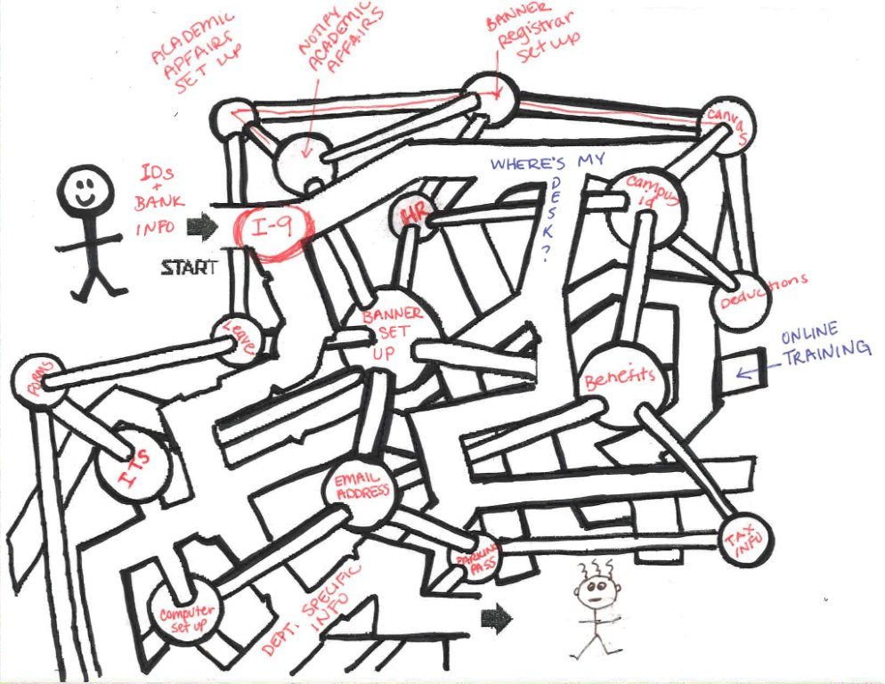

Slide 24
Terminating an Employee
What to remember/what to do/what not to do
Start Check out process early
Send Checkout Forms via email
Last day on campus and last day on resignation letter might be different
Lots of steps before and after termination

Slide 25
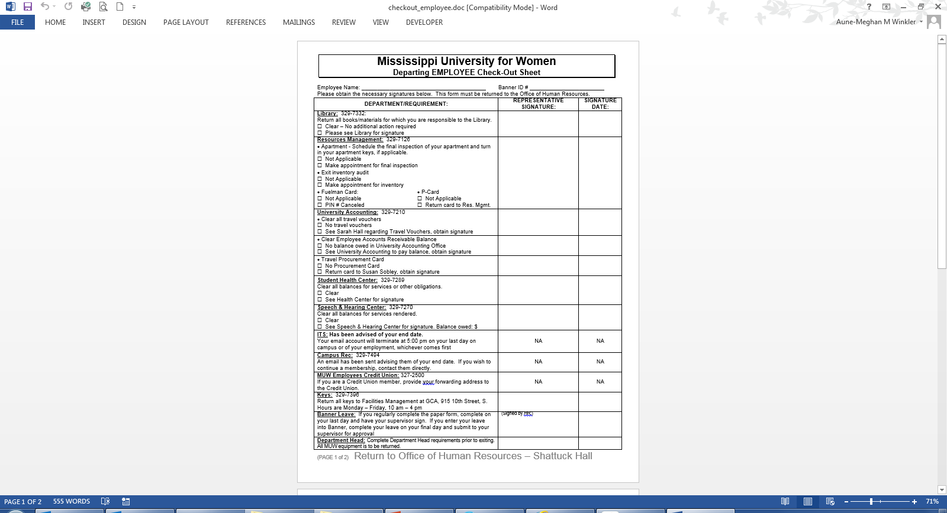
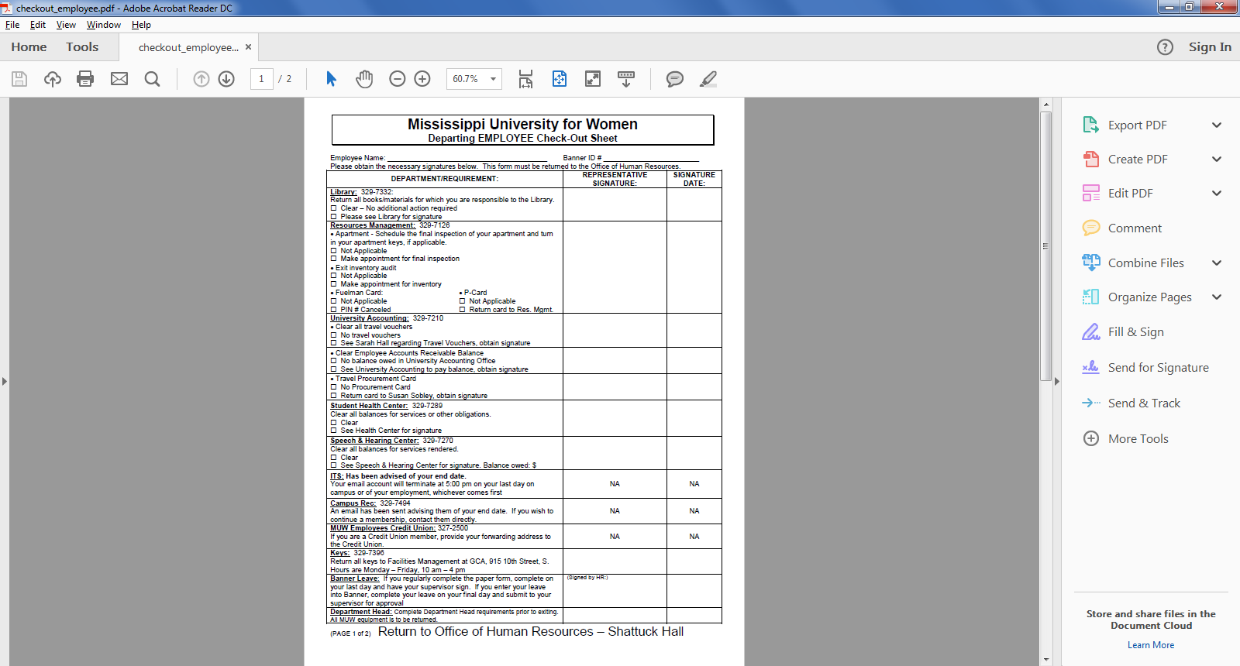

Slide 26
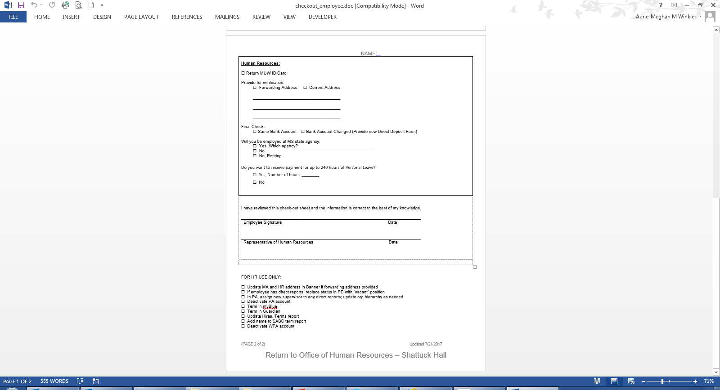
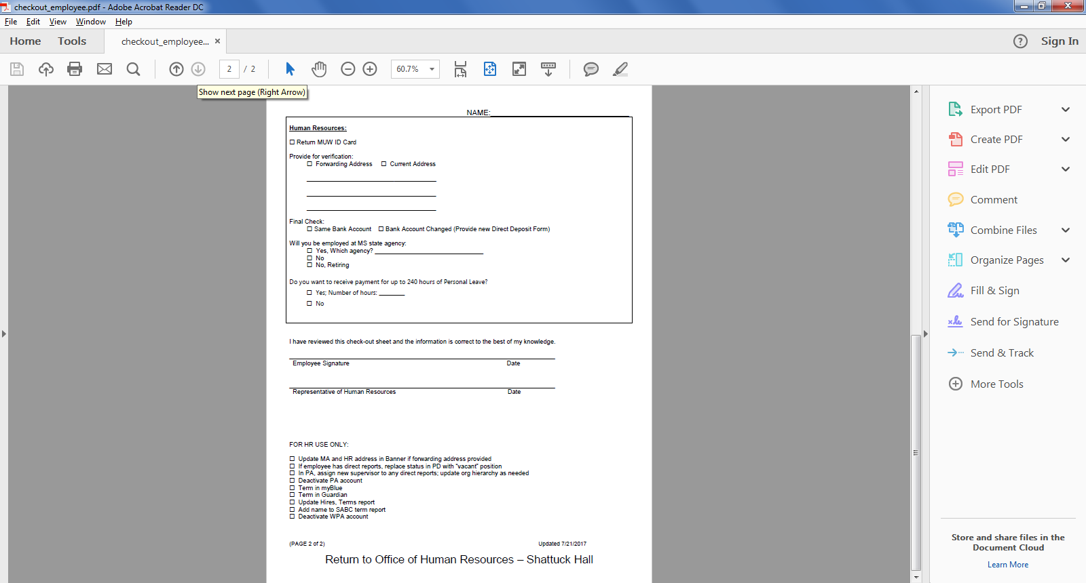

Slide 27
Terminated Employees’ Retention of I-9
The fun never ends until
either:
3 years after hire date, or
1 year after termination date, whichever is greatest

Slide 28
I-9 Math for HR:
Hire date: 01/02/2017
Term date: 06/30/2017
I-9 destroy date is the greater of
01/02/2020
06/30/2018
What is the destroy date?

Slide 29
Questions?

Slide 30
That’s all folks

