Slide 1

MBUG 2016
Session Title: Finance Self-Service
Presented By: Keilani Vanish
Institution: Jackson State University
September 11, 2017

Slide 2

Session Rules of Etiquette
Please turn off your cell phone
If you must leave the session early, please do so discreetly
Please avoid side conversation during the sessions

Slide 3
Setting Up A User for Finance Self-Service
The user must have a valid Banner ID in SPAIDEN
Must have a Oracle ID
Create a relationship between the Oracle ID and the Banner ID on GOAEACC
Set up User Profile on FOMPROF and select the Self Service Access Indicator
Enable a PIN via GOATPAC or GOATPAD.

Slide 4
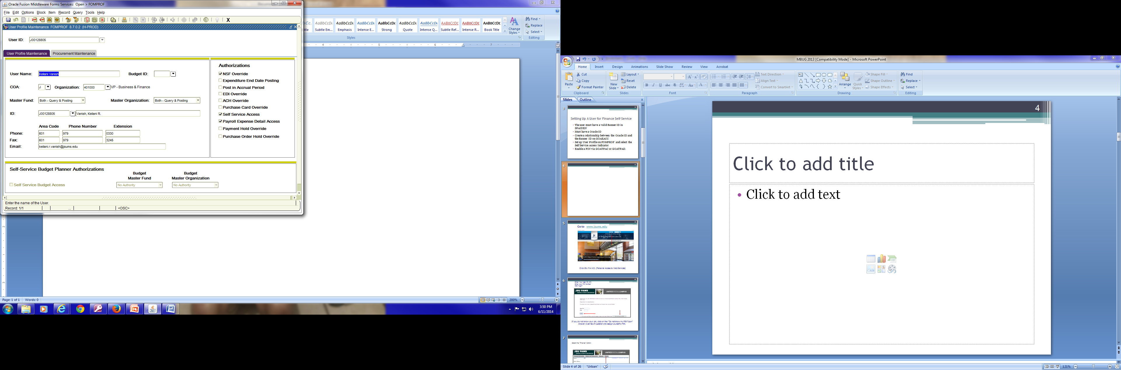

Slide 5
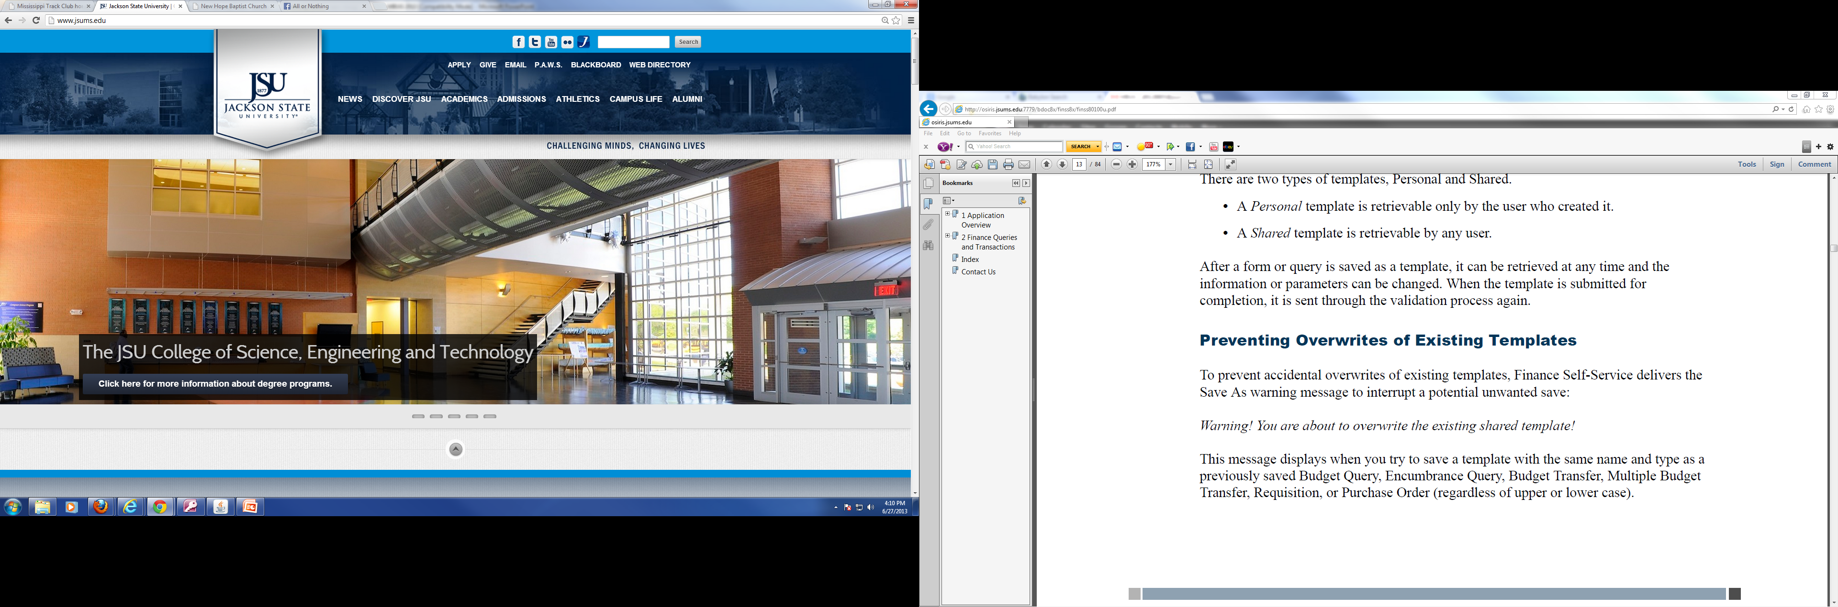
Go to www.jsums.edu
Click JSU P.A.W.S. (Personal Access to Web Services)

Slide 6
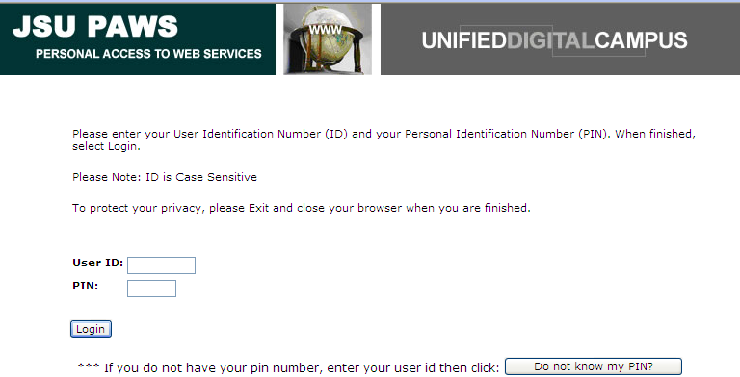
Enter Your User ID (J#)
Enter your PIN Number
Click “Login”
If you do not know your pin, click on the “Do not know my PIN? Icon”
Answer a series of question and assign yourself a PIN.

Slide 7
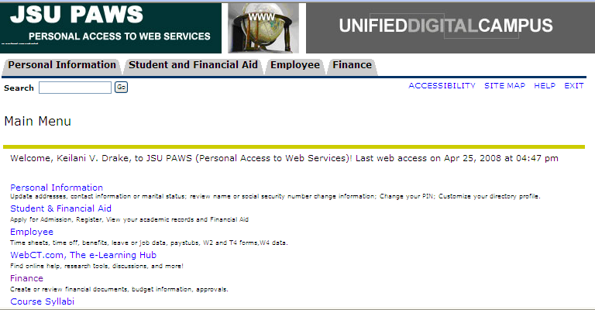
Select the “Finance” Option

Slide 8
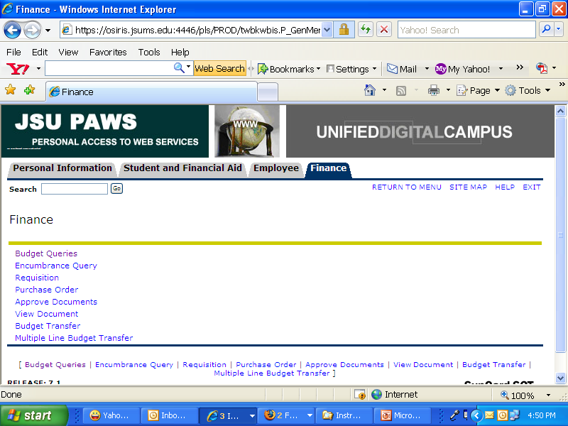
Select “Budget Queries” to navigate to the Query Page

Slide 9
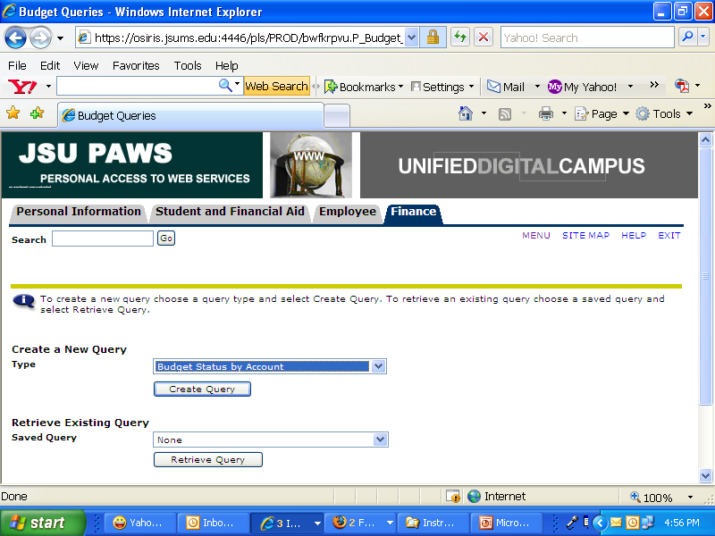
OPTION I: CREATE A NEW QUERY (See slides 8 – 13)
OPTION II: RETRIEVE EXISTING QUERY (See slides 14)

Slide 10
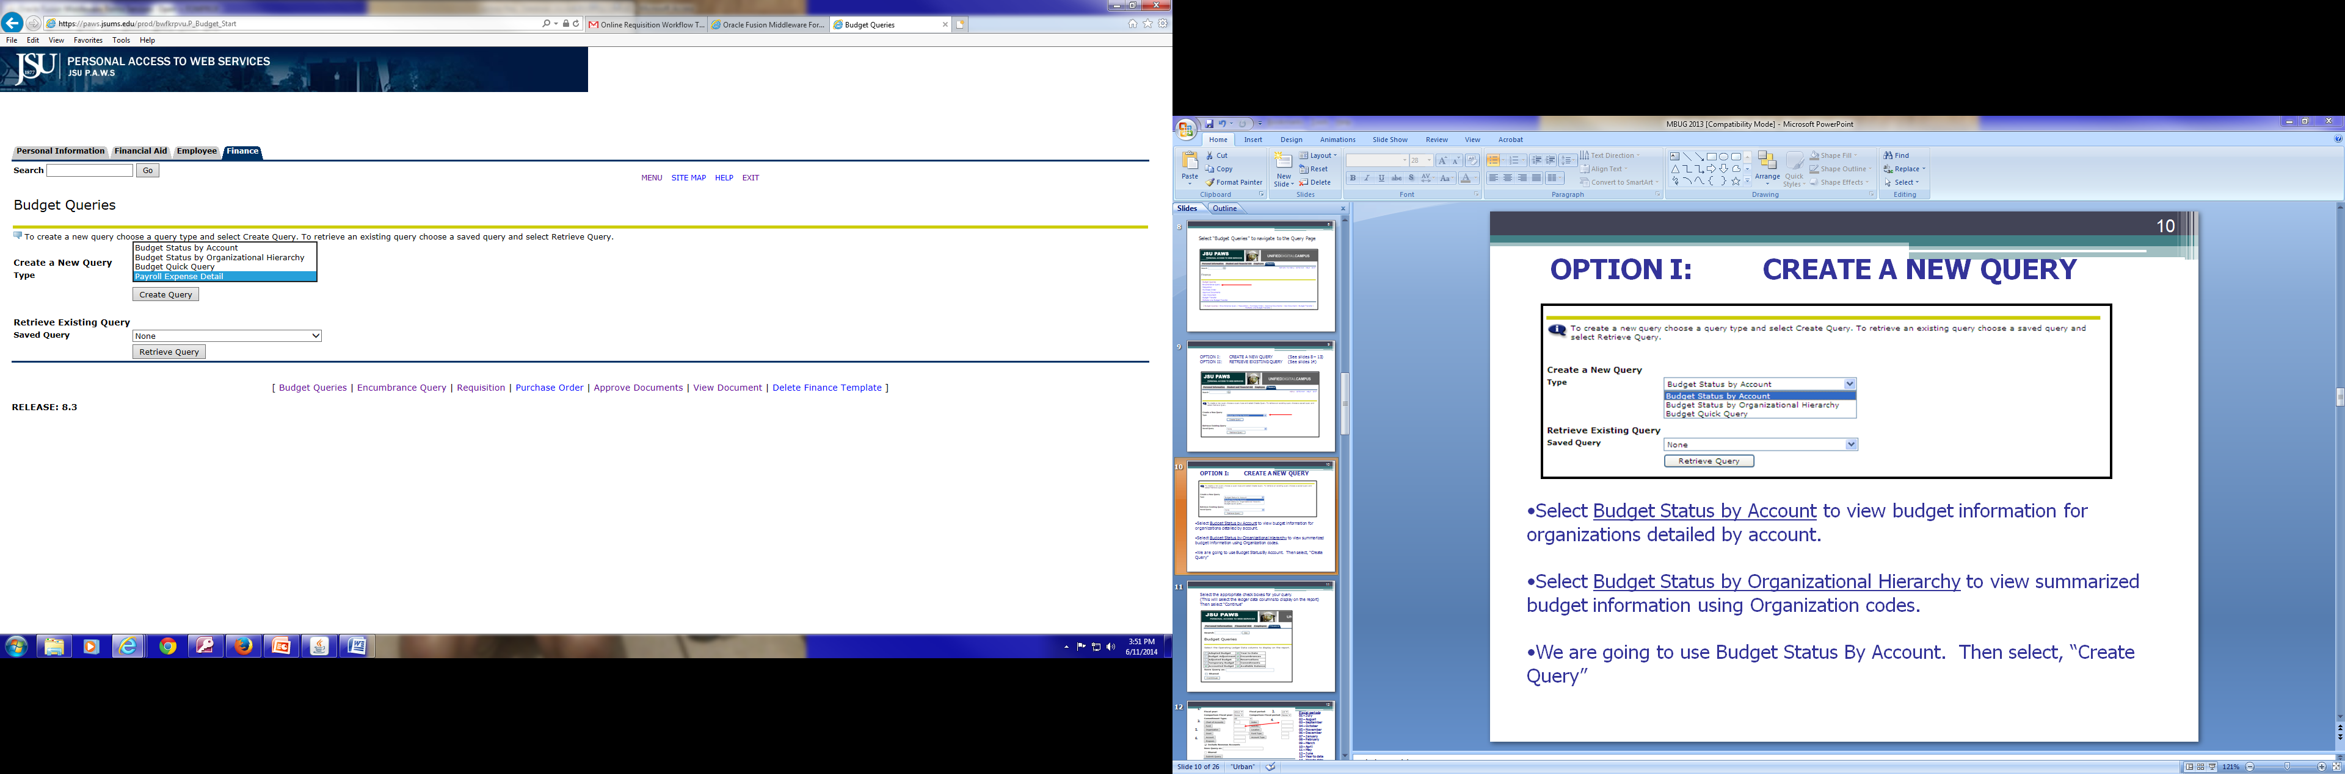

OPTION I: CREATE A NEW QUERY
Select Budget Status by Account to view budget information for organizations detailed by account.
Select Budget Status by Organizational Hierarchy to view summarized budget information using Organization codes.
Select Payroll Expenses Detail to view the payroll detail for a specific fund and organization codes
We are going to use Budget Status By Account. Then select, “Create Query”

Slide 11
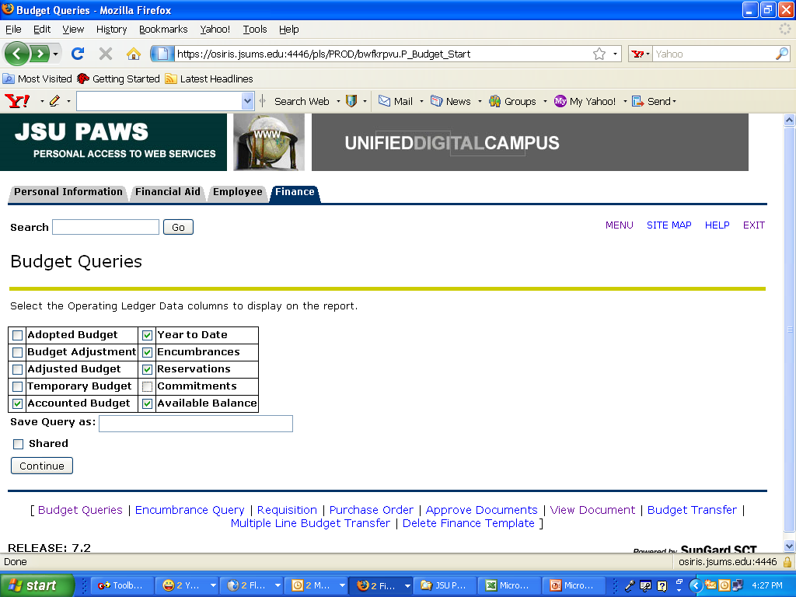
Select the appropriate check boxes for your query.
(This will select the ledger data columns to display on the report)
Then select “Continue”

Slide 12
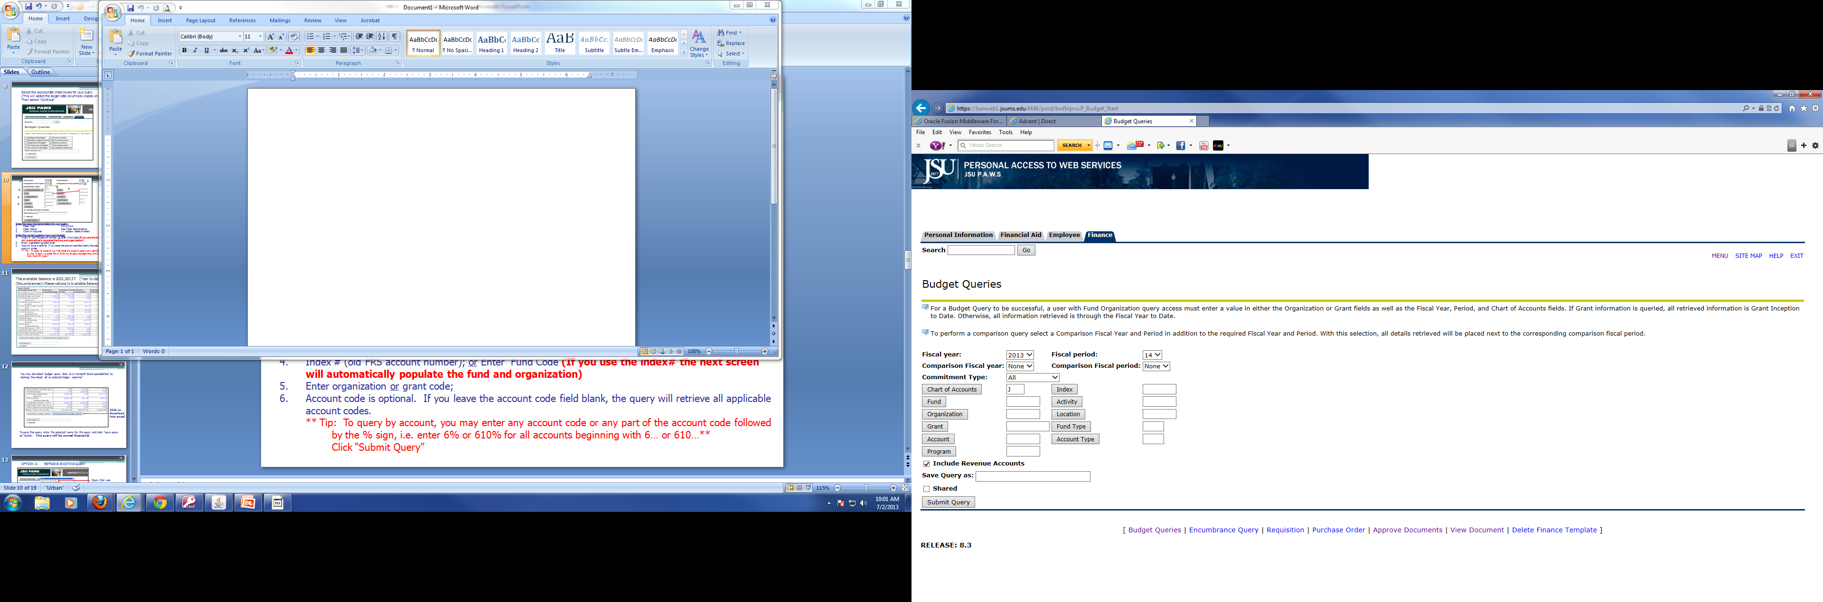
1.
2.
Fiscal periods
01 – July
02 – August
03 – September
04 – October
05 – November
06 – December
07 – January
08 – February
09 – March
10 – April
11 – May
12 – June
13 – Year to date
14 – Year to date
3.
4.
5.
6.
Enter the required parameters for your query:
Fiscal Year: 2013/2014
Fiscal Period: See Fiscal Periods above
Chart of Accounts: J – Jackson State University
Enter the correct code to view your budget:
Index # (old FRS account number); or Enter Fund Code (If you use the index# the next screen will automatically populate the fund and organization)
Enter organization or grant code;
Account code is optional. If you leave the account code field blank, the query will retrieve all applicable account codes.
** Tip: To query by account, you may enter any account code or any part of the account code followed by the % sign, i.e. enter 6% or 610% for all accounts beginning with 6… or 610…**
  Click “Submit Query”

Slide 13
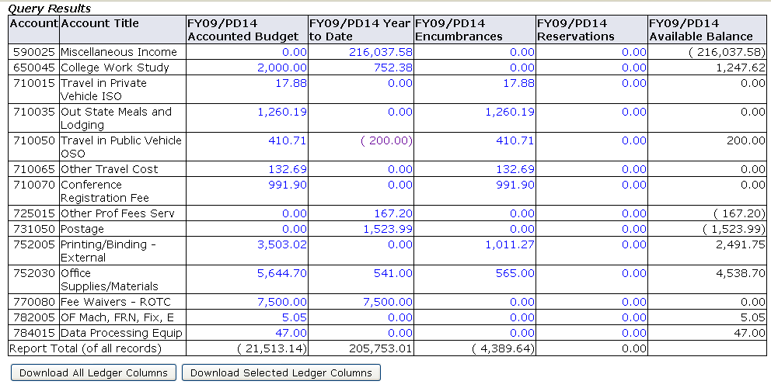

The available balance is $201,363.37. (Year to date)-(Encumbrances)-(Reservations)=Available Balance

Slide 14
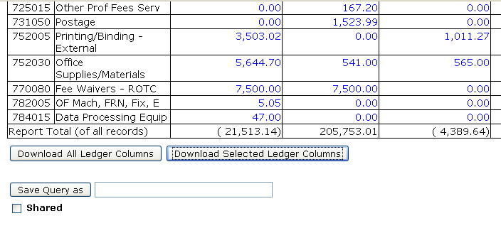

You may download budget query data to a Microsoft Excel spreadsheet by clicking “Download all or selected ledger columns”.
Click to download into excel
To save this query, enter the selected name for the query and click “save query as” button. This query will be named finance101

Slide 15
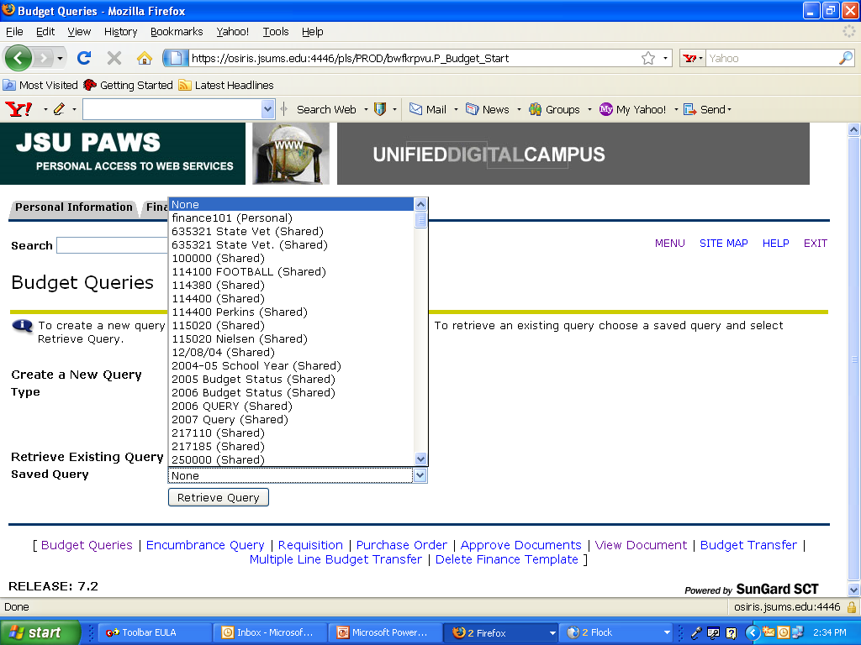
OPTION II: RETRIEVE EXISTING QUERY
Query that was previously saved
To Retrieve an Existing Query
In the “Retrieve Existing Query” Drop-down box,
Scroll to select the query you would like to retrieve
Then select “Retrieve Query”

Slide 16
Select Encumbrance Queries

Slide 17
1.
2.
Fiscal periods
01 – July
02 – August
03 – September
04 – October
05 – November
06 – December
07 – January
08 – February
09 – March
10 – April
11 – May
12 – June
13 – Year to date
14 – Year to date
3.
4.
5.
6.
Enter the required parameters for your query:
Fiscal Year: 2013/2014
Fiscal Period: See Fiscal Periods above
Chart of Accounts: J – Jackson State University
Enter the correct code to view your budget:
Index # (old FRS account number); or Enter Fund Code (If you use the index# the next screen will automatically populate the fund and organization)
Enter organization or grant code;
Account code is optional. If you leave the account code field blank, the query will retrieve all applicable account codes.
** Tip: To query by account, you may enter any account code or any part of the account code followed by the % sign, i.e. enter 6% or 610% for all accounts beginning with 6… or 610…**
  Click “Submit Query”

Slide 18
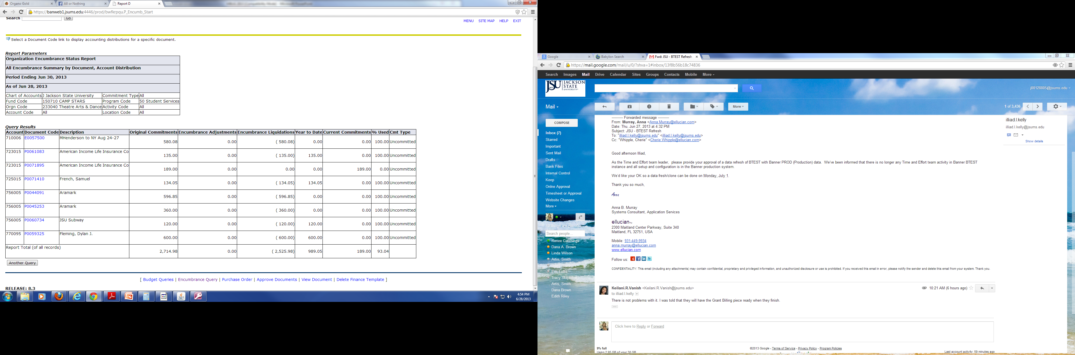
Encumbrance Detail

Slide 19
Select Requisition

Slide 20
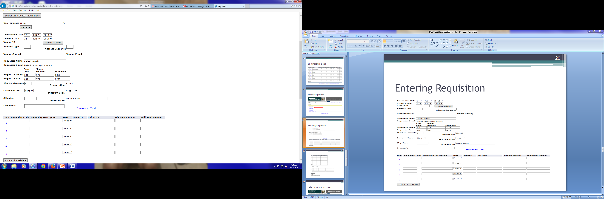

Entering Requisition

Slide 21
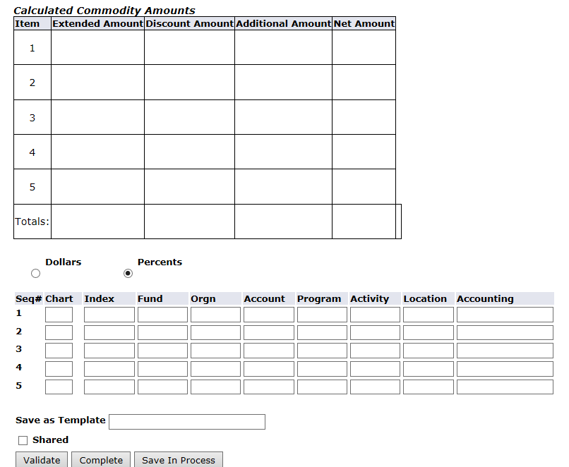

Slide 22
Select Approve Documents

Slide 23
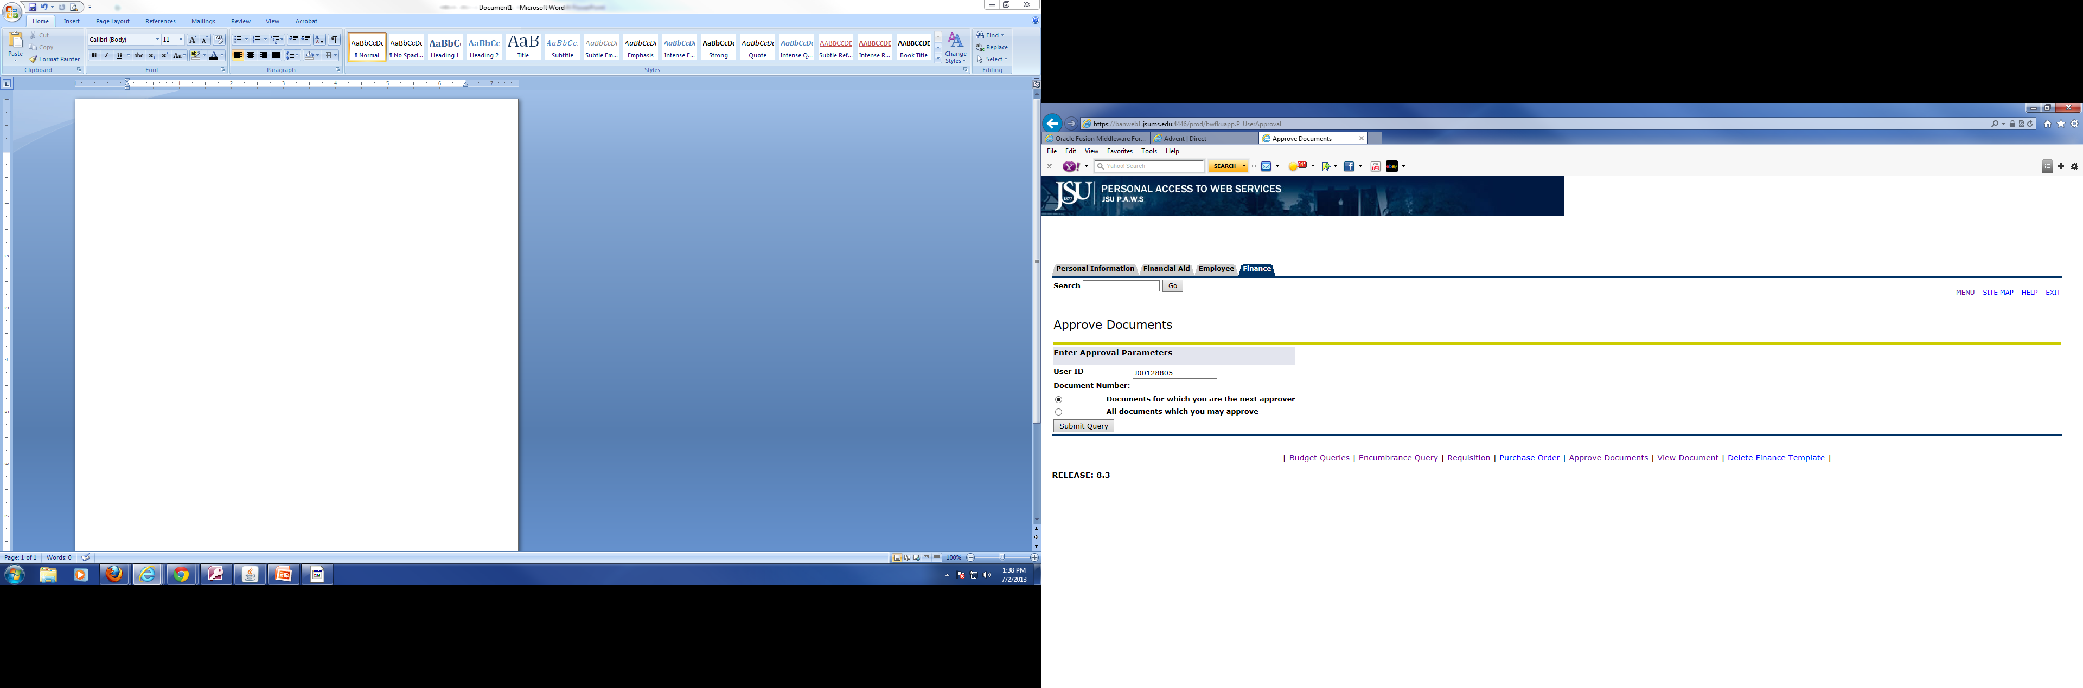
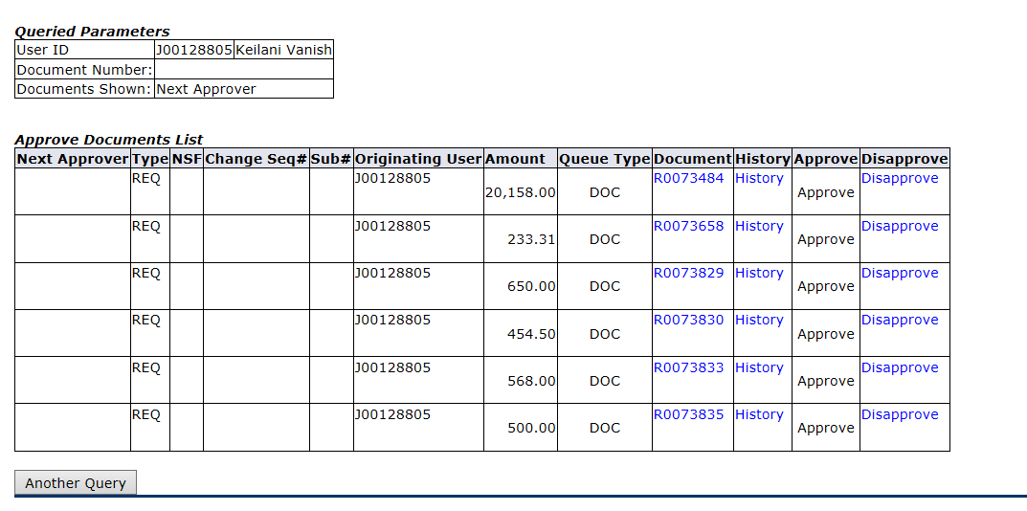
Approving Documents

Slide 24
Select View Documents

Slide 25
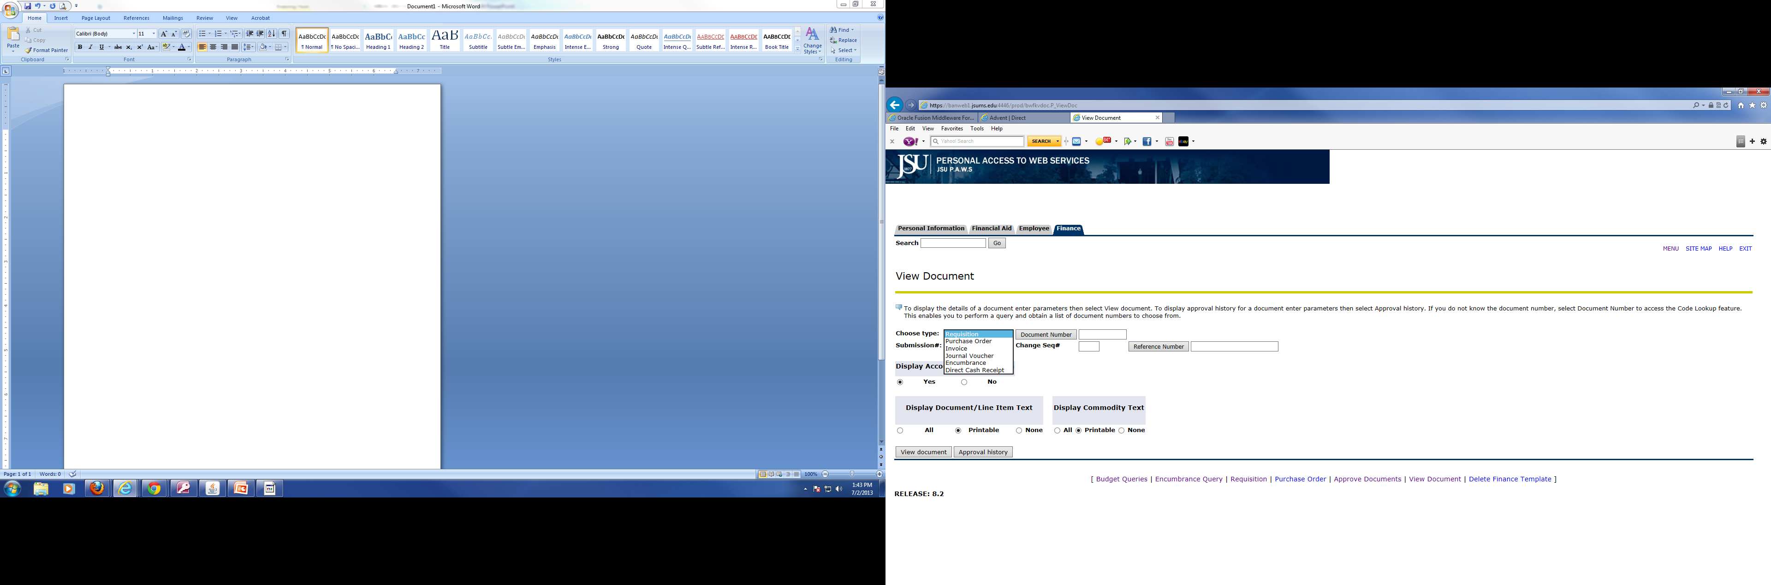
Viewing Documents

Slide 26
Any Questions
Keilani Vanish
601-979-0330
Keilani.r.vanish@jsums.edu

