Slide 1
MBUG 2017
Session Title: F&A Costs (Indirect Cost) From Manual to
Automatic
Presented By: Sallie R. McMillian
Institution: Alcorn State University
Date: September 12, 2017

Slide 2
Session Rules of Etiquette
Please turn off your cell phone
If you must leave the session early, please do so discreetly
Please avoid side conversation during the session

Slide 3
F&A COSTS (Indirect Cost) From Manual to Automatic
Overview
Introduction
The goal of this presentation is to demonstrate to users how to set up cost codes for F&A calculations that can be linked to a grant.
Source of Revenue to Institution
Post Automatically in Banner
Transaction by transaction
Periodic (Deferred Basis)

Slide 4
F&A COSTS (Indirect Cost) From Manual to Automatic
Overview (cont’d)
Prerequisites
Institution system should already be set up.
Experience in navigating SCT Banner system.

Slide 5
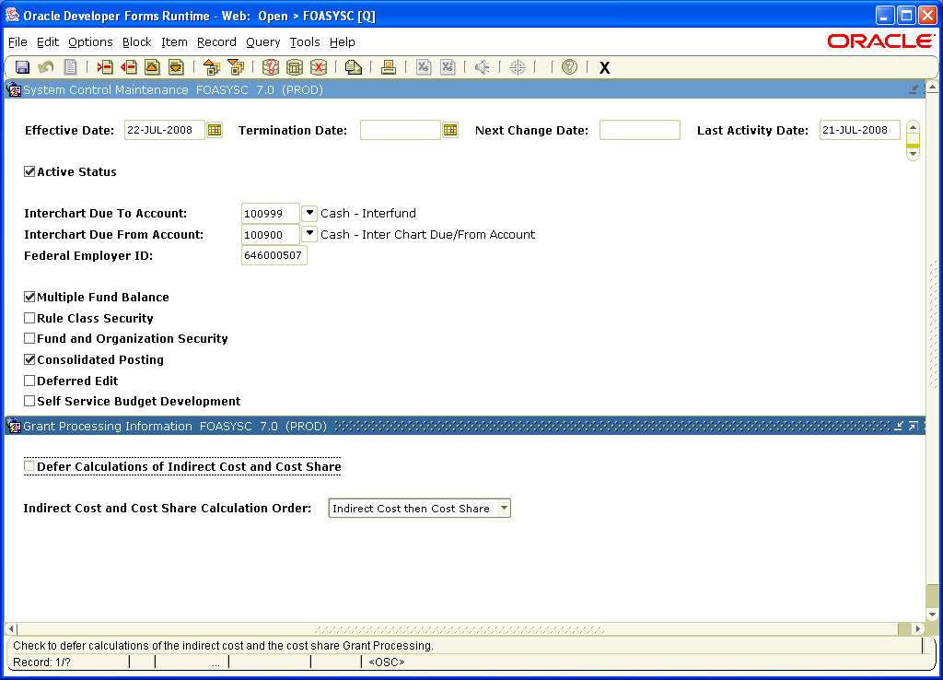
F&A COSTS (Indirect Cost) From Manual to Automatic
Getting Started
System Control Maintenance Form (FOASYSC)
Specify whether you want to perform grant accounting calculations on a transaction-by-transaction (online) basis or on a periodic (deferred) basis.

Slide 6
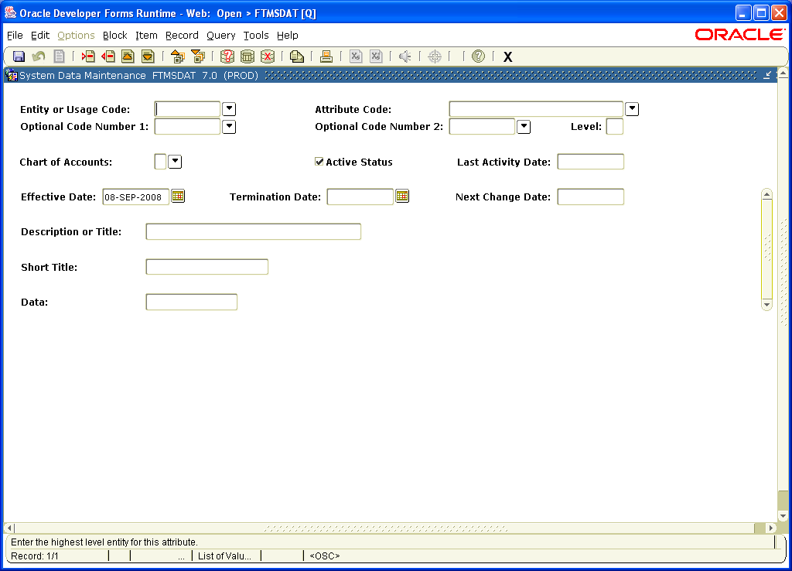
F&A COSTS (Indirect Cost) From Manual to Automatic
Getting Started (cont’d)
System Data Maintenance Form (FTMSDAT)
Allows users to define codes for the four classificatory fields for defining grants which will be used in the Grant Maintenance Form (FRAGRNT).
Status Code
Type
Category
Sub-Category

Slide 7
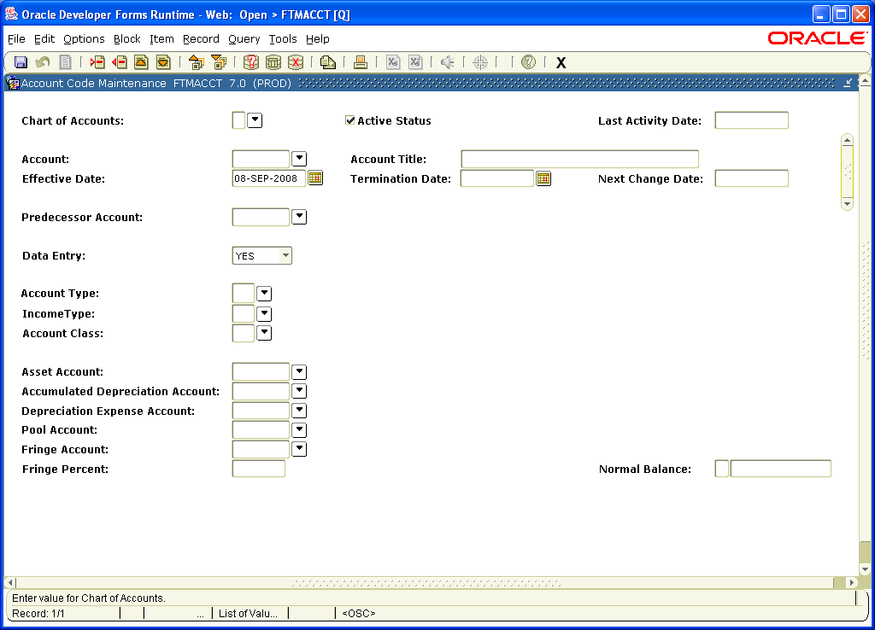
F&A COSTS (Indirect Cost) From Manual to Automatic
Getting Started (cont’d)
Account Code Maintenance Form (FTMACCT)
Enables users to establish an object of expenditure account.
Indirect Cost Expense Code Account Class = “I”

Slide 8
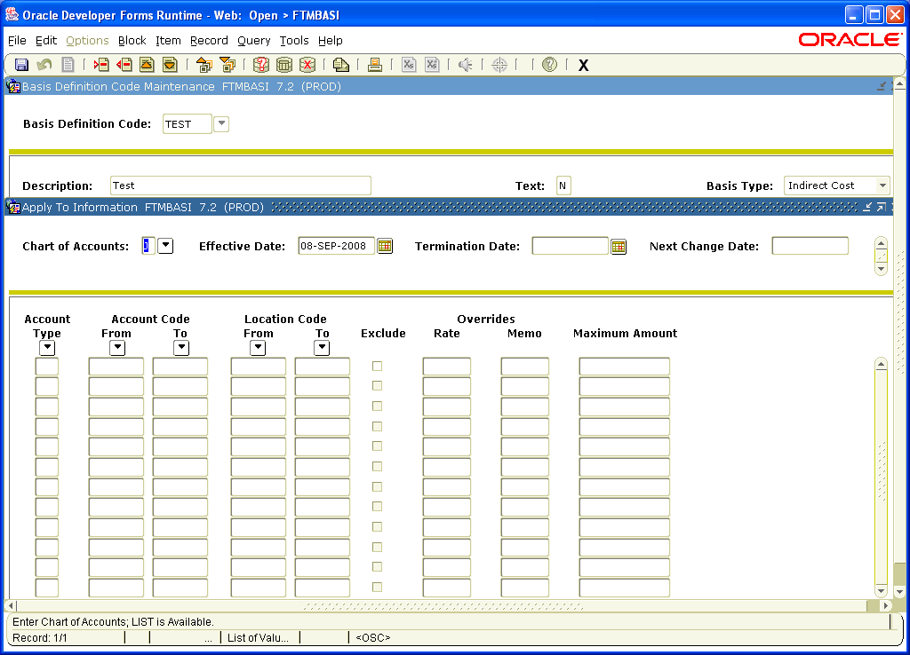
F&A COSTS (Indirect Cost) From Manual to Automatic
Setting Up Cost Codes for F&A Calculations (Cont’d)
Basic Definition Code Maintenance Form (FTMBASI)
Used to define and establish the base for F&A calculations

Slide 9
F&A COSTS (Indirect Cost) From Manual to Automatic
Basic Definition Code Maintenance Form (FTMBASI)

Slide 10
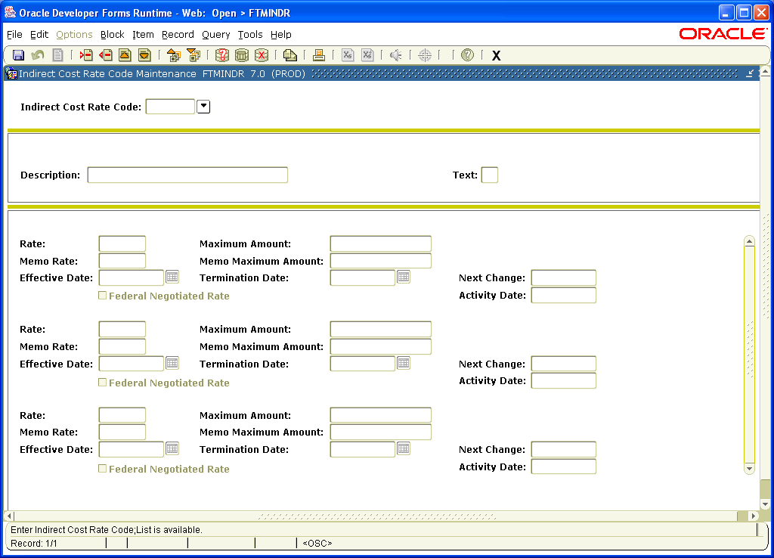
F&A COSTS (Indirect Cost) From Manual to Automatic
Setting Up Cost Codes for F&A Calculations (Cont’d)
Indirect Cost Rate Code Maintenance Form (FTMINDR)
Used to define the F&A Cost Rate.

Slide 11
F&A COSTS (Indirect Cost) From Manual to Automatic
Indirect Cost Rate Code Maintenance Form (FTMINDR)

Slide 12
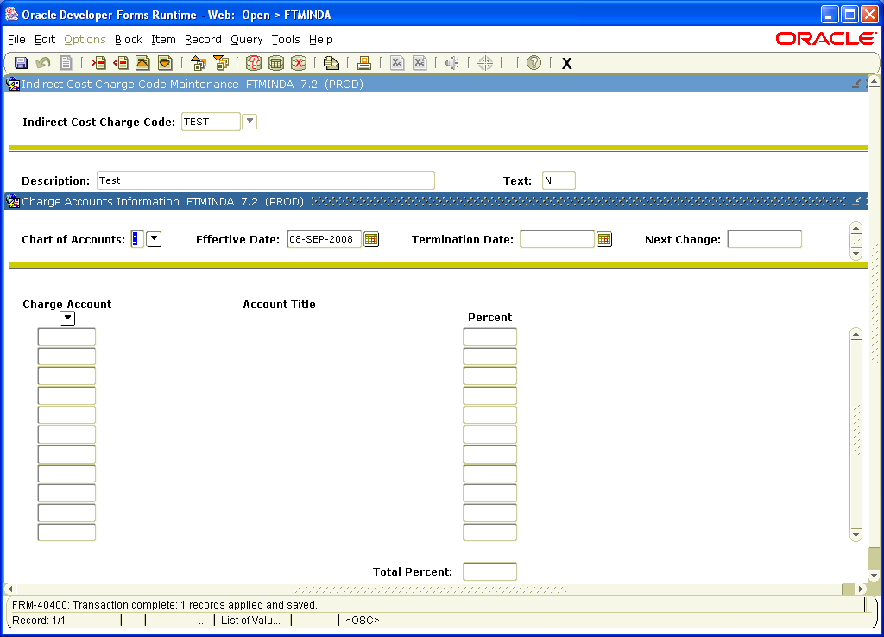
F&A COSTS (Indirect Cost) From Manual to Automatic
Setting Up Cost Codes for F&A Calculations (Cont’d)
Indirect Cost Charge Code Maintenance Form (FTMINDA)
Used to enter the account or accounts for overhead charge calculations.

Slide 13
F&A COSTS (Indirect Cost) From Manual to Automatic
Indirect Cost Charge Code Maintenance Form (FTMINDA)

Slide 14
F&A COSTS (Indirect Cost) From Manual to Automatic
Indirect Cost Charge Code Maintenance Form (FTMINDA) (cont’d)

Slide 15
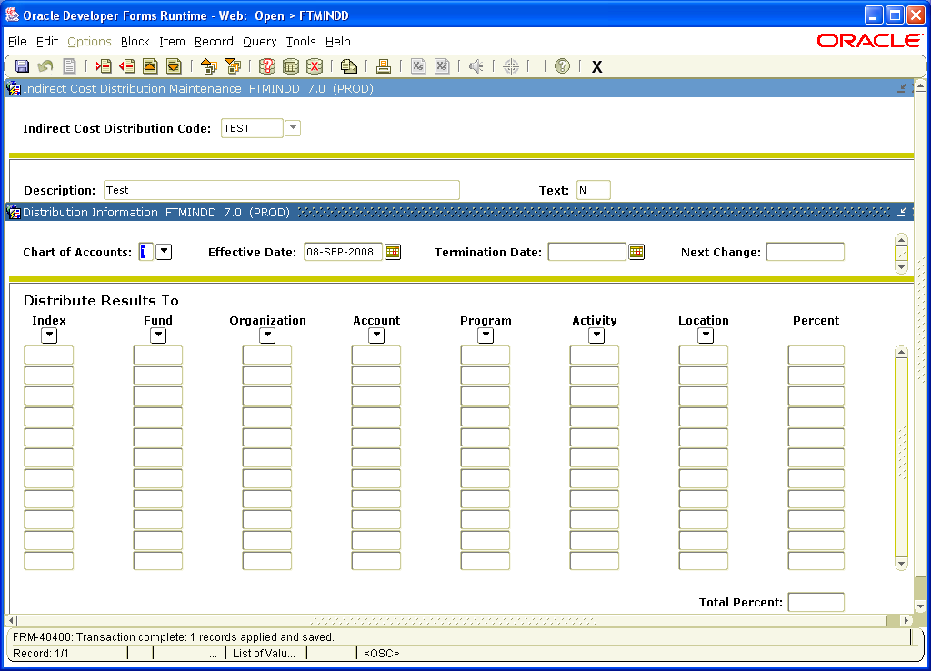
F&A COSTS (Indirect Cost) From Manual to Automatic
Setting Up Cost Codes for F&A Calculations (Cont’d)
Indirect Cost Distribution Maintenance Form (FTMINDD)
Used to enter the
FOAPAL distribution for
the recovery
of F&A charges.
Creates transactions
used on the credit side
for F&A costs in the ledgers.
All of the FOAPAL elements
are defined on this form.

Slide 16
F&A COSTS (Indirect Cost) From Manual to Automatic
Indirect Cost Distribution Maintenance Form (FTMINDD)

Slide 17
F&A COSTS (Indirect Cost) From Manual to Automatic
Indirect Cost Distribution Maintenance Form (FTMINDD) (cont’d)

Slide 18
F&A COSTS (Indirect Cost) From Manual to Automatic
PRACTICE EXERCISES
Attached is an award with the approved budget received by your institution
You are responsible for setting up grants
Additional data is given

Slide 19
`
F&A COSTS (Indirect Cost) From Manual to Automatic
Description | Exercise 1 | Exercise 2
Travel | 10,000.00 | 10,000.00
Contractual | 0.00 | 0.00
Consultant | 5,000.00 | 5,000.00
Stipends | 15,000.00 | 15,000.00
Sub #1 | 25,000.00 | 25,000.00
Sub #2 | 50,000.00 | 50,000.00
Sub #3 | 50,000.00 | 50,000.00
Other Contractual Services | 0.00 | 15,000.00
Commodities | 5,000.00 | 4,721.00
Equipment | 0.00 | 0.00
Desktops (3X1,500) | 4,500.00 | 0.00
Desktops (21X1,500) |  | 31,500.00
Ultra Sound Machine | 29,075.00 | 0.00
Salaries | 33,127.00 | 33,127.00
Student Wages | 5,000.00 | 5,000.00
Fringes (35% of Salaries) | 11,594.00 | 11,594.00
Approved F&A Rate | 243,296.00 | 255,942.00
38.00% | 56,704.00 | 44,058.00
Exclusions: Stipends, Scholarships, Fellowships, Equipment unit cost =/> $5,000, and subawards in excess of the first $25,000.
Notes:
Budget amounts highlighted or portions of should be excluded from the F&A base.

Slide 20
F&A COSTS (Indirect Cost) From Manual to Automatic
Q U E S T I O N S
???????

Slide 21
F&A COSTS (Indirect Cost) From Manual to Automatic
Contact Information
ALCORN STATE UNIVERSITY
Office of Grants and Contracts
1000 ASU Drive, #509
Lorman, Mississippi 39096
(Fax: 601-877-6217)
Sallie R. McMillian 601-877-6377 (smcmillian@alcorn.edu)
Tasha Brown 601-877-6689 (tjohnson@alcorn.edu)
Sabrena L. Johnson 601-877-4471 (sljohnson@alcorn.edu)
THANK YOU

