Slide 1
MBUG 2017
Session Title: Banner 9 or Bust: Implementation Lessons Learned
Presented By: Laura Hollis and Sterling McCool
Institution: Mississippi State University
September 11, 2017

Slide 2
Session Rules of Etiquette
Please turn off your cell phone
If you must leave the session early, please do so discreetly
Please avoid side conversation during the session

Slide 3
Let’s Begin
Has your institution begun the Banner 9 transformation process?
Has your institution made any modifications to baseline Banner forms?
Has your institution created any homegrown Banner forms?

Slide 4
Overview
Module licenses: ALL Banner modules
Number of Banner users: 1,520
Number of Databases:
4 production
6 test
Number of Servers:
14 production (4 for code; 10 for deployment)
10 test (2 for code; 8 for deployment)
Notes:
We think we’re a little backwards from everyone else that started… They started with self-service pages first.

Slide 5
Our Banner 9 Timeline
April 2017: Finance and General
July 2017: HR and Position Control
October 2017: Advancement and AR
November 2017: Financial Aid
January 2018: Student

Slide 6
Finance & General Timeline
January 2017
Initial (baseline) deployment to test
Began developing extensions and homegrown pages
February 2017
Preview sessions/presentations
March 2017
User testing/open labs
April 2017
GO LIVE!
Notes:
Training began September 2016
Extension/Homegrown work began January 2017

Slide 7
Page Development
Finance and General Modules
4 General baseline extended pages
10 General homegrown pages
11 Finance baseline extended pages
26 Finance homegrown pages
Development Training
Java and OO Overview
Modifying Banner Admin XE Apps
Site-specific Banner Admin XE Page Extensions

Slide 8
Page Development (Cont.)
Development Tools Needed
Eclipse with proprietary (Morphis) plugins
git bash
TortoiseGit (optional)

Slide 9
Results/Examples
ESM

Slide 10
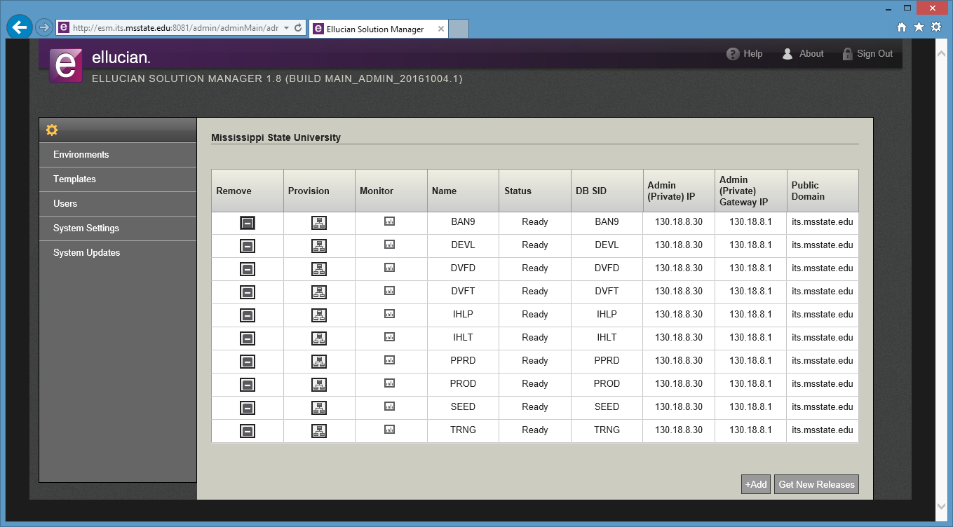

Slide 11
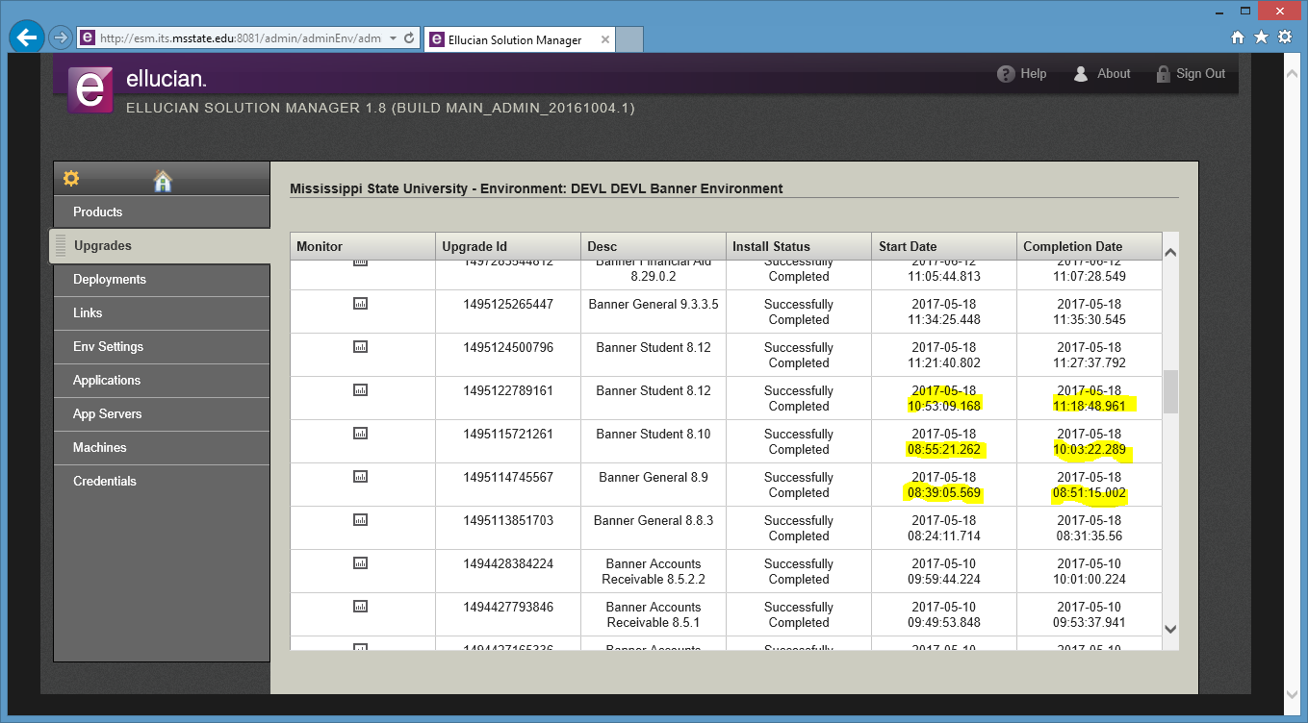

Slide 12
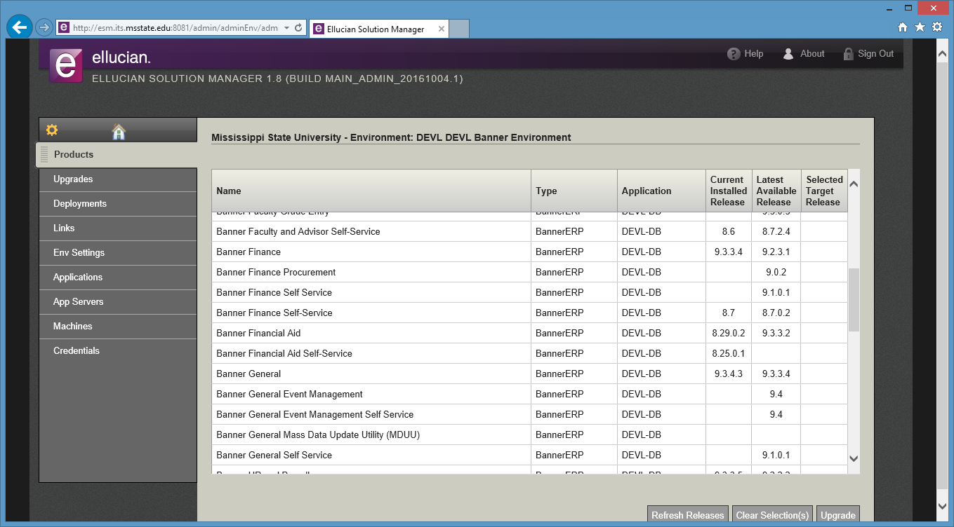

Slide 13
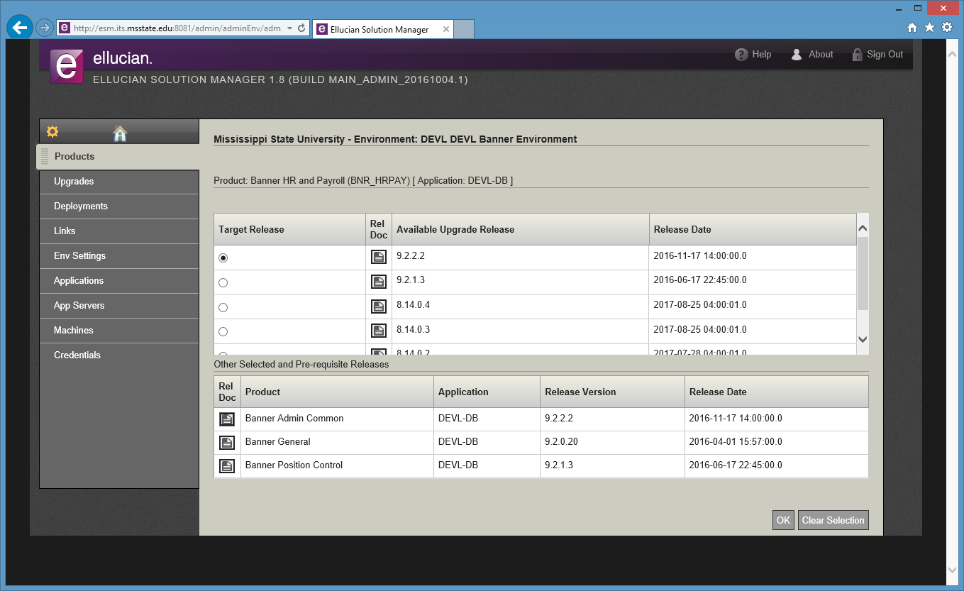

Slide 14
Results/Examples
Improvement in Upgrade Time

Slide 15
Results/Examples
Using Banner 8 and 9 Together
GUAPAGE (homegrown pages)

Slide 16
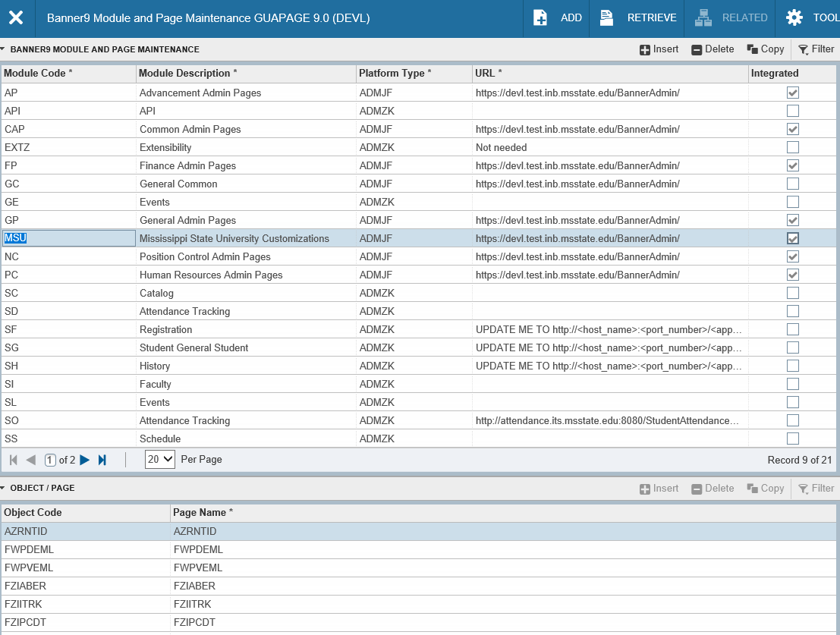

Slide 17
Results/Examples
Using Banner 8 and 9 Together
GUAOBJS (display option)

Slide 19
Going Forward
Banner Financial Aid and Student Pages
Banner Self-Service Modules

Slide 20
Summary
Most Important Lessons Learned
Ask for help
eCommunities
Ellucian Support Center
Talk with users early and often
Test. TEST. TEST!
Allow more time than you think you need
Browser may make a difference
For developers: This is a steep learning curve from current Banner technology.

Slide 21
Questions?

Slide 22
Contact Information
Laura Hollis (HR and Position Control support)
Senior Systems Analyst
lhollis@its.msstate.edu
Sterling McCool (DBA)
Senior Systems Analyst
sterling.mccool@msstate.edu

