Slide 1
MBUG 2016
Session Title: Return to Title IV in Banner
Presented By: Terry Bland
Institution: ICC
Date: September 12, 2016

Slide 2
SESSION RULES OF ETIQUETTE
Please turn off your cell phone
If you must leave the session early, please do so discreetly
Please avoid side conversation during the session

Slide 3
Setup

Slide 4
R2T4
Setup
TSADETC – Detail Code Control Form
SOATERM – Term Control
SOATBRK – Student Term Break
SFAREGF – Student Course Query
SFAREGS – Student Course Registration
STVESTS – Enrollment Status Code Validation
STVWDRL – Withdrawal Code Validation
SFRNOWD – Withdraw Pending Status Change

Slide 5
R2T4
Setup - TSADETC
Verify that all charges that should be included in R2T4 are marked as “institutional charges”.

Slide 6
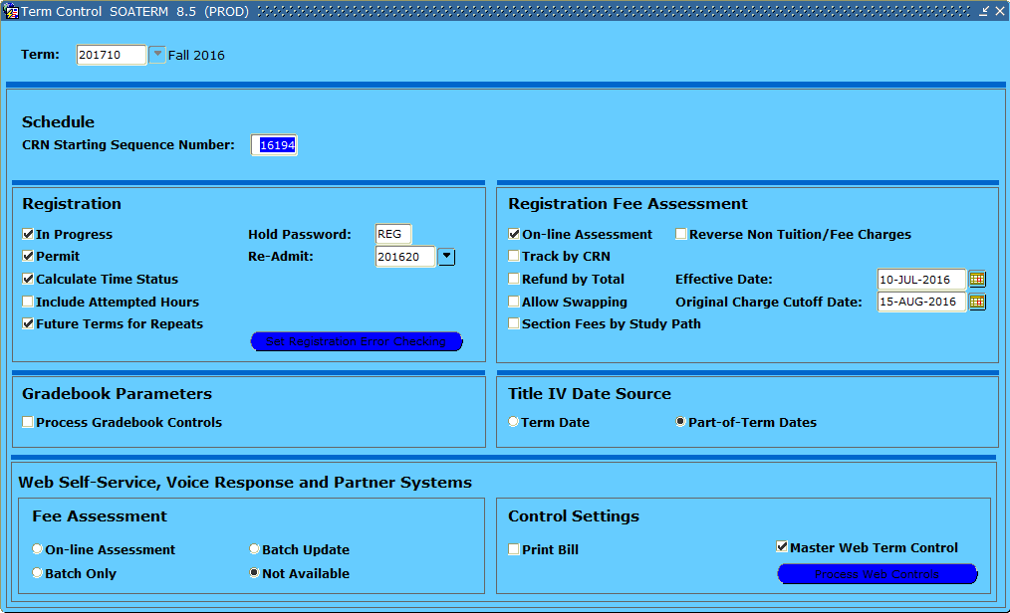
R2T4
The cutoff date will come into play later. It should be the last day of add/drop period.
Setup - SOATERM
Use part-of-term dates for modules.

Slide 7
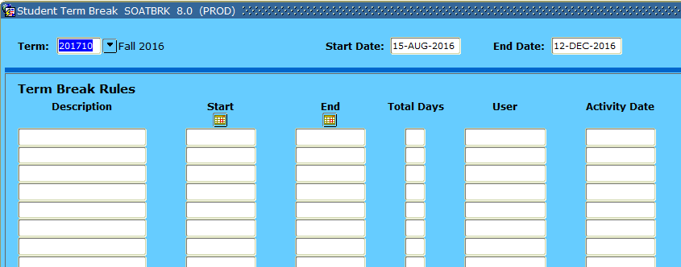
R2T4
Setup - SOATERM
If you have breaks of 5 days or longer that apply to ALL of your terms, enter it here. Don’t forget about online terms. Ours don’t observe Spring Break.

Slide 8
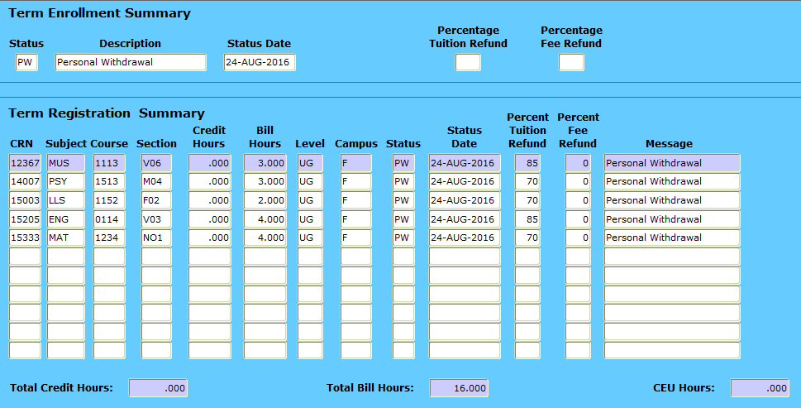
R2T4
Make sure you have access. Lots of valuable info here when you start processing.
Setup – SFAREGF

Slide 9
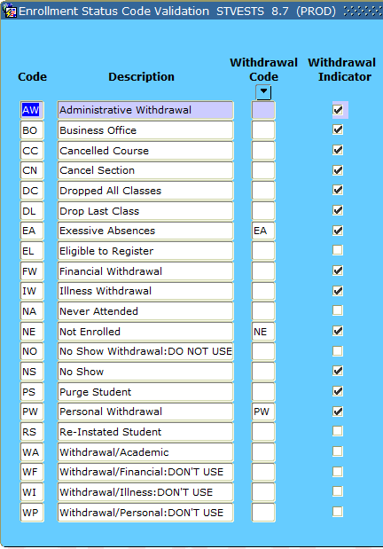
R2T4
Setup – STVESTS
Take these withdrawal codes…

Slide 10
R2T4
Setup – STVWDRL
… and enter them here.

Slide 11
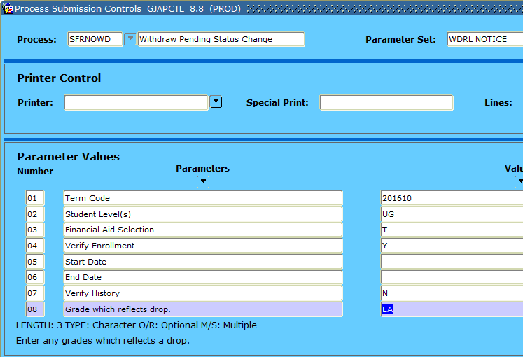
R2T4
Setup – SFRNOWD
Make sure you have access. You’ll need it to generate withdrawal notices.

Slide 12
TOAD Script

Slide 13
R2T4
TOAD Script
We pull a TOAD Script to capture all of the dropouts and/or withdrawals.
Sometimes, the enrollment status does not get set to NE, PW, or EA. It may still be EL (Eligible to Register).
The results of the script are sent to the Registrar to update so that the withdrawal will pull in our process.

Slide 14
R2T4
TOAD Script
finaid_dropouts_byterm.sql
select spriden_id ID, rpratrm_term_code term, rpratrm_aidy_code aidy, spriden_last_name last_name,
spriden_first_name first_name, spriden_mi mi,
max(sfrstcr_rsts_date) lastdrop,max(sfrstcr_activity_date) lastchange, max(getLDA(sfrstcr_term_code,sfrstcr_crn,sfrstcr_pidm)) LatestLDA,
rfrbase_fund_title fund
from spriden, rpratrm, sfrstcr, rfrbase,
(select sum(sfrstcr_credit_hr) hrs, sfrstcr_pidm pidm from sfrstcr where sfrstcr_term_code='&&term'
and sfrstcr_rsts_code in ('RE','RW') group by sfrstcr_pidm)
where spriden_change_ind is null and spriden_pidm = rpratrm_pidm and rpratrm_term_code = '&term'
and spriden_pidm = sfrstcr_pidm and rpratrm_term_code = sfrstcr_term_code and rpratrm_fund_code =
rfrbase_fund_code and sfrstcr_activity_date > to_date ('&date','MM/DD/YYYY')
and (hrs = 0 or hrs is null) and spriden_pidm = pidm (+)
group by spriden_id, rpratrm_term_code, rpratrm_aidy_code, spriden_last_name, spriden_first_name,
spriden_mi, rfrbase_fund_title
order by spriden_last_name, spriden_first_name, spriden_mi

Slide 15
Processing R2T4

Slide 16
R2T4
Processing
SFRNOWD – Withdraw Pending Status Change
SFRWDRL – Withdrawn Student Report
SFAWDRL – Student Withdrawal
SFAREGF – Student Course Query
RPATIVC – Return of Title IV Funds Calculation
GLBDATA – Population Selection Extract
RPRTIVI – Return of Title IV Funds

Slide 17
R2T4
Parameters:
01: 201710
02: UG
03: T
04: Y
07: N
08: EA
08: PW
08: NE
09: %
10: N
Processing - SFRNOWD
Captures students eligible to enroll who have no active registration.
Need to be set to either EA, PW, or NE in order to process.
Doesn’t always catch everyone and sometimes includes ones we don’t need. Thus TOAD.

Slide 18
No show
Typically the Withdrawal Date

Slide 19
R2T4
Parameters:
01: U
02: 201710
03: UG
04: %
05: Y
06: %
07: EA
08: N
10: 1PR
11: %
Processing - SFRWDRL
Withdrawn Student Report

Slide 20
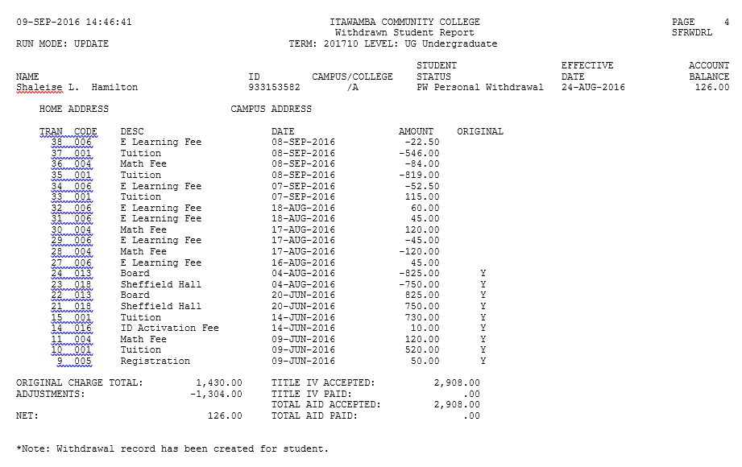
Notice that the original charges stopped after 8/15/2016. Ties back to setting on SOATERM.

Slide 21
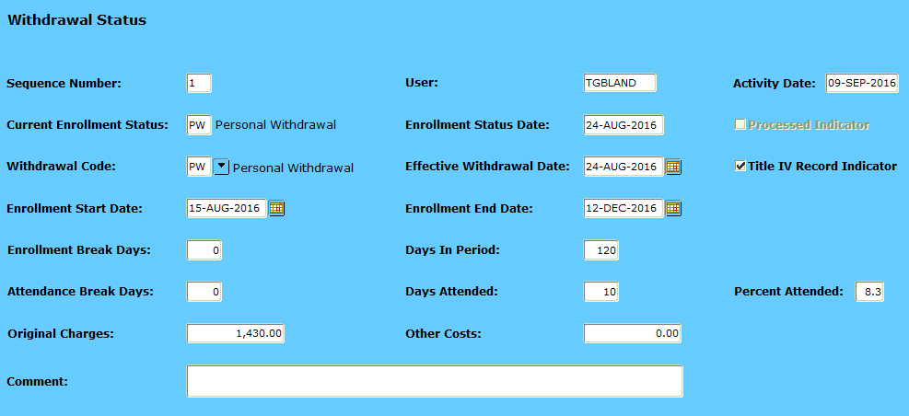
R2T4
Processing - SFAWDRL
You need to know maximum start and end dates.

Slide 22
R2T4
Processing - SFAREGS
Student had 3 on-campus 15 wk classes and 2 online 15 wk classes.
On-campus 15 wk: 8/15/2016 – 12/12/2016
Online 15 wk: 8/22/2016 – 12/2/2016

Slide 23
R2T4
Processing - SFAREGF
SFAREGS has Part of Term info.
SFAREGF has Status Dates for each class.

Slide 24
R2T4
Processing - SFAWDRL
In this case, the dates are correct.
If we needed to enter Spring Break, we would do it here.

Slide 25
R2T4
Processing - SFAWDRL
Calculates based on start/end dates and breaks.
Ctrl – Pg Down

Slide 26
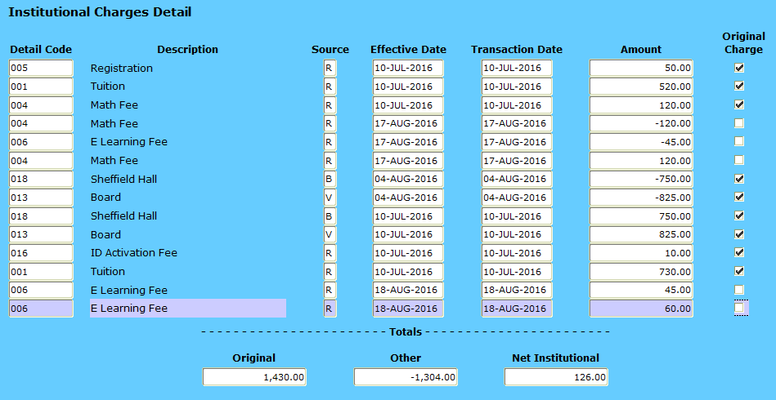
R2T4
Processing - SFAWDRL
If you need to add one of the items to original charges, click the box and save.

Slide 27
R2T4
Processing – ROAENRL / ROAIMMP
If you determine that the student’s award needs to be adjusted, go to ROAENRL and adjust their hours. Then ROAIMMP before proceeding.
Example: Student was NS for 6 hours and EA for 6 hours. You need to adjust award from 12 hours down to 6 hours. Your R2T4 should not include the no show hours.

Slide 28
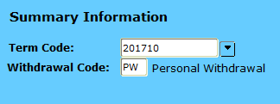
R2T4
Processing - RPATIVC
Ctrl + Pg Down to bring in the withdrawal information.
Then go to Options, Simulation Mode.

Slide 29
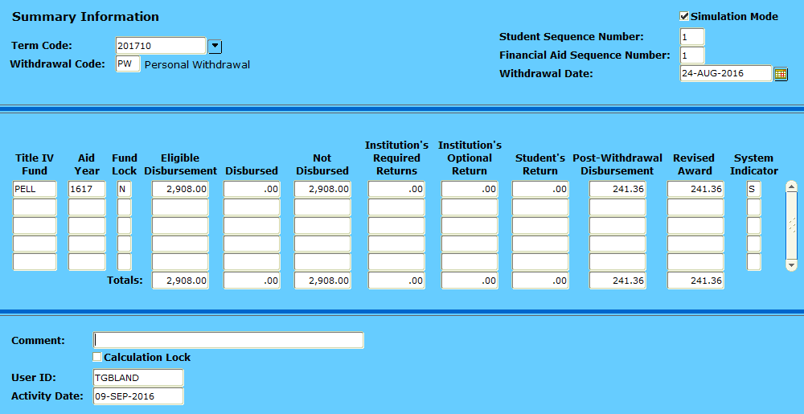
R2T4
Processing - RPATIVC
Calculates the amount of post-withdrawal disbursement / revised award.

Slide 30
R2T4
Processing - RPATIVC
Moves from simulation to calculation locked.

Slide 31
R2T4
Processing - RPATIVC
Farther into the semester, you have to watch these fields. There will be times when you have to manually adjust the eligible disbursement amount and fund lock it prior to Calculate & Save.

Slide 32
R2T4
Processing - RPATIVC
Example:
Student drops to 6 hours prior to census and is only due half Pell. You will need to manually reduce the eligible disbursement field and change fund lock to Y in order to remove the amount for which the student is no longer eligible from the not disbursed field. Otherwise, the calculation may tell you the student is due a post-withdrawal disbursement.

Slide 33
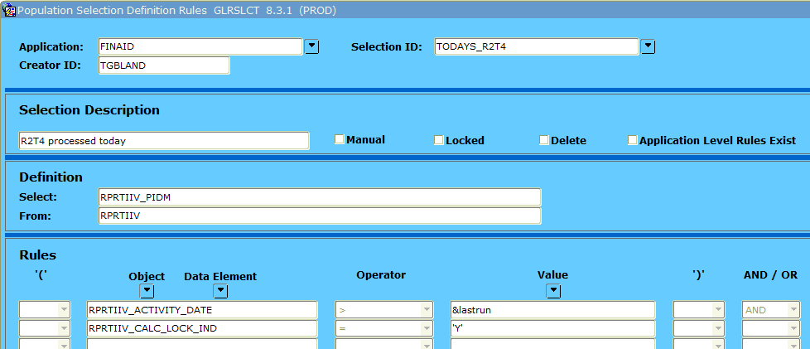
R2T4
Processing – GLRSLCT / GLBDATA
Run GLBDATA

Slide 34
R2T4
Processing - RPRTIVI
Parameters:
01: 201710
02: B
06: N
07: Y
08: FINAID
09: TODAYS_R2T4
10: TGBLAND
11: TGBLAND
Print R2T4 Calculations

Slide 35
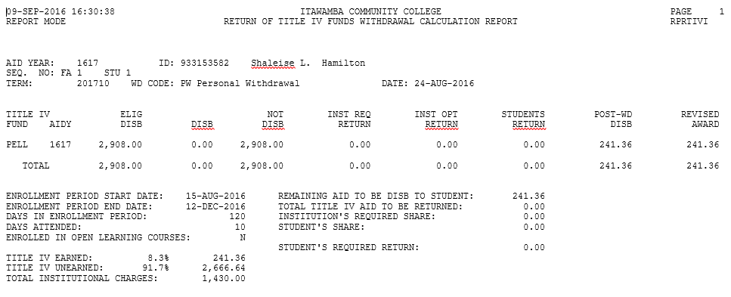

Slide 36
R2T4
Processing – RPAAWRD / ROAIMMP
Make your adjustments on RPAAWRD.
We lock the disbursement so that nothing adjusts the award after R2T4 has been done.
ROAIMMP it to adjust on RSIAREV.

Slide 37
QUESTIONS?

