Slide 1
MBUG 2016
Session Title: Phishing: They Are After You!
Presented By: Tom Ritter
Institution: Mississippi State University
September 12th, 2016

Slide 2
Session Rules of Etiquette
Please turn off your cell phone
If you must leave the session early, please do so discreetly
Please avoid side conversation during the session

Slide 3
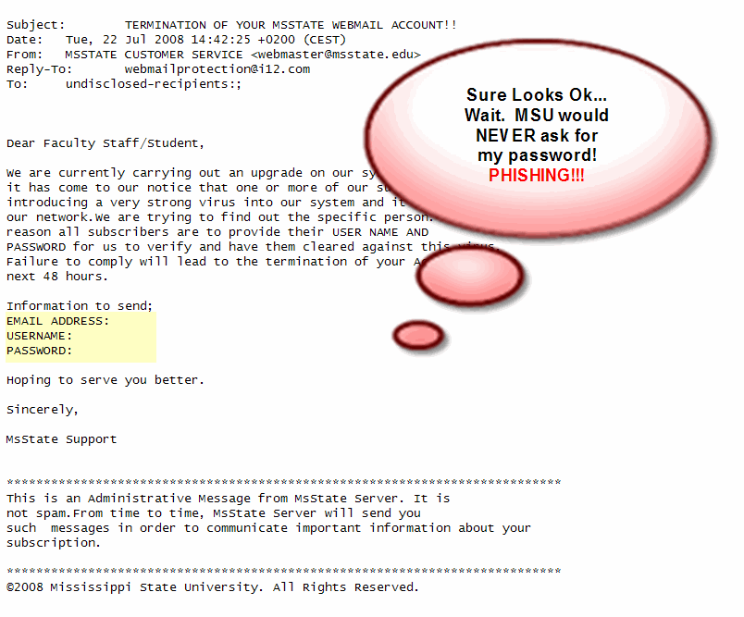

Slide 4
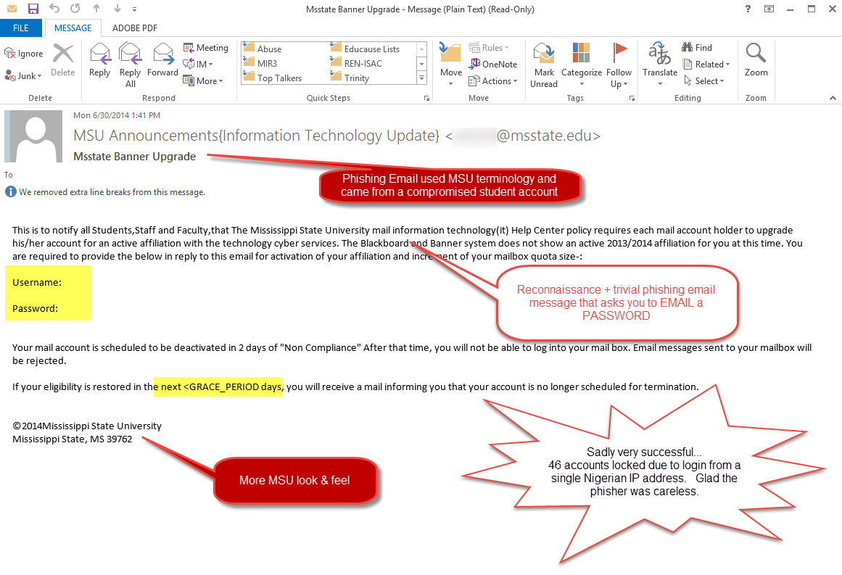

Slide 5
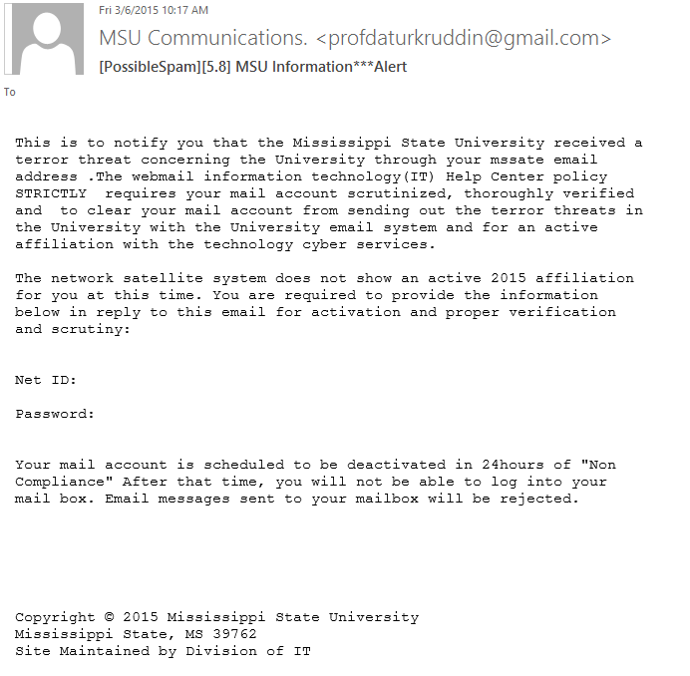

Slide 6
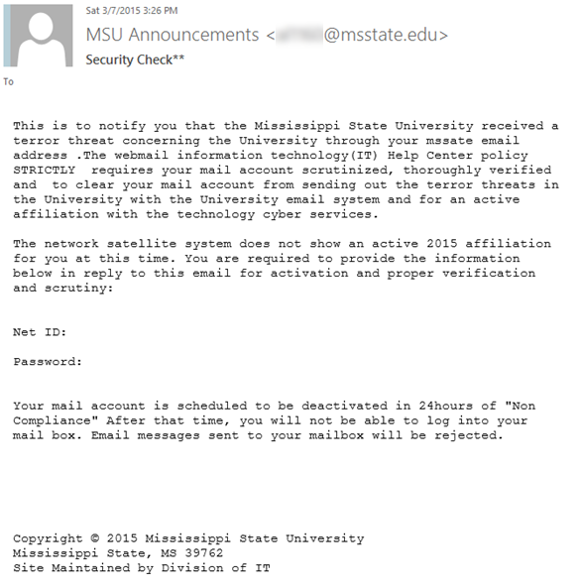

Slide 7
Impact
Over 100 separate pages to ITS after hours support staff
55 plus accounts compromised (only 1 staff member)
Over 300 Help Desk tickets

Slide 8
Response
Users disabled as identified
Reply-to addresses blocked as new variants sent
14,400 copies sent with 5 variants

Slide 9
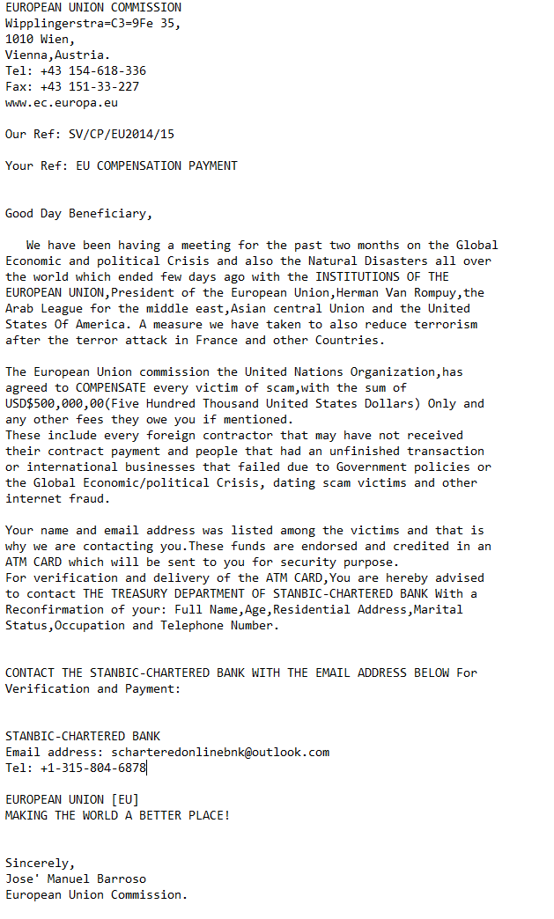
This was what they went to all that trouble to send!
Cyber Crime is big business

Slide 10
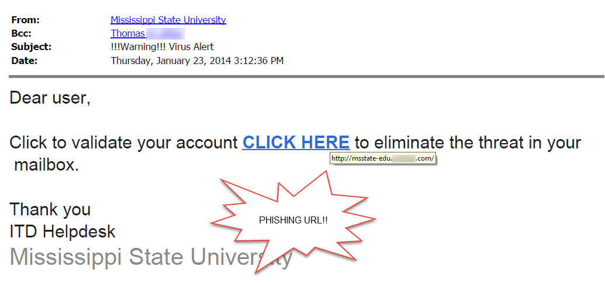

Slide 11
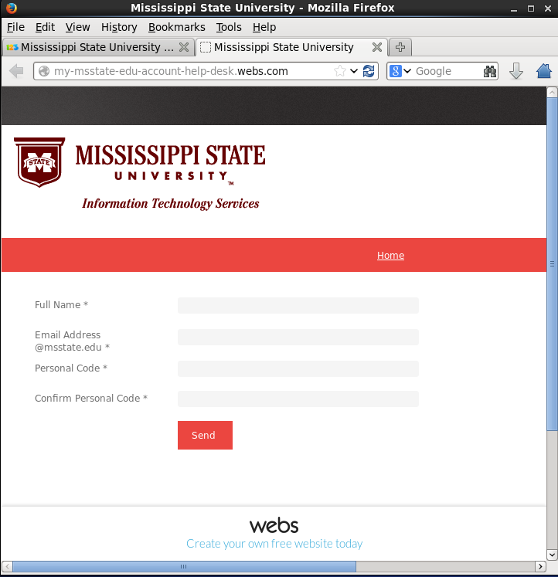

Slide 12
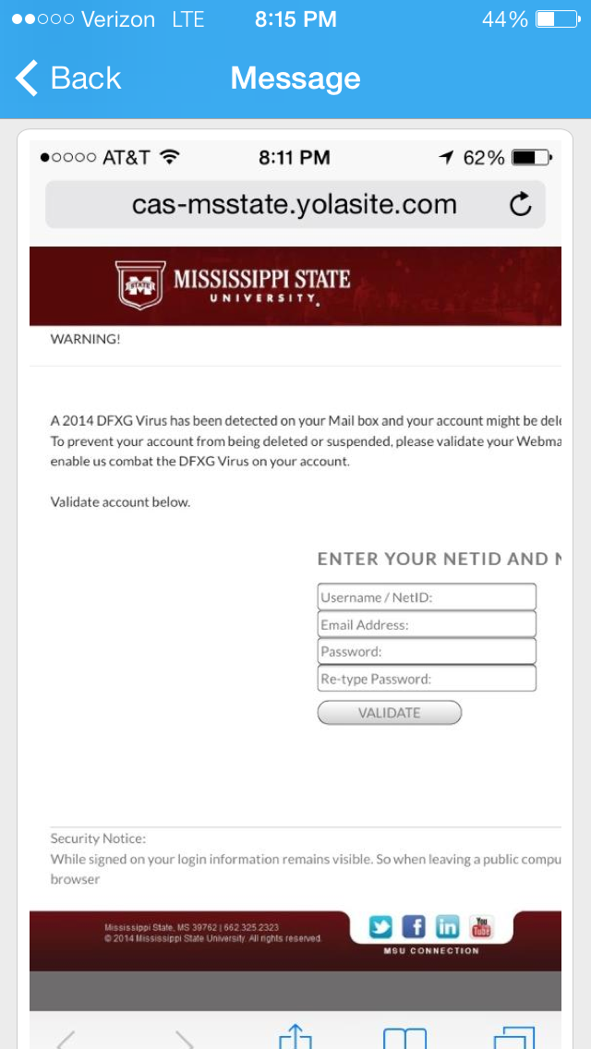

Slide 13
StopSpam URL Redirection
Proactive rewriting of known malicious/phishing URL’s in email
Implemented on all the free website builder sites seen @ MSU
Ability to redirect selected sites to a warning page and then continue

Slide 14
MSU Specific Phishing
mailbox-confirmation.webs.com
webmailmsstate.webs.com
msstate.webs.com
msstate.yolasite.com
cas-msstate.yolasite.com
staffwebmailupgrade.jimdo.com
Total: 78 blocked from webs.com

Slide 15
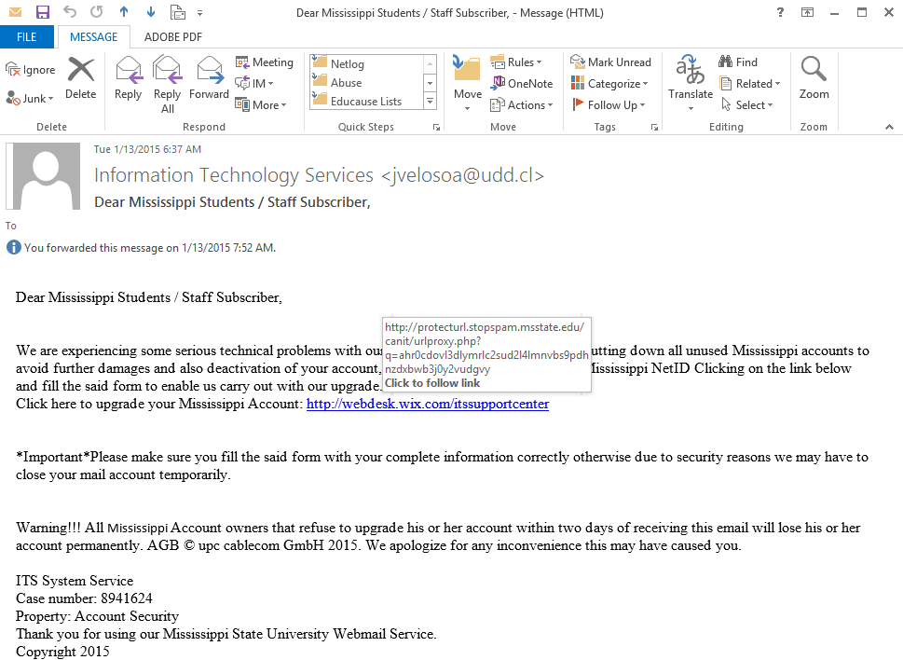

Slide 19
You’ve been phished…
Login from “known badguy”
Currently 21 network ranges and 2979 IP addresses have been listed
Unusual login behavior “Red Flags”
VPN from non-US address with no previous VPN history
Overseas usage overlapping US usage

Slide 20
Ransomware Alerts

Slide 21
It can happen and has….
Three departments were compromised one individual laptop
All local data on individual machine and network shares encrypted
Data restored from previous daily backup
Backup Strategy is critical!
Network storage
Logical segmentation of unit storage has been a big protector of data
User awareness
http://money.cnn.com/2016/04/04/technology/ransomware-cybercrime/

Slide 22
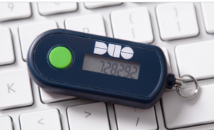
Two – Factor Authentication

Slide 23
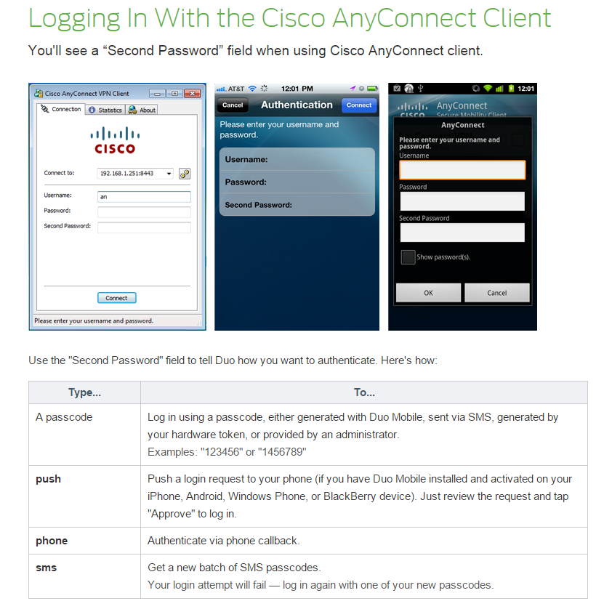

Slide 24
Questions? General Discussion

