Slide 1
Maximize Your Scholarship Performance
through On-Line Processes
Megan Smith, Mississippi University for Women
Chris Rivera, Next Gen Web Solutions

Slide 2
Objective:
Share how the Mississippi University for Women simplified their scholarship review and selection processes through data integration with Banner and Scholarship Manager.
Highlight other workflow and integration opportunities, available in Scholarship Manager, that can help you streamline your scholarship workflows.

Slide 3
About MUW
About the Mississippi University for Women
First public college for women, founded in 1884
Dedicated to liberal arts and professional education programs
Offers undergraduate and graduate programming
Student-faculty ratio at Mississippi University for Women is 14:1
Institutional and donor driven scholarship programs
Approximately $300,000 was available to be awarded
Scholarship process administered by the Financial Aid office, in partnership with the foundation

Slide 4
About NextGen
EFFICIENCY SOLUTIONS FOR THE HIGHER EDUCATION MARKEPLACE
Scholarship Manager automates, simplifies and transforms the scholarship process
Dynamic Forms process any form electronically and eliminate paper, including electronic signature and eCommerce capabilities
TimesheetX automates the collection, approval, processing, and compliance of student timesheets
JobX automates, simplifies, and reduces expenses associated with on- and off-campus processes, including online job postings, applications, compliance checks, hiring, and reporting

Slide 5
High Level Overview
Web-based software solutions hosted entirely by Next Gen
Annual Hosted License is campus-wide (finaid, admissions, foundation, departments, etc.)
License is all inclusive, including renewable scholarships
Historical Uptime > 99.5%
Data protection a priority – Annual SSAE16 and independent vulnerability audits
FERPA and ADA compliant
Multi-year solution; maintain 7 years of client data
Substantial Savings to clients
Hard Costs
Printing
Postage
Processing
Re-processing
Storage
Failed compliance
Soft Costs
Retrieve info faster
Easier access to information
Perception
Customer Service
Becomes a recruitment tool
Measure effectiveness of programs

Slide 6
Product Platform
Cloud-Based Solution
Single Sign On (SSO)
API Infrastructure
Students can access the scholarship application from their student portal
We support multiple SSO methods, including CAS, LDAP, Shibboleth, and SAML
SIS Integration
Automate data load process on your schedule
Automated export process on your schedule
API Integration
Ellucian Community Partner
Robust platform allows manual, automated, or real time integration; ensures most current data is being evaluated
Any data, including student profiles / awards can be exchanged

Slide 7
Challenges
Challenges
What challenges did the scholarship process face?
Matching process was completely manual
Approximately $300,000 was available to be awarded
With many foundation awards, the criteria was so specific, it made it difficult to match students with the funds
Caused some awards to be overlooked and money not be spent.
Award/matching reports were all contained in excel workbooks
Excel books were sent to the Foundation Office and Comptroller for billing the Foundation
Calculations were all contained in the printed out copies of paperwork, which was recycled each academic year
None of the awards could be tracked in Banner
If a student did not return the following semester, it could be a hassle to re-award the funds
The time commitment for the process was massive
NGWeb Solutions, LLC - Confidential and Proprietary - Do not share without permission

Slide 8
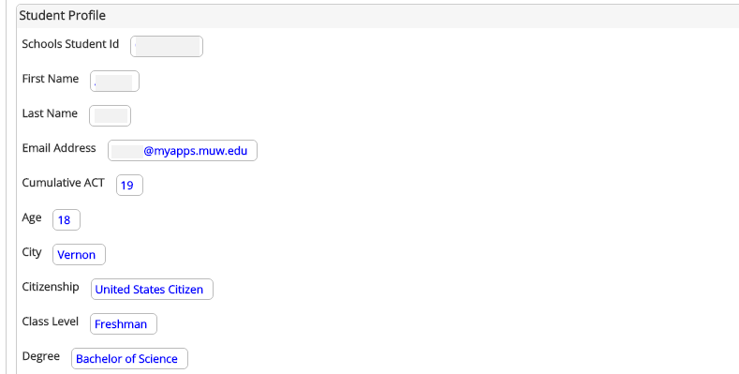
Challenges
Solution
Import Data from Banner
Defined the data needed to effectively qualify students for scholarship opportunities
Built a robust student profile in Scholarship Manager
Populated student profile with Banner information via data feed
Data feed can be automated and/or run on demand
No limit to the number of data fields that can be pulled in from Banner
Easy to add to the feed when a new scholarship requires a new data point from Banner
NGWeb Solutions, LLC - Confidential and Proprietary - Do not share without permission

Slide 9
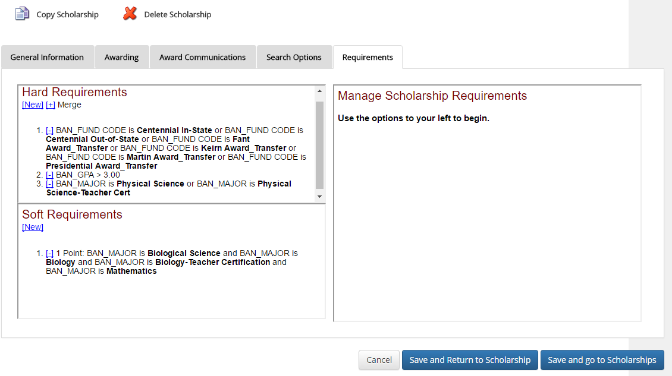
Challenges
Solution
Scholarship Configuration
Imported baseline scholarship information to establish scholarship profiles
Mississippi University for Women staff configured scholarship profiles, which contain general fund information, awarding parameters, and requirements
NGWeb Solutions, LLC - Confidential and Proprietary - Do not share without permission

Slide 10
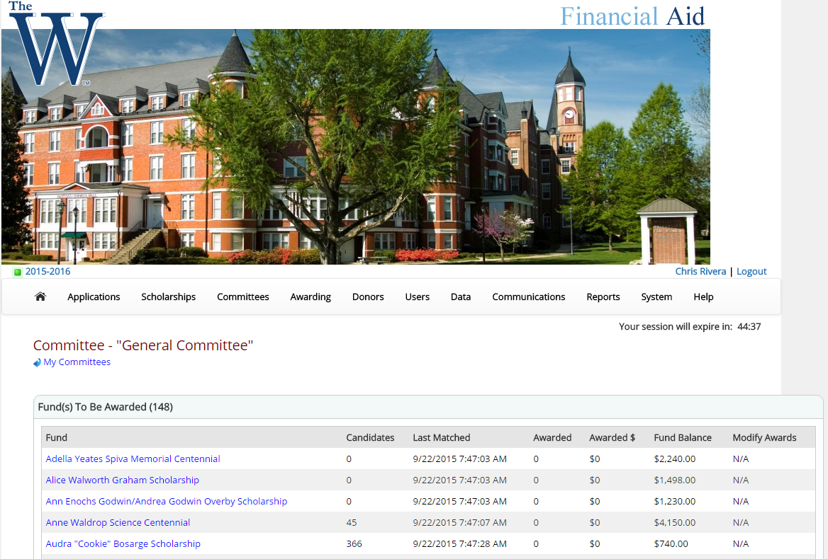
Challenges
Solution
Candidate Review
Mississippi University for Women established their preferred committee workflow
Single committee comprised of all scholarships
Access limited to Financial Aid team members
Matching engine automatically matched candidates to scholarships based on the scholarship requirements
NGWeb Solutions, LLC - Confidential and Proprietary - Do not share without permission

Slide 11
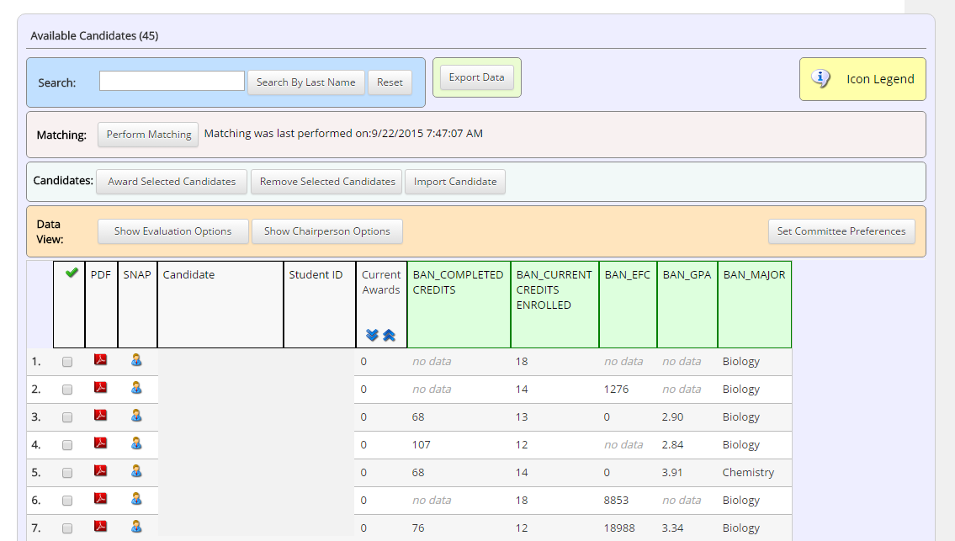
Challenges
Solution
Candidate Review
Mississippi University for Women committee members log into Scholarship Manager
Reviewer selects the scholarship they wish to view
From here committee member can click the name of a candidate to review their detailed profile and/or customize a data grid with the data fields needed in order to effectively select candidates
Committee members also can rank and/or comment on candidates as they review their profiles
NGWeb Solutions, LLC - Confidential and Proprietary - Do not share without permission

Slide 12
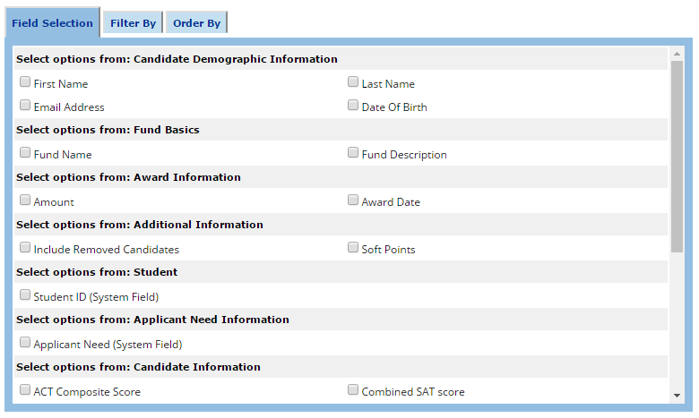
Solution
Reporting
System comes with multitude of out-of-the-box reports
Any additional customized reports required will be created during implementation
Additional reports can be requested at any time and will be added to your site
Can do on-the-fly reporting and export to Excel
NGWeb Solutions, LLC - Confidential and Proprietary - Do not share without permission

Slide 13
Challenges
Solution
Posting Awards in Banner
After the Mississippi University for Women committee members select a scholarship recipient, they post the awards in Banner
Automated award exports and API calls directly to Banner are also options for posting awards to student records
Results
Using the matching system significantly reduced the amount of time devoted to matching each individual with scholarships to help fund their institutional award
Funds awarded can be easily tracked - whether it is to determine the amount of monies remaining or how many students received the award
Readily accessible forms can be pulled for reporting purposes or when general inquiries are placed
Matching process can be executed within a matter of minutes
Real-time reports are generated immediately
NGWeb Solutions, LLC - Confidential and Proprietary - Do not share without permission

Slide 14
Challenges
Other Available Features
Application Experience
Responsive design
Scholarship search helps you to advertise your scholarships
Donor profiles recognize donors and assist students in personalizing their thank you letters
Task lists communicate to students their outstanding and completed scholarship tasks
Flexible application workflow options empower you to simplify the process for your students
No application - single Application - specific departmental or donor applications
Present just those applications that a student needs to see based on their unique profile
Drive students through the application so that they see only those questions relevant to them
Allows student to attach any type of file (e.g., transcript, copies of test scores, etc.)
Letter of recommendations
Emails are sent to individuals identified by the student
Individuals click on email link to go to recommendation page to complete or decline request
Completed letters automatically attach to student application
Student sees letter status not letter content
Students notified via email when recommendation complete
NGWeb Solutions, LLC - Confidential and Proprietary - Do not share without permission

Slide 15
Challenges
Other Available Features
Other Available Features
Review Experience
Staff and faculty can access the review process via Single Sign On
Committee members from the community can access the process with a manual login
Committee members only see the committees to which they are assigned
Flexible review options available for your committees
Show committee members all candidates or just a sub group of candidates
Show committee members all fund and qualified candidate data
Control over which data points to show to a committee
Customizable ranking menus enable reviewers to score candidates on attributes relevant to a scholarship
Online review process enables clients to move decision making process to an earlier timeframe
Eliminates subjective awarding, making award process more equitable
Administrators can email members at any time prior to, during, or after the review cycle
NGWeb Solutions, LLC - Confidential and Proprietary - Do not share without permission

Slide 16
Other Available Features
Awarding and Thank You Letter Experience
System prevents over-awarding
Award notifications are SCHOLARSHIP-SPECIFIC
Can require acceptance of award if needed
Submission of thank you letters through the system
Encourages student to complete thank you letter task
School has opportunity to review letters before they go to donor
Personalized thank you letters using donor information shows appreciation and encourages future contributions
Collection of scholarship agreements via the Scholarship Manager and Dynamic Forms connection
NGWeb Solutions, LLC - Confidential and Proprietary - Do not share without permission

Slide 17
New Feature Usage
Future Items MUW Looks to Add to their Process
Foundation Office is interested in implementing the donor profile and thank you letter option
Some departments have expressed interest in using the scholarship application and selection process
This would simplify the process for them reviewing and awarding scholarships
Would streamline the application so that it’s more of a standard process for all colleges
NGWeb Solutions, LLC - Confidential and Proprietary - Do not share without permission

Slide 18
Implementation Lifecycle
GO LIVE!
Average 8-12 weeks
Date is always client driven
Variable: Client resources
Kick off call
Site Creation
Data Imports
Testing
Go Live!
Load Scholarships
Build Applications
Identify Criteria
Data Mapping
Identify Criteria
SIS data
Online application
Training
Week 1
Testing
Test data imports
Test applications
Pilot group?
Training
Week 8
Week 2
Site Creation
Create website
Apply database
Apply web-skin
Authentication
Training
Kick Off Call
Identify team
Discuss scope
Provide prior applications
Provide list of scholarships
Training
Week 7
Week 3
Data Imports
Set up SFTP folders
Test data import process
Schedule
Test / Train
Data Mapping
Map SIS data
Training
Create Applications
Create student applications
Smart application logic
Training
Load Scholarships
Load from Excel
Create shell
Add requirements
Training
Week 6
Week 4
Week 5

Slide 19
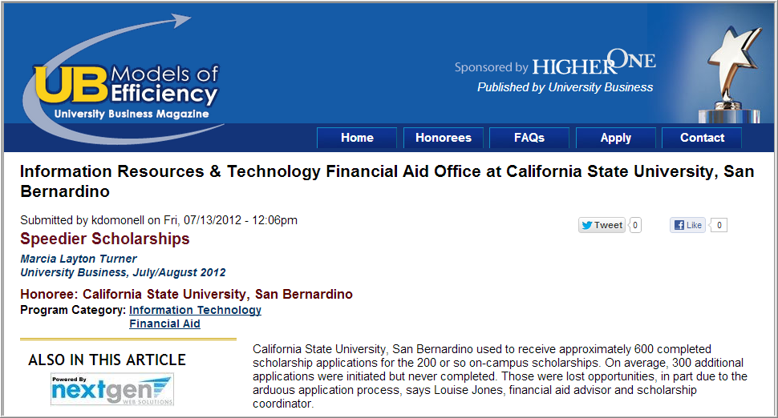
Client Feedback
California State University, San Bernardino
Before Scholarship Manager
Arduous application process
Labor intensive and time consuming for students and Financial Aid Office employees alike
The amount of work meant scholarships frequently weren’t awarded until just weeks before the fall quarter
With Scholarship Manager
The process now is a shadow of its former self
103 percent increase in number of applications
Eliminated the need for paper copies
Scholarships are being awarded in April now, four months sooner than in previous years
More competitive with other universities in our recruitment and retention efforts

Slide 20
Client Feedback
"One of the biggest reasons that I feel we made the right decision in selecting and using Scholarship Manager as our endowed scholarship application processing solution is because they keep adding enhancements to meet schools' needs. In the last few years, there have been a number of enhancements that make our jobs easier….. That's a great thing. And believe me, it is usable enhancement, not just a bunch of 'fluff.' Scholarship Manager is AWESOME in filling the gap for what our ERP cannot do.“
George Fox University
“We purchased this package about 10 years ago and I can personally tell you it saves hundreds of hours every year in awarding scholarships. It truly saved my staff and I having to work weekends for weeks on-end to get scholarships awarded. Even my Register said to me, I can't believe all those years he had to run hundreds of reports for me to get at list of potential students to award scholarships for each semester.
It is a one-stop shop for students, one application, parents and students really appreciate it. The criteria is established for each scholarship ahead of time and the system provides list of qualified students and we then send to committees for final selections.”
Pennsylvania College of Technology

Slide 21
Client Feedback
When you look at the amount of time we spend on the scholarship process, and you allocate that out across the year, I can easily say that Scholarship Manager has cut that total time down to 1/10 of what it previously was. Our scholarship process is now managed 100% through Scholarship Manager and it has been just super-efficient for us.
For example I have a sub-committee over our board that is very interested in certain emancipated foster youth in our system. And they want to provide them with assistance through scholarships. I said “hey, it’s easy, all we have to do it is add a few questions in Scholarship Manager”. Now with your new smart application and dynamic questions we can ask a single question – “Have you ever been a foster youth or in the system – yes or no?” If they answer yes, then a whole other set of questions pops up. It's fantastic!
Norbert Tan
Executive Director
Ventura County Community College Foundation

Slide 22
Thank You Megan Smith Megan Smith
Assistant Director of Financial Aid
Mississippi University for Women
(662)329-7114
mlsmith5@muw.edu
Chris Rivera
Director of Installation and Training
Next Gen Web Solutions
(904)332-9001 Ext. 3259
chris.rivera@ngwebsolutions.com

