Slide 1

MBUG 2016
Session Title: Financial Aid Boot Camp
Presented By: Terry Bland and Gail Muse-Beggs
Institution: ICC/HCC
Date: September 12, 2016

Slide 2
SESSION RULES OF ETIQUETTE
Please turn off your cell phone
If you must leave the session early, please do so discreetly
Please avoid side conversation during the session

Slide 3

NAVIGATING BANNER

Slide 4
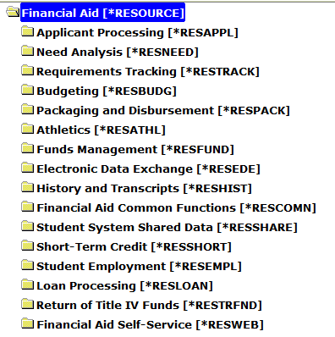
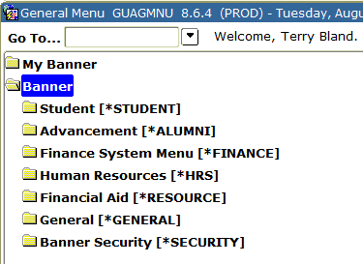
OVERVIEW OF BANNER
NAVIGATING BY MENU - GENERAL

Slide 5
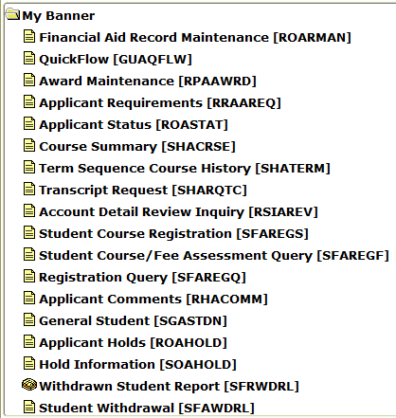
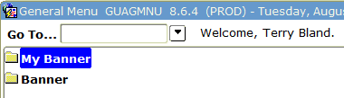

OVERVIEW OF BANNER
NAVIGATING BY MENU – MY BANNER

Slide 6
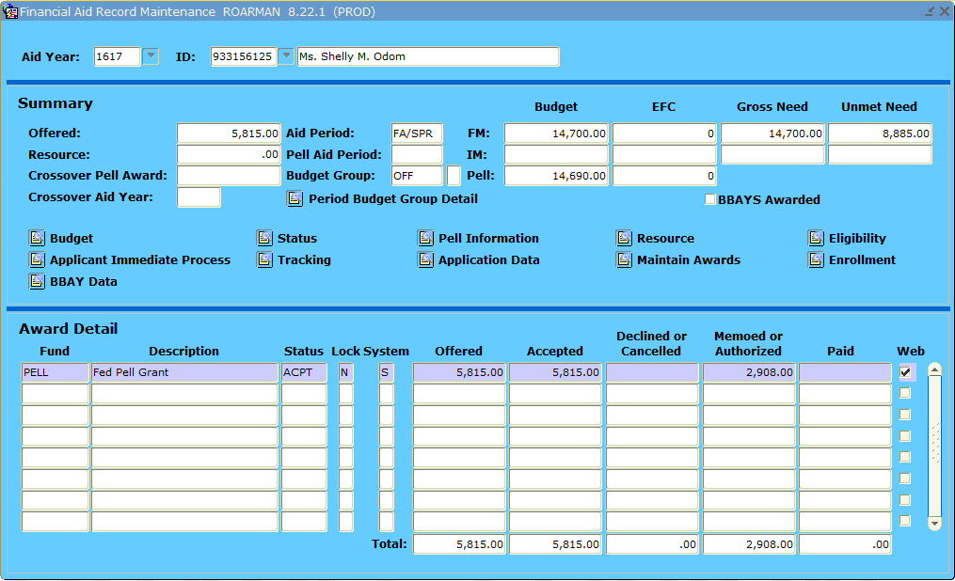
OVERVIEW OF BANNER
NAVIGATING BY MENU BAR

Slide 7
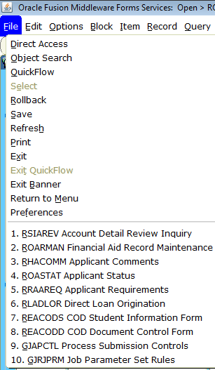
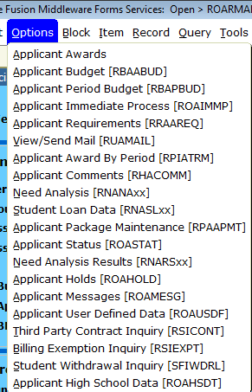
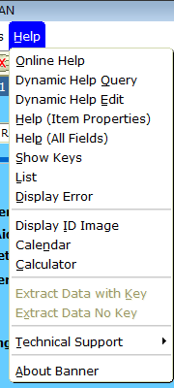
OVERVIEW OF BANNER
NAVIGATING BY MENU BAR

Slide 8
OVERVIEW OF BANNER
NAVIGATING BY MENU BAR

Slide 9
OVERVIEW OF BANNER
NAVIGATING BY MENU BAR
Form
functions
Record
functions
Block
functions
Query
functions
Print
Help

Slide 10
OVERVIEW OF BANNER
NAVIGATING BY SHORT CUT KEYS

Slide 11
OVERVIEW OF BANNER
NAVIGATING BY SHORT CUT KEYS

Slide 12

OVERVIEW OF BANNER
NAVIGATING BY QUERY
To get these results | Enter these criteria
All entries that contain GRP | %GRP%
All entries that begin with GRP | GRP%
All entries that end with GRP | %GRP
All entries that have G as the second character | _G%

Slide 13
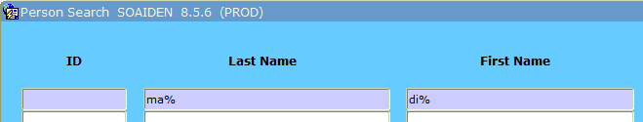
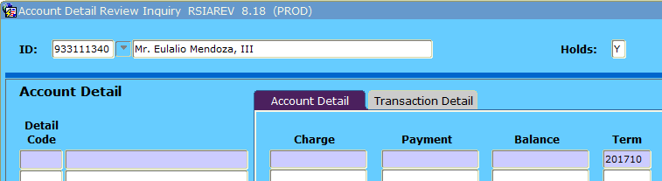
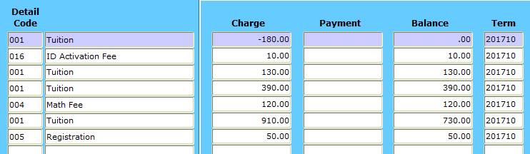
OVERVIEW OF BANNER
NAVIGATING BY QUERY
F7
F8

Slide 14

OVERVIEW OF BANNER
NAVIGATING BY FAST PATH CODE
ROARMAN
ROASTAT
RPAAWRD
ROAENRL
RRAAREQ
RHACOMM
RSIAREV
SHATERM
SHACRSE
SHARQTC
SFAREGS
SFAREGF
SFAREGQ
SGASTDN
ROAHOLD
RTVTREQ
ROASMRY
RPAPROM
RPACASH
RLADLOR
RLPDLOC
SOAHOLD
SFRWDRL
SFAWDRL
SPAIDEN
SOAPCOL
SOAHSCH
SOADEST

Slide 15
OVERVIEW OF BANNER
NAMING CONVENTIONS
R P A AWRD
System
Module
Type
Unique Identifier

Slide 16
OVERVIEW OF BANNER
NAMING CONVENTIONS – POSITION 1
CODE | SYSTEM
A | Advancement
F | Finance
G | General
N | Position Control
P | Human Resources
R | Financial Aid
S | Student
T | Accounts Receivable

Slide 17
OVERVIEW OF BANNER
NAMING CONVENTIONS – POSITION 2
CODE | MODULE | CODE | MODULE
A | Athletics | L | Logging
B | Budgeting | N | Need Analysis
C | Record Creation | O | Common Functions
E | Electronic Data Exchange (EDE) | P | Packaging & Disbursements
F | Funds Management | R | Requirements Tracking
H | History & Transcripts | S | Student System Shared Data
J | Student Employment | T | Validation Form/Table

Slide 18
OVERVIEW OF BANNER
NAMING CONVENTIONS – POSITION 3
CODE | TYPE
A | Application Form
B | Base Table
I | Inquiry Form
R | Rule Table
T | Temporary Table
V | Validation Table

Slide 19
OVERVIEW OF BANNER
NAMING CONVENTIONS
CODE | SYSTEM | MODULE | TYPE | UNIQUE IDENTIFIER
ROAENRL | R Financial Aid | O Common Functions | A Application | ENRL Enrollment
SHACRSE | S Student | H History & Transcripts | A Application | CRSE Course Summary
GLRSLCT | G General | L Logging | R Temporary Table | SLCT Population Selection Definition Rules

Slide 20

BANNER FORMS

Slide 21
OVERVIEW OF BANNER
FORMS
Setup
Validation
Setup
Rule
Setup
Control
Day-to-Day
Application
Day-to-Day
Inquiry
Day-to-Day
Maintenance

Slide 22
OVERVIEW OF BANNER
FORMS
GTVLETR – Letter Code Validation
RORELTR – E-Mail Letter Rules
RORELTF – E-Mail Letter Format Rules
ROREMAL – Generate Financial Aid E-Mail
RUAMAIL – Applicant Mail Inquiry
GLBDATA – Population Selection Extract
GLRSLCT – Population Selection Definition Rules

Slide 23
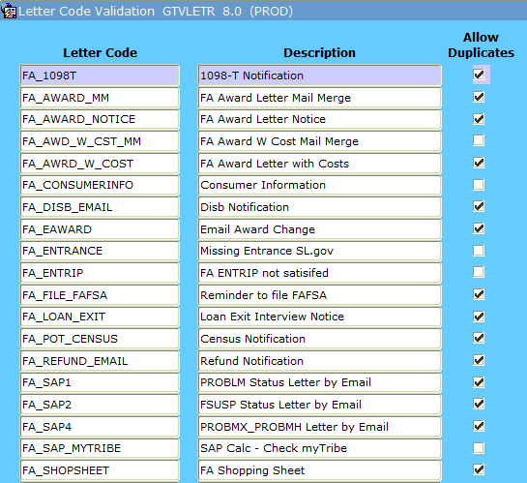
OVERVIEW OF BANNER
FORMS
SETUP

Slide 24
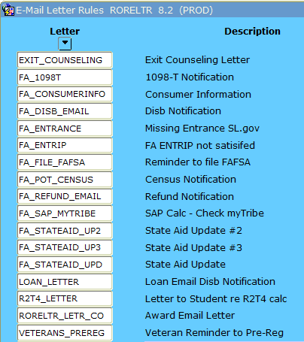
OVERVIEW OF BANNER
FORMS
SETUP

Slide 25
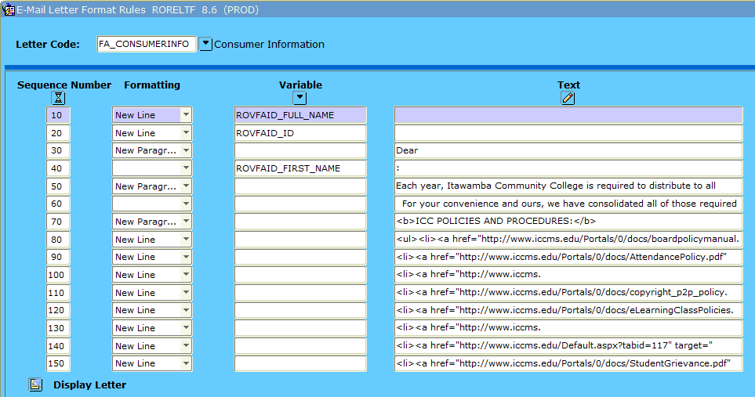
OVERVIEW OF BANNER
FORMS
SETUP

Slide 26
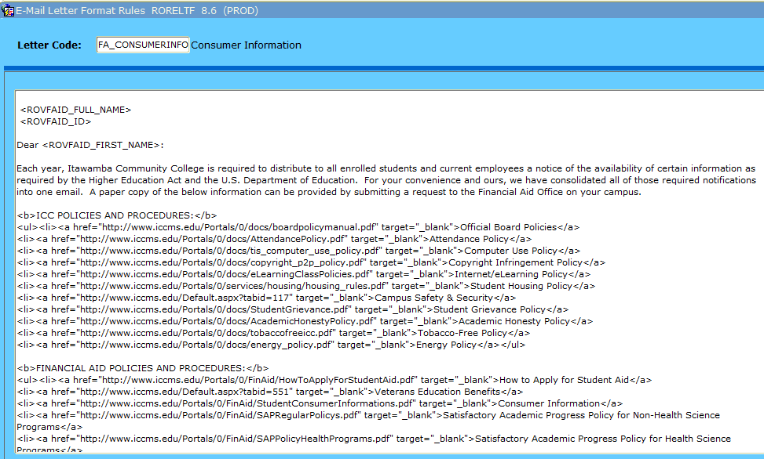
OVERVIEW OF BANNER
FORMS
SETUP

Slide 27
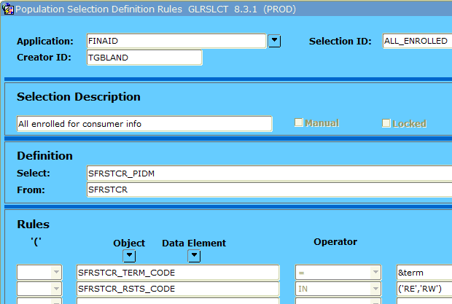
OVERVIEW OF BANNER
FORMS
SETUP

Slide 28
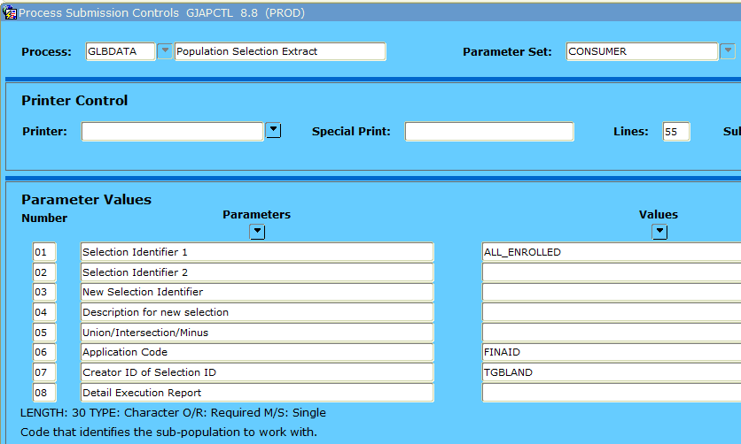
OVERVIEW OF BANNER
FORMS
DAY-TO-DAY

Slide 29
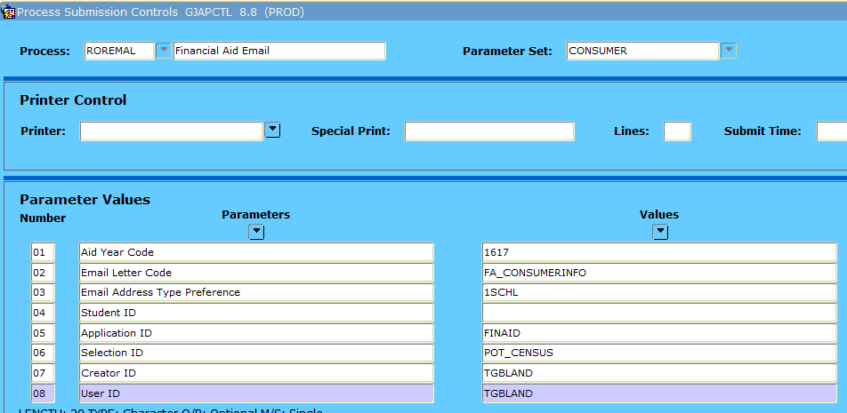
OVERVIEW OF BANNER
FORMS
DAY-TO-DAY

Slide 30
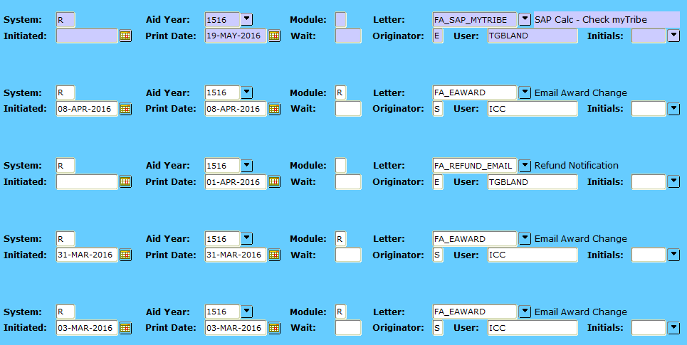
OVERVIEW OF BANNER
FORMS
DAY-TO-DAY

Slide 31
OVERVIEW OF BANNER
FORMS
DAY-TO-DAY

Slide 32
OVERVIEW OF BANNER
FORMS
DAY-TO-DAY
RBAPBUD
ROAENRL
One screen gets you to all of these forms. Great for work-studies or new employees.
ROAIMMP
RPAAWRD
ROASTAT
RPAARSC
RRAAREQ
ROAPELL
RNANAxx

Slide 33
OVERVIEW OF BANNER
FORMS
DAY-TO-DAY
ROARMAN – Record Maintenance
ROASTAT Tab 1 – Applicant Status (Verification, Packaging)
ROASTAT Tab 2 – Period Status (year in college)
ROASTAT Tab 3 – Eligibility Status (SAP)
RPAAWRD – Award Maintenance
ROAENRL – Financial Aid Enrollment
RRAAREQ – Applicant Requirements
RHACOMM – Applicant Comments
RSIAREV – Applicant Detail Review Inquiry (Business Office)

Slide 34
OVERVIEW OF BANNER
FORMS
DAY-TO-DAY
ROAHOLD – Applicant Holds
ROASMRY – Applicant Summary (memo’d, authorized)
RLPDLOC – DL Origination Creation
RLADLOR – Direct Loan Origination
RSIHIST – Academic History Inquiry
RSISTDN – Student Information Inquiry
RSIAPPL – Admission Application Inquiry
RSIDEGR – Degrees Awarded Inquiry
RSIHOUS – Housing Information Inquiry
RSIHSCH – High School Inquiry
RSITEST – Test Score Inquiry (ACT)

Slide 35

POPULATION SELECTION

Slide 36
OVERVIEW OF BANNER
POPULATION SELECTION
Within Banner, you can perform functions on groups of students as long as you can isolate that particular group within a “population selection” or popsel.
  Students with a specific aid type and amount for a specific aid year.
  Students who have submitted a scholarship application.
  Students who have filed a FAFSA.

Slide 37
OVERVIEW OF BANNER
POPULATION SELECTION
What functions use popsels?
Send emails
Batch post with RORPOST & RORBPST
Set financial aid enrollment with RSRENRL
Any of the GJAJOBS that can be run with GJAPCTL

Slide 38
OVERVIEW OF BANNER
POPULATION SELECTION
Table Name | Description
RCRAPP1 | FAFSA Table Part 1
RPRATRM | Applicant Award by Term
RRRAREQ | FA Requirements
SFRSTCR | Enrollment
TBRACCD | Student Account Detail
RPRTIIV | R2T4
RORSAPR | SAP
RORSTAT | Applicant Status

Slide 39
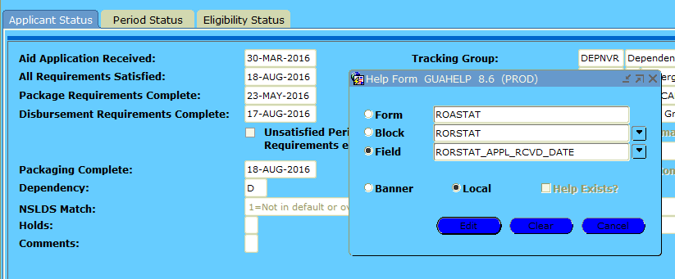
OVERVIEW OF BANNER
POPULATION SELECTION
Help – Dynamic Help Query

Slide 40
OVERVIEW OF BANNER
POPULATION SELECTION
GLBDATA – Population Selection Extract
GLRSLCT – Population Selection Definition Rules
GLAEXTR – Population Selection Extract Data

Slide 41
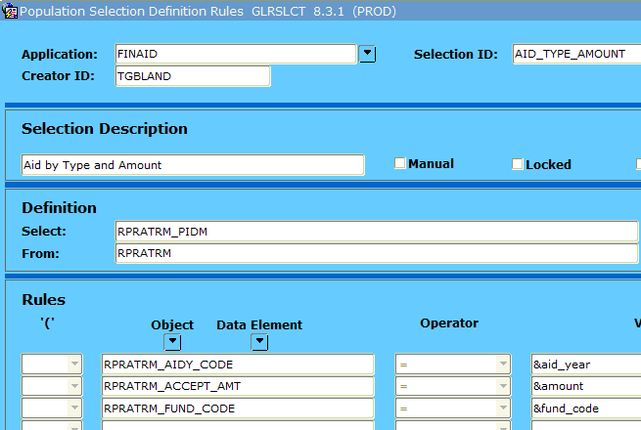
OVERVIEW OF BANNER
Finds aid type by amount
POPULATION SELECTION

Slide 42
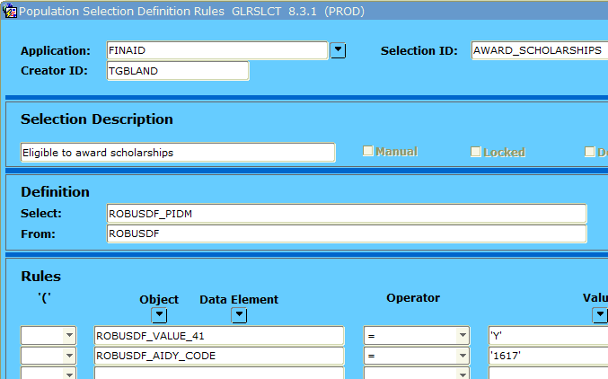
OVERVIEW OF BANNER
Finds scholarship applicants
POPULATION SELECTION

Slide 43
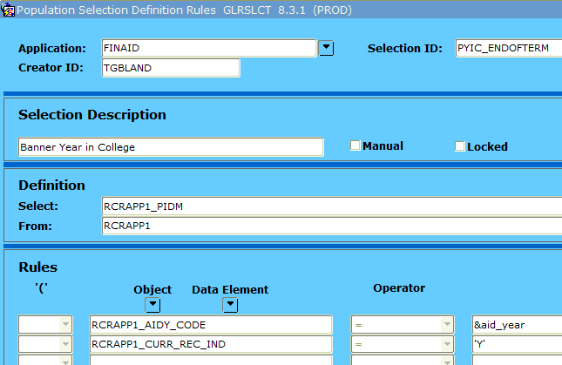
OVERVIEW OF BANNER
Finds all who filed FAFSA
POPULATION SELECTION

Slide 44
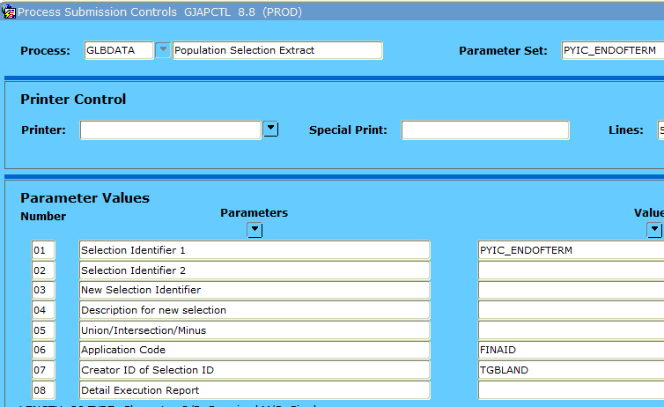
OVERVIEW OF BANNER
Gathers the popsel data
POPULATION SELECTION

Slide 45
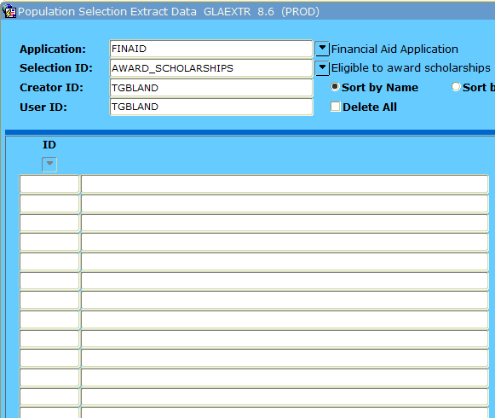
OVERVIEW OF BANNER
Displays the popsel data
POPULATION SELECTION
Davy Jones
Tom Jones
Clark Kent
Bruce Wayne

Slide 46

RULES

Slide 47
OVERVIEW OF BANNER
RULES
RORPOST – Batch Posting Rules
RORRULE – FA Selection Rules
RORALGO – General Algorithmic Rules
RORWTAB - Web Tab Rules
RORWTXT – Web Text Rules

Slide 48
OVERVIEW OF BANNER
RULES
RORALGO
  Set Period Year in College on ROASTAT Tab 2 for use in loan processing.
  Roll period budget to Spring/Summer if student does not enroll for Fall/Spring.

Slide 49
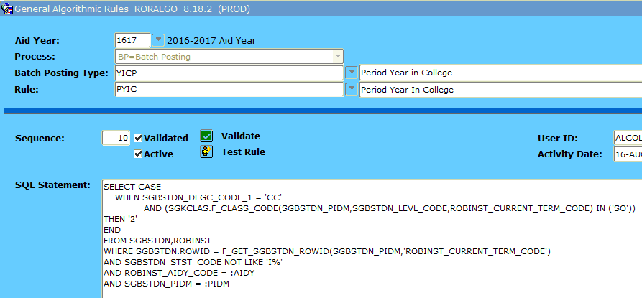
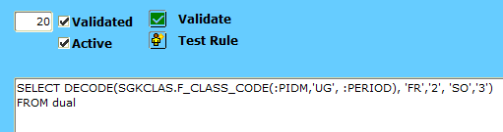
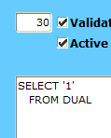
OVERVIEW OF BANNER
RULES

Slide 50
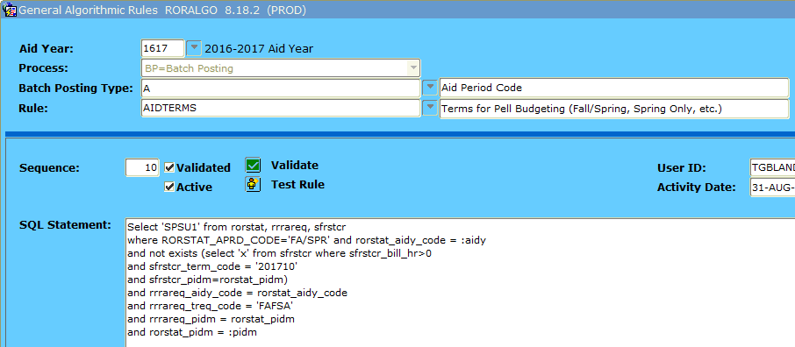
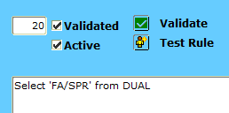
OVERVIEW OF BANNER
RULES

Slide 51
OVERVIEW OF BANNER
RULES
RORPOST
  Batch post requirement codes based on SAR comments after upload.
  Batch post requirement codes based on answers within the FAFSA data (i.e. legal guardianship, foster child/ward of the court, active military, etc.)
  Batch update requirement code statuses (i.e. bankruptcy set to E for “not yet received” but needs to be S for “satisfied”).

Slide 52
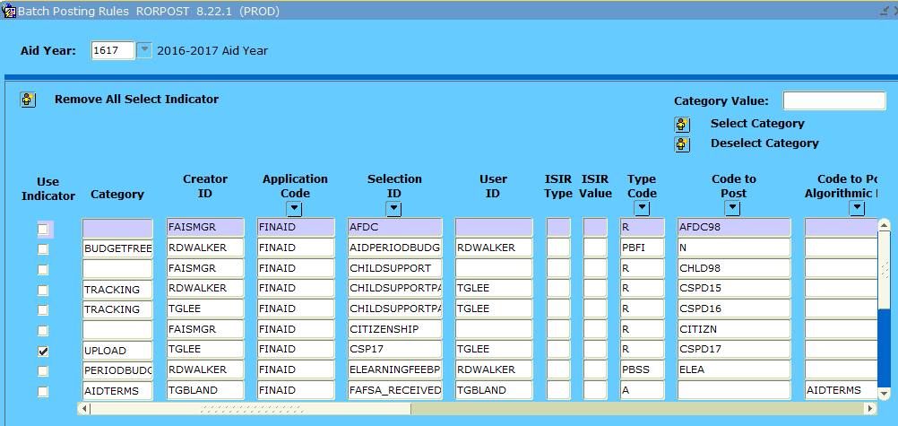
OVERVIEW OF BANNER
RULES

Slide 53
OVERVIEW OF BANNER
RULES
RORRULE
  Stop Pell from disbursing/authorizing until receive COD acknowledgement. (prevent reconciling issues)
  Stop scholarships from disbursing if student is enrolled in less than 15 hours with exception of healthcare students who are enrolled in at least 6 hours.
  Package scholarships if ROAUSDF fields are marked appropriately.

Slide 54
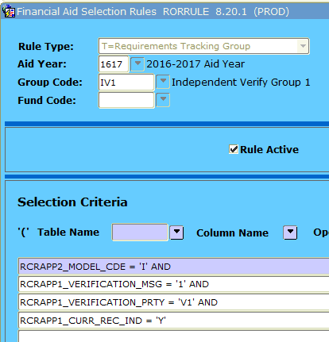
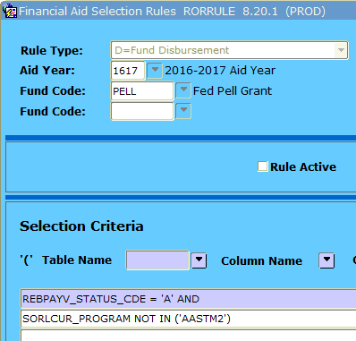
OVERVIEW OF BANNER
RULES

Slide 55
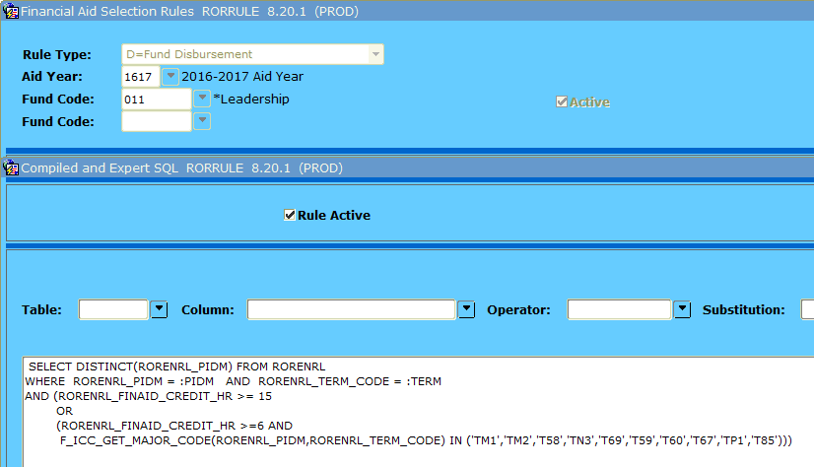
OVERVIEW OF BANNER
RULES

Slide 56
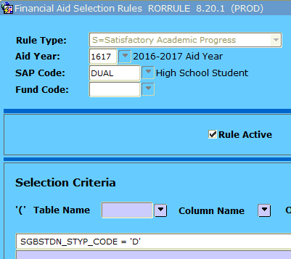
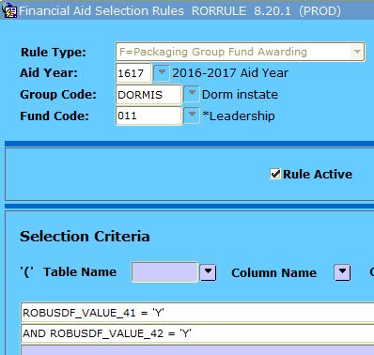
OVERVIEW OF BANNER
RULES

Slide 57
OVERVIEW OF BANNER
RULES
RORWTAB / RORWTXT to display messages on Self-Service
  Display R2T4 information (% earned, amount owed)
  Pull comments from RHACOMM to display reasons appeal was denied
  Inform students that they are eligible for county tuition grant based on their EFC and county

Slide 58
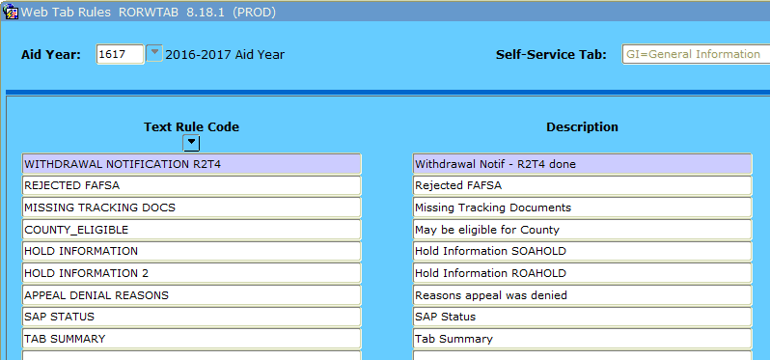
OVERVIEW OF BANNER
RULES

Slide 59
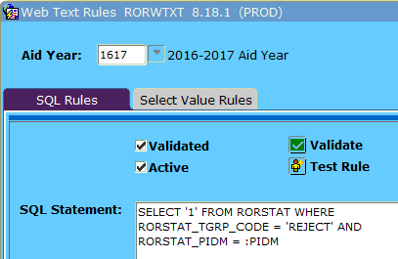
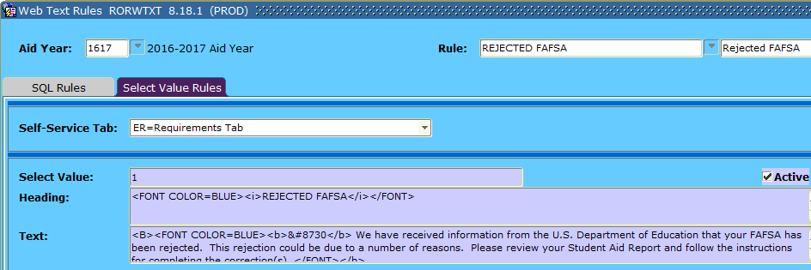
OVERVIEW OF BANNER
RULES

Slide 60

QUESTIONS?

