Slide 1
MBUG 2016
Degree Works Implementation
Lessons Learned/Tips
Presented By: Carroll Keyes (Database Administrator) & Melody Nabors (Registrar)
Institution: Christian Brothers University. Memphis, TN
September 12, 2016

Slide 2
Session Rules of Etiquette
If you must leave the session early, please do so discreetly
Please avoid side conversation during the session

Slide 3
Christian Brothers University
Founded in 1871
FTE = 1660
Main Systems: Ellucian Banner and Degree Works
Prior Degree Audit system: Paper based Degree Checklists

Slide 4
Degree Works Vocabulary
Three tools
SureCode – manage validation codes and configurations
Transit – perform functions such as creating audits from batch
Scribe – build your degree audits It is an easy, intuitive programming tool.

Slide 5
Degree Works Implementation
Began working with consultant in spring 2010 and went live in fall 2011
Two upgrades before going live
Consultant scribed three degree programs
We scribed two full catalogs including our graduate programs
Used the former registrar and an intern for scribing

Slide 6
Degree Works Roll Out
Went live with the Degree Audit and the Classic Student Planner
Consultant presented DW to the Academic units and advisors
Provided training via help aids on the website
Incoming freshmen introduced to DW in Orientation

Slide 7
Lesson Learned
Make sure you have a top level champion for the project
Review your catalogs well in advance to identify any curriculum errors or issues that need to be addressed
Include graduation analysts, advisors and departments early in the vetting process – you need their input and buy-in
Set up excel file with all active program codes, degrees, majors, and minors
Use consultant to set up your most common degree/major and your most complex degree/major

Slide 8
Lesson Learned (con’t)
Have consultant bring up as many features as possible even if you are not ready to use them
Join ecommunities “Degree Works and Transfer Equivalency” and sign up to receive the daily email
Search online to see examples of how others set up their degree programs and their help aids
Attend the Degree Works Forum

Slide 9
Scribe Tips
Develop templates and prepare data standards for scribe so that all scribing is consistent (i.e. remarks, alphabetical listing
Maintain the change log at the bottom of all blocks – this is your audit trail of who, when, & why
Think about maintenance when creating blocks. You can extend the blocks to the next catalog year if nothing changed
Develop an excel change log for yearly maintenance of blocks
HIDE is your best friend or your worst enemy – keeps the advice clean
Sharing is sometimes hard to grasp
Multiple requirements can be completed with same class
Credits only count once

Slide 10
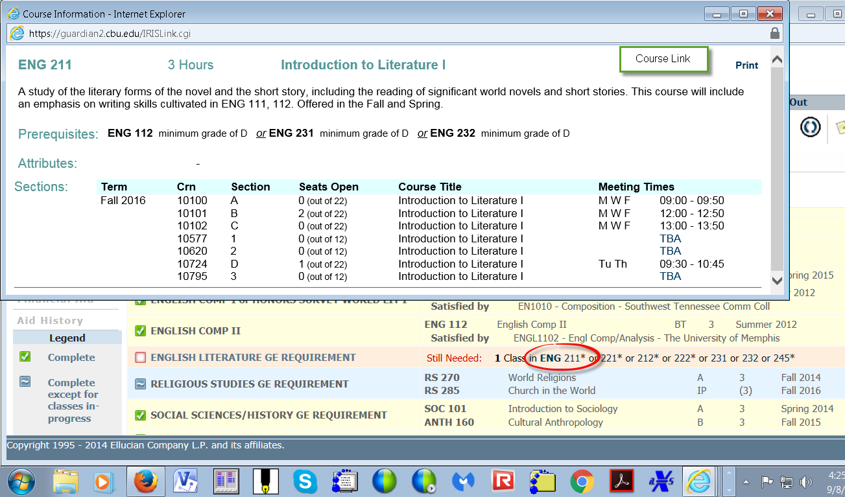
Best Parts I
Course Link

Slide 11
Best Parts II
What-if
Calculates a major gpa and other block gpas
Planner
Extremely helpful in advising incoming transfer students
Set up the semester specific courses (offered in the spring only) which will give a warning if placed in a term it is not offered

Slide 12
Best Parts III
Link to website listing of Special Topics classes (non-specific course numbers) with the semester they were approved to satisfy GER’s

Slide 13
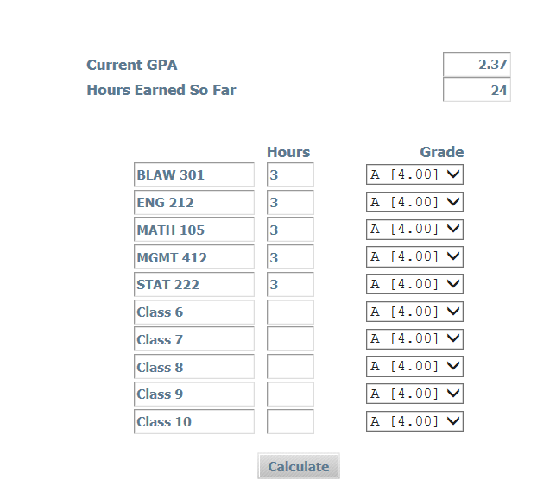
Best Parts IV
GPA Calculator

Slide 14
Best of All….
Header
Advisor email – student is cc’d
Academic Standing
Overall GPA
ALT PIN
Petition to Graduate
Holds

Slide 15
Todays tip
How to add an item to the Degree Works Student View header

Slide 16
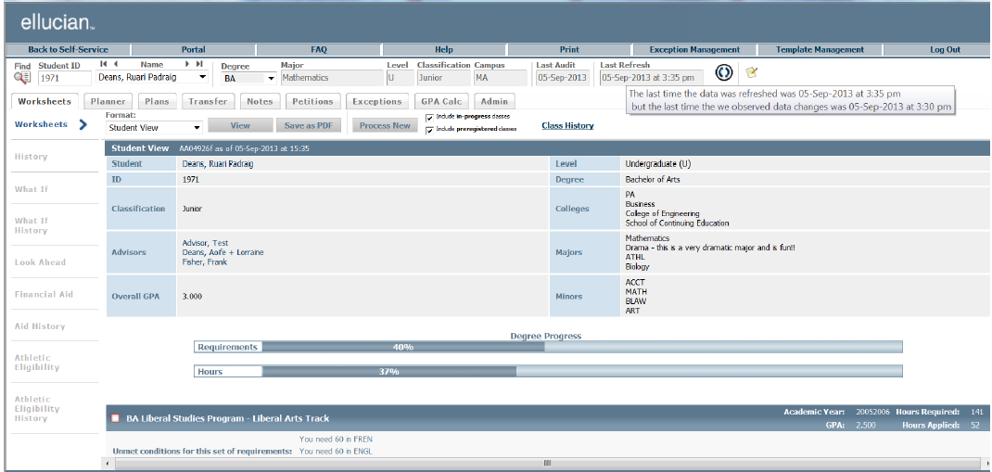
The section we want to modify

Slide 17
Your point of view

Slide 18
Degree Works DWSHELL

Slide 19
DWShell Surecode tab

Slide 20
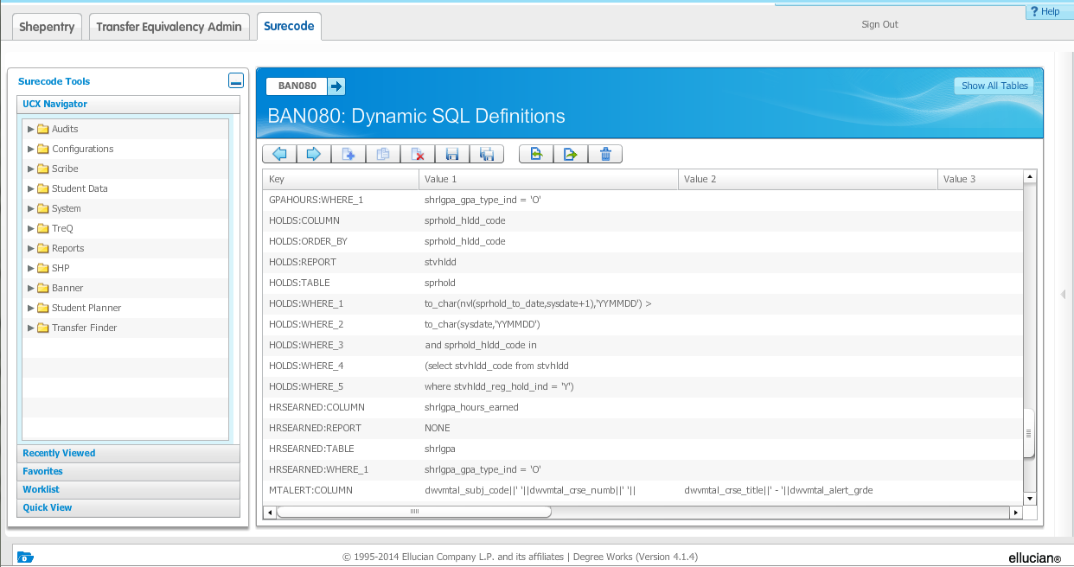
BAN080 Dynamic SQL Definitions

Slide 21
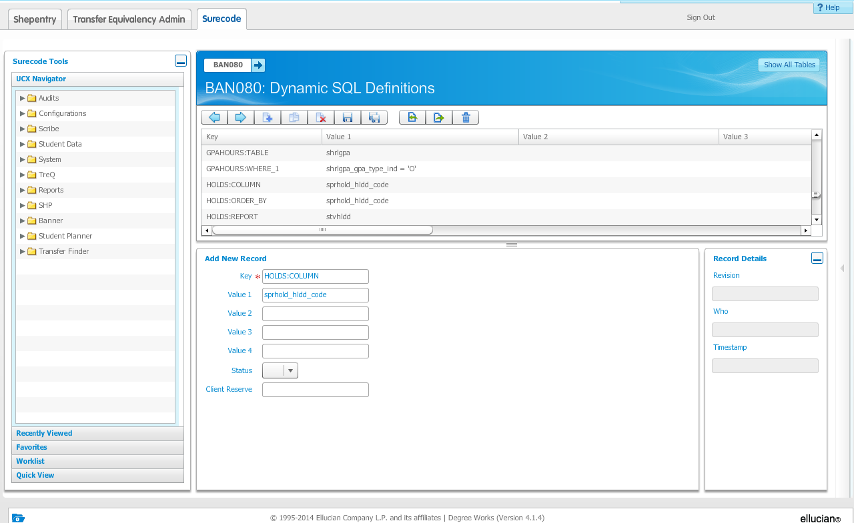
BAN080 Adding a new record

Slide 22
Key words
Definitions use keys or key words
TABLE
COLUMN
WHERE
ORDER_BY
HOLDS:COLUMN sprhold_hldd_code
HOLDS:TABLE sprhold

Slide 23
The final piece…
This step requires a little programming
<path>/app/dw/DWPROD_web/AuditStudentHeader.xsl
<td class="StuTableData" >
<xsl:for-each select="/Report/Audit/Deginfo/Report[@Code='HOLDS']">
<xsl:value-of select="@Value" />
<xsl:if test="position()!=last()"><br /></xsl:if>
</xsl:for-each>
</td>
</xsl:if>
<xsl:if test="not(/Report/Audit/Deginfo/Report[@Code='HOLDS'])">
<td class="StuTableData" >None</td>
</xsl:if>
</tr>

Slide 24
The result

Slide 25
Another Tip or Two

Slide 26
Tip

Slide 27
Tip

Slide 28
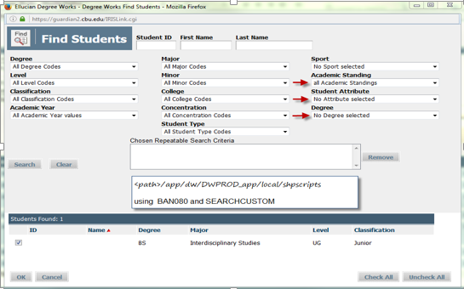
Tip

Slide 29
Questions
Carroll Keyes (Database Administrator) ckeyes@cbu.edu
Melody Nabors (Registrar) mnabors@cbu.edu
Christian Brothers University. Memphis, TN

