Slide 1
MBUG 2016
Session Title: Handling Comp Time in Banner
Presented By: Amy Bostick
Institution: Mississippi State University
September 12, 2016

Slide 2
Session Rules of Etiquette
Please turn off your cell phone
If you must leave the session early, please do so discreetly
Please avoid side conversation during the session

Slide 3
Overtime/Compensatory Time Policy
Establish guidelines to comply with Federal & State laws regarding overtime and compensatory time off.
Concept of hours worked is a crucial determining factor in complying with the Fair Labor Standards Act (FLSA)
New FLSA laws go into effect December 1, 2016

Slide 4
Procedure
Under the FLSA, overtime is defined as time worked by a non-exempt employee that exceeds 40 hours in a workweek – a workweek being defined as 7 consecutive days.
Under the provisions of the FLSA, nonexempt employees must be paid overtime for hours worked over 40 in a workweek.

Slide 5
Overtime Pay
Based on time actually worked.
Calculated at the rate of one and one-half times the employee’s regular hourly rate for each hour worked beyond 40 hours during each workweek.
In determining total overtime hours worked, hours of leave time with pay(personal and major medical leave), compensatory time off and hours taken on approved University paid holidays during the workweek are not counted as time worked in computing overtime pay.

Slide 6
Example – When not Overtime Pay
Employee works 3 days at 10 hours each day for a total of 30 hours
Personal leave of 8 hours taken
Holiday pay of 8 hours
Total of 46 hours for workweek
Only 30 hours were actually worked so overtime is not paid for the total of 46 hours
Employee would receive their regular hourly rate of pay for all 46 hours in that workweek.

Slide 7
Record of Hours Worked
Record must be maintained in the administrative unit of total hours worked by use of the official University Semi-Monthly Time Report or approved time and attendance system.
Essential that the time report accurately reflect time worked on a hour for hour basis.
Each department/unit head is responsible for approving all overtime work before it is performed and adhering to the procedures relative to overtime pay or comp time off in lieu of overtime pay.

Slide 8
Compensatory Time Off
FLSA provides element of flexibility for state and local government employers regarding compensation for statutory overtime hours.
Law authorizes a public agency to provide comp time off in lieu of monetary compensation, at a rate of not less than one and one-half (1.5) hours of comp time for each hour of overtime worked in excess of 40 in a workweek.

Slide 9
Comp Time Off - continued
Discretion of department/unit head as to whether to grant overtime pay or compensatory time off
Consideration is given to budgetary resources.
Department/unit head is responsible for the administration of comp time off in lieu of overtime. Records maintained for 3 years in unit.

Slide 11
COMP Codes in Banner
COME – Comp Time Earned
- This is input into Banner by the dept.
COMT – Comp Time Taken
- Code Employee uses to take comp hours
earned
COMP – Comp Time Paid
- Code used when dept. needs to pay

Slide 12
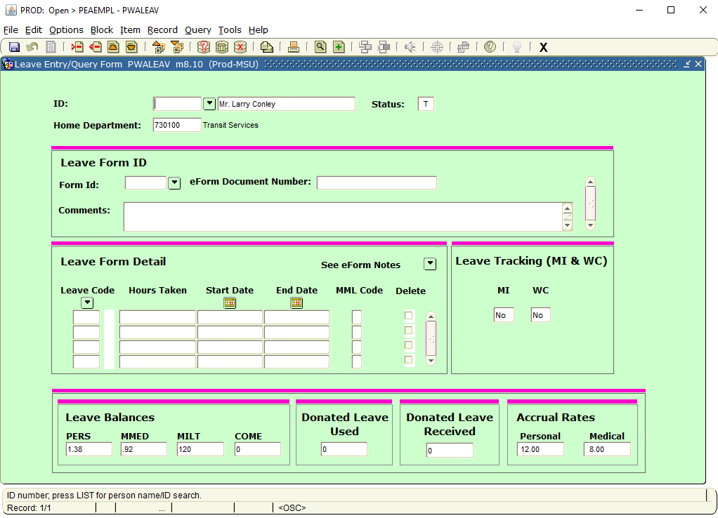

Slide 13
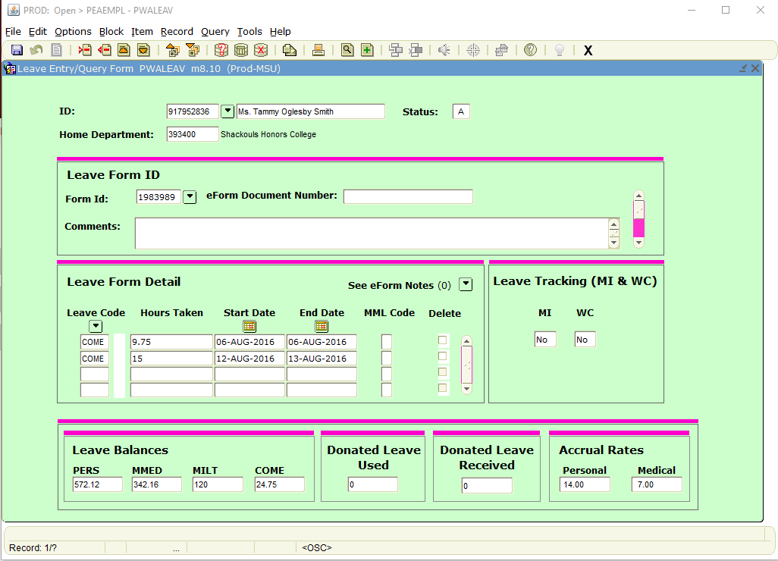

Slide 14
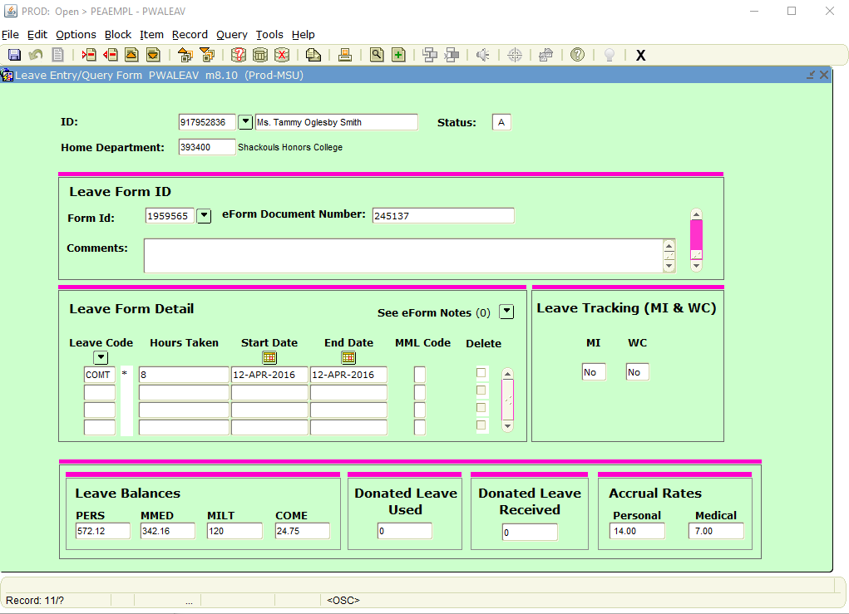

Slide 15
COMP Code – When to Use
COMP = Comp Time Paid
Use this code when:
- COME balance is more than 240 hours
(at that time dept. must pay excess hrs.)
- Employee transfers to another dept.
(At that time all unused COME must be pd.)
- Employee separates from University

Slide 16
Comp Time Information
Calculated at a rate of one and one-half times the hours worked in excess of 40 hours during a workweek.
May accrue to a maximum of 240 hours.
Must be paid excess for balance larger than 240 hours.
Comp time used instead of personal time when leave time off requested.

Slide 17
Amy Bostick Leave Specialist
Mississippi State University
ab1890@msstate.edu
(662)325-3713

